Slide 1
Programming in C#
Observer Design Pattern
CSE 494R
(proposed course for 459 Programming in C#)
Prof. Roger Crawfis

Slide 2
Keeping Objects Informed
A very common requirement in any complex system is the ability for an object to know whenever an event happens or whenever another object changes its state (which can also be viewed as an event).
Examples:
  Interest rates lowered
  File I/O request is complete
  Mouse button was depressed.

Slide 3
Polling vs. Notification
There are two primary approaches:
  Polling – Any object that is interested in state changes will periodical inquire the state. Difficult to get to work with events.
  Notification – Objects register to receive an update or notification whenever state changes or an event occurs. A publisher ensures that everyone is notified.
    Observer Design Pattern

Slide 4
Observer Pattern
This one of the common design patterns published by Gamma, et. al.
Also goes by the name Publisher-Subscriber.
When one object changes state, all the dependent objects are notified and updated.
  Allows for consistency between related objects without tightly coupling classes
    e.g. “reduces coupling between objects”

Slide 5
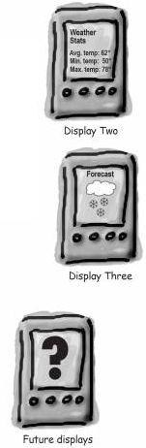
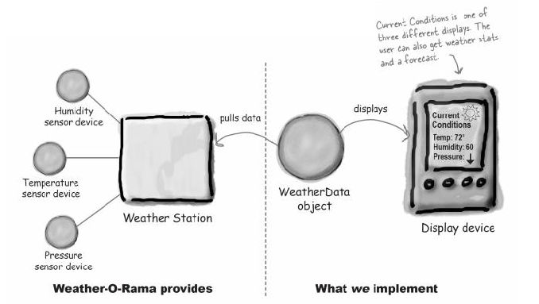
A Problem
Multiple displays need to be updated with weather data from a single weather station
©Head First Design Patterns, Freeman and Freeman, p. 39

Slide 6
A naive solution
public class WeatherData {
// instance variable declarations
public void MeasurementsChanged() {
float temperature = getTemperature();
float humidity = getHumidity();
float pressure = getPressure();
currentConditionsDisplay.update( temperature, humidity, pressure);
statisticsDisplay.Update( temperature, humidity, pressure);
forecastDisplay.Update( temperature, humidity, pressure);
}
// other weather data methods here
}

Slide 7
Problems with this Solution
Identify the aspects of your application that vary and separate them from what stays the same.
Program to an interface, not an implementation.
Strive for loosely coupled designs between objects that interact.
– fails
– fails
– fails

Slide 8
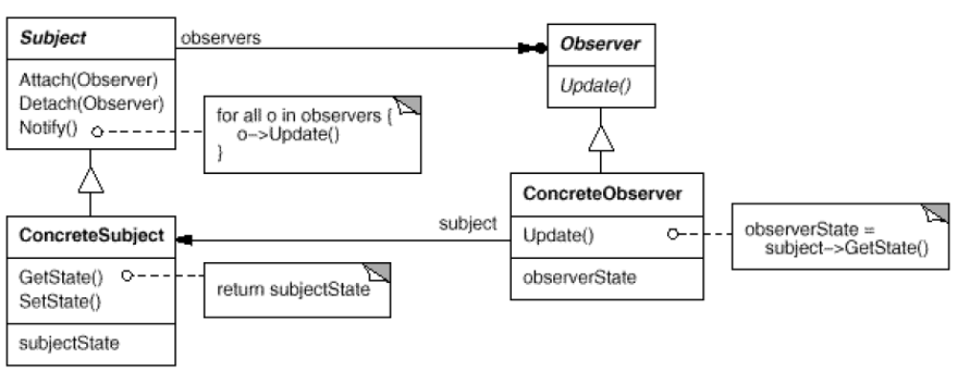
The Observer Pattern
The Observer Pattern defines a one-to-many dependency between objects so that when one object changes state, all of its dependents are notified.

Slide 9
Key Players
Subject Interface
  Knows its observers – provides interface for attaching/detaching subjects
Observer Interface
  Defines an interface for notifying the subjects of changes to the object (ex. Data)
ConcreteSubject
  Sends notification to observers when state changes
ConcreteObserver
  Implements Observer interface

Slide 10
Code Example
public interface IPublisher
{
public void AddSubscriber( ISubscriber subscriber );
public void RemoveSubscriber( ISubscriber subscriber );
}
public interface ISubscriber
{
public void Update( object sender );
}

Slide 11
Consequences
This is perhaps too abstract. Usually have a more semantic-based interface.
Abstract coupling between subject and observer
  Coupling is abstract, thus minimal (concrete class isn’t known)
  Can have multiple layers of abstraction
Support for broadcast communication
  Subject doesn’t need to know its receivers or even how many subscribers it has.

Slide 12
Implementing to Interfaces
public interface IWeatherPublisher
{
void AddSubscriber( IWeatherObserver subscriber );
void RemoveSubscriber( IWeatherObserver subscriber );
}
public interface IWeatherObserver
{
void Update( float temp, float humidity, float pressure );
}
public interface DisplayElement {
void Display();
}

Slide 13
Implementing IWeatherPublisher
public class WeatherData : IWeatherPublisher
{
private IList<IWeatherObserver> observers = new List<IWeatherObserver>();
private float temperature;
private float humidity;
private float pressure;
public void AddSubscriber( IWeatherObserver subscriber ) {
observers.Add( subscriber );
}
public void RemoveSubscriber( IWeatherObserver subscriber ) {
if( !observers.Contains(subscriber) )
throw new ArguementException(“Subscriber does not exist”);
observers.Remove(subscriber);
}

Slide 14
Implementing IWeatherPublisher
public void SetMeasurements( float temperature, float humidity,
float pressure) {
this.temperature = temperature;
this.humidity = humidity;
this.pressure = pressure;
notifyObservers();
}
private void NotifyObservers() {
foreach (IWeatherObserver observer in observers)
{
observer.Update( temperature, humidity, pressure );
}
}
// other WeatherData methods here - getters
}

Slide 15
Implementing Observers
public class CurrentConditionsDisplay : IWeatherObserver , DisplayElement {
private float temperature;
private float humidity;
public CurrentConditionsDisplay( IWeatherPublisher weatherData ) {
weatherData.AddSubscriber( this );
}
public void Update( float temperature, float humidity, float pressure ) {
this.temperature = temperature;
this.humidity = humidity;
Display();
}
public void Display() {
System.Console.Writeline( "Current conditions: " + temperature
+ "F degrees and " + humidity + "% humidity");
}
}

Slide 16
Push vs Pull
This solution pushes data to the observers
public void Update( float temperature, float humidity, float pressure) {
this.temperature = temperature;
this.humidity = humidity;
Display();
}
The observers may not use all of the data or may need different data?
Observers can pull the specific data they need from the subject
public void Update( IWeatherPublisher weatherData ) {
this.temperature = weatherData.Temperature;
this.humidity = weatherData.Humidity;
Display();
}

Slide 17
Loose Coupling
When two objects are loosely coupled, they can interact, but have very little knowledge of each other.
The Observer Pattern provides an object design where subjects and observers are loosely coupled.
  The only thing the subject knows about an observer is that it implements a certain interface
  We can add new observers at any time.
  We never need to modify the subject to add new types of observers.
  We can reuse subjects or observers independently of each other.
  Changes to either the subject or an observer will not affect the other.

Slide 18
Observer Pattern in C#
This pattern is so prevalent, that C# added language support for it (as opposed to class libraries).
The next topic will present the event keyword in C#.
Events combined with delegates provide first-class support for the Observer Pattern in C#.

Slide 19
Programming in C#
Observer Design Pattern
CSE 494R
(proposed course for 459 Programming in C#)
Prof. Roger Crawfis

