Slide 1
Observer Design Pattern

Slide 2
Observer pattern is used when there is one-to-many relationship between objects such as if one object is modified, its depenedent objects are to be notified automatically. Observer pattern falls under behavioral pattern category.

Slide 3
Implementation
Observer pattern uses three actor classes. Subject, Observer and Client. Subject is an object having methods to attach and detach observers to a client object. We have created an abstract class Observer and a concrete class Subject that is extending class Observer.

Slide 4
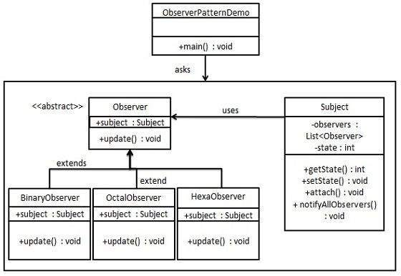
ObserverPatternDemo, our demo class, will use Subject and concrete class object to show observer pattern in action.

Slide 5
Subject.java
import java.util.ArrayList;
import java.util.List;
public class Subject {
private List<Observer> observers = new ArrayList<Observer>();
private int state;
public int getState() {
return state;
}

Slide 6
public void setState(int state) {
this.state = state;
notifyAllObservers();
}
public void attach(Observer observer){
observers.add(observer);
}
public void notifyAllObservers(){
for (Observer observer : observers) {
observer.update();
}
}
}

Slide 7
public abstract class Observer {
protected Subject subject;
public abstract void update();
}

Slide 8
public class BinaryObserver extends Observer{
public BinaryObserver(Subject subject){
this.subject = subject;
this.subject.attach(this);
}
@Override
public void update() {
System.out.println( "Binary String: " + Integer.toBinaryString( subject.getState() ) );
}
}

Slide 9
public class OctalObserver extends Observer{
public OctalObserver(Subject subject){
this.subject = subject;
this.subject.attach(this);
}
@Override
public void update() {
System.out.println( "Octal String: " + Integer.toOctalString( subject.getState() ) );
}
}

Slide 10
public class HexaObserver extends Observer{
public HexaObserver(Subject subject){
this.subject = subject;
this.subject.attach(this);
}
@Override
public void update() {
System.out.println( "Hex String: " + Integer.toHexString( subject.getState() ).toUpperCase() );
}
}

Slide 11
public class ObserverPatternDemo {
public static void main(String[] args) {
Subject subject = new Subject();
new HexaObserver(subject);
new OctalObserver(subject);
new BinaryObserver(subject);
System.out.println("First state change: 15");
subject.setState(15);
System.out.println("Second state change: 10");
subject.setState(10);
}
}

Slide 12
Verify the output.
First state change: 15
Hex String: F
Octal String: 17
Binary String: 1111
Second state change: 10
Hex String: A
Octal String: 12
Binary String: 1010

Slide 13
Facade Controller

Slide 14
If you look around the real world, there are a lot of examples that will help you understand Facade Pattern.
E-commerce website to place an order with a selected product, payment, and invoice generation.
Home Automation to turn on/off the electronic appliances when unlocking/locking of main house door and control the devices like AC, Television, Geyser, Fan, Tube lights, music system, camera and many more.
A mobile shopkeeper having different brands of mobile phones to sell like Nokia, Samsung, iPhone, Motorola, and many more.
An encryption library to generate the hash of data with a different algorithm like SHA, SHA256, SHA512, MD5, and many more
And many more. If you know something unique, please do post it in a comment box.

Slide 15
Example with Illustration
Let’s consider a laptop. When we want to turn ON the Laptop, we just press a single button to turn ON the computer, and internally many subsystems are inter-connected like Motherboard, Hard Drive, RAM, Graphics card, Wi-Fi device, Bluetooth, Keyboard, Mouse pad, and more. All those subsystems combine and forms as a single unit. Here once the system turns ON, Motherboard, RAM, Graphics card, Hard drive, Keyboard, Mouse pad will start functioning, whereas Bluetooth and Wi-Fi device can function based on individual settings to turn on/off.

Slide 16
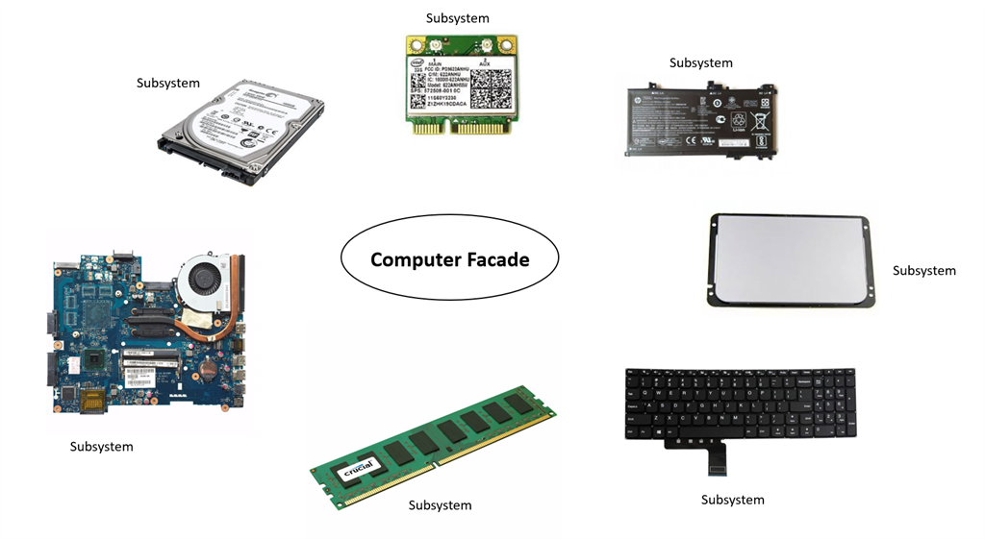

Slide 17
When can we use the Facade design pattern?
When the system has many complex subsystem/modules and needs to use a combination as a single system.
When you want to isolate the code from the complex subsystem.

Slide 18
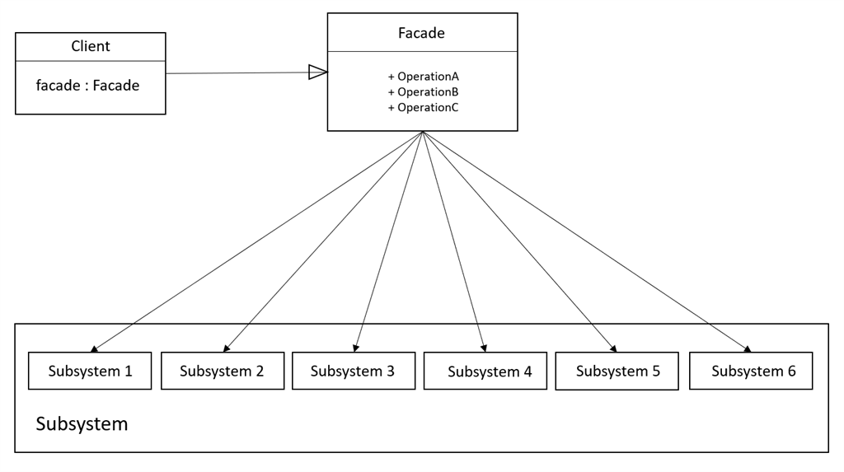

Slide 19
Home Automation to control the appliances.
Let’s consider a Home Automation to turn ON/OFF the electronic appliances when unlocking/locking the main door of the house and control the devices like AC, Television, Geyser, Fan, Tube lights, Music system, Camera and many more.
Let's refer to the above UML diagram to represent Home Automation. Here we can consider Subsystem as ‘AirConditioner’, ‘HomeSecurity’, ‘Lights’, and ‘MusicSystem’. All the subsystems are independent in functionality.
Define 'Subsystem', here Subsystem as the "AirConditioner" class has the functionality to turn ON/OFF the device.

Slide 20
using System;
public class AirConditioner
{
public void TurnOnAirConditioner()
{
Console.WriteLine("TURN ON AC");
}
public void TurnOffAirConditioner()
{
Console.WriteLine("TURN OFF AC");
}
}
}

Slide 21
using System;
public class HomeSecurity
{
public void TurnOnHomeSecurity()
{
Console.WriteLine("TURN ON HOME SECURITY");
}
public void TurnOffHomeSecurity()
{
Console.WriteLine("TURN OFF HOME SECURITY");
}
}
}

Slide 22
using System;
public class Lights
{
public void TurnOnLights()
{
Console.WriteLine("TURN ON LIGHTS");
}
public void TurnOffLights()
{
Console.WriteLine("TURN OFF LIGHTS");
}
}
}

Slide 23
using System;
public class MusicSystem
{
public void TurnOnMusicSystem()
{
Console.WriteLine("TURN ON MUSIC");
}
public void TurnOffMusicSystem()
{
Console.WriteLine("TURN OFF MUSIC");
}
}

Slide 24
Define 'Facade', here Facade as ‘HomeFacade’ class to control the appliances, which allows two actions to control the set of appliances.
When a person unlocks the main door of the house and gets in the house, it should turn ON the Lights, AC, and Music system, and should turn OFF the Security system by calling a function "ArriveAtHome()".
When a person locks the main door of the house and moves out from the house, should turn OFF the Lights, AC, and Music system, and should turn ON the Security system by calling a function "LeaveFromHome()".

Slide 25
public class HomeFacade
{
private Lights _lights = null;
private AirConditioner _airConditioner = null;
private MusicSystem _musicSystem = null;
private HomeSecurity _homeSecurity = null;
public HomeFacade()
{
_lights = new Lights();
_airConditioner = new AirConditioner();
_musicSystem = new MusicSystem();
_homeSecurity = new HomeSecurity();
}

Slide 26
public void ArriveAtHome()
{
_lights.TurnOnLights();
_musicSystem.TurnOnMusicSystem();
_airConditioner.TurnOnAirConditioner();
_homeSecurity.TurnOffHomeSecurity();
}
public void LeaveFromHome()
{
_lights.TurnOffLights();
_musicSystem.TurnOffMusicSystem();
_airConditioner.TurnOffAirConditioner();
_homeSecurity.TurnOnHomeSecurity();
}
}
}

Slide 27
class Program
{
static void Main(string[] args)
{
HomeFacade homeFacade = new HomeFacade();
homeFacade.LeaveFromHome();
Console.ReadKey();
}
}

