Slide 1
Proxy Design Pattern

Slide 2
Intent
Provide a surrogate or placeholder for another object to control access to it.
Use an extra level of indirection to support distributed, controlled, or intelligent access.
Add a wrapper and delegation to protect the real component from undue complexity.

Slide 3
Problem
You need to support resource-hungry objects, and you do not want to instantiate such objects unless and until they are actually requested by the client.

Slide 4
Discussion
Design a surrogate, or proxy, object that: instantiates the real object the first time the client makes a request of the proxy, remembers the identity of this real object, and forwards the instigating request to this real object. Then all subsequent requests are simply forwarded directly to the encapsulated real object.

Slide 5
Proxy Situations
There are four common situations in which the Proxy pattern is applicable.
A virtual proxy is a placeholder for "expensive to create" objects. The real object is only created when a client first requests/accesses the object.
A remote proxy provides a local representative for an object that resides in a different address space. This is what the "stub" code in RPC and CORBA provides.
A protective proxy controls access to a sensitive master object. The "surrogate" object checks that the caller has the access permissions required prior to forwarding the request.

Slide 6
Proxy Situations
A smart proxy interposes additional actions when an object is accessed. Typical uses include:
Counting the number of references to the real object so that it can be freed automatically when there are no more references (aka smart pointer),
Loading a persistent object into memory when it's first referenced,
Checking that the real object is locked before it is accessed to ensure that no other object can change it.

Slide 7
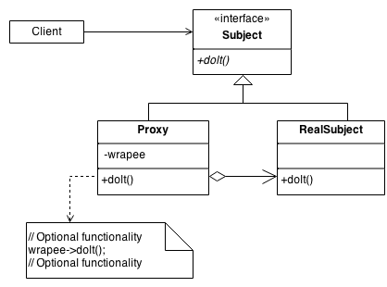
Structure
By defining a Subject interface, the presence of the Proxy object standing in place of the RealSubject is transparent to the client.

Slide 8
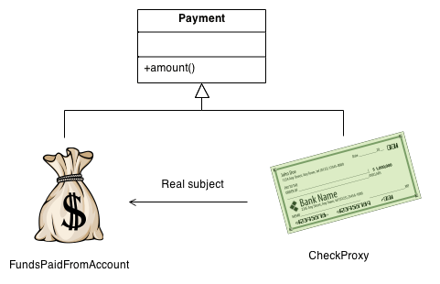
Example
The Proxy provides a surrogate or place holder to provide access to an object. A check or bank draft is a proxy for funds in an account. A check can be used in place of cash for making purchases and ultimately controls access to cash in the issuer's account.

Slide 9
Check list
Identify the leverage or "aspect" that is best implemented as a wrapper or surrogate.
Define an interface that will make the proxy and the original component interchangeable.
Consider defining a Factory that can encapsulate the decision of whether a proxy or original object is desirable.
The wrapper class holds a pointer to the real class and implements the interface.
The pointer may be initialized at construction, or on first use.
Each wrapper method contributes its leverage, and delegates to the wrappee object.

Slide 10
Virtual Proxy
The Virtual Proxy pattern is a memory saving technique that recommends postponing an object creation until it is needed; it is used when creating an object the is expensive in terms of memory usage or processing involved. In a typical application, different objects make up different parts of the functionality. When an application is started, it may not need all of its objects to be available immediately. In such cases, the Virtual Proxy pattern suggests deferring objects creation until it is needed by the application. The object that is created the first time is referenced in the application and the same instance is reused from that point onwards. The advantage of this approach is a faster application start-up time, as it is not required to created and load all of the application objects.

Slide 11
Virtual Proxy
One way to save time and memory is to avoid loading of the employee objects until required, and this is done using the Virtual Proxy. This technique is also known as Lazy Loading where you are fetching the data only when it is required.

Slide 12
public class Company {
private String companyName;
private String companyAddress;
private String companyContactNo;
private ContactList contactList ;
public Company(String companyName,String companyAddress, String companyContactNo,ContactList contactList){
this.companyName = companyName;
this.companyAddress = companyAddress;
this.companyContactNo = companyContactNo;
this.contactList = contactList;
System.out.println("Company object created...");
}
public String getCompanyName() {
return companyName;
}

Slide 13
public String getCompanyAddress() {
return companyAddress;
}
public String getCompanyContactNo() {
return companyContactNo;
}
public ContactList getContactList(){
return contactList;
}
}

Slide 14
import java.util.List;
public interface ContactList {
public List<Employee> getEmployeeList();
}

Slide 15
public class ContactListImpl implements ContactList{
@Override
public List<Employee> getEmployeeList() {
return getEmpList();
}
private static List<Employee>getEmpList(){
List<Employee> empList = new ArrayList<Employee>(5);
empList.add(new Employee("Employee A", 2565.55, "SE"));
empList.add(new Employee("Employee B", 22574, "Manager"));
empList.add(new Employee("Employee C", 3256.77, "SSE"));
empList.add(new Employee("Employee D", 4875.54, "SSE"));
empList.add(new Employee("Employee E", 2847.01, "SE"));
return empList;
}
}

Slide 16
public class Employee {
private String employeeName;
private double employeeSalary;
private String employeeDesignation;
public Employee(String employeeName,double employeeSalary,String employeeDesignation){
this.employeeName = employeeName;
this.employeeSalary = employeeSalary;
this.employeeDesignation = employeeDesignation;
}
public String getEmployeeName() {
return employeeName;
}
public double getEmployeeSalary() {
return employeeSalary;
}

Slide 17
public String getEmployeeDesignation() {
return employeeDesignation;
}
public String toString(){
return "Employee Name: "+employeeName+", EmployeeDesignation: "+employeeDesignation+", Employee Salary: "+employeeSalary;
}
}

Slide 18
public class TestVirtualProxy {
public static void main(String[] args) {
ContactList contactList = new ContactListProxyImpl();
Company company = new Company("ABC Company", "India", "+91-011-28458965", contactList);
System.out.println("Company Name: "+company.getCompanyName());
System.out.println("Company Address: "+company.getCompanyAddress());
System.out.println("Company Contact No.: "+company.getCompanyContactNo());
System.out.println("Requesting for contact list");
contactList = company.getContactList();
List<Employee>empList = contactList.getEmployeeList();
for(Employee emp : empList){
System.out.println(emp);
}
}
}

Slide 19
The above program will have as a result the following output:
01 02 03 04 05 06 07 08 09 10 11 | Company object created... Company Name: ABC Company Company Address: India Company Contact No.: +91-011-28458965 Requesting for contact list Creating contact list and fetching list of employees... Employee Name: Employee A, EmployeeDesignation: SE, Employee Salary: 2565.55 Employee Name: Employee B, EmployeeDesignation: Manager, Employee Salary: 22574.0 Employee Name: Employee C, EmployeeDesignation: SSE, Employee Salary: 3256.77 Employee Name: Employee D, EmployeeDesignation: SSE, Employee Salary: 4875.54 Employee Name: Employee E, EmployeeDesignation: SE, Employee Salary: 2847.01

