Slide 1

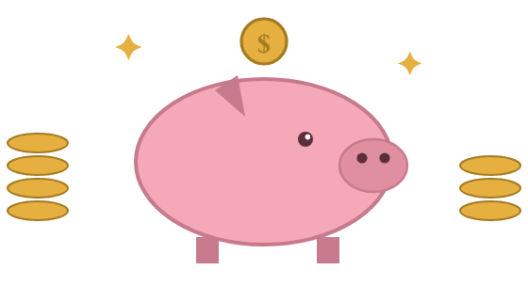
Simple Automated Cashflow System (SACS)
COLE HOUSEHOLD
X= Monthly
Expenses
January 21, 2026
$
INFLOW
OUTFLOW
$14,500- Marcus
X=$11,500/month*
$14,500
$11,500
$1,000 Floor
Automated transfer on the 20th
$1,000 Floor
PRIVATE
RESERVE
$3,000/mo*
MONTHLY EXPENSES

Slide 2
Simple Automated Cashflow System (SACS)
PINNACLE
PR
SCHWAB
$84,000
$38,000
BROKERAGE
$76,500 TARGET
6x Monthly Expenses + Deductible= $76,500
Remainder
$2,500- Homeowner
$1,000 x 2 = $2,000- Auto
$3,000- Medical*
LONG TERM CASHFLOW
( Magnified Private Reserve Cashflow)

