Slide 1




KubeSecure
AI-Driven Anomaly Detection in Kubernetes Cluster
Muhammad Hani
I21-2595
M. Usman Azam i21-0653
Dr. Arshad Islam
Supervisor
Daniyal Ahmad
I21-2493

Slide 2

Project Overview
Critical Security Needs
Monitoring Challenges
Sophisticated Threats
Vulnerability Concerns

Slide 3




Traditional Methods
Rising Threats
Motivation
Project Goal
Enhanced Defense

Slide 4
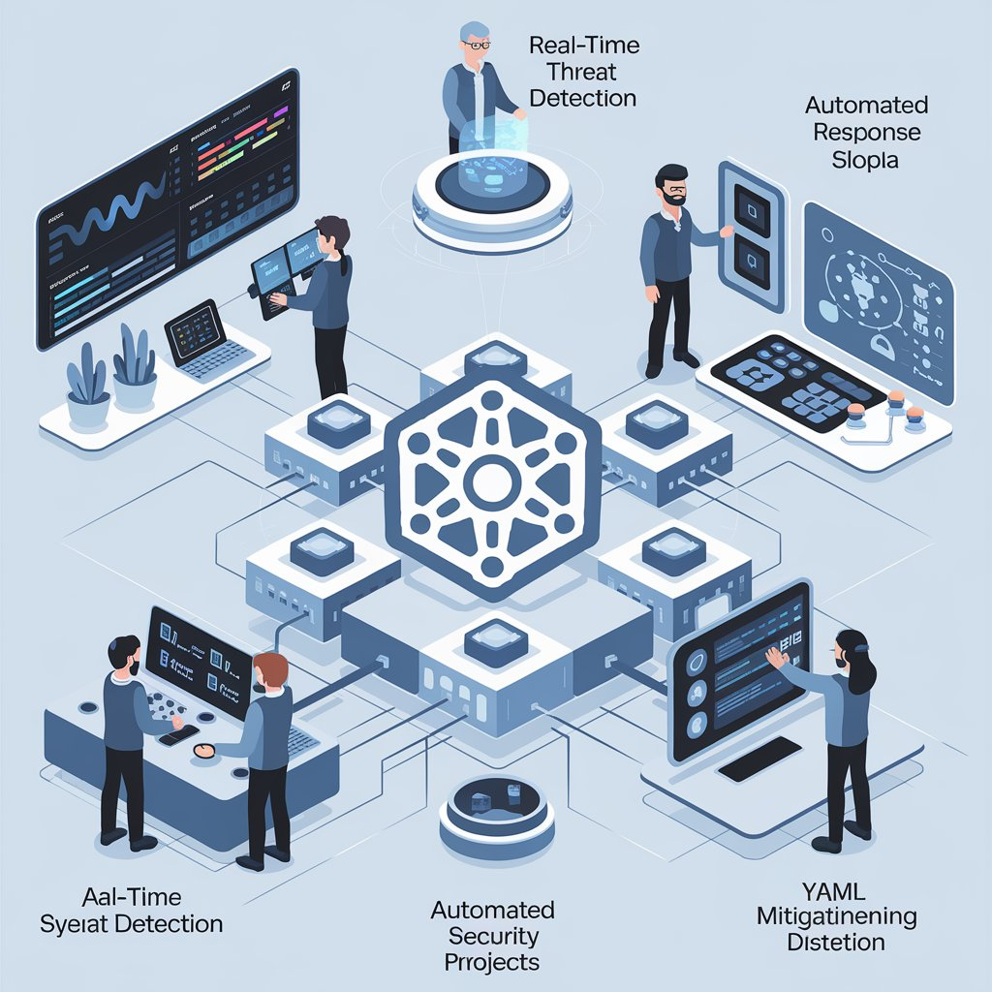
High Level Goals
AI-Driven DDOS Detection in Kubernetes Pods
Automated Mitigation System
Comprehensive Traffic Analysis
App for Alerts

Slide 5


Product Comparison
SNORT
Falco
KubeSecure
Fully Free
Machine Learning based anomaly detection
Network Graphs
Detect different type of attacks
Static rules based detection

Slide 6

Project Scope
In-Time Network Anomaly Detection
01
02
Model Training And Testing
Automated Response Mechanism
03
04
Deep Traffic Analysis
YAML Misconfiguration Detection
05
Creating Custom Dataset (tentative)
06

Slide 7
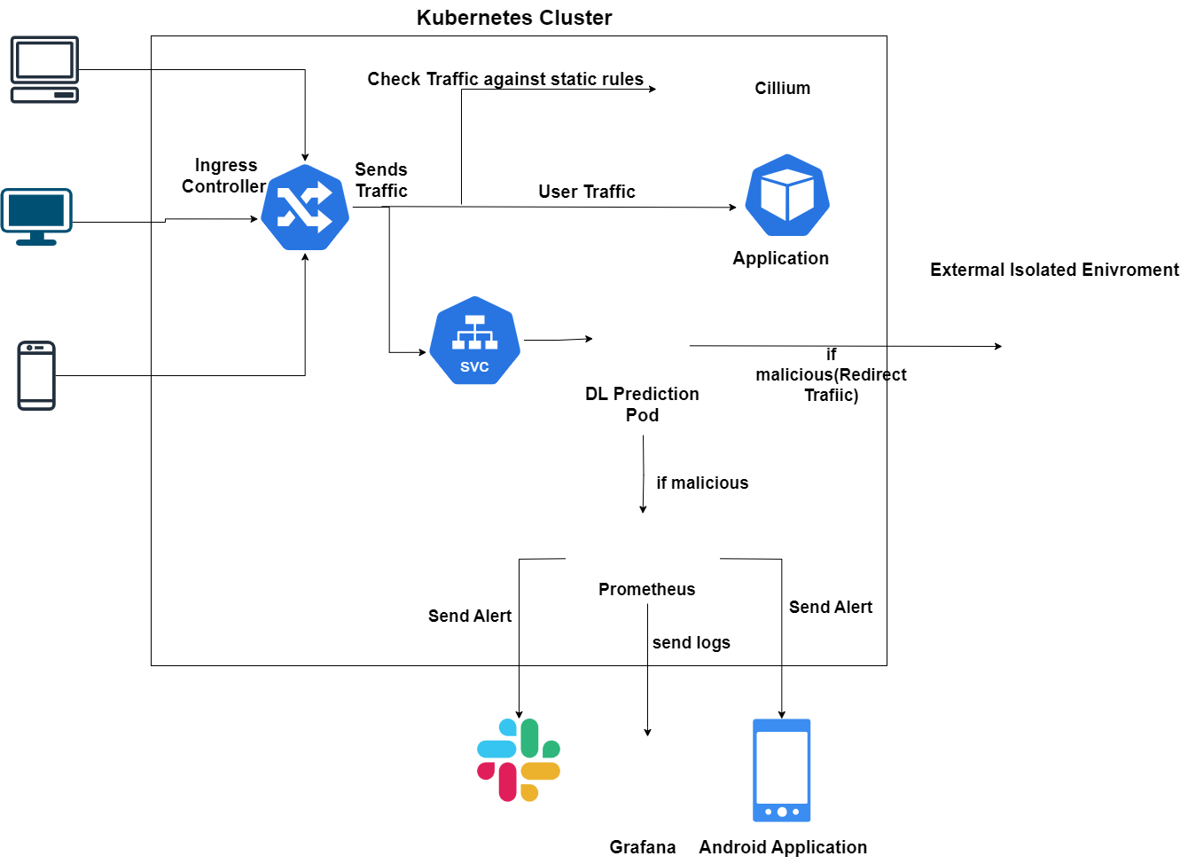






Slide 8
Cilium
01
Networking
02
Observability
03
Service Mesh

Slide 9
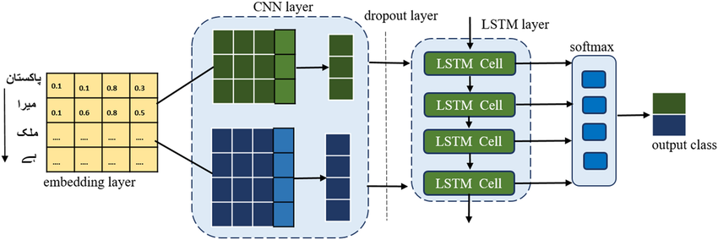
DL Model
01
Network Traffic in Batch
02
Spatial & Temporal
03
Evolving Attacks

Slide 10
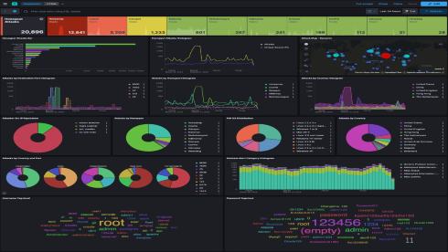

HoneyPot
01
Isolated Environment
02
Traffic Redirection
03
Threat Intelligence

Slide 11


Slide 12
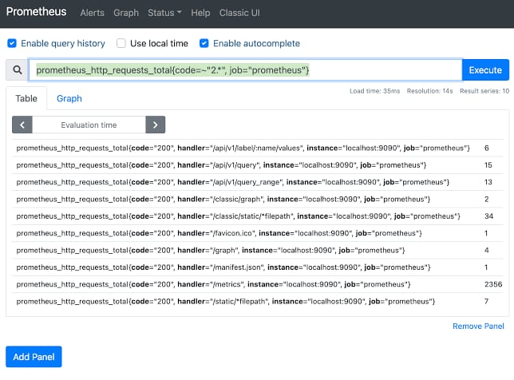
Prometheus
Data Collection and Integration with Grafana
01
02
Alerting System
In-Time Network Anomaly Detection
03

Slide 13
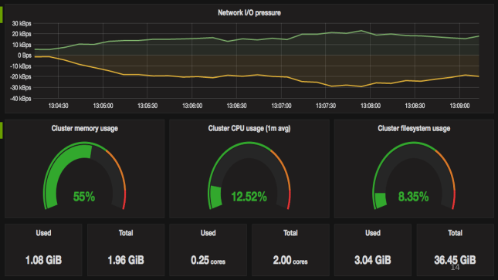
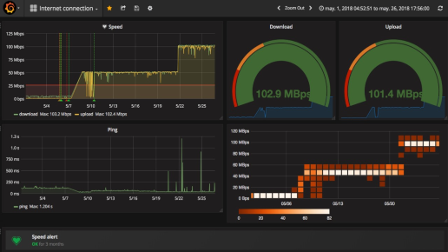
Grafana
01
Monitoring Insights
02
Visualization Dashboard
03
Historical Analysis

Slide 14


Slide 15
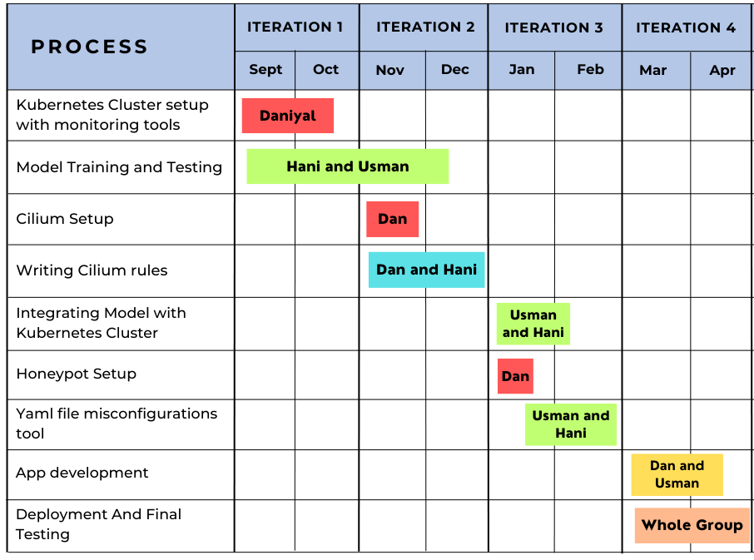

Slide 16
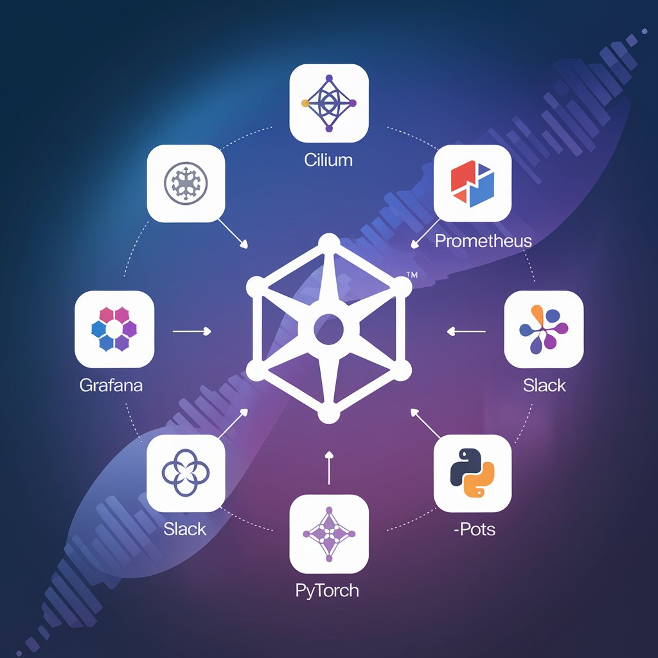






Tools and Technologies
Flutter
Python
T

Slide 17
References
Anomaly Detection Market Analysis (Jul 2024)
Global Anomaly Detection Market Size, Share, Trends, Growth Forecast Report (June 2024)
Detection of distributed denial of service attacks based on information theoretic approach in time series models (Jisa David, Oct 2020 )
DDoS Detection (July 2024)
Agyemang, Emmanuel, and Daniel Adu-Gyamfi. "One-Class LSTM Network for Anomalous Network Traffic Detection." Journal of Network and Computer Applications (2024): DOI: 10.1016/j.jnca.2024.103500.
Huo, J., Gao, Y., Yang, W., & Yin, H. "CNN Features with Bi-Directional LSTM for Real-Time Anomaly Detection in Surveillance Networks." Multimedia Tools and Applications (2024): DOI: 10.1007/s11042-024-14108-5.
Wiz. (2023). Kubernetes Security Report 2023: The State of K8s Security
Singh, R., & Lal, R. (2024). "A Comprehensive Analysis of DDoS Attack Patterns in Kubernetes Clusters." Journal of Network and Computer Applications, 115, 102907

Slide 18
Thank You

