Slide 1
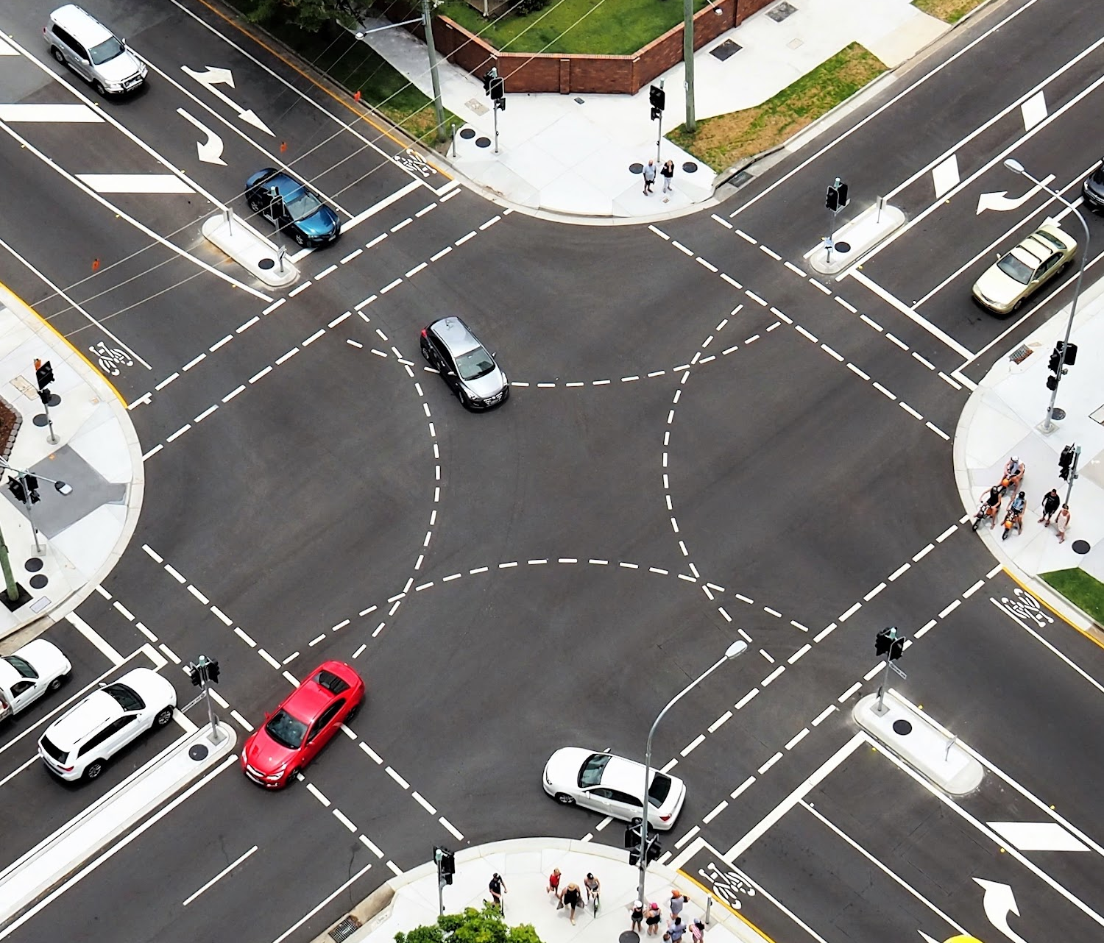
Traffic Light System for Emergency Vehicle
Presented by:
Khadija Muhammad Haroon
Muhammad Ahsan
Muhammad Anas Hassan
Muhammad Ibtesam

Slide 2

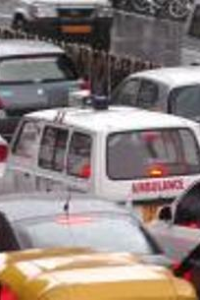
Problem
Due to overpopulation, traffic signal lights have become a problem for emergency vehicles.
Solution :
Through this Project, we are :
Improving the traffic light system to prioritize the passage of emergency vehicles efficiently.
It saves time for emergency vehicles.
It maintains the traffic flow by adjusting the traffic signal according to
the emergency vehicles.
6

Slide 3

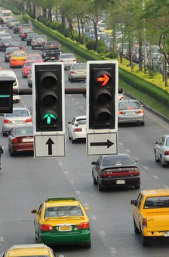
Introduction
Good traffic management is crucial to handle more people and cars on the roads.
The proposed traffic light system gives priority to emergency vehicles using a special device that sends signals.
At the intersection, when an emergency vehicle approaches, it gets a green light while other cars have to stop.
Once the emergency vehicle has passed, the traffic lights go back to normal using a small computer.
This system helps emergency vehicles move quickly and reduces traffic problems. It can also be improved with technology to analyze traffic in real-time and work together with other traffic systems.
1
2
3
4
5
6

Slide 4

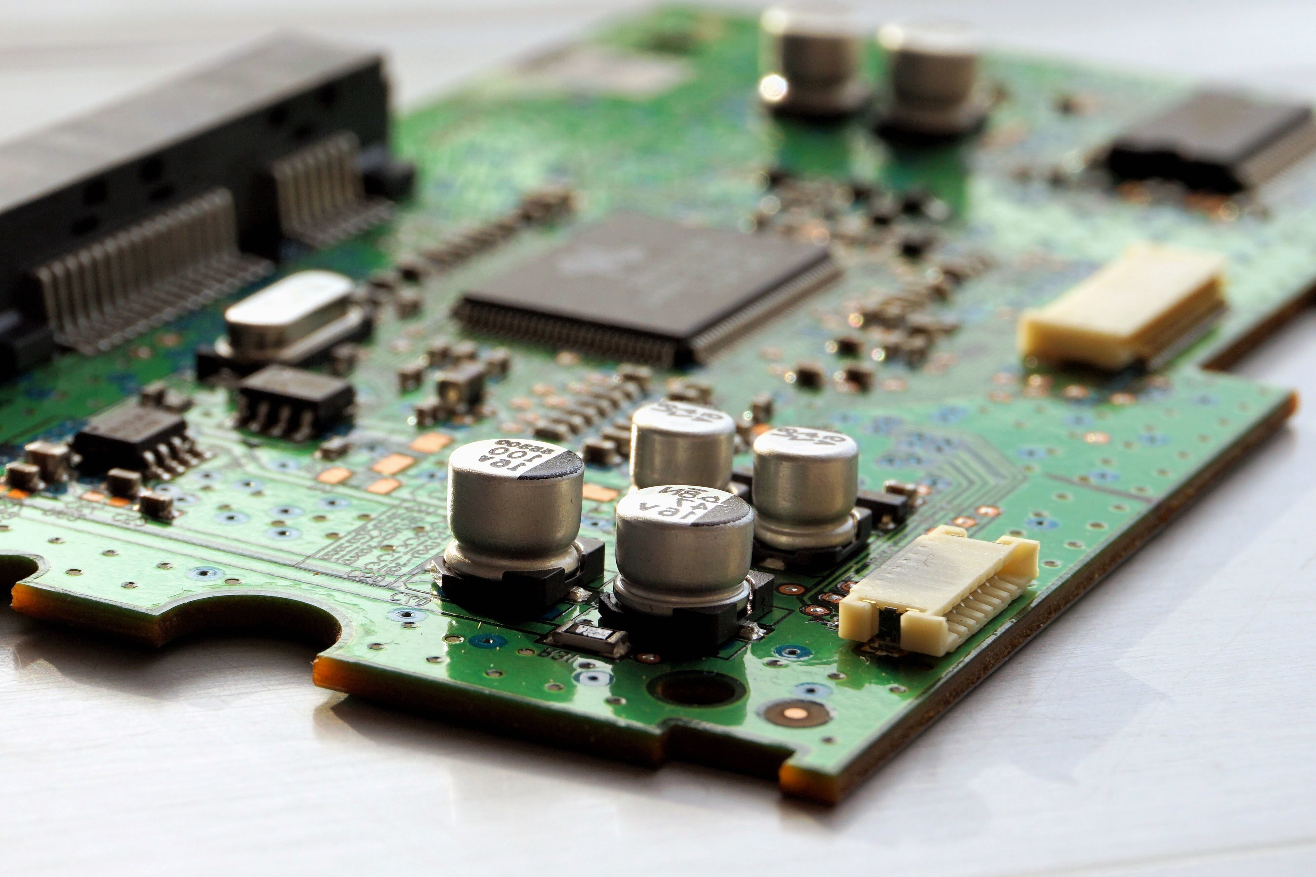
Material Used :
Arduino
Transmitter
Receiver

Slide 5

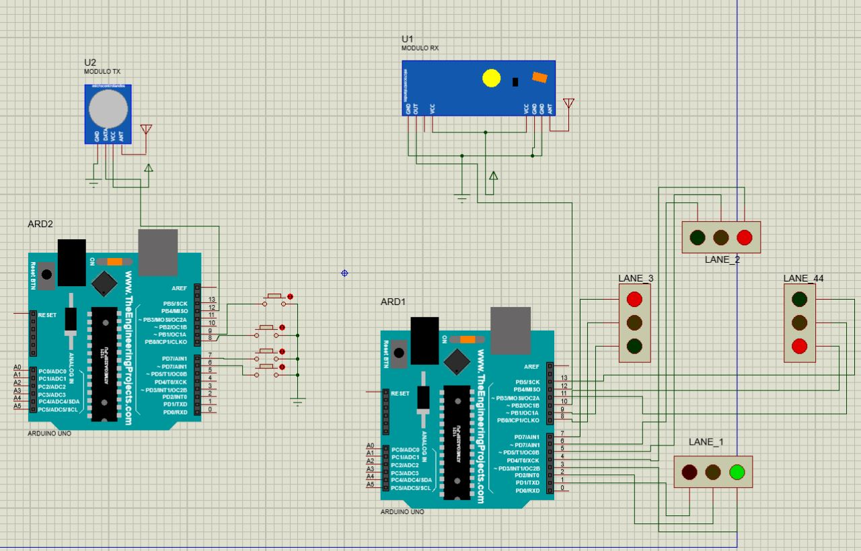
Circuit Diagram

Slide 6
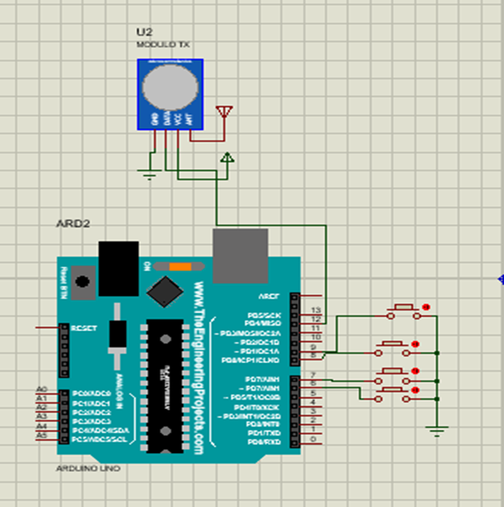
Working Procedure
Transmitter
- Set up VirtualWire library for RF communication.
- Define button pins and variables for button states.
- Initialize transmitter and button configuration.
- Enter the loop to monitor button presses.
- If a button is pressed and not already processed:
- Send corresponding signal using vw_send.
Mark the button as processed to avoid repeated transmission.
Print a message indicating the button press.
Add a small delay for button debouncing.

Slide 7
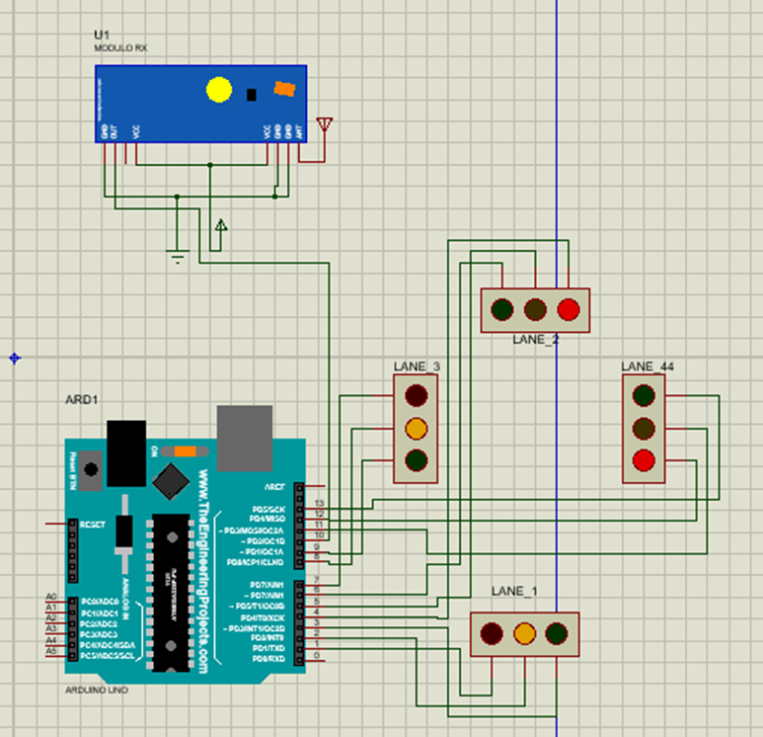
Working Procedure
Receiver
- The code uses the VirtualWire library for RF communication.
It defines lane arrays for each traffic light lane and sets up the receiver configuration.
Pins are assigned to control the traffic lights, which are initially turned off.
The main loop monitors RF messages and determines the traffic light sequences based on the received messages.
For each lane, specific sequences are executed based on the received messages.
The loop continues to repeat, allowing for ongoing monitoring and control of the traffic lights.

Slide 8
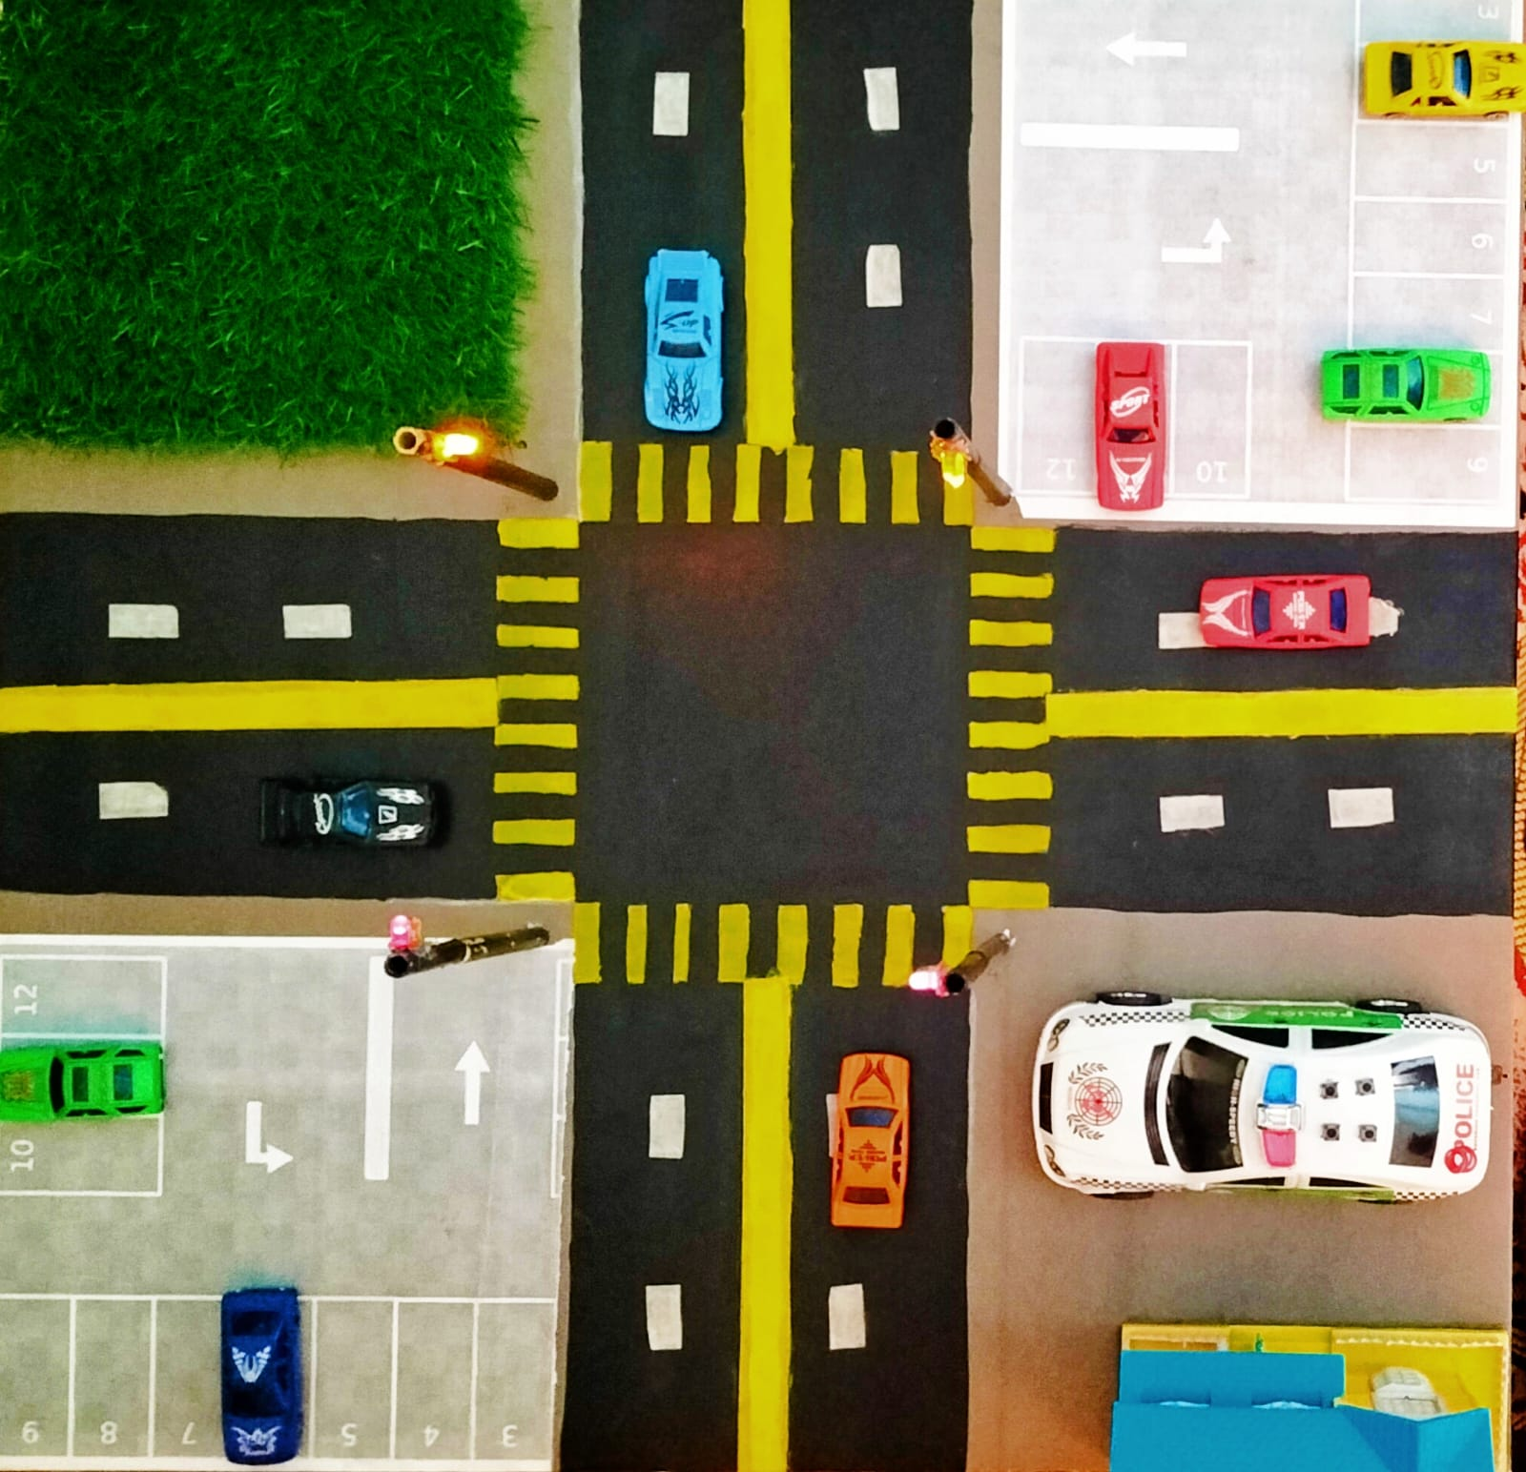
Practical Representation

Slide 9

Thank You Any Queries ?

