Slide 1
AI Security Automation Platform
Advanced Track Capstone - Week 10
Muhammad Haseeb

Slide 2
Problem Statement
Organizations face overwhelming volumes of security alerts.
  Security operations are often siloed, leading to delayed response times.
  There is a lack of automated, intelligent correlation between raw logs and actionable threat intelligence.

Slide 3
The Solution: Integrated Platform
An end-to-end security automation platform featuring:
  Automated Data Ingestion and Normalization
  Real-time Threat Intelligence Enrichment (simulated AbuseIPDB/AlienVault)
  Machine Learning Anomaly Detection (Isolation Forest)
  SOAR Orchestration for automated playbooks
  Live Streamlit Dashboard for analysts

Slide 4
Technical Architecture
Decoupled Microservice Architecture:
  Python 3 core modules communicating via file-based message queues.
  Machine Learning via Scikit-Learn (Isolation Forest).
  Visualization via Streamlit and Plotly.

Slide 5
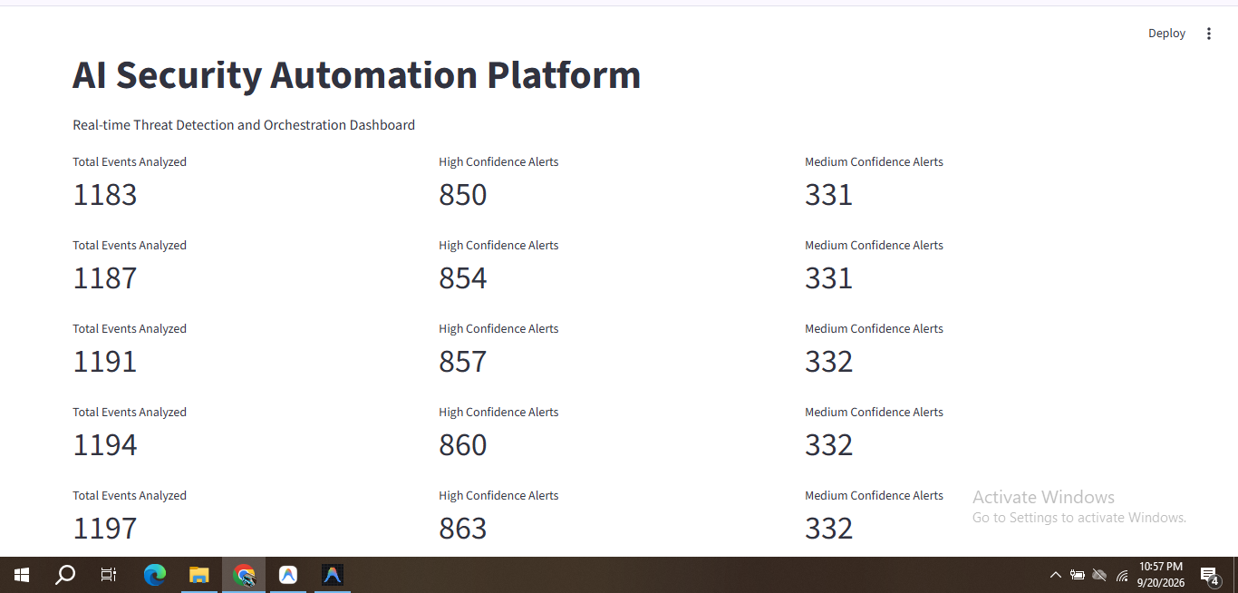
Platform Demo - p1.PNG

Slide 6
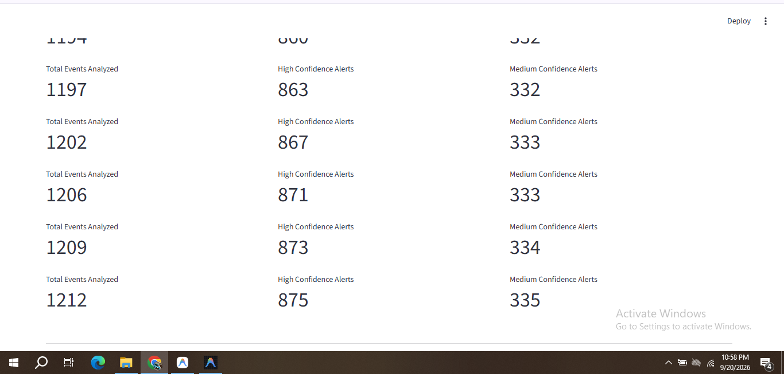
Platform Demo - p2.PNG

Slide 7
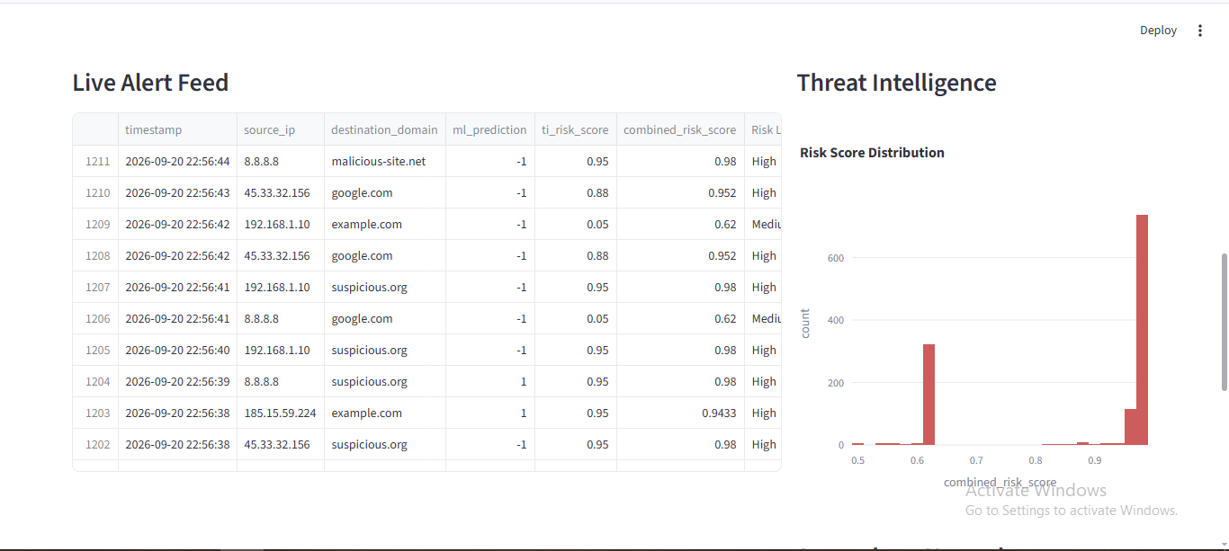
Platform Demo - p3.PNG

Slide 8
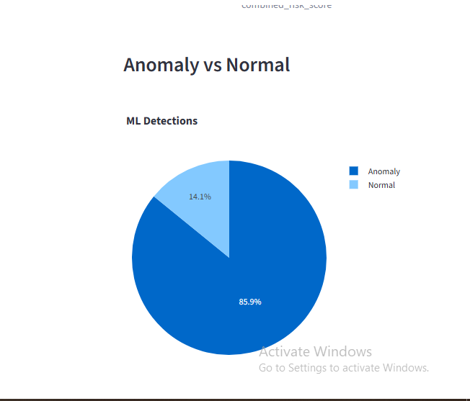
Platform Demo - p4.PNG

Slide 9
Challenges Overcome
Integrating disparate modules gracefully.
  Ensuring real-time communication without complex broker setups (achieved via tailing JSONL).
  Handling Windows terminal encoding issues for SOAR outputs.

Slide 10
Future Improvements
Production Enhancements:
  Replace JSONL queues with Apache Kafka / RabbitMQ.
  Store alerts in Elasticsearch.
  Dockerize modules for Kubernetes deployment.

Slide 11
Thank You
Questions?

