Slide 1
Inventory Management System

Slide 2
Group Members
Muhammad Hasnain
Saleem Ahmed
Kelash

Slide 3
Introduction
An Inventory Management System (IMS) helps businesses track and manage stock levels, orders, sales, and deliveries efficiently. This project aims to digitalize the inventory process to reduce manual errors and improve workflow.

Slide 4
Objective
Automate inventory tracking
Simplify the process of managing products, customers, and employees
Efficient Order Tracking and Management

Slide 5
Features
👥 Employee Management
Add new employees
View employee list
Delete employee records
Manage and update employee details
📦 Product Management
Add new products
Update product inventory
Delete existing products

Slide 6
Features
🗂️ Category Management
Add new product categories
Delete categories
👤 Customer Management
Add and manage customer information
View customer details
🛒 Orders Management
Track customer orders
Record new orders

Slide 7
Features
📘 Customer Ledger
Track dues
Track transactions
🔐 Logout System
Secure exit from the application
Prevent unauthorized access after logout

Slide 8
Tools & Technologies
Frontend: JAVA GUI (AWT + SWING)
Backend: MySQL
Language: JAVA

Slide 9

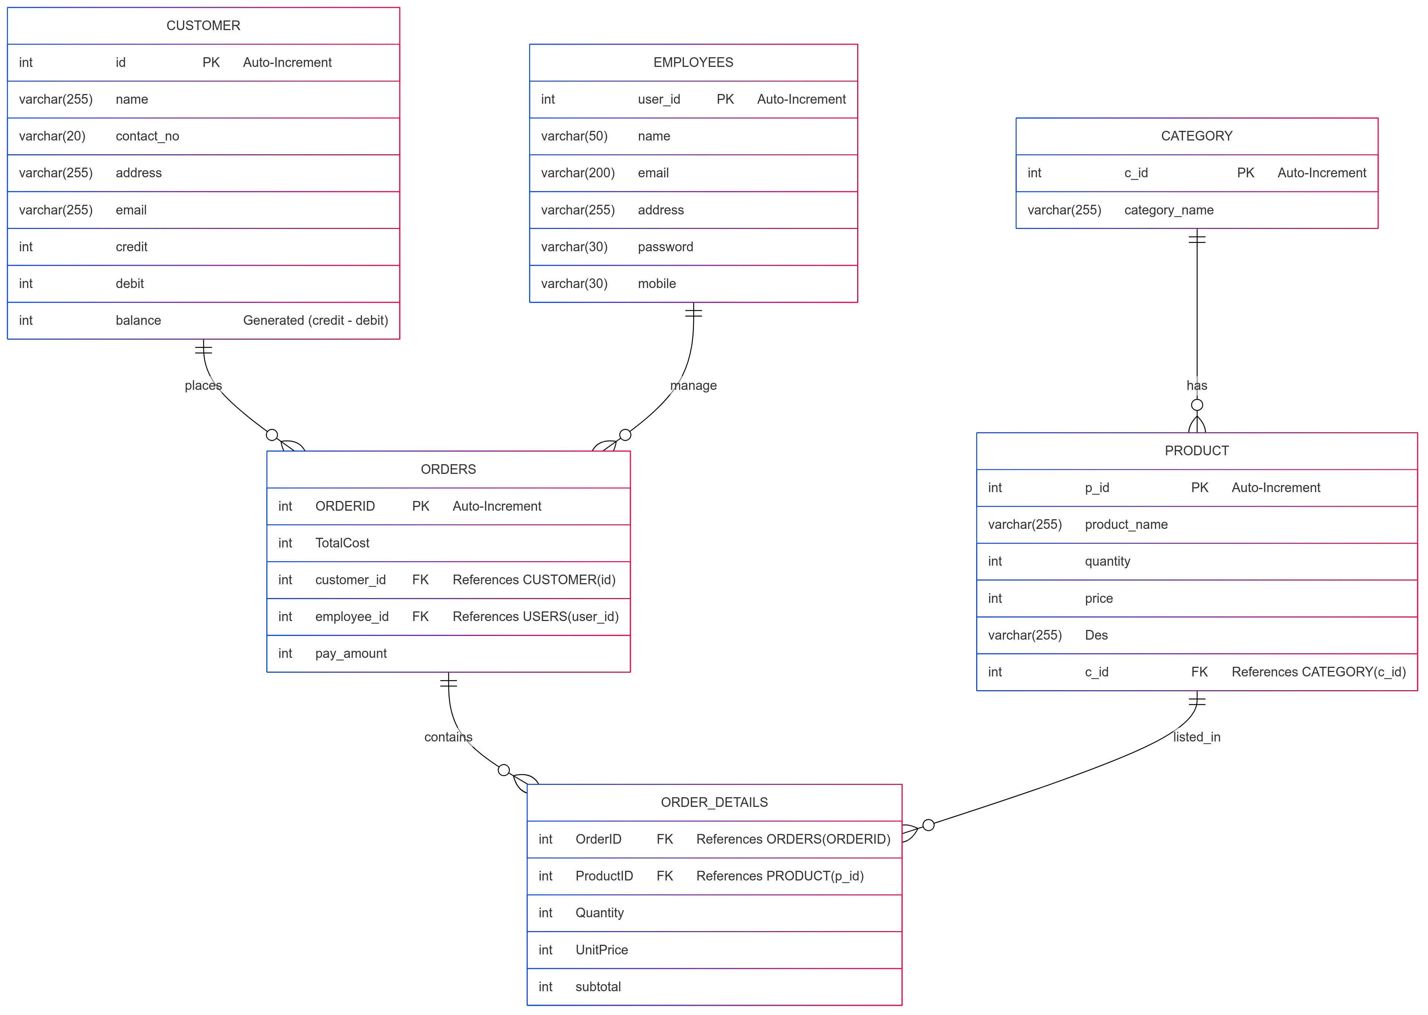

Slide 10
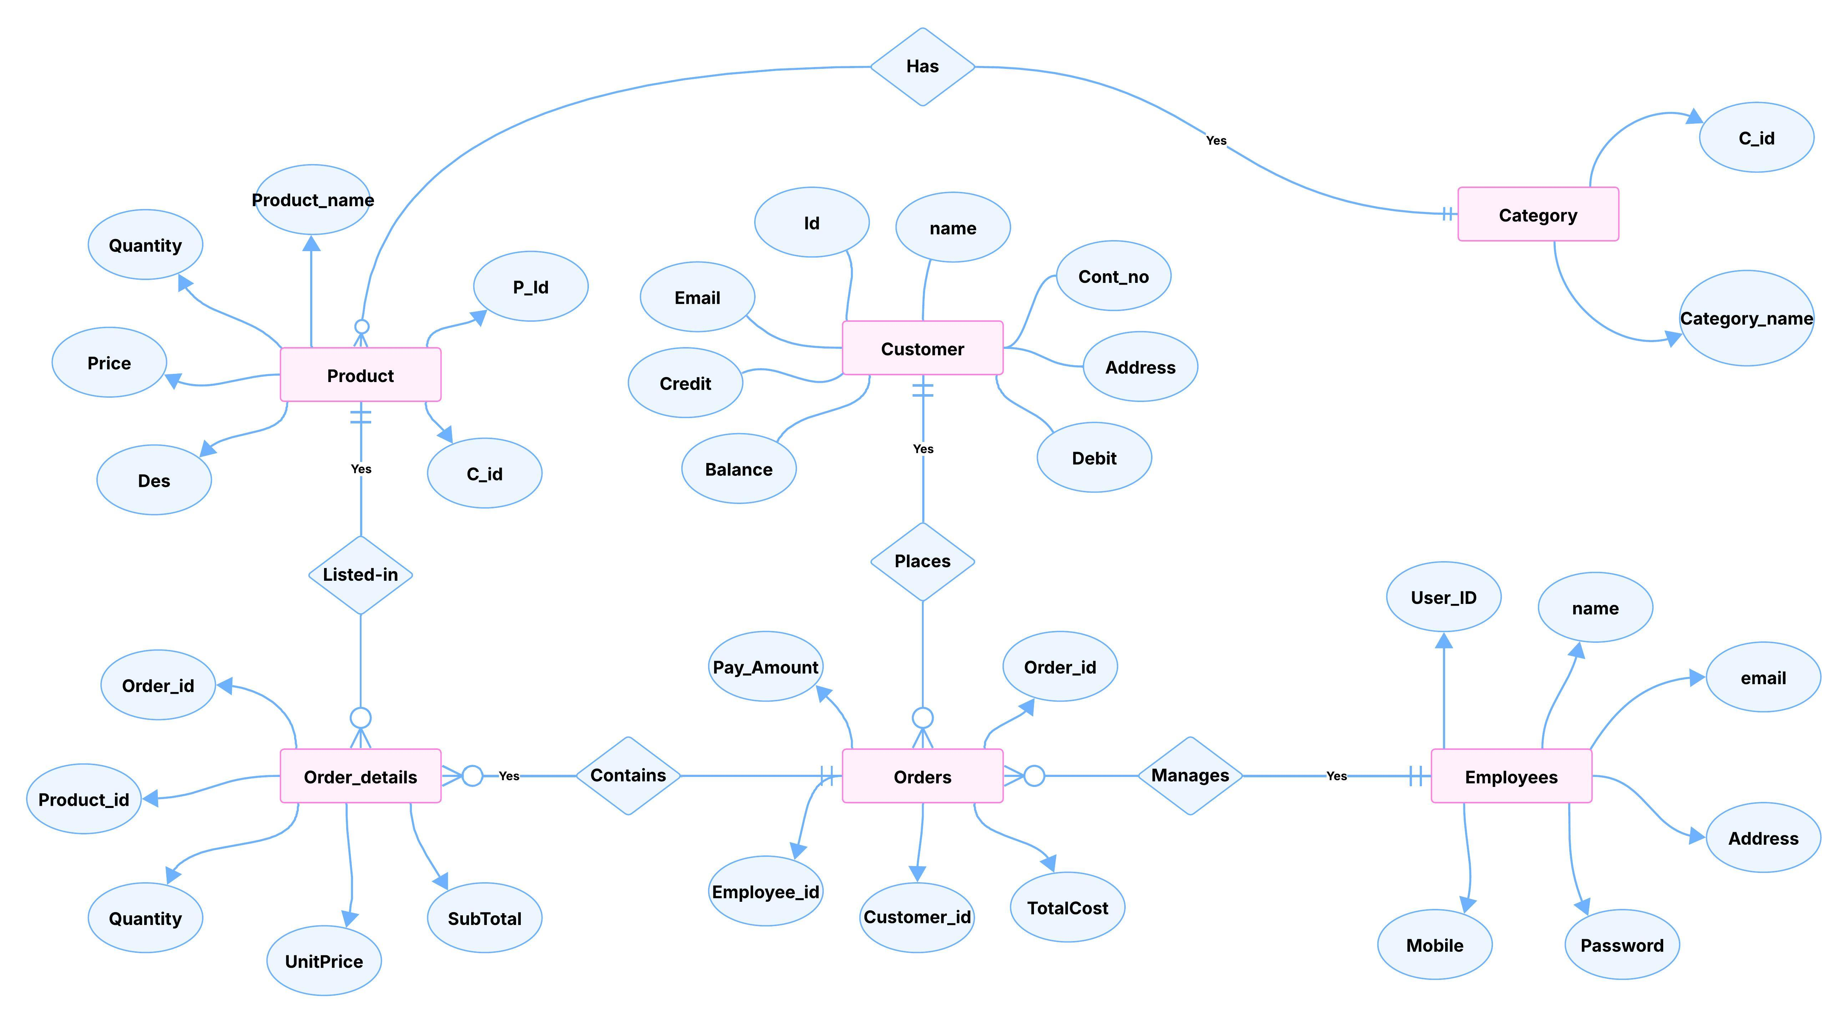

Slide 11
Schema
Category Table
CREATE TABLE category (
c_id INT NOT NULL AUTO_INCREMENT,
category_name VARCHAR(255) DEFAULT NULL,
);

Slide 12
Customer Table
CREATE TABLE customer (
id INT NOT NULL AUTO_INCREMENT,
name VARCHAR(255) NOT NULL,
contact_no VARCHAR(20),
address VARCHAR(255),
email VARCHAR(255),
credit INT DEFAULT 0,
debit INT DEFAULT 0,
balance INT GENERATED ALWAYS AS (debit - credit) STORED,
);

Slide 13
Employees Table
CREATE TABLE employees (
user_id INT NOT NULL AUTO_INCREMENT,
name VARCHAR(50) NOT NULL,
email VARCHAR(200) NOT NULL,
address VARCHAR(255) NOT NULL,
password VARCHAR(30) NOT NULL,
mobile VARCHAR(30) NOT NULL,
);

Slide 14
Product Table
CREATE TABLE product (
p_id INT NOT NULL AUTO_INCREMENT,
product_name VARCHAR(255) NOT NULL,
quantity INT DEFAULT NULL,
price INT DEFAULT NULL CHECK (price > 0),
Description VARCHAR(255) DEFAULT NULL,
c_id INT DEFAULT NULL,
FOREIGN KEY (c_id) REFERENCES category (c_id) ON DELETE CASCADE ON UPDATE CASCADE
);

Slide 15
Orders Table
DROP TABLE IF EXISTS orders;
CREATE TABLE orders (
TotalCost INT DEFAULT NULL,
customer_id INT DEFAULT NULL,
OrderID INT NOT NULL,
pay_amount INT DEFAULT NULL,
FOREIGN KEY (customer_id) REFERENCES customer (id) ON DELETE CASCADE ON UPDATE CASCADE
);

Slide 16
OrderDetails Table
CREATE TABLE orderdetails (
OrderID INT DEFAULT NULL,
ProductID INT DEFAULT NULL,
Quantity INT DEFAULT NULL,
UnitPrice INT DEFAULT NULL,
subtotal INT DEFAULT NULL,
FOREIGN KEY (ProductID) REFERENCES product (p_id) ON DELETE CASCADE ON UPDATE CASCADE,
FOREIGN KEY (OrderID) REFERENCES orders (OrderID) ON DELETE CASCADE ON UPDATE CASCADE
);

Slide 17
Conclusion
The Inventory Management System simplifies inventory control and improves accuracy in tracking orders and stock, making business operations more efficient.

