Slide 1
CSSE-313
Software Requirements Engineering
LECTURE 2
References: Text Book Chapters 1, 2

Slide 2
Lecture Outline
Requirement Engineer’s Role
Requirements Classification
Characteristics of Excellent Requirements

Slide 3
Requirement engineer’s Role
Gather, analyze, document, and validate the needs of the project stakeholders.
Principal conduit through which requirements flow between the customer community and the software development team
A project role, not necessarily a job title.
  May be a dedicated specialists or project manager, subject matter expert (SME), developer, and even user.
Must have skills, knowledge, training.

Slide 4
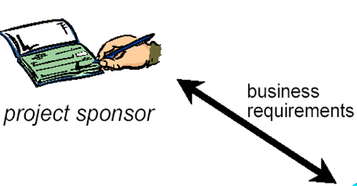
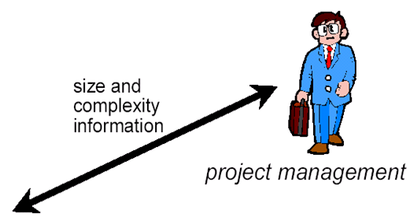
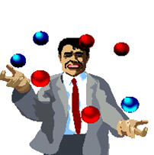
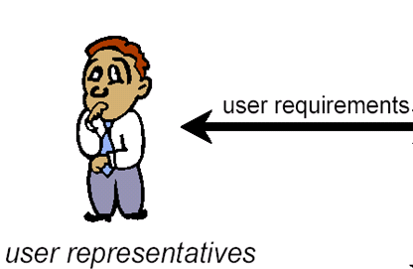
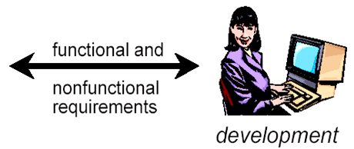


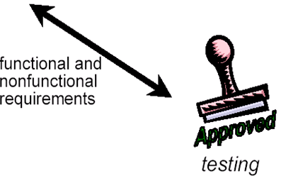


Role of Requirements Engineer
Requirements
Engineer

Slide 5
Requirement Engineer's Tasks
Define business requirements.
  Help the business or funding sponsor, product manager, or marketing manager define the project's business requirements.
  "Why are we undertaking this project?"
  Business requirements include a statement of the organization's business objectives and the ultimate vision of what the system will be and do.
  Suggest a template for a vision and scope document and work with those who hold the vision to help them express it.

Slide 6
Requirement Engineer's Tasks
Identify project stakeholders and user classes.
  Select appropriate representatives for each user class, enlist their participation, and negotiate their responsibilities.
  Write down the contributions required from customer collaborators and agree on an appropriate level of participation from each one.

Slide 7
Requirement Engineer's Tasks
Elicit requirements.
  Interviews, Facilitated requirements workshops, Document analysis, Surveys, Customer site visits, Business process analysis, Work flow and task analysis, Competitive product analysis, Retrospectives performed on the previous project
  Users naturally emphasize the system's functional requirements, so steer the discussions to include quality attributes, performance goals, business rules, external interfaces, and constraints.

Slide 8
Requirement Engineer's Tasks
Analyze requirements.
  Look for
    derived requirements
    unstated requirements.
  Spot the vague, weak words that cause ambiguity.
  Point out
    conflicting requirements
    areas that need more detail.

Slide 9
Requirement Engineer's Tasks
Facilitate requirements prioritization.
  The R. Engr. brokers collaboration and negotiation between the various user classes and the developers to ensure that they make sensible priority decisions.
  Requirements prioritization spreadsheet tool might be helpful.

Slide 10
Requirement Engineer's Tasks
Write requirements specifications.
  Shared understanding of a system that will address the customer's problem.
  Specify the functional requirements at a level of detail suitable for use by the developers who will implement them. This level of detail will vary from project to project.
    E.g. a Web site being built incrementally by a small, well-synchronized team can get away with limited requirements documentation. In contrast, a complex embedded system that will be outsourced to an offshore supplier needs a precise, detailed SRS.
  Using standard templates for use cases and the SRS accelerates requirements development.

Slide 11
Requirement Engineer's Tasks
Model the requirements.
  Determine when it is helpful to represent requirements using methods other than text.
  Graphical analysis models, tables, mathematical equations, and prototypes.
  Depict information at a higher level of abstraction than does detailed text.
  To maximize communication and clarity, draw analysis models according to the conventions of a standard modeling language (e.g. UML).

Slide 12
Requirement Engineer's Tasks
Lead requirements validation.
  Ensure that requirement statements possess all the desired characteristics (that we discuss later in this lecture) and that a system based on the requirements will satisfy user needs.
  R. Engrs. are the central participants in peer reviews of requirements documents.
  They should also review designs, code, and test cases that were derived from the requirements specifications to ensure that the requirements were interpreted correctly.

Slide 13
Requirement Engineer's Tasks
Manage requirements.
  A Requirements Engr. is involved throughout the entire software development life cycle, so (s)he should help create, review, and execute the project's requirements management plan.
  Storing the requirements in a requirements management tool facilitates this ongoing management.

Slide 14
Requirement Engineer's Tasks
Requirements management includes tracking the status of individual requirements as they progress from inception to verification in the integrated product.
With input from various colleagues, the R. Engr. collects traceability information that connects individual requirements to other system elements.
Managing changes to the baselined requirements by using a change-control process and tool.

Slide 15
Lecture Outline
Requirement Engineer’s Role
Requirements Classification
Characteristics of Excellent Requirements

Slide 16
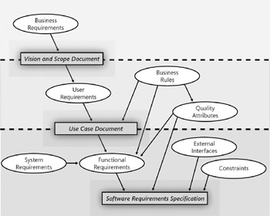
LEVELS OF REQUIREMENTS

Slide 17
BUSINESS REQUIREMENTS
Represent high-level objectives of the organization or customer who requests the system.
  Typically come from the funding sponsor for a project, the acquiring customer, the manager of the actual users, the marketing department, or a product visionary.
Describe why the organization is implementing the system—the objectives the organization hopes to achieve.
Recorded in a vision and scope document, sometimes called a project charter.
Defining the project scope is the first step in controlling the common problem of scope creep.

Slide 18
USER REQUIREMENTS
Describe user goals or tasks that the users must be able to perform with the product.
Valuable ways to represent user requirements include
  use cases
  scenario descriptions
An example of a use case is "Make a Reservation" using an airline, or a hotel web site.

Slide 19
FUNCTIONAL REQUIREMENTS
Specify the software functionality that the developers must build into the product to enable users to accomplish their tasks.
Almost any action, e.g. calculate, inspect, publish, or most other active verbs can be a functional requirement.
Example:
  The product shall predict which road sections will freeze within the selected time parameters.
  The user shall be able to search either the entire database of patients or select a subset from it (admitted patients, or patients with asthma, etc.)

Slide 20
Business vs. Functional Requirements
Business requirements are high level requirements that management and a board of directors would typically understand, as follows:
Requirement 1
"We need to establish an online customer portal."
Requirement 2:
"The portal should list our products."

Slide 21
Business vs. Functional Requirements
Functional requirements are very detailed and outline exactly what needs to be delivered and would typically be read by developers, project manager and testers:
Requirement 3:
"The system shall be able to register a product using the following fields: Name (20 characters long), Details (2000 characters long), Price (currency)."
Requirement 4:
"The system shall support that up to 5 pictures can be listed per product."
A business requirement (“The portal should list our products”) can be broken in to one or more detailed functional requirements

Slide 22
SYSTEM REQUIREMENTS
The top-level requirements for a product that contains multiple subsystems—that is, a system (IEEE 1998c).
A system can be all software or it can include both software and hardware subsystems.
People are a part of a system, too, so certain system functions might be allocated to human beings.

Slide 23
BUSINESS RULES
Corporate policies, government regulations, industry standards, etc.
Business rules are not themselves software requirements because they exist outside the boundaries of any specific software system. However, they often restrict who can perform certain use cases or they dictate that the system must contain functionality to comply with the pertinent rules.

Slide 24
NFRs/QUALITY ATTRIBUTES
Non-Functional Requirements (NFR)
Augment product's functionality by describing the product's characteristics in various other dimensions that are important either to users or to developers.
Characteristics that relate to the system as a whole
  usability, portability, efficiency, and robustness etc.

Slide 25
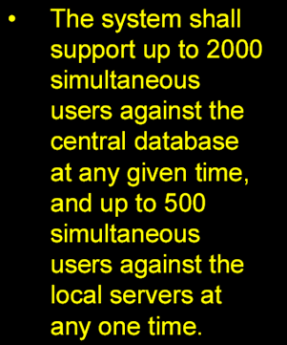
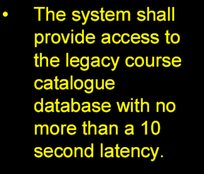
Examples: NFRs

Slide 26
OTHER NON-FUNCTIONAL REQUIREMENTS
External interfaces between the system and the outside world.
Constraints that impose restrictions on the choices available to the developer for design and construction of the product.
  Constraints do not affect the external behavior of the system, but must be fulfilled to meet technical, business, or contractual obligations.
  Example: The system development process and deliverable documents shall conform to the military standard MIL-STD-2167A

Slide 27
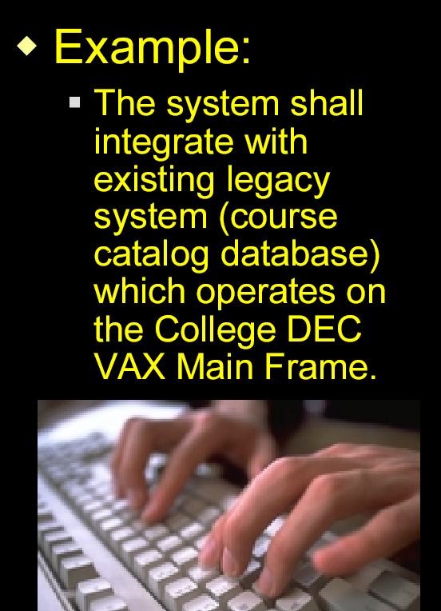
Example: Constraints

Slide 28
“FURPS+” Classification of Requirements
Functional
Non-Functional (NFRs)
  Usability
    The ease with which the system can be learned and operated by the intended users.
    Help, documentation, required training time, task times for typical tasks, conformance to usability standards, etc.
  Reliability
    Allowed MTBF (Mean Time Between Failures)
    Maximum defect rate allowed per KLOC
    Recoverability, etc.

Slide 29
FURPS+ Classification of Requirements
  Performance
    Response time, throughput, …
    Average, maximum response time for a transaction
    Number of customers/transactions the system can accommodate
    Example:
      Buyers want to complete sales processing very quickly. One bottleneck is external payment authorization. Our goal: authorization in less than 1 minute, 90% of the time.
  Supportability:
    Supportability is the ability of the software to be easily modified to accommodate enhancements and repairs
    Maintainability, adaptability, configurability, etc.

Slide 30
FURPS+ Classification Cont.
+ indicates additional constraints such as:
  Design Constraints
    E.g. requiring a relational database
  Interface constraints
    i.e. protocols for interaction with external systems
  Implementation Constraints
    Required platform, implementation language
  Physical constraints
    Hardware devices

Slide 31
Agenda
Requirement Engineer’s Role
Requirements Classification
Characteristics of Excellent Requirements

Slide 32
Characteristics of INDIVIDUAL Requirement Statements
Complete
Correct
Feasible
Necessary
Prioritized
Unambiguous
Verifiable

Slide 33
Complete
Each requirement must fully describe the functionality to be delivered.
It must contain all the information necessary for the developer to design and implement that bit of functionality.
If you know you're lacking certain information, use TBD (to be determined) as a standard flag to highlight these gaps.
Resolve all TBDs in each portion of the requirements before you proceed with construction of that portion.
Notes:
Organize the requirements hierarchically in the SRS to help reviewers understand the structure of the functionality described, so it will be easier for them to tell if something is missing.
Resolve all TBDs from a given set of the requirements
before you proceed with construction of that part of the product.

Slide 34
Correct
Each requirement must accurately describe the functionality to be delivered.
The reference for correctness is the source of the requirement, e.g.
  an actual client
  a higher level requirements specification.
Notes:
Correctness: The requirements represent the client’s needs

Slide 35
Feasible
It must be possible to implement each requirement within the known capabilities and limitations of the system and its environment.
To avoid infeasible requirements, have a developer or marketing personnel work with the requirements analysts throughout the elicitation process.
Incremental development approaches and proof-of-concept prototypes are ways to evaluate requirement feasibility.
Notes:
feasability: Requirements can be implemented and delivered

Slide 36
Necessary
Each requirement originates from a source you recognize as having the authority to specify requirements.
Trace each requirement back to its origin:
  use case
  system requirement
  regulation
  or some other voice-of-the-customer input.

Slide 37
PRIORITIZED
Assign an implementation priority to each functional requirement, feature, or use case to indicate how essential it is to a particular product release.
If all the requirements are considered equally important, it's hard for the project manager to respond to
  budget cuts
  schedule overruns
  personnel losses
  new requirements added during development.

Slide 38
Unambiguous
The reader of a requirement statement should be able to draw only one interpretation of it.
  Natural language is highly prone to ambiguity
  Effective ways to reveal ambiguity include:
    formal inspections of the requirements specifications,
    writing test cases from requirements
    creating user scenarios that illustrate the expected behavior of a specific portion of the product.

Slide 39
Verifiable
See whether you can devise tests or use other verification approaches, such as inspection or formal specification, to determine whether each requirement is properly implemented in the product.
Requirements that are in-feasible, or ambiguous are also not verifiable.
Notes:
If a requirement is not verifiable, determining whether it was correctly implemented is a matter of opinion.

Slide 40
Example: VERIFIABLE NFR
  An operator shall not have to wait for the transaction to complete… change to measureable
  An operator shall not have to wait more than 1sec for a transaction to complete for at least 95% of the transactions.
Interesting phenomenon: What gets measured gets done.
Notes:
Therefore, unless a quantified requirement is unrealistic, it will
probably be met. Its value will determine how hard the developer
will have to work to achieve the requirement and may determine
how many design alternatives from which the developer has to
choose and still meet the requirements.
Note that the numbers cannot be arbitrary or guessed at. They
must be well-understood. If the requirement is “reduce response
time by 25%”, it means that the current response time must be
known and documented; and there must be a reason for wanting
25% reduction and not 20% or 30%. It’s not likely that the
customers are going to be able to provide such precision in the
beginning. Don’t slow down the requirement gathering process
to make the requirements measurable. Rather, elicit the required
attributes, and later go back and negotiate a measurable
requirement.

Slide 41
Characteristics of Requirement Specification SET (SRS)
Complete
Consistent
Modifiable
Traceable
Noiseless
Free of Over-specification

Slide 42
COMPLETE SRS
No requirements or necessary information should be absent.
Missing requirements are hard to spot because they aren't there!
Focusing on user tasks, rather than on system functions, can help you to prevent incompleteness.

Slide 43
Consistent SRS
Consistent requirements do not conflict with other software requirements or with higher level requirements.
“Doors must always be kept closed between platforms”
and “Doors must be opened in case of emergency stop”
Inconsistencies can slip in undetected if you review only the specific change and not any related requirements.
Recording the originator of each requirement lets you know who to talk to if you discover conflicts.
Notes:
Disagreements among requirements must be
resolved before development can proceed. You may not know which (if any) is correct until you
do some research. Be careful when modifying the requirements

Slide 44
Modifiable SRS
You must be able to revise the SRS when necessary and to maintain a history of changes made to each requirement.
Each requirement be uniquely labeled and expressed separately from other requirements so you can refer to it unambiguously.
Related requirements are grouped together.
Each requirement should appear only once in the SRS.
Create a table of contents, index, traceability matrices
Notes:
You must be able to revise the SRS when necessary and maintain a history of changes made to each requirement.

Slide 45
Traceable SRS
A traceable requirement can be linked
  backward to its origin
  forward to the design elements and source code that implement it and to the test cases that verify the implementation as correct.
Traceable requirements are
  uniquely labeled
  written in a structured, fine-grained way, as opposed to large, narrative paragraphs.
Notes:
You must be able to revise the SRS when necessary and maintain a history of changes made to each requirement. Link each software requirement to the design elements, source code, and test cases that are constructed to implement and verify the requirement.

Slide 46
Noiseless SRS
Noise is an SRS item yielding no information on any problem world feature
  Example: “Non-smoking signs shall be posted on train windows”

Slide 47
Overspecification-free SRS
Overspecification is an SRS item stating a feature not in the problem world, but in the machine solution.
Example:
“The setAlarm method shall be invoked on receipt of an Alarm message”
Note: Do not include implementation details in SRS

Slide 48
Exercise 1
“The product shall provide status messages at regular intervals not less than every 60 seconds.”
Quality Analysis?
Notes:
This requirement is incomplete: what are the status messages and how
are they supposed to be displayed to the user? The requirement contains several ambiguities.
What part of “the product” are we talking about? Is the interval between status messages really supposed to be at least 60 seconds, so showing a new message every 10 years is okay? Perhaps the intent is to have no more than 60 seconds elapse between messages; would 1 millisecond be too short? As a result of these problems, the requirement is not verifiable.

Slide 49
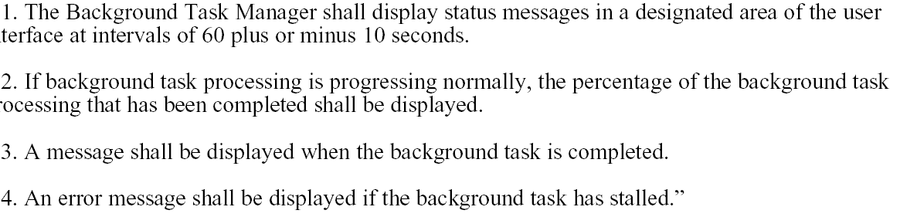
Exercise 1: Improved
Notes:
I split this into multiple requirements because each will require separate test cases and because
each should be separately traceable. If several requirements are strung together in a paragraph, it
is easy to overlook one during construction or testing.

Slide 50
Exercise 2
“The product shall switch between displaying and hiding non-printing characters instantaneously.”
Analysis?
Notes:
Computers cannot do anything instantaneously, so this requirement
is not feasible. It is incomplete because it does not state the conditions that trigger the state
switch. Is the software making the change on its own under some conditions, or does the user
take some action to stimulate the change? Also, what is the scope of the display change within the
document: selected text, the entire document, or something else? There is an ambiguity problem, too. Are “non-printing” characters the same as hidden text, or are they attribute tags or control characters of some kind? As a result of these problems this requirement cannot be verified.

Slide 51
Exercise 2: Improved
“The user shall be able to toggle between displaying and hiding all HTML markup tags in the document being edited with the activation of a specific triggering condition.”
Notes:
Now it is clear that the non-printing characters are
HTML markup tags. This requirement does not constrain the design because it does not define
the triggering condition. When the designer selects an appropriate triggering condition, you can
write specific tests to verify correct operation of this toggle.

Slide 52
Exercise 3
“Charge numbers should be validated on-line against the master corporate charge number list, if possible.”
Analysis?
Notes:
what does “if possible” mean? If it’s technically feasible? If the master charge number list can be accessed on line? Avoid imprecise words like
“should.” The customer either needs this functionality or he doesn’t. I have seen some requirements specifications in which subtle distinctions are drawn among keywords like “shall”, “will”, and “should” as a way to indicate priority. I prefer to stick with “shall” as a clear statement of what is intended by the requirement and to explicitly specify the priorities.

Slide 53
Exercise 3: Improved
“The system shall validate the charge number entered against the online master corporate charge number list.
If the charge number is not found on the list, an error message shall be displayed and the order shall not be accepted.”

Slide 54
Exercise 4
Which of these quality attributes: efficiency, reliability, usability, maintainability would be important for the system computing income taxes, that will be used by government employees at FBR who audit taxpayers?
Answer:
  Income tax software is an application domain in which maintainability will be a big concern since tax regulations tend to change frequently.
  Usability will also be important so the auditors can do their job efficiently.
  Reliability will be of moderate importance
  Efficiency will be of minimal importance .

