Slide 1
Mongoose
A mongodb orm

Slide 2

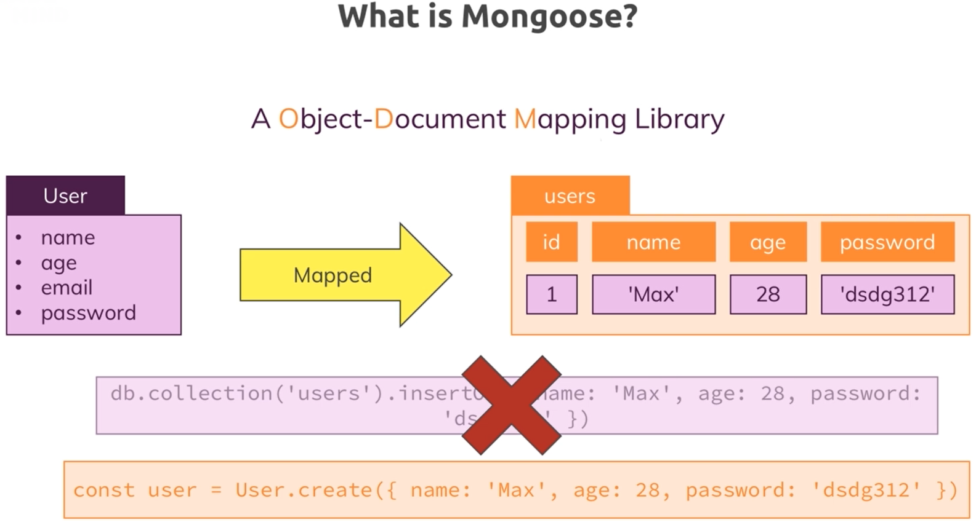



What is Mongoose?

Slide 3
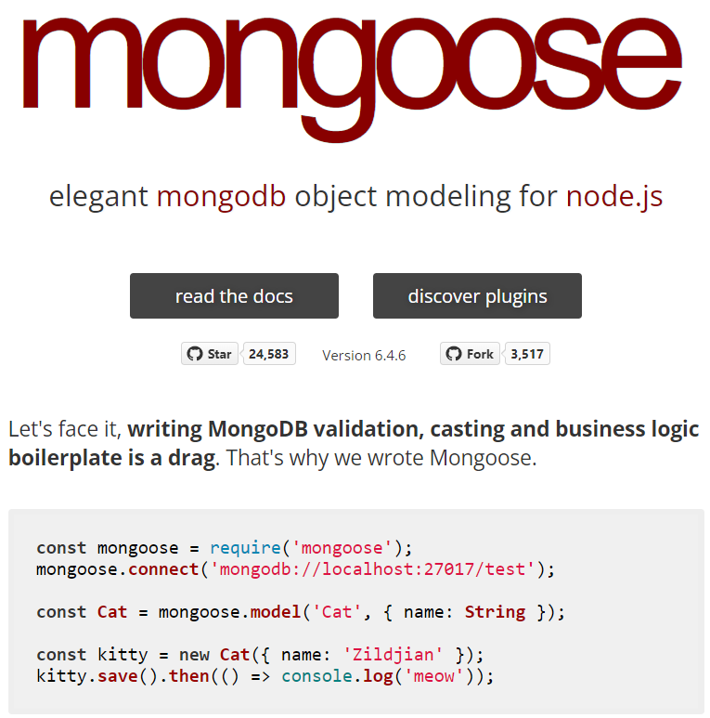
Connecting to the MongoDB server with Mongoose

Slide 4
Connecting to the MongoDB server with Mongoose (Cont.)
Npm install –save mongoose
Mongoose.connect(‘connection-string’).then(result => {app.listen(3000);})

Slide 5
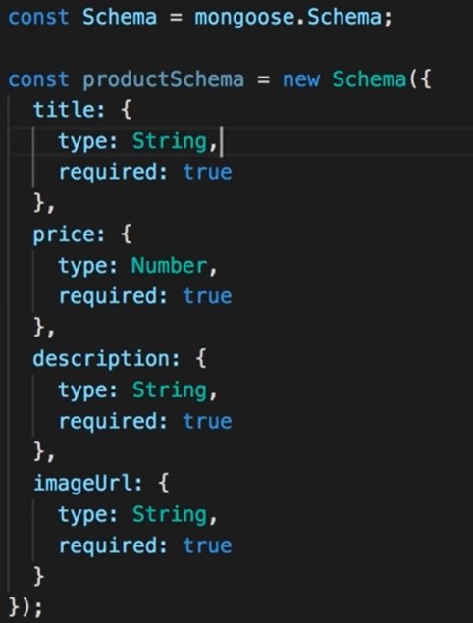
Creating Product Schema

Slide 6
Saving the Data through Mongoose

Slide 7
Fetching All Products

Slide 8
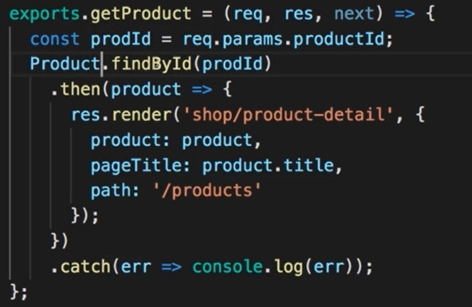
Fetching a single products

Slide 9
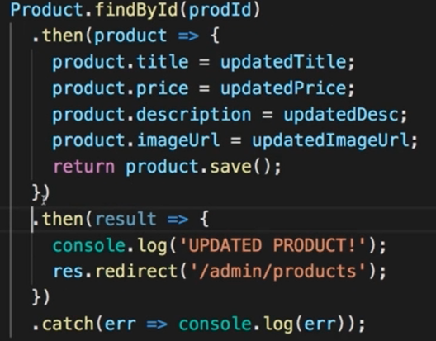
Updating Products

Slide 10
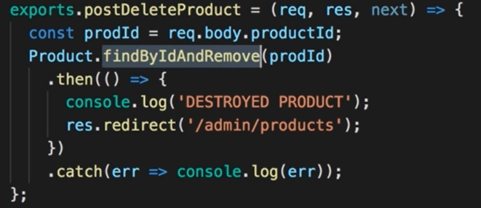
Deleting a Product

Slide 11
Adding a User Model

Slide 12
Using Relations in Mongoose

Slide 13
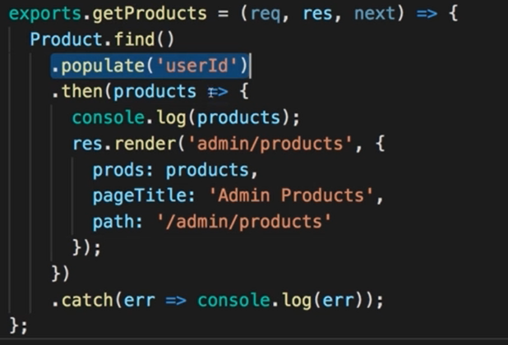
One important thing about fetching relations

