Slide 1
Model View Controller (MVC)
Structuring the code

Slide 2
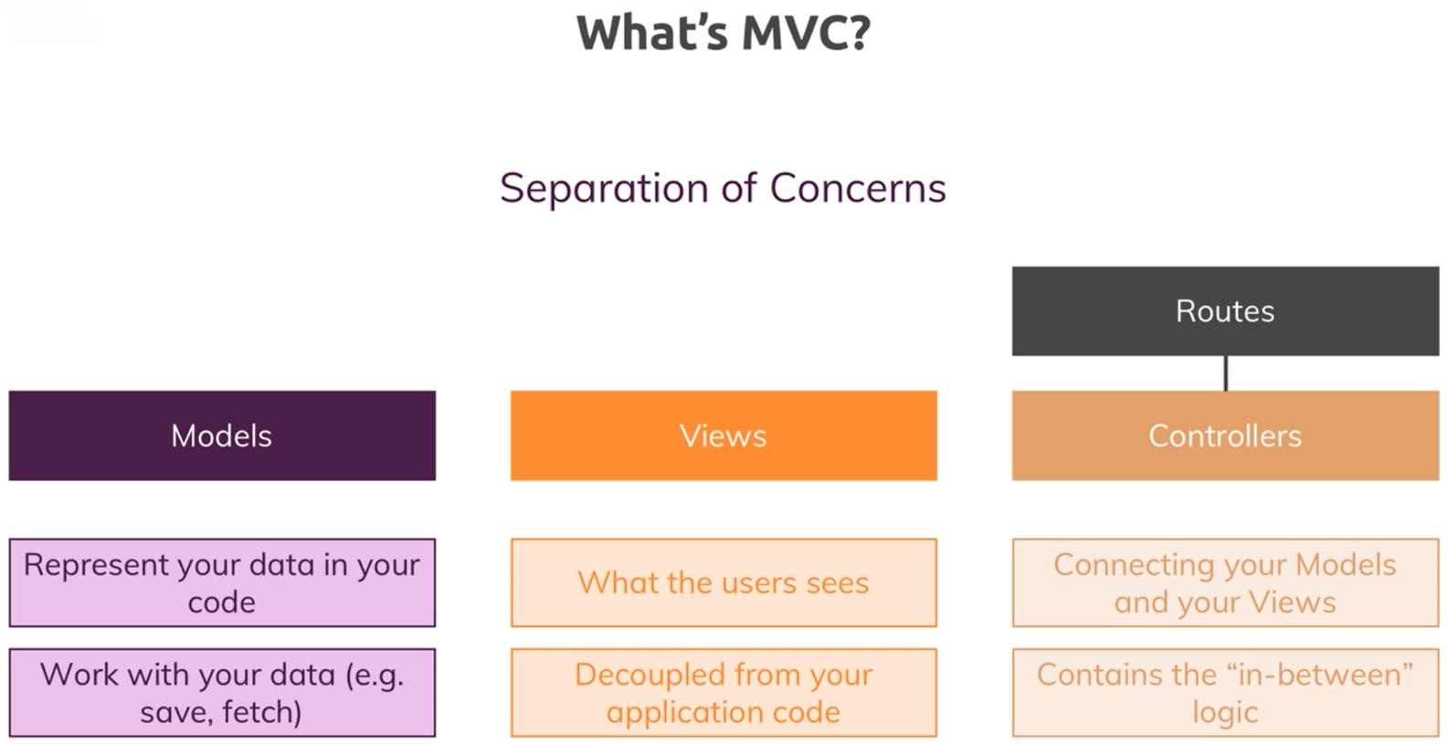

Slide 3
Controllers

Slide 4
Addin a Product Model

Slide 5
Storing Data in Files using Models

Slide 6
Refactoring Code

