Slide 1



Creating Integrated Python QML GUI with MQTT Practical Training Handout
Written by :
Muhammad Husni Muttaqin, S. Pd

Slide 2

About me
Name : Muhammad Husni Muttaqin, S. Pd.
Birth date : 5 June 1998
Hometown : Bandung
Current Job : python programmer at PT Syergie Indoprima and part time teacher
Experiences :
- 2019 - 2020 : Dynamics Positioning System engineer on cable ship (PT Syergie Indoprima)
- 2021 - 2022 : Electronics and control system engineer for Vent-I (PT Syergie Automa Teknologi)
- 2022 – now : Python Programmer PT Syergie Indoprima

Slide 3
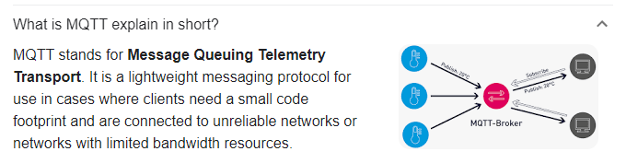
What is MQTT

Slide 4
File links
Ppt, example code
https://github.com/muhammadhusni777/ARDUMEKA-MQTT-GUI
Software tools
https://drive.google.com/drive/folders/1eKmwfIYVEk9dNEoskVgPkrd7ihbXmtxf?usp=sharing
Contoh project
https://wokwi.com/projects/345223004701065810

Slide 5
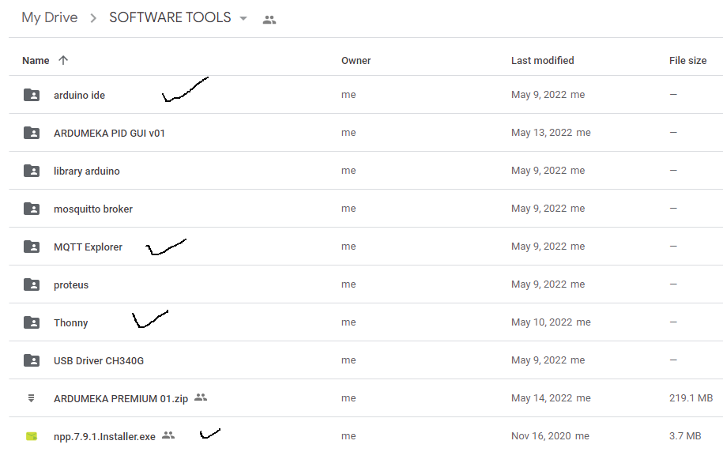

Slide 6
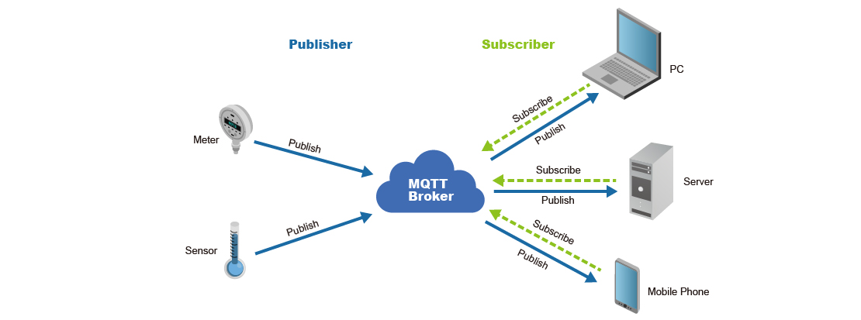

Slide 7
Broker mqtt :
broker.emqx.io => port 1883
test.mosquito.org => port 1883
mqtt.ardumeka.com => port 11219

Slide 8
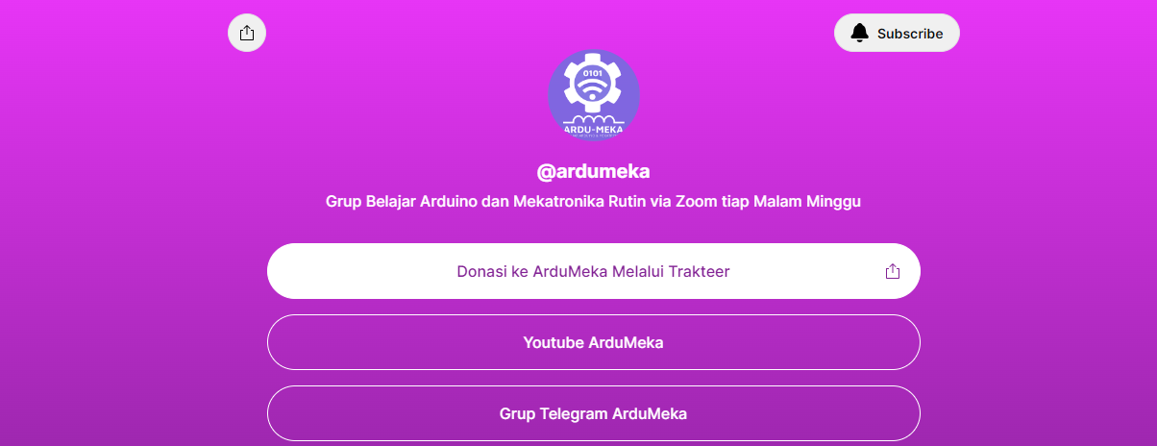

Slide 9
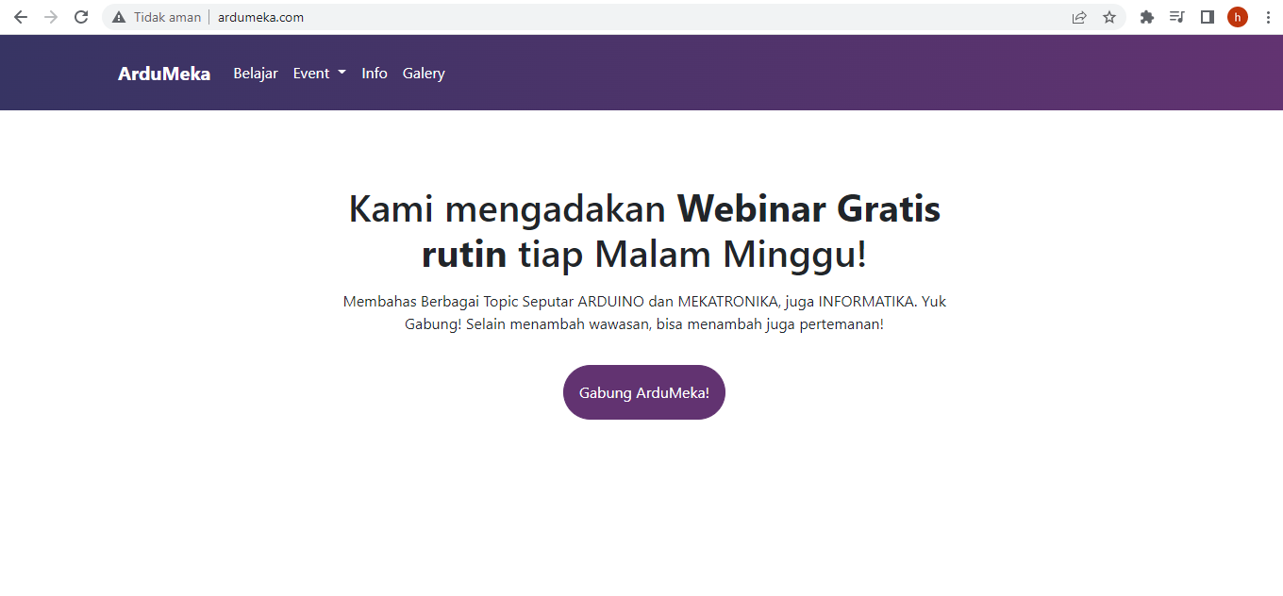

Slide 10
SPACE AVAILABLE
https://linktr.ee/ardumeka

Slide 11
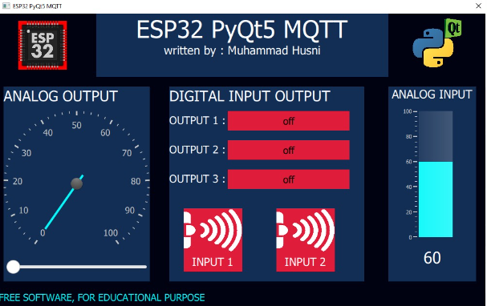
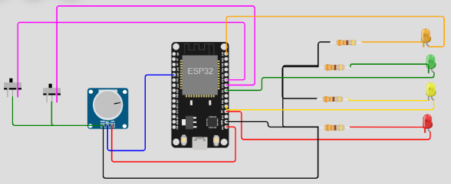
Today Workshop Project with PyQt5
https://wokwi.com/projects/345223004701065810

Slide 12
Preparation
Software Installation
Notepad++
Thonny IDE
- PyQt5 Library
- paho.mqtt Library
Arduino IDE
- ESP32 Board - Pubsubclient Library
CP211 Driver
MQTT Explorer

Slide 13
Hardware Wiring

Slide 14
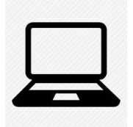
RUN EXAMPLE CODE FIRST TO MAKE SURE PREPARATION DONE PERFECTLY ☺
publish
subscribe
subscribe
publish

Slide 15
step by step on this workshop
1
5
2
1 add windows
2 add text
3 Add button
4 Add slider
5 Add image
6 Add gauge and circular gauge
7 Integrate python and qml
8 send data through MQTT Connection
3
6
6
4

Slide 16
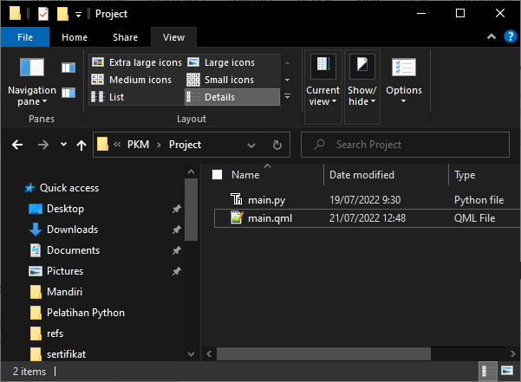
Create new folder
.py
.qml

Slide 17
Python base code
from PyQt5.QtCore import *
from PyQt5.QtGui import *
from PyQt5.QtQml import *
from PyQt5.QtWidgets import *
from PyQt5.QtQuick import *
import sys
class table(QObject):
def __init__(self, parent = None):
super().__init__(parent)
self.app = QApplication(sys.argv)
self.engine = QQmlApplicationEngine(self)
self.engine.rootContext().setContextProperty("backend", self)
self.engine.load(QUrl("main.qml"))
sys.exit(self.app.exec_())
if __name__ == "__main__":
main = table()

Slide 18
Qml base code
import QtQuick 2.12
import QtQuick.Window 2.13
import QtQuick.Controls 2.0
import QtQuick.Controls.Styles 1.4
import QtQuick.Extras 1.4
import QtQuick.Extras.Private 1.0
Window {
id : root
width: 400
height: 400
title:"membuat windows"
color : "pink"
visible: true
//flags: Qt.WindowMaximized //Qt.Dialog
}

Slide 19
Experiment
Make your windows with your favorite color ☺

Slide 20
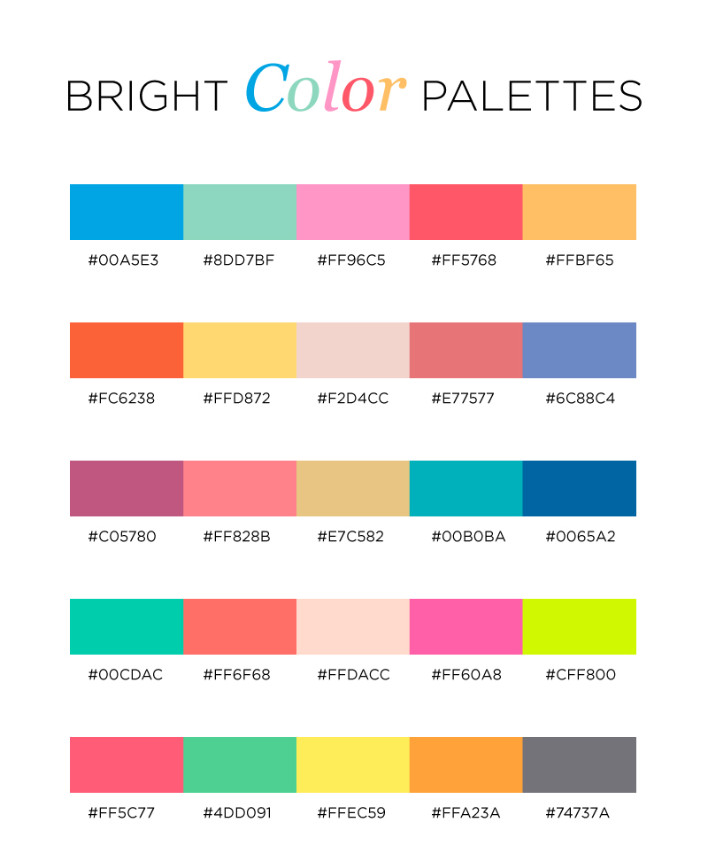
Little tricks => color pallete
color : “#FF96C5"

Slide 21
Add some text on your window
Text{
id : text1
x:100
y:200
text:"Hello World"
color: "#00FF00"
font.family : "Comic Sans MS"
font.pixelSize: 35
font.bold : true
}
WRITE YOUR NAME ON YOUR WINDOW

Slide 22
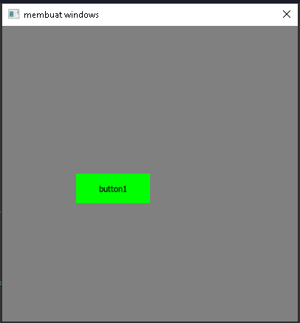
Add some buttons on your window
Button {
id: button1
x :100
y :200
text: "button1"
palette {
button: "#00FF00"
buttonText: "black"
}
onClicked:{
}
}
MAKE THREE BUTTONS

Slide 23
Little tricks => toggle button
Button {
id: button3
x :120
y :170
width : 250
text: "off"
font.pixelSize : 20
onClicked:{
if(button3.text == "on"){
text = "off";
button3_color.color = "#df1c39"
}else
if(button3.text == "off"){
text = "on";
button3_color.color = "#04f8fa"
}
}
}

Slide 24
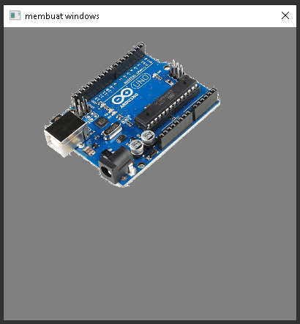
Add some picture on your window
Image{
x:50
y:0
width : 250
height : 250
source: "arduino.png"
}

Slide 25
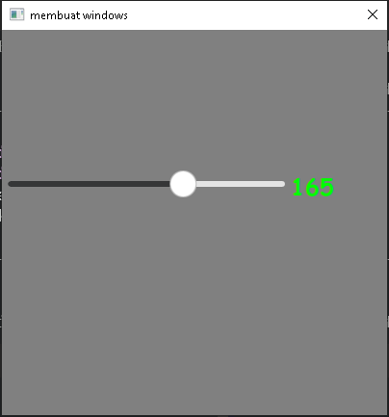
Add slider on your window
Slider {
id: slider1
x:0
y:150
height: 20
width: 300
value: 0
from:10
to: 255
stepSize: 5
orientation: Qt.Horizontal
onValueChanged: {
}
}

Slide 26
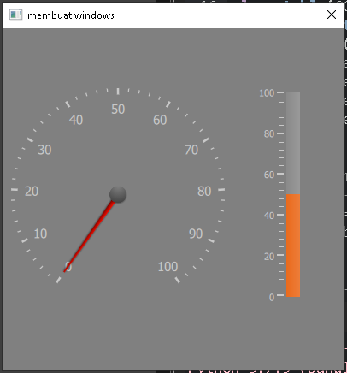
Add gauge on your window
Gauge {
id : gauge2
x: 300
y: 70
height : 250
width : 250
minimumValue: 0
value: 50
maximumValue: 100
tickmarkStepSize: 20
style: GaugeStyle {
valueBar: Rectangle {
color: "#e85d08"
implicitWidth: 16
}
}
}

Slide 27
Add circular gauge on your window
CircularGauge {
id : gauge1
x: 10
y: 70
height : 250
width : 250
value: 0
minimumValue: 0
maximumValue: 100
style: CircularGaugeStyle {
labelStepSize: 10
}
}

Slide 28
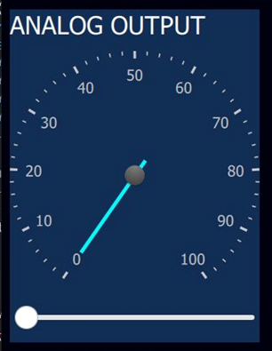
Little tricks => grouping using Rectangle
Rectangle{
x: 200
y:0
width : 600
height : 130
color : "#122e55"
//insert your QML Component inside here ☺
}

Slide 29
Integrate python with qml
Python <= QML
class table(QObject):
def __init__(self, parent = None):
super().__init__(parent)
self.app = QApplication(sys.argv)
self.engine = QQmlApplicationEngine(self)
self.engine.rootContext().setContextProperty("backend", self)
self.engine.load(QUrl("main.qml"))
##############TOMBOL QML KE PYTHON ##########
@pyqtSlot(str)
def button1(self, message):
print(message)
##########SLIDER QML KE PYTHON###################
@pyqtSlot(str)
def analog_output(self, message):
print(message)
Button {
…….
onClicked:{
backend.button1("clicked")
}
}
Slider {
…….
onValueChanged:{
backend.button1("clicked")
}
}

Slide 30
Integrate python with qml
Python => QML
Timer{
id:transferdata
interval: 50
repeat: true
running: true
onTriggered: {
pot_val.text = backend.get_analog()
}
}
##########KIRIM DATA ANALOG KE GAUGE##############
@pyqtSlot(result=float)
def get_analog(self): return analog

Slide 31
How to Integrated MQTT to our system
……..
@pyqtSlot(str)
def button1(self, message):
global button1_status
print(message)
button1_status = message
client.publish("button",str(message))
if __name__ == "__main__":
client= paho.Client("GUI")
client.on_message=on_message
print("connecting to broker ",broker)
client.connect(broker,port)#connect
print(broker," connected")
client.loop_start()
print("Subscribing")
client.subscribe("topic_test")
import paho.mqtt.client as paho
#broker="127.0.0.1"
broker="broker.emqx.io"
port = 1883
def on_message(client, userdata, message):
msg = str(message.payload.decode("utf-8"))
t = str(message.topic)
if(msg[0] == 'c'):
val = 1
else:
val = (msg)
if (t == "topic_test"):
global topic_test
topic_test = (msg)
print(topic_test)

Slide 32
ESP32 Code
#include <WiFi.h>
#include <PubSubClient.h>
#include <Wire.h>
// Replace the next variables with your SSID/Password combination
const char* ssid = "Wokwi-GUEST";
const char* password = "";
const char* mqtt_server = "broker.emqx.io";
WiFiClient espClient;
PubSubClient client(espClient);
long lastMsg = 0;
char msg[50];
int value = 0;
// LED Pin
const int led1_pin = 2;
const int led2_pin = 4;
const int led3_pin = 5;
const int pwm_pin = 23;
// button pin
const int button1_pin = 18;
const int button2_pin = 19;
int button1_state;
int button2_state;
int pwm_value;
int analog;

Slide 33
void setup() {
Serial.begin(115200);
setup_wifi();
client.setServer(mqtt_server, 1883);
client.setCallback(callback);
pinMode(led1_pin, OUTPUT);
pinMode(led2_pin, OUTPUT);
pinMode(led3_pin, OUTPUT);
pinMode(button1_pin, INPUT_PULLUP);
pinMode(button2_pin, INPUT_PULLUP);
ledcSetup(0, 1000, 8);
ledcAttachPin(pwm_pin, 0);
}
void setup_wifi() {
delay(10);
Serial.println();
Serial.print("Connecting to ");
Serial.println(ssid);
WiFi.begin(ssid, password);
while (WiFi.status() != WL_CONNECTED) {
delay(500);
Serial.print(".");
}
Serial.println("");
Serial.println("WiFi connected");
Serial.println("IP address: ");
Serial.println(WiFi.localIP());
}

Slide 34
void callback(char* topic, byte* message, unsigned int length) {
Serial.print("Message arrived on topic: ");
Serial.print(topic);
Serial.print(". Message: ");
String messageTemp;
for (int i = 0; i < length; i++) {
Serial.print((char)message[i]);
messageTemp += (char)message[i];
}
Serial.println();
if (String(topic) == "button1_send") {
Serial.print("Changing output to ");
if(messageTemp == "on"){
Serial.println("ON");
digitalWrite(led1_pin, HIGH);
}
else if(messageTemp == "off"){
Serial.println("OFF");
digitalWrite(led1_pin, LOW);
}
}
}
void reconnect() {
while (!client.connected()) {
Serial.print("Attempting MQTT connection...");
if (client.connect("ESP32Client")) {
Serial.println("connected");
client.subscribe("button1_send");
client.subscribe("button2_send");
client.subscribe("button3_send");
client.subscribe("analog_send");
} else {
Serial.print("failed, rc=");
Serial.print(client.state());
Serial.println(" try again in 5 seconds");
delay(5000);
}
}
}

Slide 35
void loop() {
if (!client.connected()) {
reconnect();
}
client.loop();
ledcWrite(0, pwm_value);
long now = millis();
if (now - lastMsg > 1000) {
lastMsg = now;
analog = analogRead(35);
char analog_send[8];
dtostrf(analog, 1, 2, analog_send);
client.publish("potensiometer", analog_send);
button1_state = !digitalRead(button1_pin);
if (button1_state == 1){
client.publish("sensor1", "on");
} else{
client.publish("sensor1", "off");
}
button2_state = !digitalRead(button2_pin);
if (button2_state == 1){
client.publish("sensor2", "on");
} else{
client.publish("sensor2", "off");
}
}
}

Slide 36
Let’s see the result ☺

Slide 37
Thanks for your participation, I hope this means more for all of you ☺

Slide 38
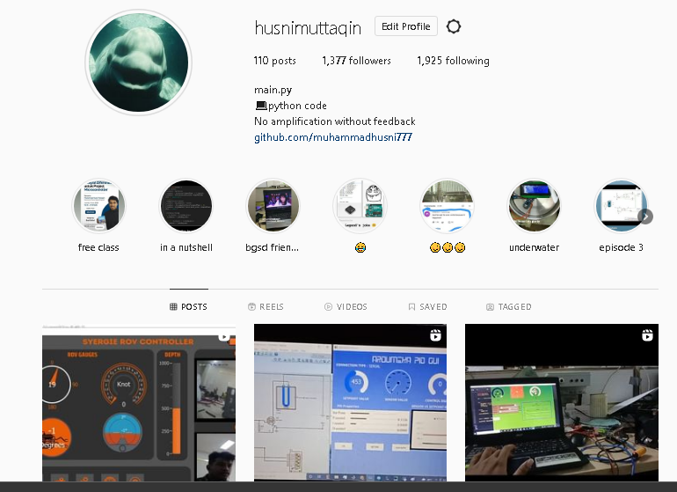
My Instagram

Slide 39
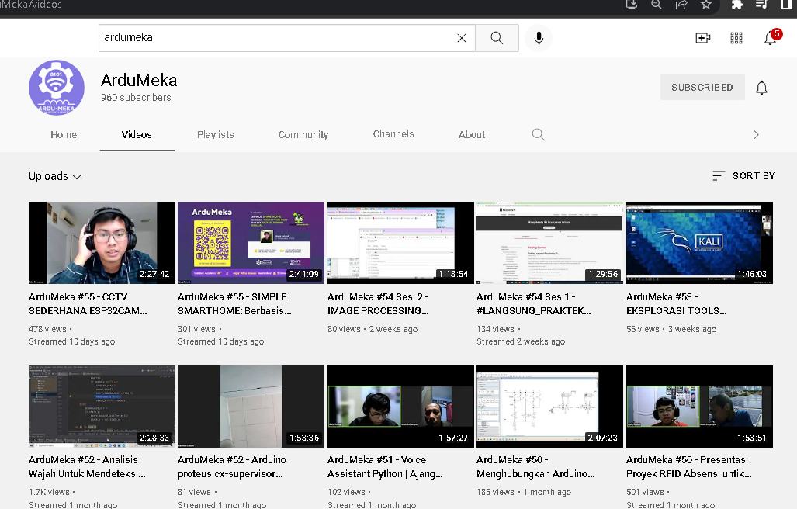
SUPPORT US

Slide 40
