Slide 1


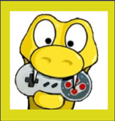
Long Range Robotics Control Using USB Joystick with Pygame and PyQt5
Written by :
Muhammad Husni Muttaqin, S. Pd

Slide 2
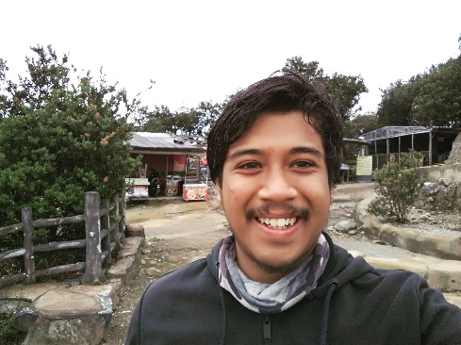
About me
Name : Muhammad Husni Muttaqin, S. Pd.
Birth date : 5 June 1998
Hometown : Bandung
Current Job : python programmer at PT Syergie Indoprima and part time teacher
Experiences :
- 2019 - 2020 : Dynamics Positioning System engineer on cable ship (PT Syergie Indoprima)
- 2021 - 2022 : Electronics and control system engineer for Vent-I (PT Syergie Automa Teknologi)
- 2022 – now : Python Programmer PT Syergie Indoprima

Slide 3
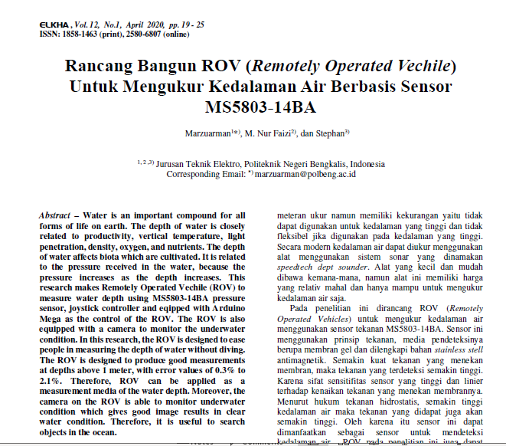

Slide 4
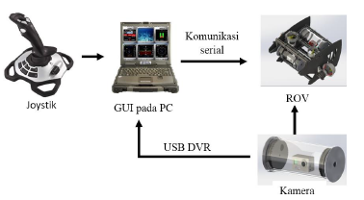

Slide 5
Ppt, example code
https://github.com/muhammadhusni777/Ardumeka-Pygame
Software tools
https://drive.google.com/drive/folders/1eKmwfIYVEk9dNEoskVgPkrd7ihbXmtxf?usp=sharing
Contoh project
https://wokwi.com/projects/348094453680964179

Slide 6
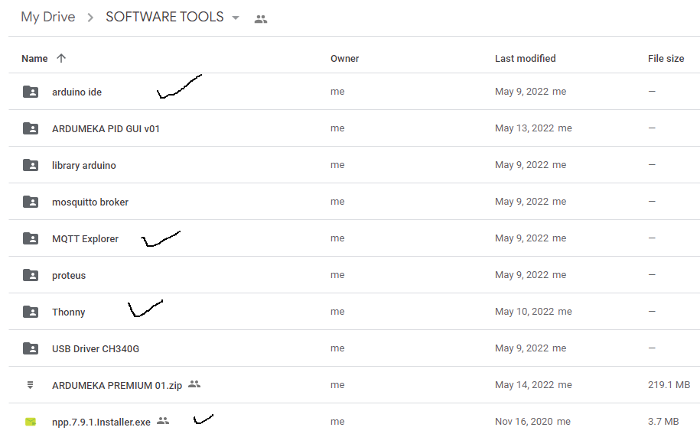

Slide 7
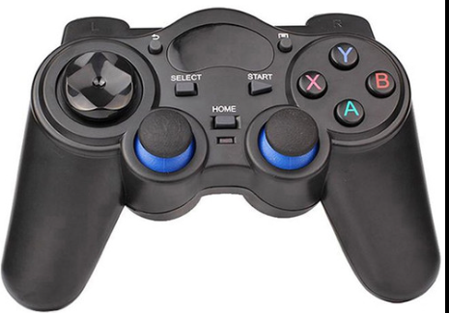
Today Project
MQTT Broker
3
2
Python
Pygame
Pyqt5
Paho.mqtt
Microcontroller
ESP32
1
4
LED
Servo

Slide 8
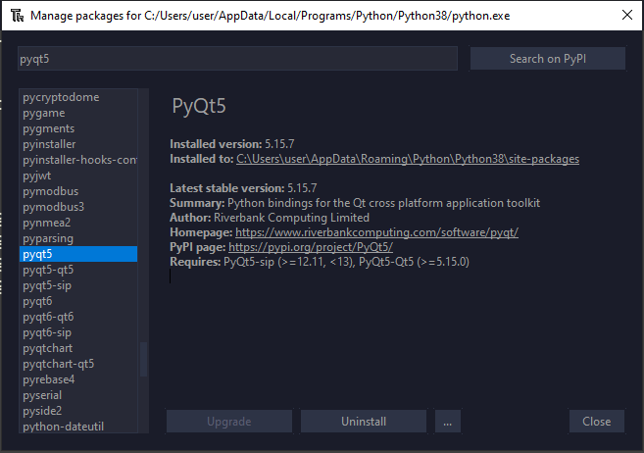
Python Library Install
PyQt5

Slide 9
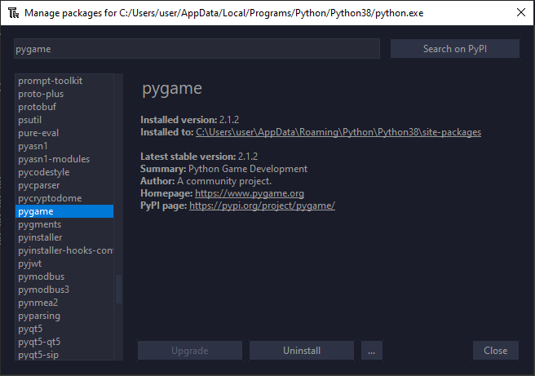
Python Library Install
Pygame

Slide 10
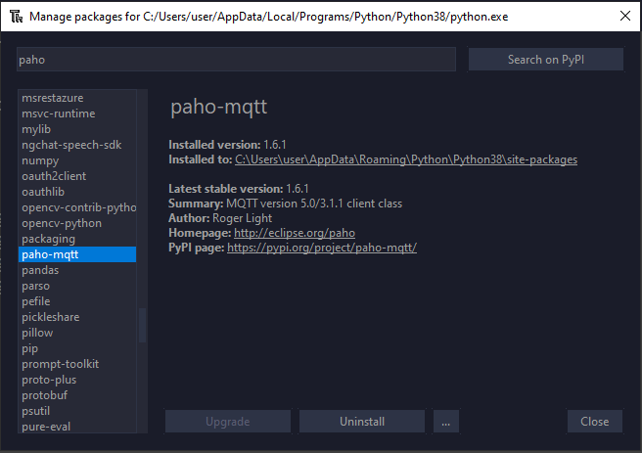
Python Library Install
Paho-mqtt

Slide 11
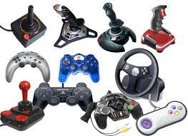

Slide 12
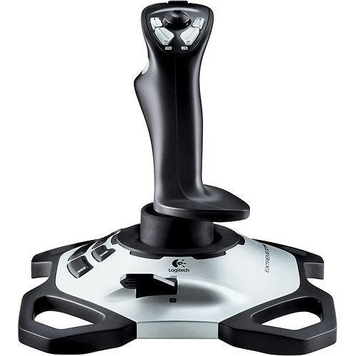
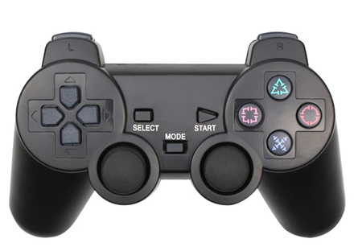

Slide 13
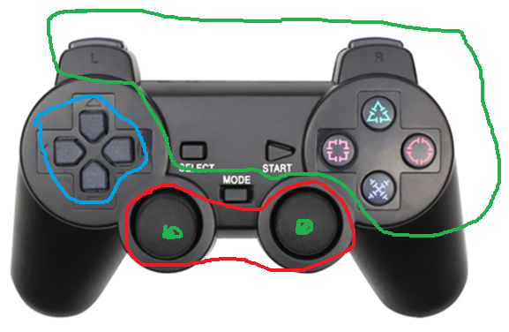
Pygame Joystick Basic Code
1
Button
Hats
Axes
2
3

Slide 14
Pygame Joystick Basic Code
Button
6
7
4
5
8
9
0
3
1
2
10
11

Slide 15
Pygame Joystick Basic Code
2. Hats
1
hats x
-1
1
(hats x, hats y)
-1
hats y

Slide 16
Pygame Joystick Basic Code
3. Axes
analog1_y
analog2_y
analog1_x
analog2_y

Slide 17
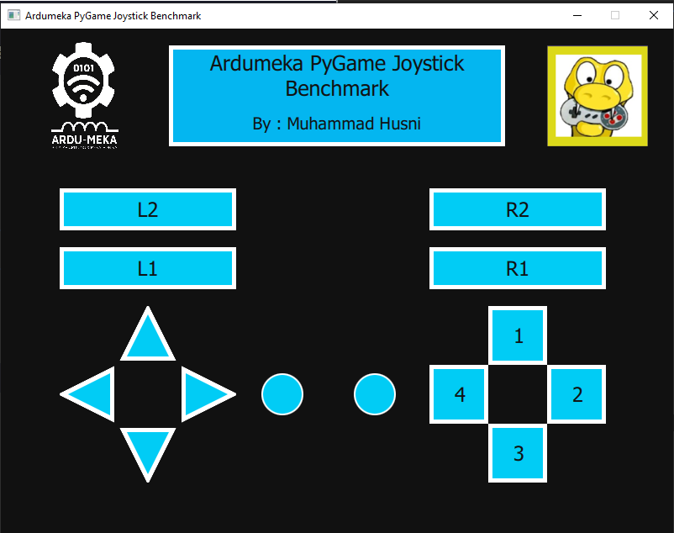

Slide 18
2
0
2
1
0. Membuat Windows
Membuat Text
Memasukkan gambar
Joystick Button
Joystick Hat
Joystick Axes
3
5
4

Slide 19
0. Membuat Window
from PyQt5.QtCore import *
from PyQt5.QtGui import *
from PyQt5.QtQml import *
from PyQt5.QtWidgets import *
from PyQt5.QtQuick import *
import sys
class table(QObject):
def __init__(self, parent = None):
super().__init__(parent)
self.app = QApplication(sys.argv)
self.engine = QQmlApplicationEngine(self)
self.engine.rootContext().setContextProperty("backend", self)
self.engine.load(QUrl("main.qml"))
sys.exit(self.app.exec_())
if __name__ == "__main__":
main = table()
import QtQuick 2.12
import QtQuick.Window 2.13
import QtQuick.Controls 2.0
import QtQuick.Controls.Styles 1.4
import QtQuick.Extras 1.4
import QtQuick.Extras.Private 1.0
Window {
id : root
width: 400
height: 400
title:"membuat windows"
color : "pink"
visible: true
//flags: Qt.WindowMaximized //Qt.Dialog
}

Slide 20
1. Membuat Text
Rectangle{
……
Text{
………
}
}

Slide 21
1. Membuat Text
Rectangle{
anchors.horizontalCenter: parent.horizontalCenter
y:20
width : 400
height : 120
color : "#04b6f0"
border.color: "white"
border.width: 5
}
Text{
anchors.horizontalCenter: parent.horizontalCenter
y: 5
//anchors.verticalCenter: parent.verticalCenter
width : 400
text : "Ardumeka PyGame Joystick Benchmark"
wrapMode: Text.WordWrap
horizontalAlignment: Text.AlignHCenter//Text.AlignJustify
color : "#111111"
font.pixelSize : 25
}

Slide 22
2. Memasukkan gambar
Image{
x : 650
y : 20
width : 120
height : 120
source : "pygame.png"
}
Catatan : File gambar harus ada di folder yang sama

Slide 23
3. Joystick Button
Rectangle{
……
Text{
………
}
}
Timer{
id : gui_timer
……
}
Catatan : materi detailnya pengembangan dari materi variable transfer. Goal nya Ketika tombol joystick ditekan maka kotak akan berubah warna

Slide 24
Integrate python with qml
Python => QML
Timer{
id:transferdata
interval: 50
repeat: true
running: true
onTriggered: {
pot_val.text = backend.get_analog()
}
}
##########KIRIM DATA ANALOG KE GAUGE##############
@pyqtSlot(result=float)
def get_analog(self): return analog

Slide 25
4. Joystick Hats
Rectangle{
……
Canvas{
………
}
}
Catatan : materi detailnya pengembangan dari materi variable transfer. Goal nya Ketika tombol joystick ditekan maka segitiga akan berubah warna

Slide 26
Rectangle{
//bawah
x: 130
y: 420
width : 70
height : 70
color : "transparent"
rotation : 180
}
Canvas {
id : down_canv
width: parent.width ; height: parent.height
anchors.centerIn: parent
onPaint: {
var ctx = getContext("2d")
ctx.beginPath();
ctx.moveTo((width )/2, 10);
ctx.lineTo(10, 60);
ctx.lineTo(width - 10 , 60);
ctx.closePath();
ctx.lineWidth = 10;
ctx.strokeStyle = 'white';
ctx.stroke();
ctx.fillStyle = plotColordown;
ctx.fill();
}
}
property color plotColordown : "blue"
onPlotColordownChanged: down_canv.requestPaint()

Slide 27
5. Joystick Axes
Rectangle {
id : axis1
width: 50
height: 50
color: "#122e55"
border.color: "white"
border.width: 2
radius: width*0.5
}
Catatan : Goal nya Ketika tombol joystick ditekan maka lingkaran akan berubah warna dan apabila analog dipindah maka posisi lingkaran berpindah

Slide 28
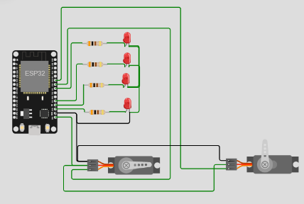
MQTT Integration
publish
subscribe

Slide 29
Broker mqtt :
broker.emqx.io => port 1883
test.mosquito.org => port 1883
mqtt.ardumeka.com => port 11219

Slide 30
Let’s see the result ☺

Slide 31
Thanks for your participation ☺

Slide 32
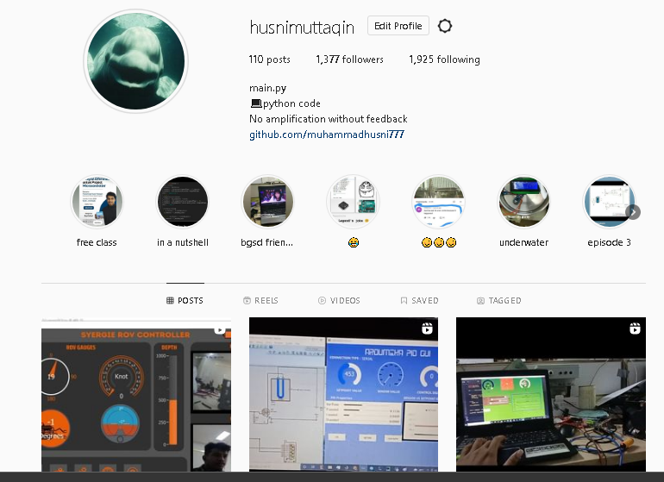
My Instagram

Slide 33
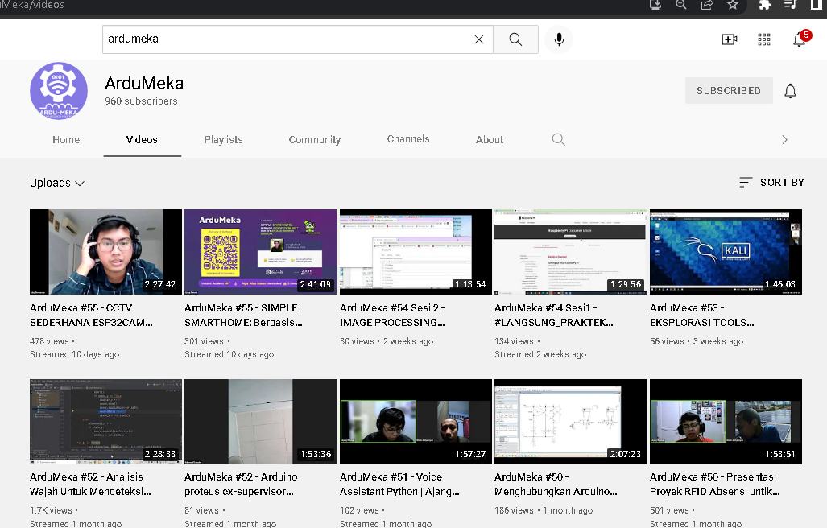
SUPPORT US

Slide 34
