Slide 1



Long Range Robotics Control Using USB Joystick with Pygame and PyQt5
Written by :
Muhammad Husni Muttaqin, S. Pd

Slide 2

About me
Name : Muhammad Husni Muttaqin, S. Pd.
Birth date : 5 June 1998
Hometown : Bandung
Current Job : python programmer at PT Syergie Indoprima and part time teacher
Experiences :
- 2019 - 2020 : Dynamics Positioning System engineer on cable ship (PT Syergie Indoprima)
- 2021 - 2022 : Electronics and control system engineer for Vent-I (PT Syergie Automa Teknologi)
- 2022 – now : Python Programmer PT Syergie Indoprima

Slide 3
Ppt, example code
Software tools
https://drive.google.com/drive/folders/1eKmwfIYVEk9dNEoskVgPkrd7ihbXmtxf?usp=sharing
Contoh project
https://wokwi.com/projects/345223004701065810

Slide 4
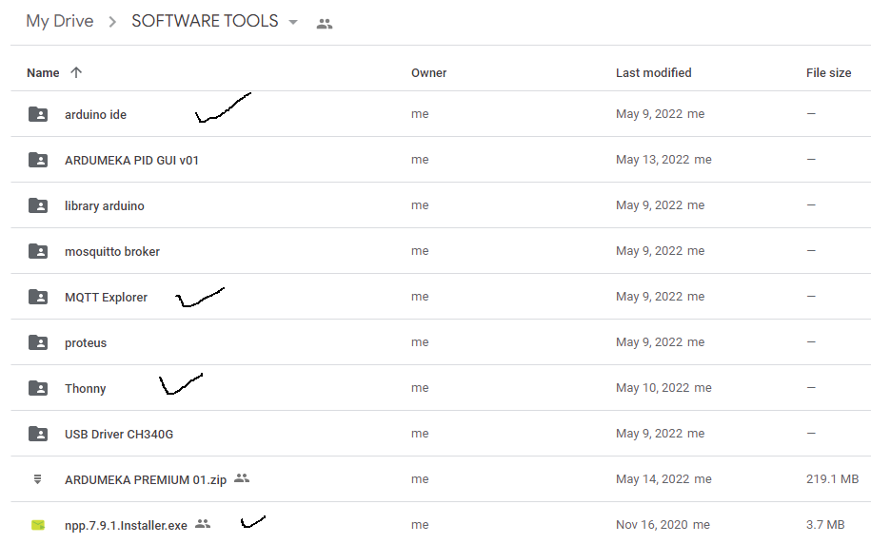

Slide 5
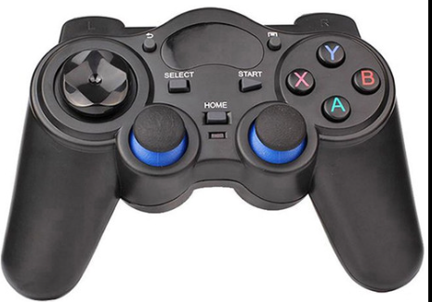
Today Project
MQTT Broker
mqtt.ardumeka.com
Port : 11219
3
2
Python
Pygame
Pyqt5
Paho.mqtt
Microcontroller
ESP32
1
4
LED
Servo

Slide 6
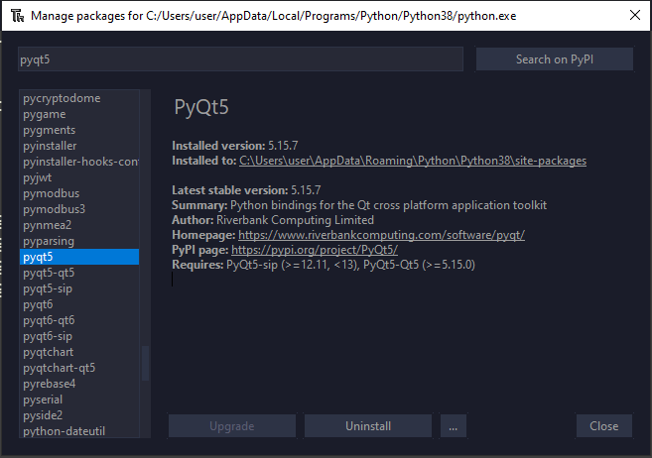
Python Library Install
PyQt5

Slide 7
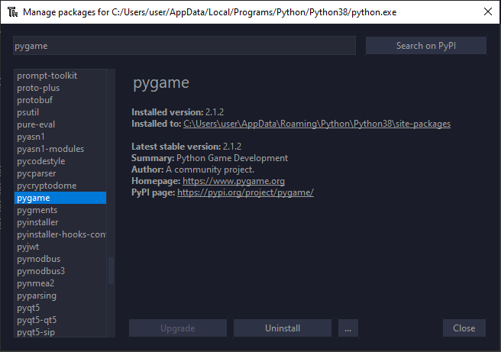
Python Library Install
Pygame

Slide 8
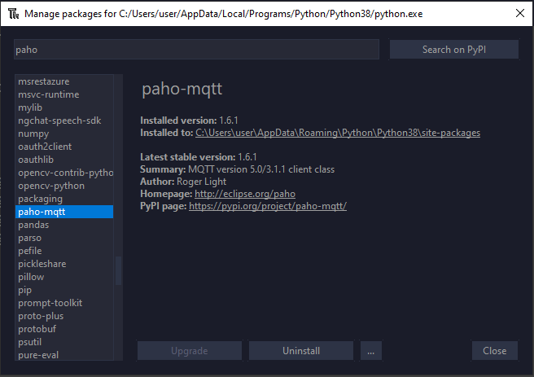
Python Library Install
Paho-mqtt

Slide 9
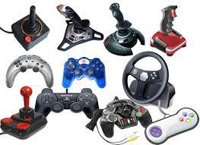

Slide 10
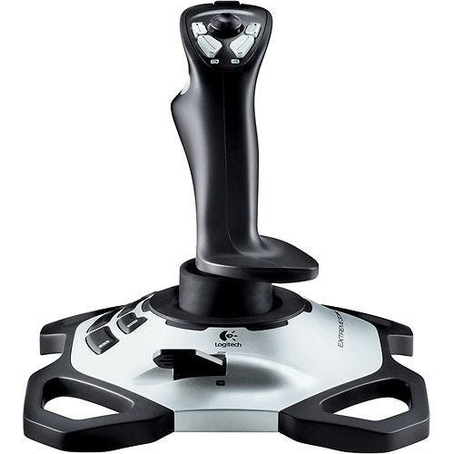
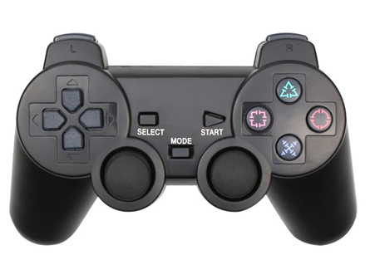

Slide 11
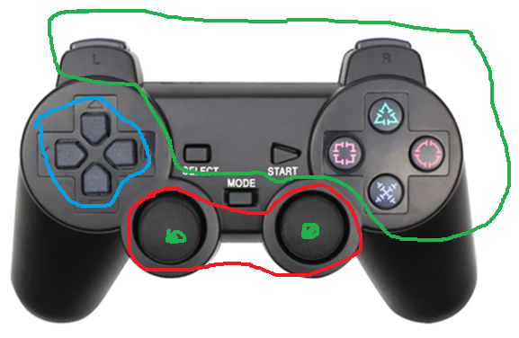
Pygame Joystick Basic Code
1
Button
Hats
Axes
2
3

Slide 12
Pygame Joystick Basic Code
Button
6
7
4
5
8
9
0
3
1
2
10
11

Slide 13
Pygame Joystick Basic Code
2. Hats
1
hats x
-1
1
(hats x, hats y)
-1
hats y

Slide 14
Pygame Joystick Basic Code
3. Axes
analog1_y
analog2_y
analog1_x
analog2_y

Slide 15
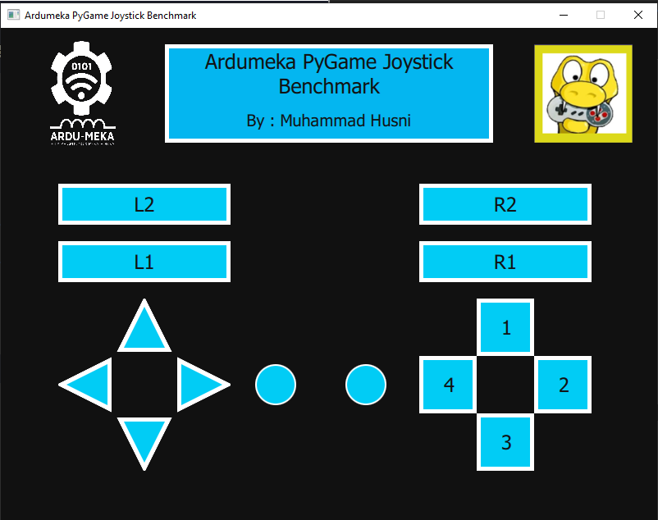

Slide 16
2
0
2
1
0. Membuat Windows
Membuat Text
Memasukkan gambar
Joystick Button
Joystick Hat
Joystick Axes
3
5
4

Slide 17
0. Membuat Window

Slide 18
1. Membuat Text

Slide 19
3. Joystick Button

Slide 20
4. Joystick Hats

Slide 21
5. Joystick Axes

Slide 22
MQTT Integration

