Slide 1

CUSTOMIZE CIRCULAR SLIDER
Written by :
Muhammad Husni Muttaqin
© Ardumeka (2022)

Slide 2

About me
Name : Muhammad Husni Muttaqin
Birth date : 5 June 1998
Hometown : Bandung
Current Job : python programmer at PT Syergie Indoprima and part time teacher
Experiences :
- 2019 - 2020 : Dynamics Positioning System engineer on cable ship (PT Syergie Indoprima)
- 2021 - 2022 : Electronics and control system engineer for Vent-I (PT Syergie Automa Teknologi)
2022 – now : Python Programmer PT Syergie Indoprima
2021 : Founder Komunitas Belajar Ardumeka (Arduino dan Mekatronika)

Slide 3
Bahasan
Review materi python qml sebelumnya
Mencari widget qml lainya
Circular slider untuk input
Circular slider untuk output
Membuat circular slider untuk mengukur battery laptop

Slide 4
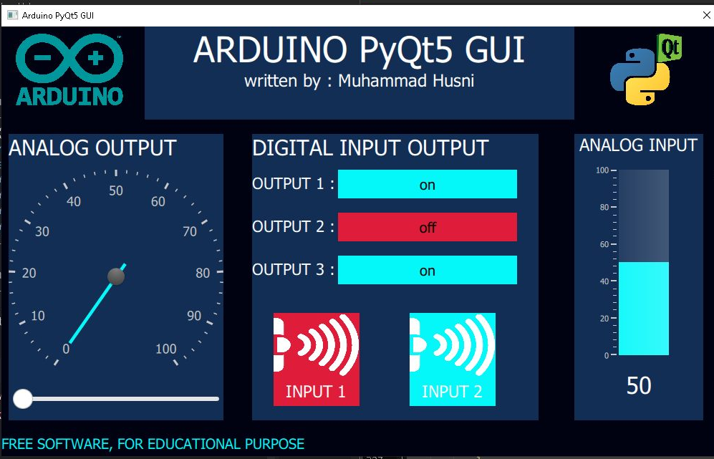
Review materi python qml sebelumnya
1
5
2
3
6
6
4

Slide 5
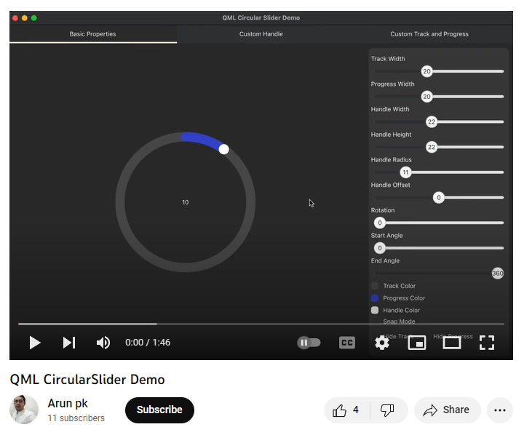
Mencari widget qml lainya
https://www.youtube.com/watch?v=6BoKmcyEWXk
https://github.com/arunpkqt/CircularSlider

Slide 6
Nge runningnya gimana ?
from PyQt5.QtCore import *
from PyQt5.QtGui import *
from PyQt5.QtQml import *
from PyQt5.QtWidgets import *
from PyQt5.QtQuick import *
import sys
class table(QObject):
def __init__(self, parent = None):
super().__init__(parent)
self.app = QApplication(sys.argv)
self.engine = QQmlApplicationEngine(self)
self.engine.rootContext().setContextProperty("backend", self)
self.engine.load(QUrl("main.qml"))
sys.exit(self.app.exec_())
if __name__ == "__main__":
main = table()

Slide 7
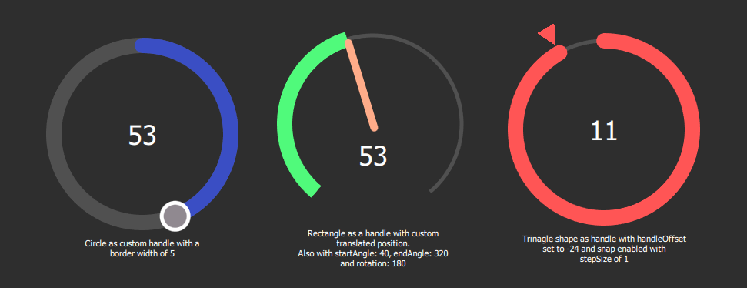
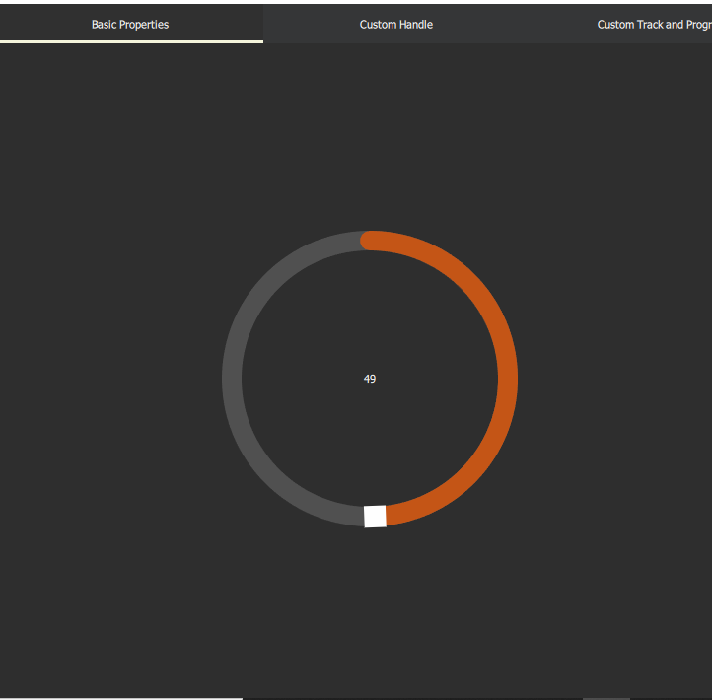
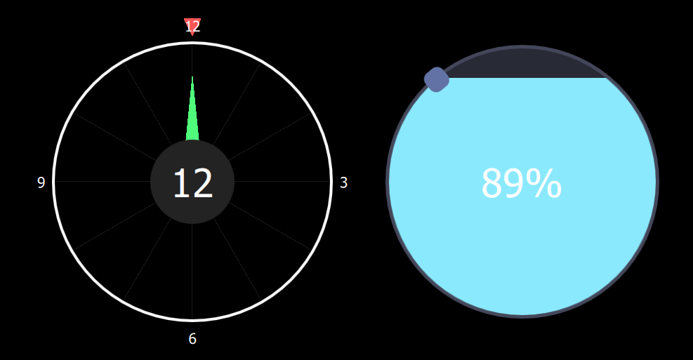
Circular slide

Slide 8

Circular slider

Slide 9
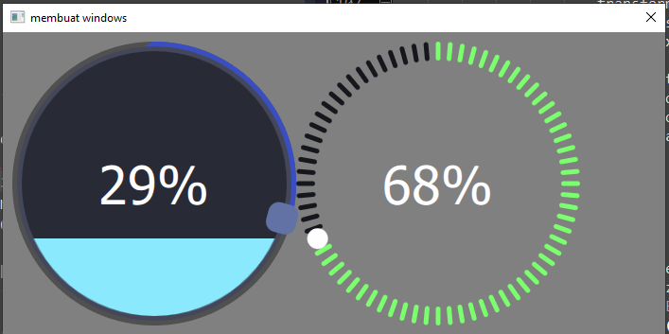
Circular slider yang kita gunakan

Slide 10
Circular Slider sebagai Input
interactive: true

Slide 11
Circular slider sebagai output
interactive: false

Slide 12
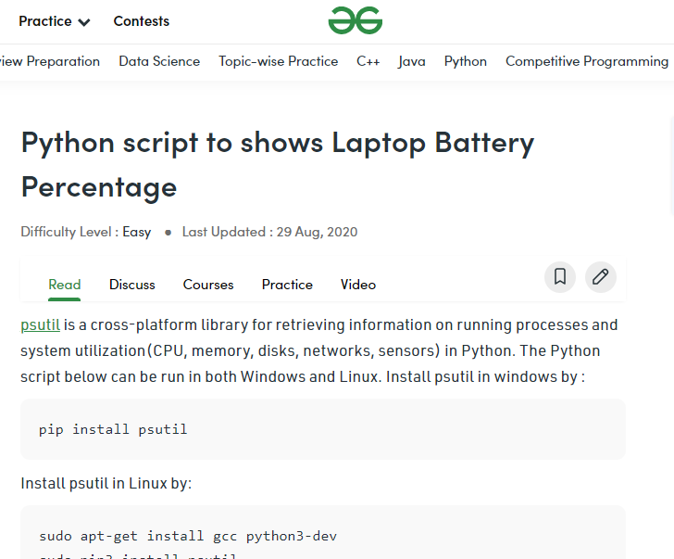
Membuat circular slider untuk mengukur battery laptop
https://www.geeksforgeeks.org/python-script-to-shows-laptop-battery-percentage/

Slide 13
Oke kita coba yaaa………

Slide 14
PR…..

Slide 15
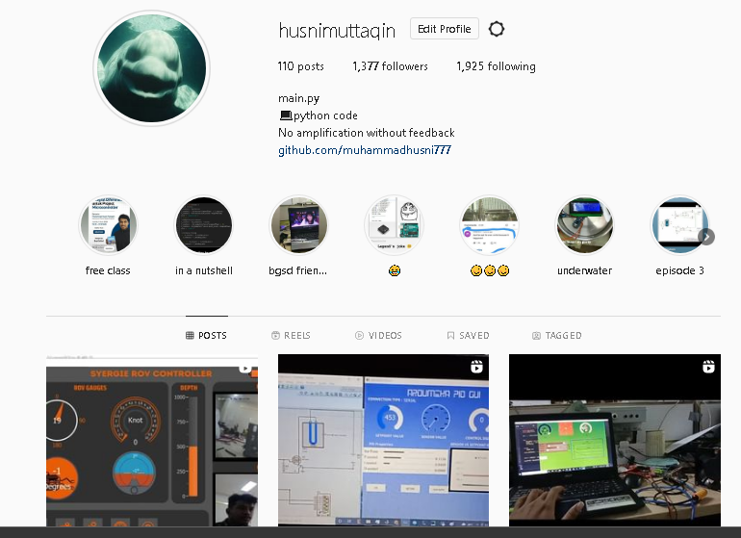
My Instagram

Slide 16
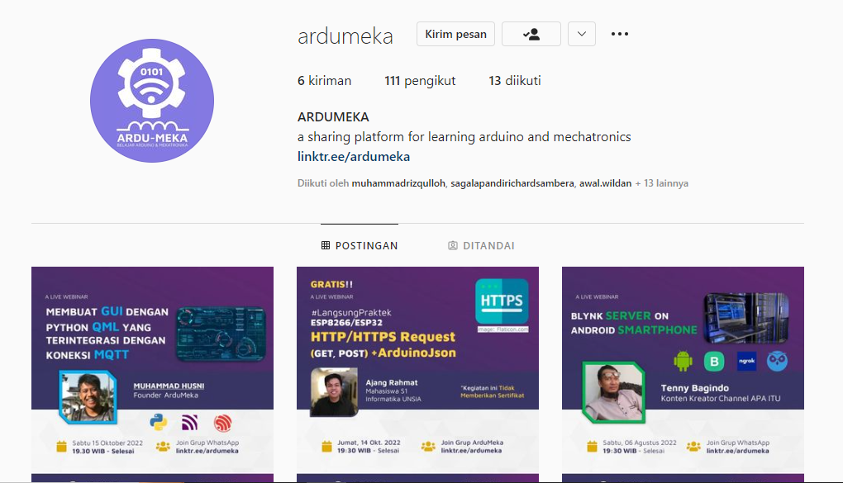

Slide 17
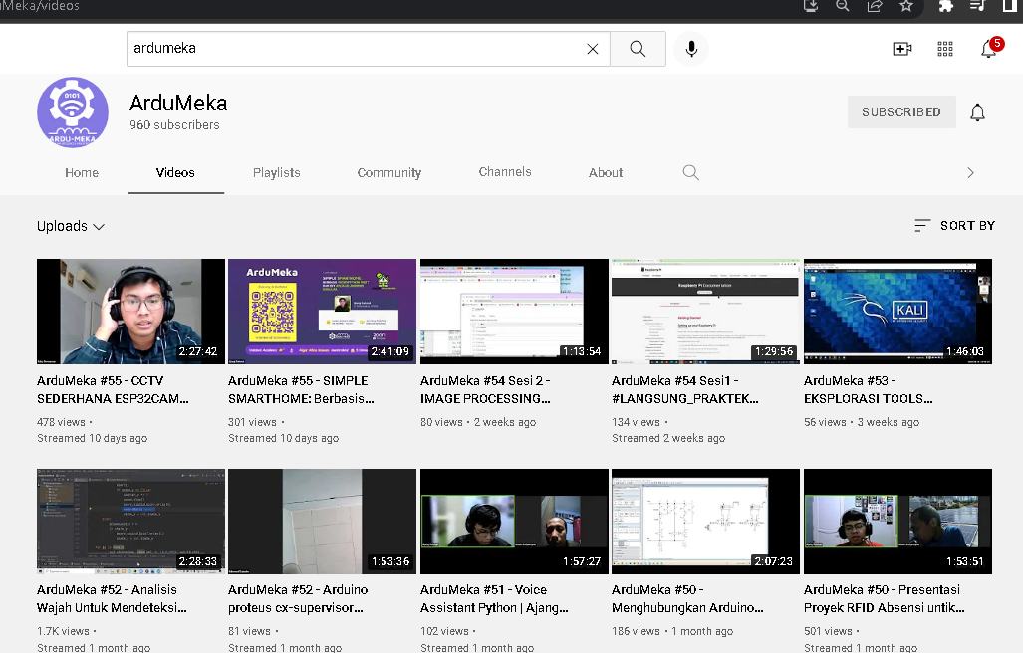
SUPPORT US

Slide 18
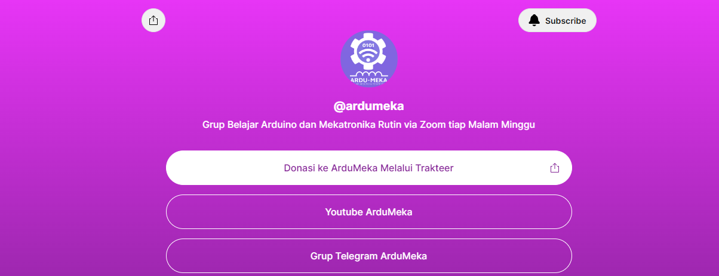

Slide 19
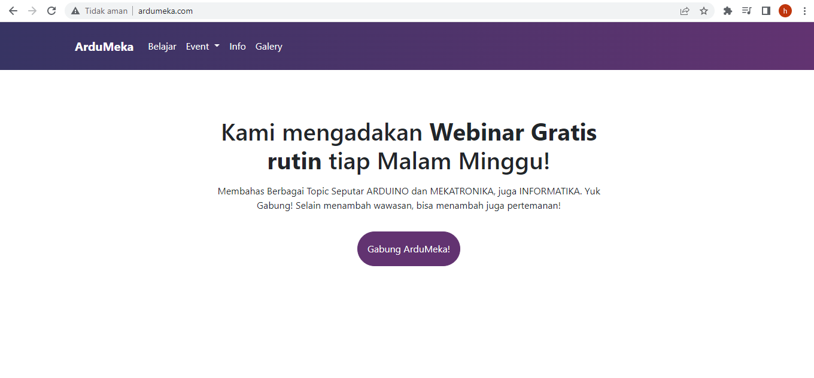

Slide 20
SEKIAN DAN TERIMAKASIH ☺

