Slide 1

CS123 Digital Logic Design
LECTURE 01
Introduction & Overview
Engr.Hammad Munami

Slide 2
Digital and Analog Quantities
The term digital is derived from the way operations are performed, by counting digits.
Digital electronics involves quantities with discrete values, and analog electronics involves quantities with continuous values.
Engr.Hammad Munami

Slide 3
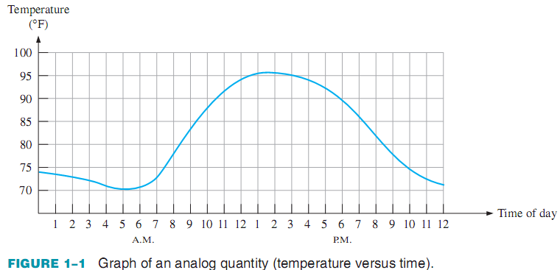
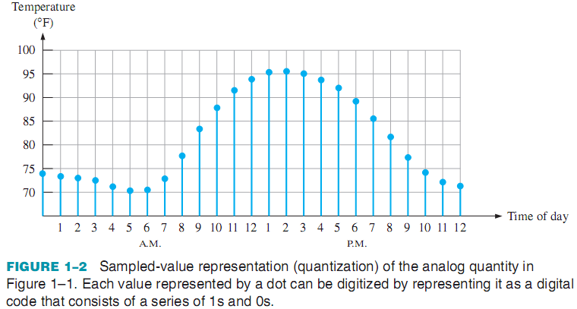
Engr.Hammad Munami

Slide 4
The Digital Advantage
Digital representation has certain advantages over analog representation in electronics applications:
Digital data can be processed and transmitted more efficiently and reliably than analog data.
Digital data has a great advantage when storage is necessary. For example, music when converted to digital form can be stored more compactly and reproduced with greater accuracy and clarity than is possible when it is in analog form.
Noise (unwanted voltage fluctuations) does not affect digital data nearly as much as it does analog signals.
Engr.Hammad Munami

Slide 5
Binary Digits
Digital electronics involves circuits and systems in which there are only two possible states.
These states are represented by two different voltage levels (or can also be represented by current levels): A HIGH and a LOW.
In digital systems such as computers, combinations of states, called codes, are used to represent numbers, symbols, alphabetic characters, and other types of information.
The two-state number system is called binary, and its two digits are 0 and 1. A binary digit is called a bit.
Engr.Hammad Munami

Slide 6
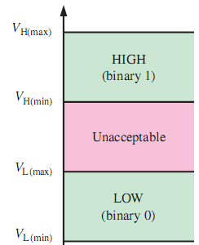
Logic Levels
The voltages used to represent a 1 and a 0 are called logic levels.
Ideally, one voltage level represents a HIGH and another voltage level represents a LOW.
In a practical digital circuit, however, a HIGH can be any voltage between a specified minimum value and a specified maximum value. Likewise, a LOW can be any voltage between a specified minimum and a specified maximum.
There can be no overlap between the accepted range of HIGH levels and the accepted range of LOW levels.
Engr.Hammad Munami

Slide 7
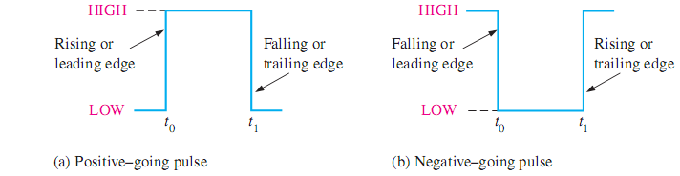
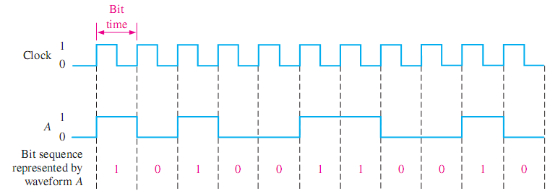
Digital Waveforms
Engr.Hammad Munami

Slide 8
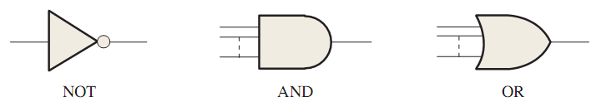
Logic Gates / Logic Function
The term logic is applied to digital circuits used to implement logic functions.
Several kinds of digital logic circuits are the basic elements that form the building blocks for such complex digital systems as the computer.
Three basic logic functions are:
Each of the three basic logic functions produces a unique response to a given set of conditions, Either a High (1) or Low (0).
Engr.Hammad Munami

Slide 9
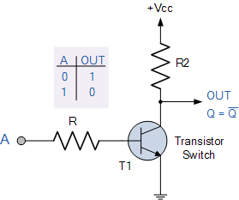
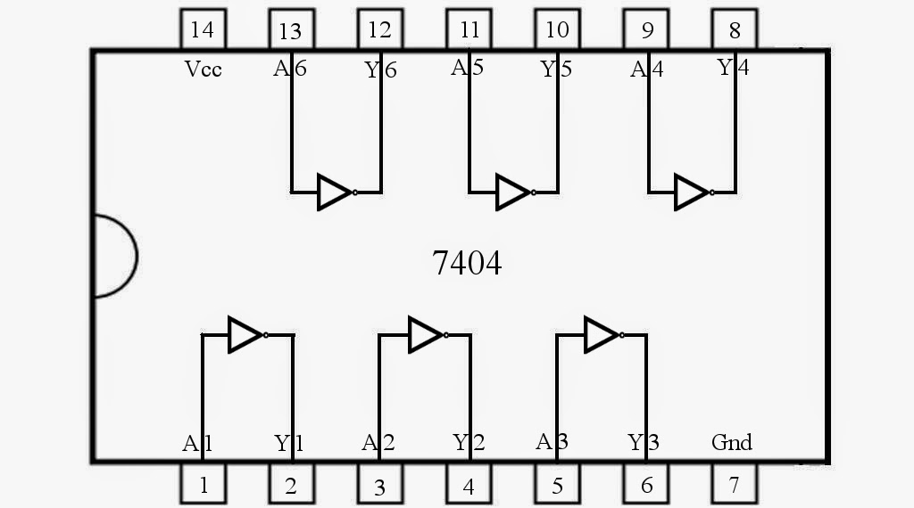
Logic Gates / Logic Function
NOT: The NOT function changes one logic level to the opposite logic level.
The NOT function is implemented by a logic circuit known as an “inverter”.
Engr.Hammad Munami

Slide 10
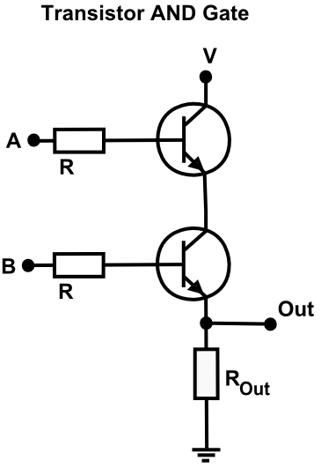
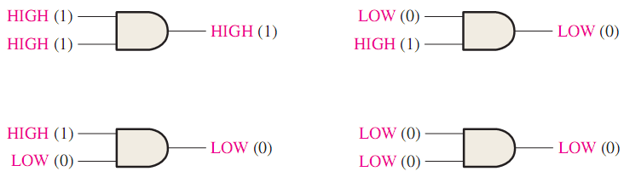
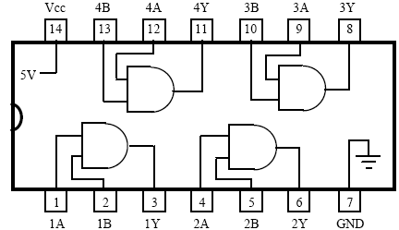
Logic Gates / Logic Function
AND: The AND function produces a HIGH output only when all the inputs are HIGH.
When any or all inputs are LOW, the output is LOW.
Engr.Hammad Munami

Slide 11
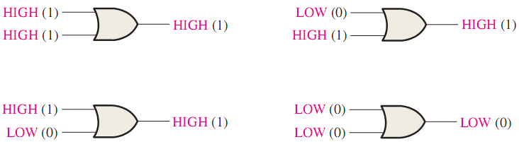
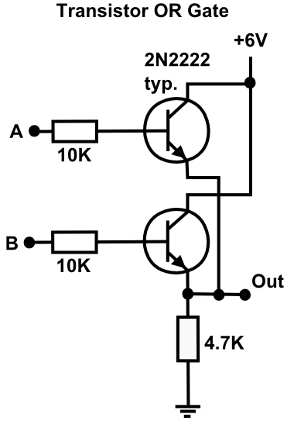
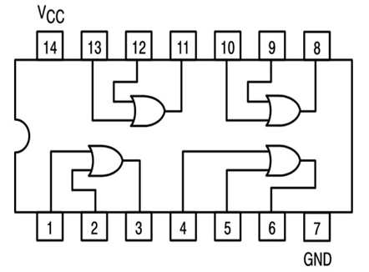
Logic Gates / Logic Function
OR: The OR function produces a HIGH output when one or more inputs are HIGH.
When both inputs are LOW, the output is LOW.
Engr.Hammad Munami

Slide 12
Review Questions
What is the difference between digital and analog quantities?
State the advantages of digital over analog.
Define binary.
Define bit.
How voltage levels are used to represent bits?
What is a logic gate?
Engr.Hammad Munami

