Slide 1

CS123 Digital Logic Design
LECTURE 16
Comparators
Engr.Hammad Munami

Slide 2
Comparators
The basic function of a comparator is to compare the magnitudes of two binary quantities to determine the relationship of those quantities.
In its simplest form, a comparator circuit determines whether two numbers are equal.
Engr.Hammad Munami

Slide 3
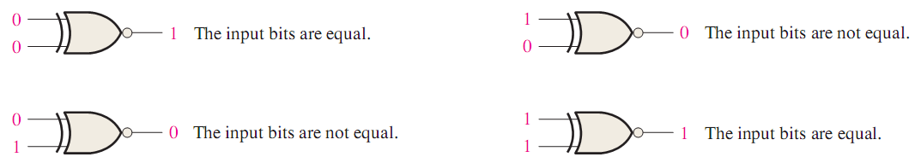
Equality
The exclusive-NOR gate can be used as a basic comparator because its output is a 0 if the two input bits are not equal and a 1 if the input bits are equal.
Engr.Hammad Munami

Slide 4
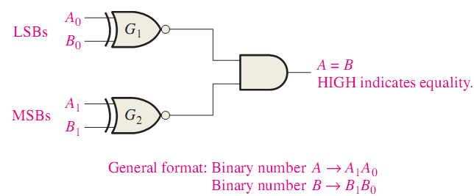
Equality
In order to compare binary numbers containing two bits each, an additional exclusive-NOR gate is necessary.
The two least significant bits (LSBs) of the two numbers are compared by gate G1, and the two most significant bits (MSBs) are compared by gate G2 as shown in below figure:
Engr.Hammad Munami

Slide 5
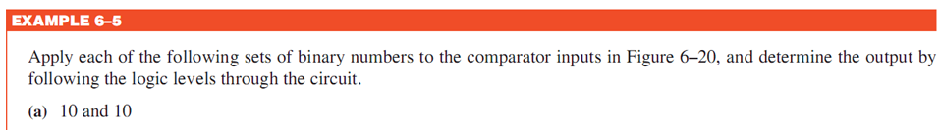
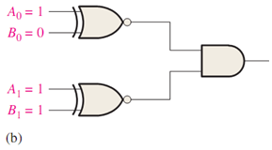
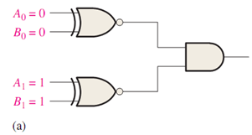
Engr.Hammad Munami

Slide 6
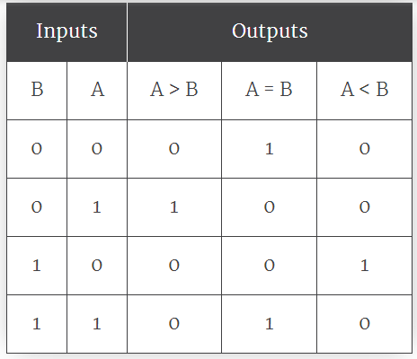
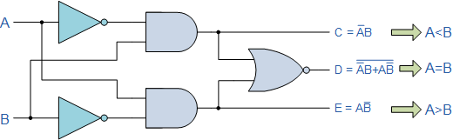
Inequality
If A = 1 and B = 0, A is greater than B.
If A = 0 and B = 1, A is less than B.
If A = 0 and B = 0, A and B are Equal
If A = 1 and B = 1, A and B are Equal
1-bit Inequality Comparator Circuit
Engr.Hammad Munami

Slide 7
4 bit digital comparator
Suppose, there are two 4 bit binary numbers,
Let us compare those two numbers;
  Condition (1), when A₁ > B₁ i.e. A₁ = 1 and B₁ = 0, ⇒ A > B or G = 1.
  Condition (2), when A₁ = B₁ and A₂ > B₂ i.e. A₂ = 1 and B₂ = 0 ⇒ A >B or G = 1.
  Condition (3), when A₁ = B₁ and A₂ = B₂ and A₃ > B₃ i.e. A₃ = 1 and B₃ = 0 ⇒ A >B or G = 1.
  Condition (4), when A₁ = B₁, A₂ = B₂, A₃ = B₃ and A₄ > B₄ i.e. A₄ = 1 and B₄ = 0 ⇒ A > B or G = 1.
Engr.Hammad Munami

Slide 8
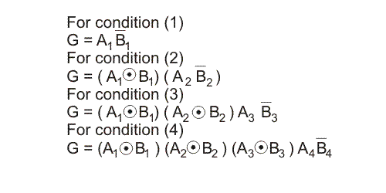

4 bit digital comparator
Hence, G = 1 if either of the above equations is true,
Engr.Hammad Munami

Slide 9

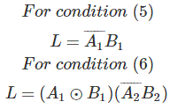
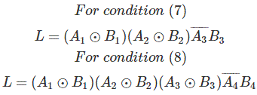
4 bit digital comparator
Similarly,
Now,
Engr.Hammad Munami

Slide 10

4 bit digital comparator
Again when,
Engr.Hammad Munami

Slide 11
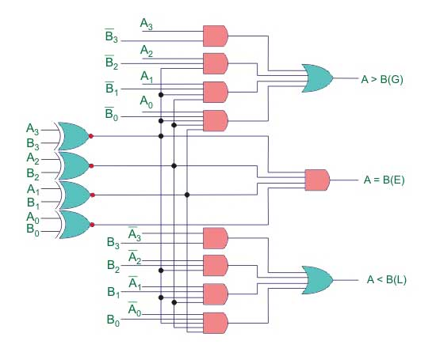
4 bit digital comparator
The logic circuit can be drawn from the equations (i), (ii) and (iii).
Engr.Hammad Munami

Slide 12
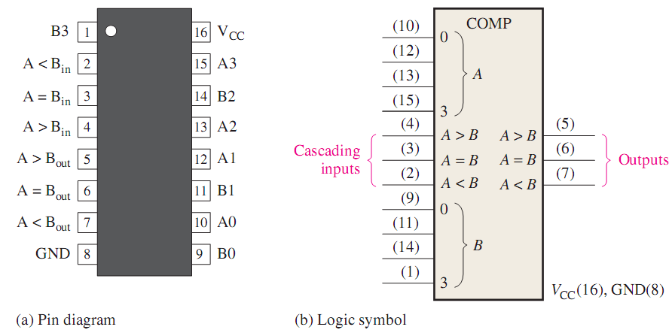
IC of Digital Comparator 7485
Engr.Hammad Munami

Slide 13
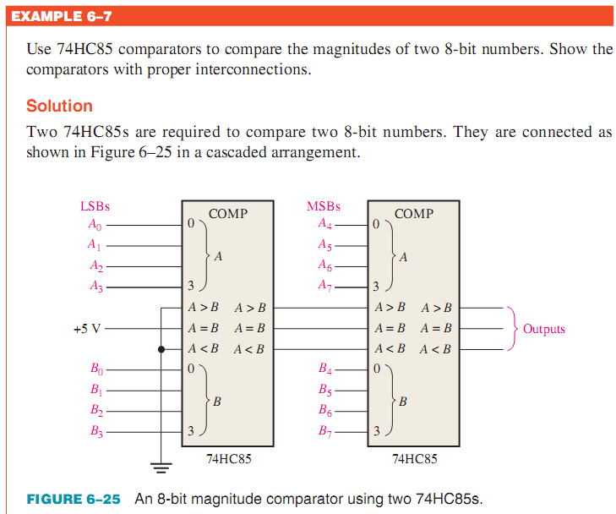
Engr.Hammad Munami

Slide 14
Introduction
A decoder is a digital circuit that detects the presence of a specified combination of bits (code) on its inputs and indicates the presence of that code by a specified output level.
In its general form, a decoder has n input lines to handle n bits and from one to 2^{n} output lines to indicate the presence of one or more n-bit combinations.
Engr.Hammad Munami

Slide 15
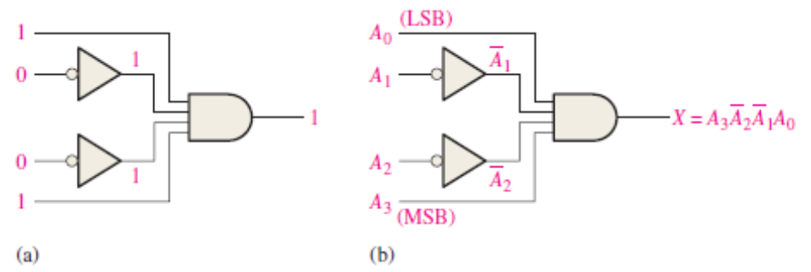
The Basic Binary Decoder
Suppose you need to determine when a binary 1001 occurs on the inputs of a digital circuit.
An AND gate can be used as the basic decoding element because it produces a HIGH output only when all of its inputs are HIGH.
Therefore, you must make sure that all of the inputs to the AND gate are HIGH when the binary number 1001 occurs; this can be done by inverting the two middle bits (the 0s), as shown in Figure
Engr.Hammad Munami

Slide 16
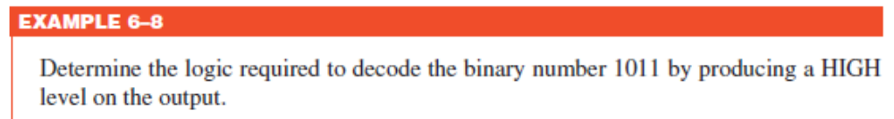
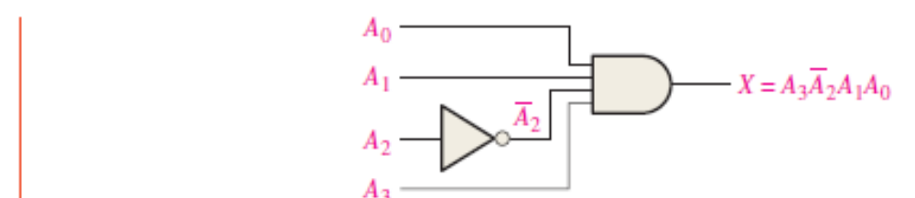
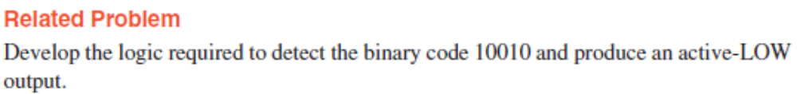
Engr.Hammad Munami

Slide 17
The 4-Bit Decoder
In order to decode all possible combinations of four bits, sixteen decoding gates are required (2⁴ = 16).
This type of decoder is commonly called either a 4-line-to-16-line decoder because there are four inputs and sixteen outputs or a 1-of-16 decoder because for any given code on the inputs, one of the sixteen outputs is activated.
Engr.Hammad Munami

Slide 18
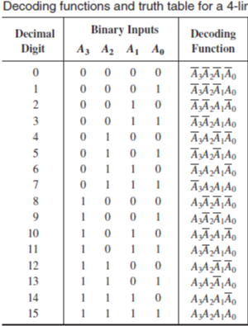
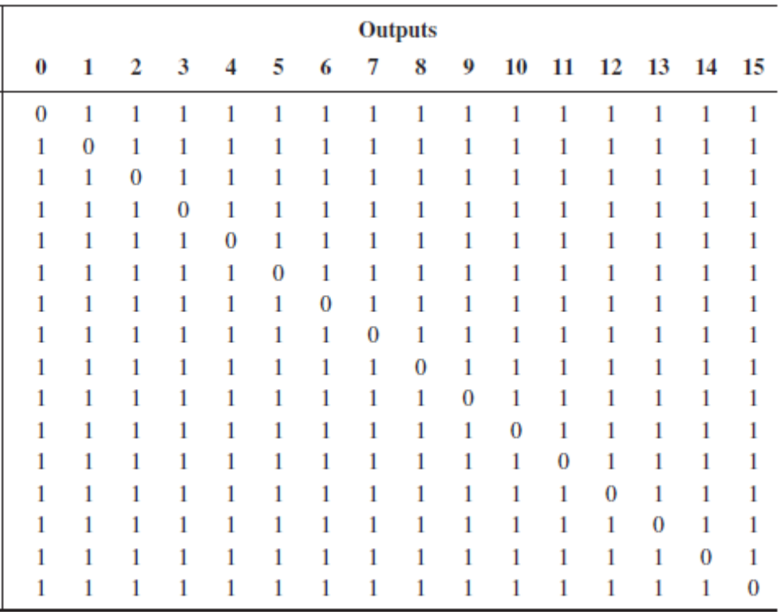
Engr.Hammad Munami

Slide 19
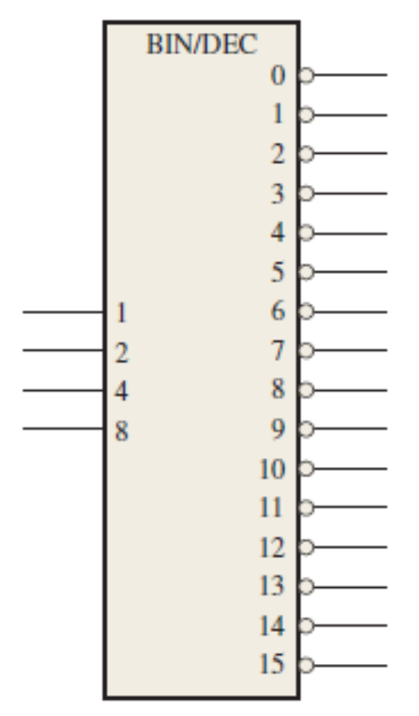
Logic symbol for a 4-line-to-16-line (1-of-16) decoder with active-LOW outputs
Engr.Hammad Munami

Slide 20
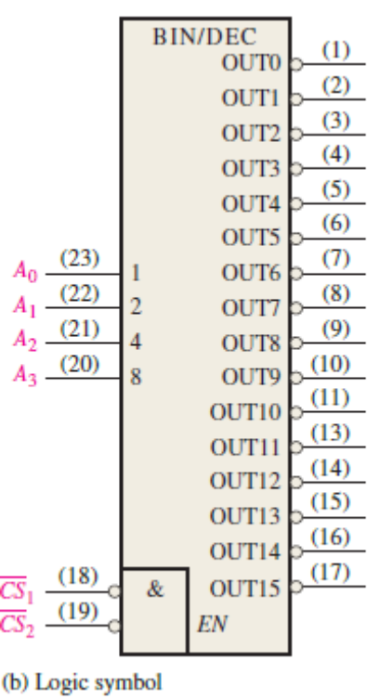
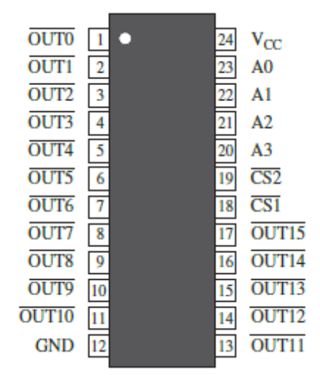

1-OF-16 DECODER 74154
Engr.Hammad Munami

Slide 21
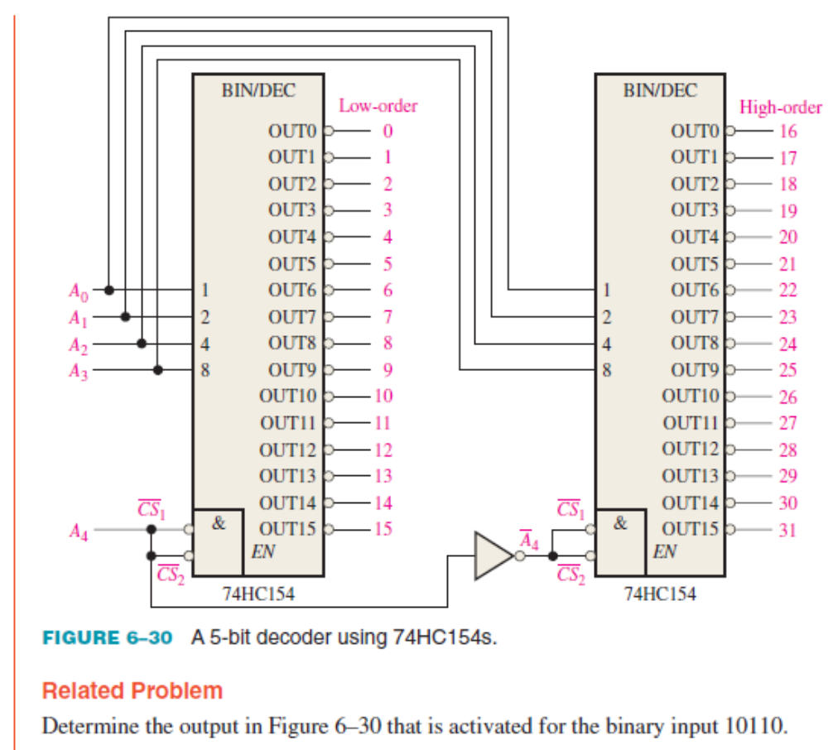
Engr.Hammad Munami

Slide 22
The BCD-to-Decimal Decoder
The BCD-to-decimal decoder converts each BCD code (8421 code) into one of ten possible decimal digit indications.
It is frequently referred as a 4-line-to-10-line decoder or a 1-of-10 decoder.
The method of implementation is the same as for the 1-of-16 decoder previously discussed, except that only ten decoding gates are required because the BCD code represents only the ten decimal digits 0 through 9.
A list of the ten BCD codes and their corresponding decoding functions is given in Table 6–5.
Engr.Hammad Munami

Slide 23
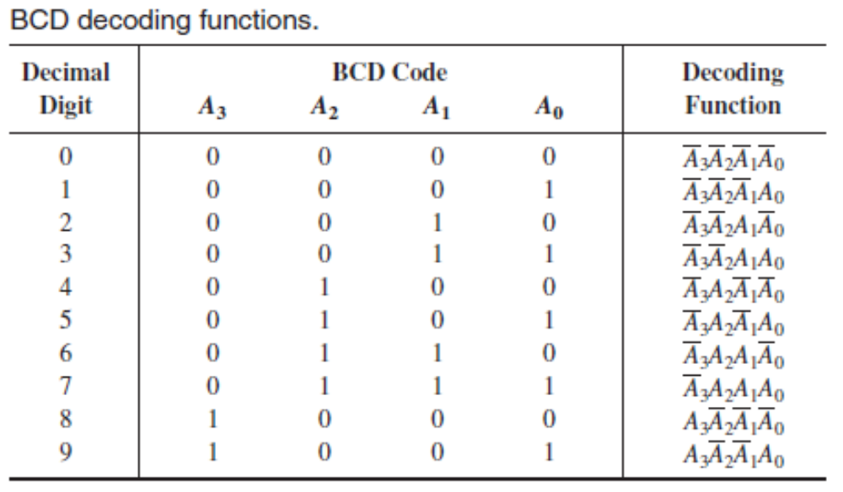
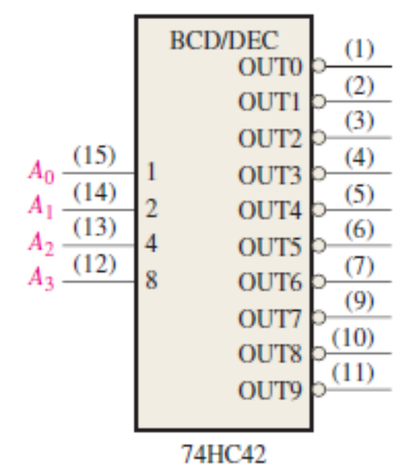
Engr.Hammad Munami

Slide 24
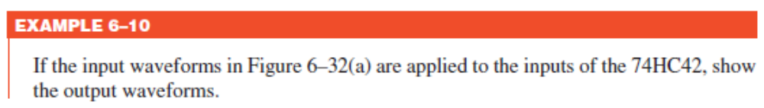
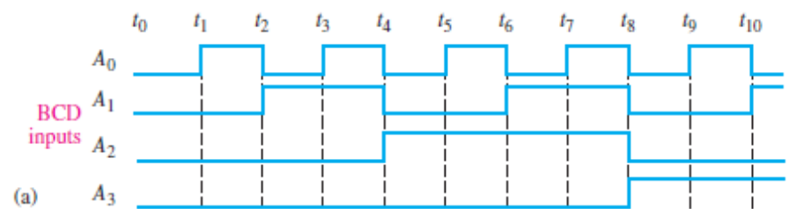
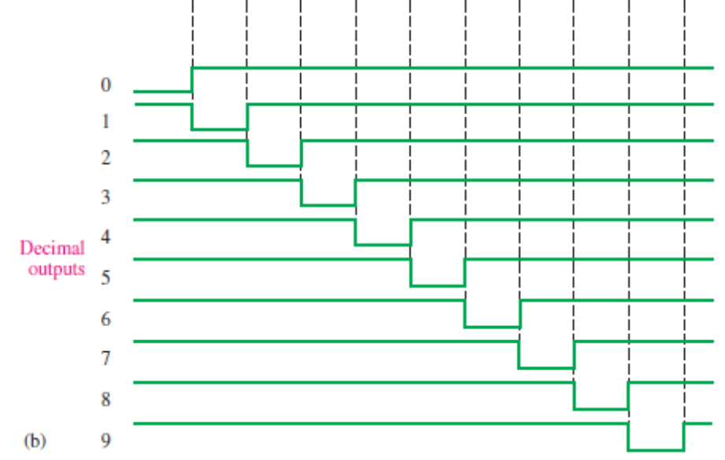
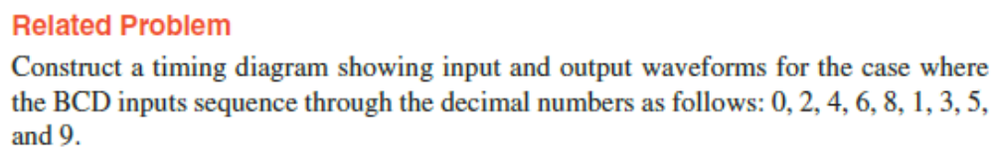
Engr.Hammad Munami

Slide 25
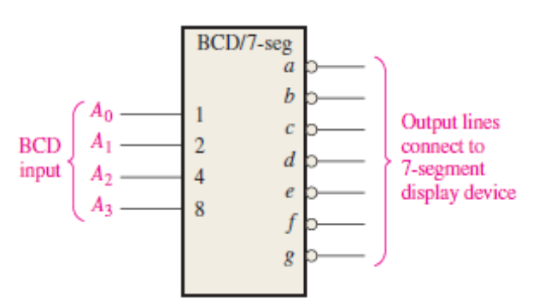

The BCD-to-7-Segment Decoder
The BCD-to-7-segment decoder accepts the BCD code on its inputs and provides outputs to drive 7-segment display devices to produce a decimal readout.
Engr.Hammad Munami

Slide 26
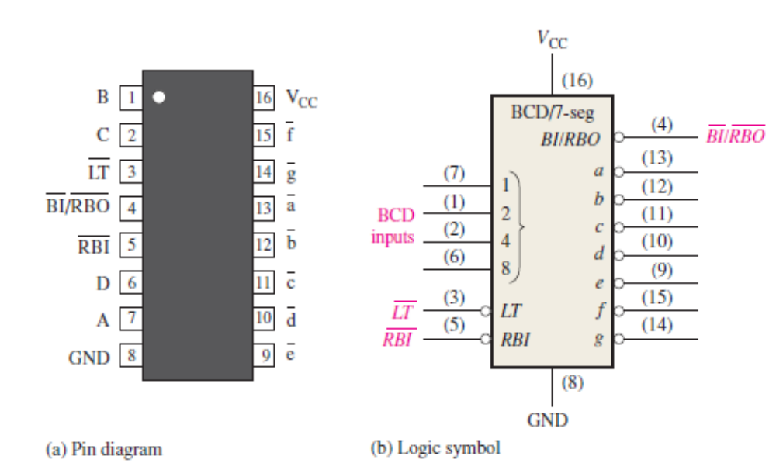
BCD-TO-7-SEGMENT DECODER/DRIVER
Engr.Hammad Munami

Slide 27
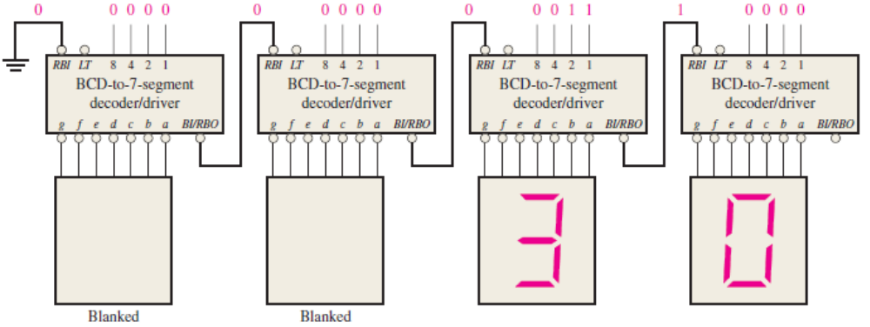
Zero Suppression for a 4-Digit Display
Illustration of leading zero suppression
Engr.Hammad Munami

Slide 28
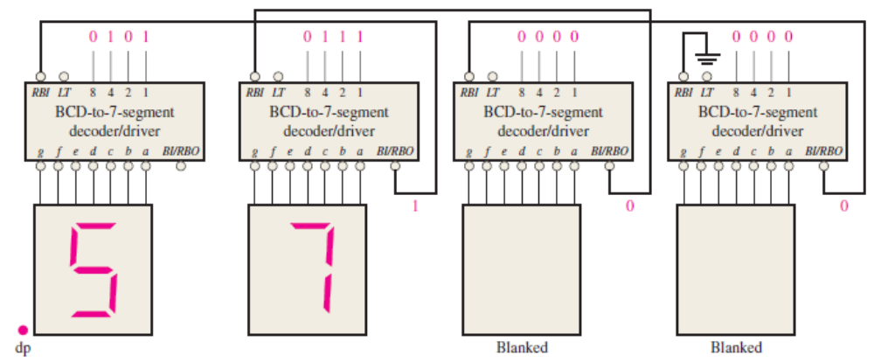
Zero Suppression for a 4-Digit Display
Illustration of trailing zero suppression
Engr.Hammad Munami

Slide 29
Encoders
An encoder is a combinational logic circuit that essentially performs a “reverse” decoder function.
An encoder accepts an active level on one of its inputs representing a digit, such as a decimal or octal digit, and converts it to a coded output, such as BCD or binary.
Engr.Hammad Munami

Slide 30
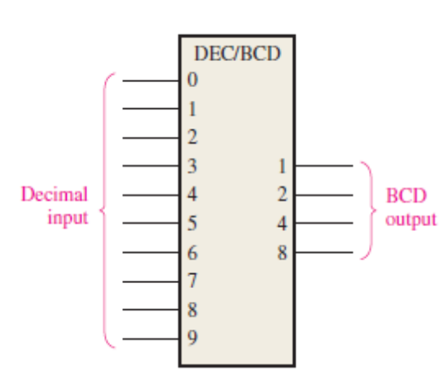
The Decimal-to-BCD Encoder
This type of encoder has ten inputs—one for each decimal digit—and four outputs corresponding to the BCD code,
This is a basic 10-line-to-4-line encoder.
Engr.Hammad Munami

Slide 31
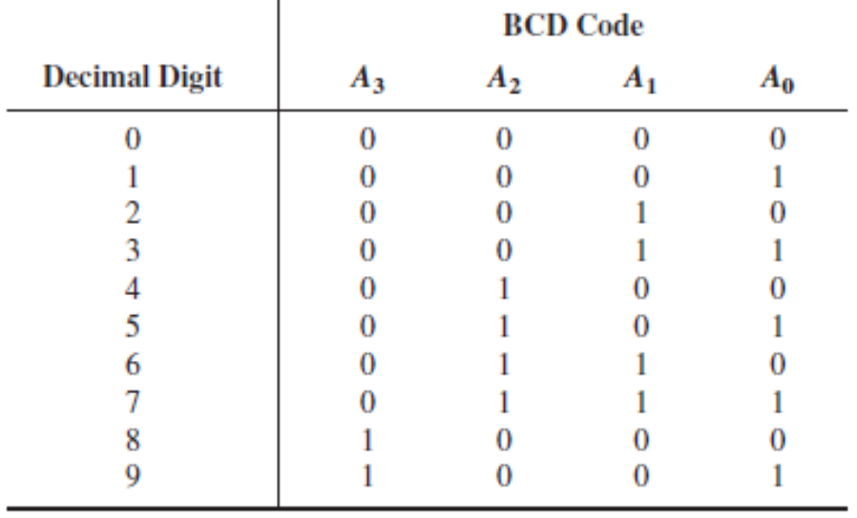
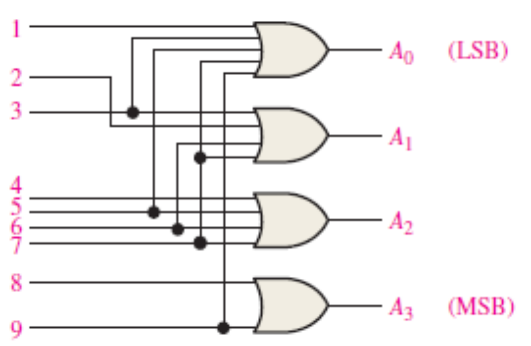
Expression for BCD Outputs
A₃ = 8 + 9
A₂ = 4 + 5 + 6 + 7
A₁ = 2 + 3 + 6 + 7
A₀ = 1 + 3 + 5 + 7 + 9
Engr.Hammad Munami

Slide 32
Priority Encoder
It includes the priority function.
However, this priority is based on the relative magnitudes of the inputs.
Hence, the input with larger magnitude is the one that is encoded first.
Engr.Hammad Munami

Slide 33
4-Input Priority Encoder
This Priority encoder consists of 4 inputs and three outputs.
Although an encoder has 2^{n} inputs and n outputs, it has a third output ‘V’ which is a valid bit indicator and is set to one when one or more inputs are active or equal to 1.
This valid bit is zero when all the inputs are zero which indicates that there is no valid input.
On this condition, other outputs are considered as don’t care conditions and are not inspected when V is zero.
The highest will be the priority of the input with a higher subscript number according to the truth table that is most significant bit will have highest priority while the least significant bit will have low priority .
Engr.Hammad Munami

Slide 34
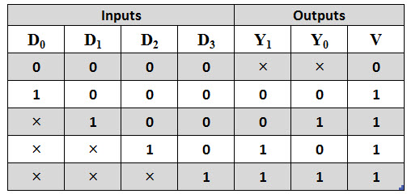
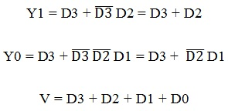
4-Input Priority Encoder
In the truth table, D3 has the highest priority and D0 has lowest priority.
When D3 is active or 1, then regardless of other inputs, the output is 11.
The next higher priority is D2 after D3 and so on.
Engr.Hammad Munami

Slide 35
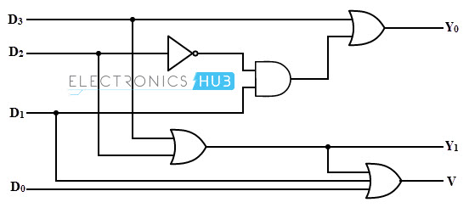
4-Input Priority Encoder
Logic Diagram:
Engr.Hammad Munami

Slide 36
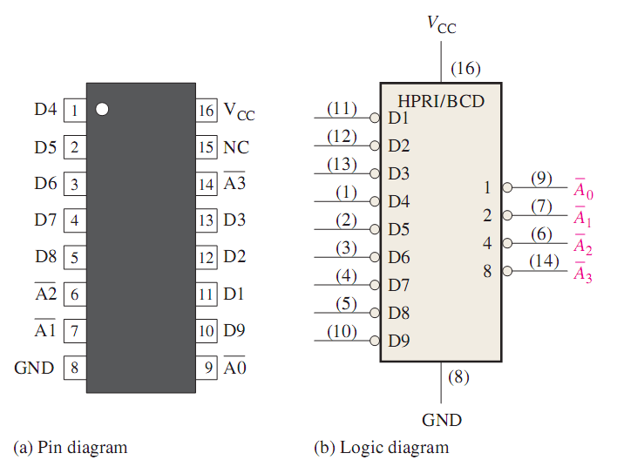
Decimal-to-BCD Priority Encoder 74147 IC
The 74HC147 is a priority encoder with active-LOW inputs (0) for decimal digits 1 through 9 and active-LOW BCD outputs as indicated in the logic symbol in Figure:
Engr.Hammad Munami

Slide 37
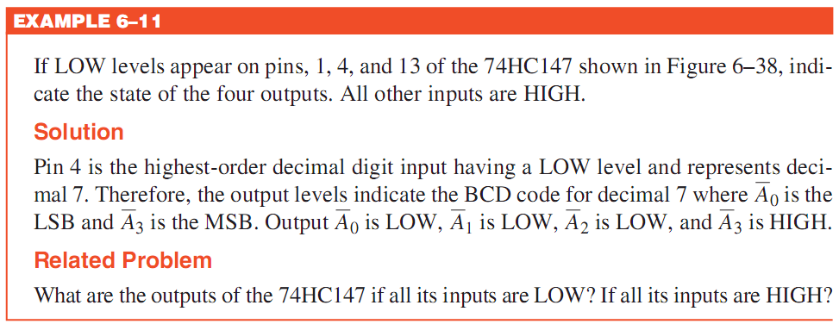
Decimal-to-BCD Priority Encoder 74147 IC
A BCD zero output is represented when none of the inputs is active.
The device pin numbers are in parentheses.
Engr.Hammad Munami

