Slide 1

CS123 Digital Logic Design
LECTURE 11
Multiplexers (Data Selectors)
Engr.Hammad Munami

Slide 2
Multiplexers (Data Selectors)
A multiplexer (MUX) is a device that allows digital information from several sources to be routed onto a single line for transmission over that line to a common destination.
The basic multiplexer has several data input lines and a single output line.
It also has data-select inputs, which permit digital data on any one of the inputs to be switched to the output line.
Multiplexers are also known as data selectors.
Engr.Hammad Munami

Slide 3
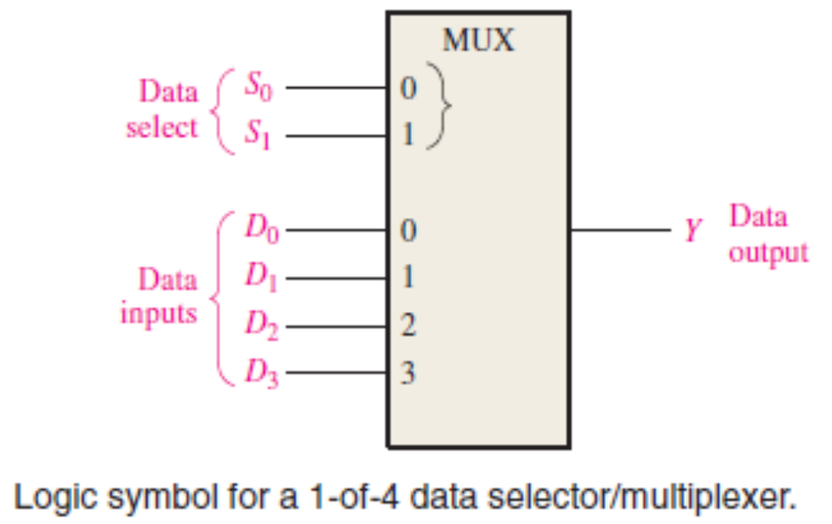
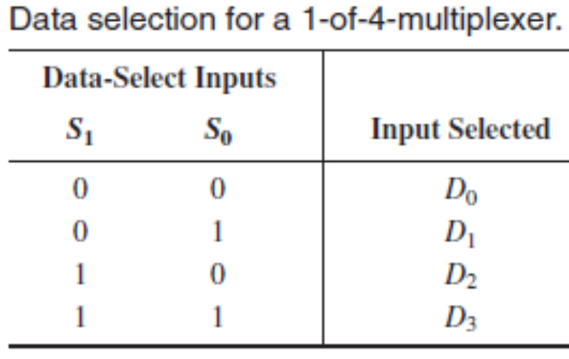
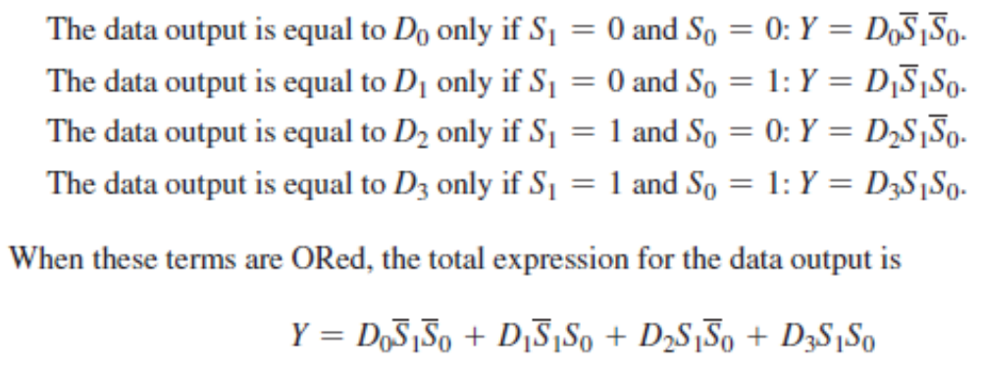
Engr.Hammad Munami

Slide 4
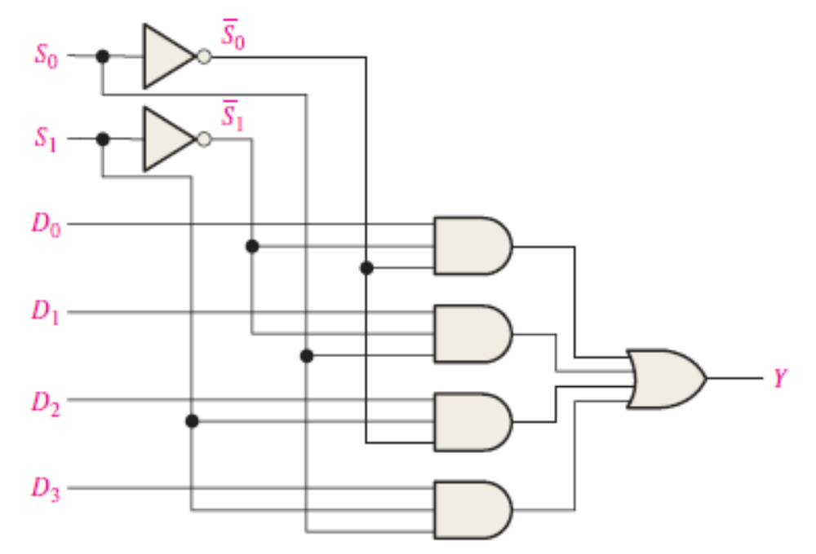
Logic Diagram for a 4-input Multiplexer
Engr.Hammad Munami

Slide 5
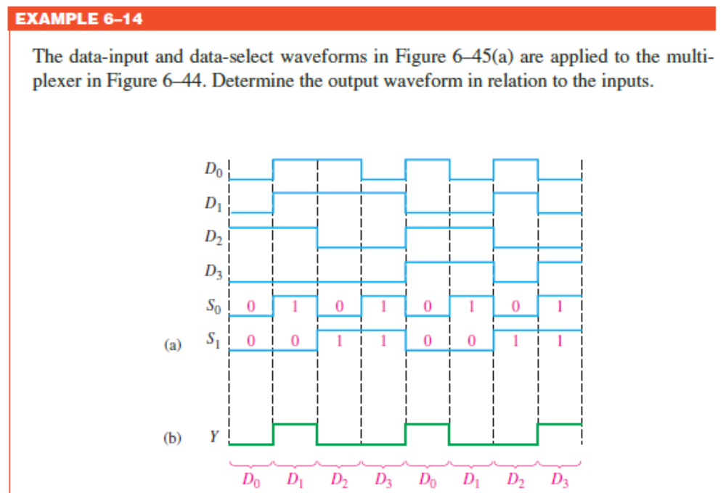
Engr.Hammad Munami

Slide 6
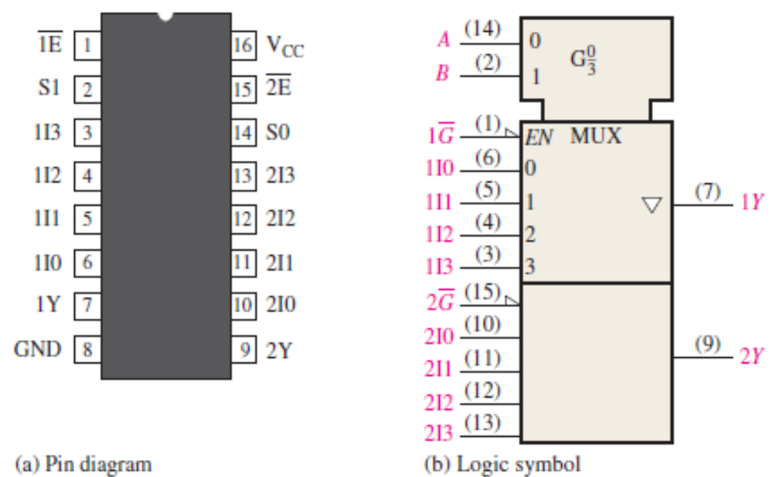
The 74HC153 Dual Four-Input Data Selector/Multiplexer
Engr.Hammad Munami

Slide 7
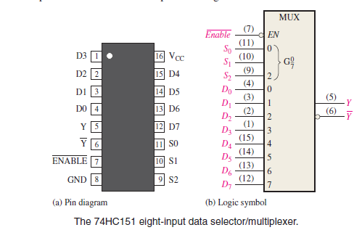
Eight-Input Data Selector/Multiplexer 74HC151
Engr.Hammad Munami

Slide 8
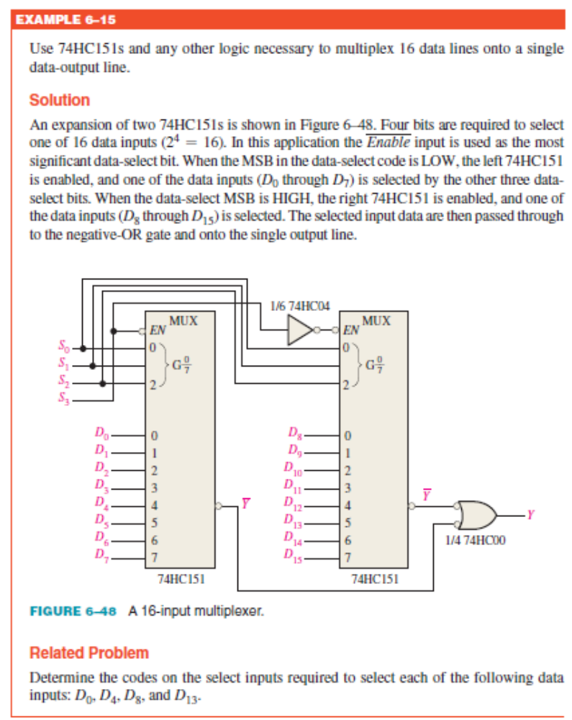
Engr.Hammad Munami

