Slide 1

CS123 Digital Logic Design
LECTURE 12
Demultiplexers
Engr.Hammad Munami

Slide 2
Introduction
A demultiplexer (DEMUX) basically reverses the multiplexing function.
It takes digital information from one line and distributes it to a given number of output lines.
For this reason, the demultiplexer is also known as a data distributor.
As you will learn, decoders can also be used as demultiplexers.
Engr.Hammad Munami

Slide 3
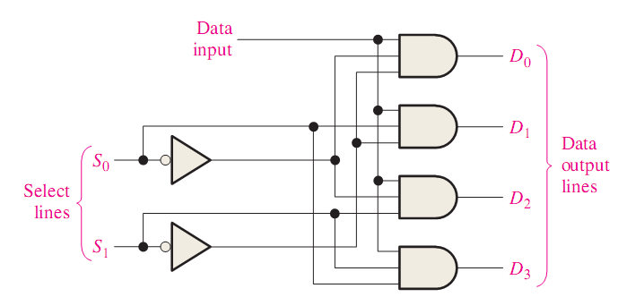
1-line-to-4-line Demultiplexer
Engr.Hammad Munami

Slide 4
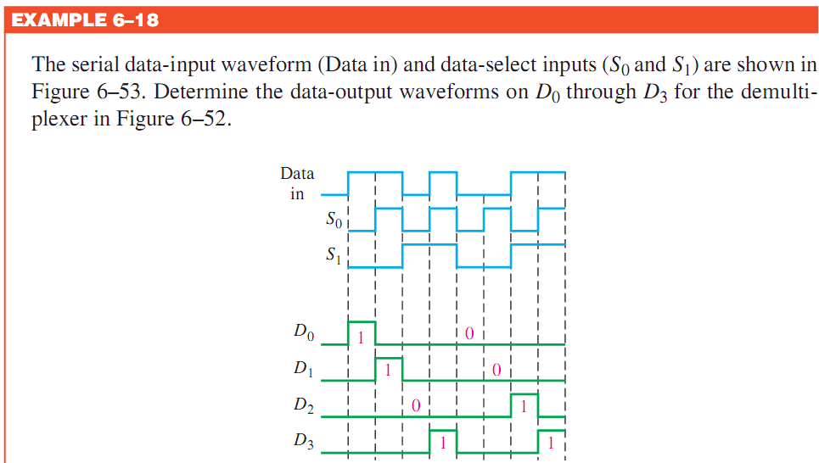
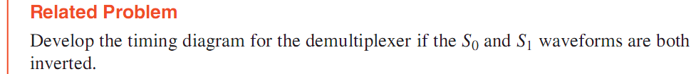
Engr.Hammad Munami

Slide 5
Parity Generators/Checkers
Errors can occur as digital codes are being transferred from one point to another within a digital system or while codes are being transmitted from one system to another.
The errors take the form of undesired changes in the bits that make up the coded information; that is, a 1 can change to a 0, or a 0 to a 1, because of component malfunctions or electrical noise.
In most digital systems, the probability that even a single bit error will occur is very small, and the likelihood that more than one will occur is even smaller.
Nevertheless, when an error occurs undetected, it can cause serious problems in a digital system.
Engr.Hammad Munami

Slide 6
Parity Method for Error Detection
Many systems use a parity bit as a means for bit error detection.
Any group of bits contain either an even or an odd number of 1s.
A parity bit is attached to a group of bits to make the total number of 1s in a group always even or always odd.
An even parity bit makes the total number of 1s even, and an odd parity bit makes the total odd.
A given system operates with even or odd parity, but not both.
For instance, if a system operates with even parity, a check is made on each group of bits received to make sure the total number of 1s in that group is even.
Engr.Hammad Munami

Slide 7
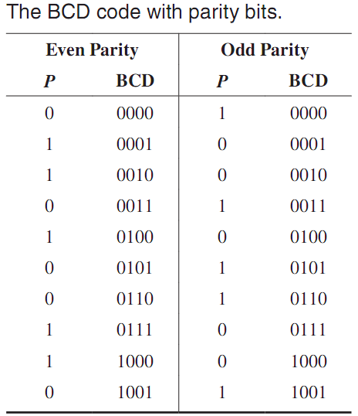
Parity Method for Error Detection
If there is an odd number of 1s, an error has occurred.
The parity bit can be attached to the code at either the beginning or the end, depending on system design.
Notice that the total number of 1s, including the parity bit, is always even for even parity and always odd for odd parity.
Engr.Hammad Munami

Slide 8
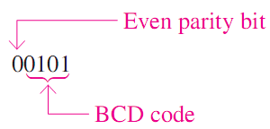
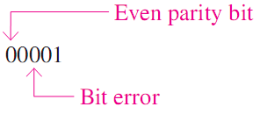
Detecting an Error
A parity bit provides for the detection of a single bit error (or any odd number of errors, which is very unlikely) but cannot check for two errors in one group.
For instance, let’s assume that we wish to transmit the BCD code 0101.
Now let’s assume that an error occurs in the third bit from the left (the 1 becomes a 0).
Engr.Hammad Munami

Slide 9
Detecting an Error
When this code is received, the parity check circuitry determines that there is only a single 1 (odd number), when there should be an even number of 1s.
Because an even number of 1s does not appear in the code when it is received, an error is indicated.
An odd parity bit also provides in a similar manner for the detection of a single error in a given group of bits.
Engr.Hammad Munami

Slide 10
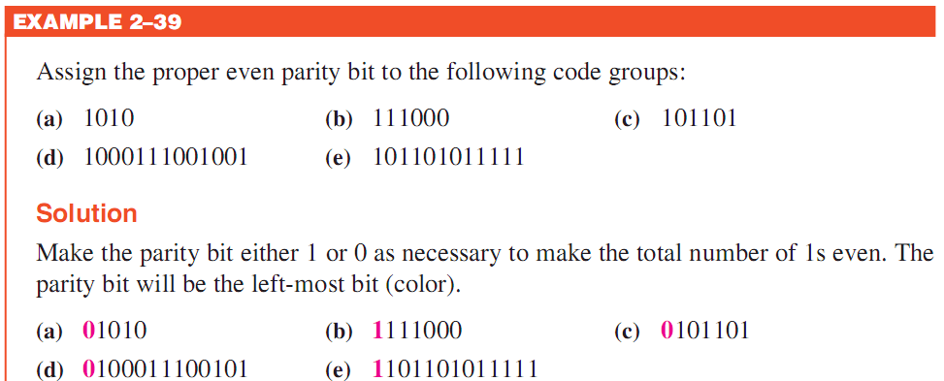
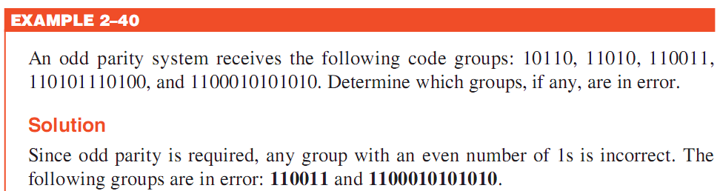
Engr.Hammad Munami

Slide 11
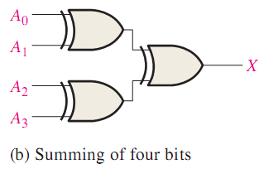
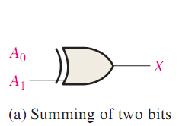
Basic Parity Logic
In order to check for or to generate the proper parity in a given code, a basic principle can be used:
The sum of an even number of 1s is always 0, and the sum of an odd number of 1s is always 1.
Therefore, to determine if a given code has even parity or odd parity, all the bits in that code are summed.
As you know, the sum of two bits can be generated by an exclusive-OR gate.
Engr.Hammad Munami

Slide 12
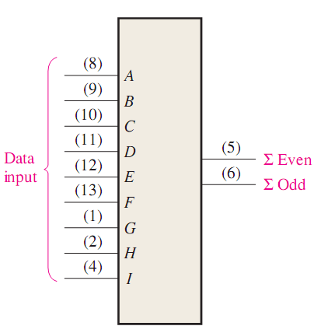
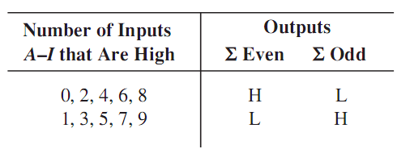
9-BIT PARITY GENERATOR/CHECKER 74280 IC
Engr.Hammad Munami

Slide 13
9-BIT PARITY GENERATOR/CHECKER 74280 IC
As Parity Checker:
  When this device is used as an even parity checker, the number of input bits should always be even; and when a parity error occurs, the ∑Even output goes LOW and the ∑Odd output goes HIGH.
  When it is used as an odd parity checker, the number of input bits should always be odd; and when a parity error occurs, the ∑Odd output goes LOW and the ∑Even output goes HIGH.
Engr.Hammad Munami

Slide 14
9-BIT PARITY GENERATOR/CHECKER 74280 IC
As Parity Generator:
  If this device is used as an even parity generator, the parity bit is taken at the ∑Odd output because this output is a 0 if there is an even number of input bits and it is a 1 if there is an odd number.
  When used as an odd parity generator, the parity bit is taken at the ∑Even output because it is a 0 when the number of inputs bits is odd.
Engr.Hammad Munami

