Slide 1

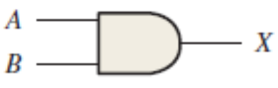
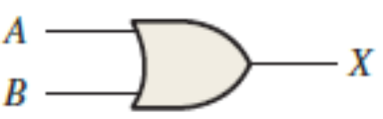
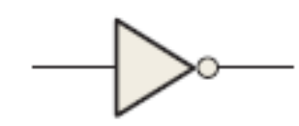
CS123 Digital Logic Design
LECTURE 02
Logic Gates
Engr.Hammad Munami

Slide 2
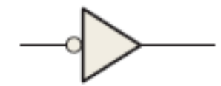
The Inverter
The inverter (NOT circuit) performs the operation called inversion or complementation.
The inverter changes one logic level to the opposite level.
In terms of bits, it changes a 1 to a 0 and a 0 to a 1.
The negation indicator is a “bubble” (O) that indicates inversion or complementation when it appears on the input or output of any logic element, for the inverter.
Generally, inputs are on the left of a logic symbol and the output is on the right.
Engr.Hammad Munami

Slide 3
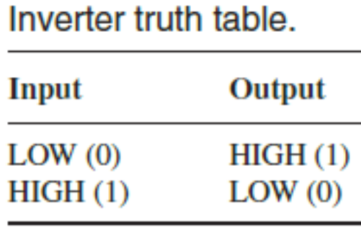
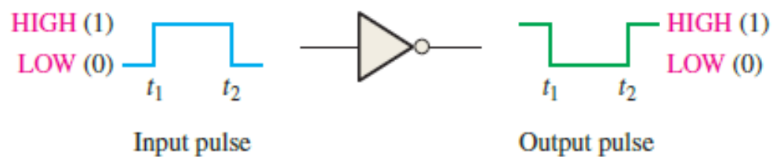
The Inverter
When appearing on the output, the bubble means that a 0 is the active or asserted output state, and the output is called an active-LOW output.
The absence of a bubble on the input or output means that a 1 is the active or asserted state, and in this case, the input or output is called active-HIGH.
When the input is LOW, the output is HIGH; when the input is HIGH, the output is LOW, thereby producing an inverted output pulse.
Engr.Hammad Munami

Slide 4
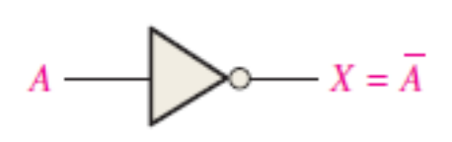

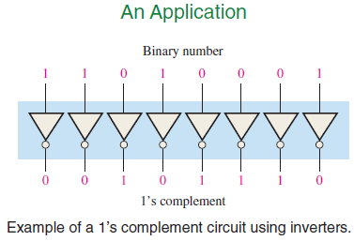
The Inverter
Logic Expression for an Inverter:
Where, the input variable is called A and the output variable is called X,
Engr.Hammad Munami

Slide 5
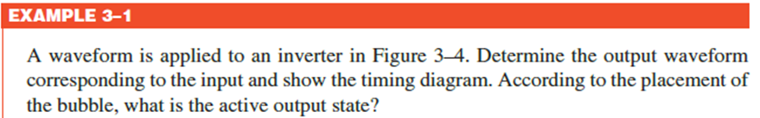


Engr.Hammad Munami

Slide 6
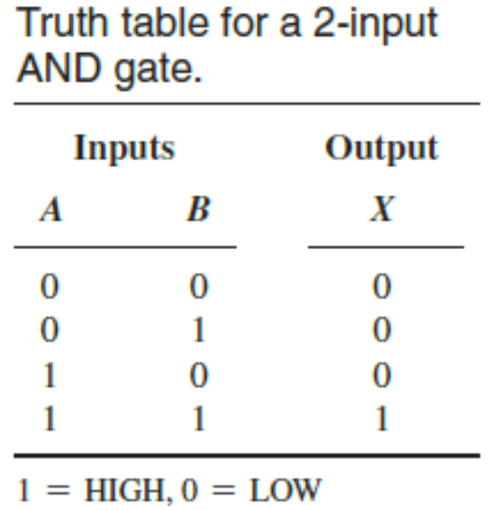
The AND Gate
An AND gate can have two or more inputs and performs what is known as logical multiplication.
An AND gate produces a HIGH output only when all of the inputs are HIGH.
When any of the inputs is LOW, the output is LOW.
Therefore, the basic purpose of an AND gate is to determine when certain conditions are simultaneously true.
Engr.Hammad Munami

Slide 7
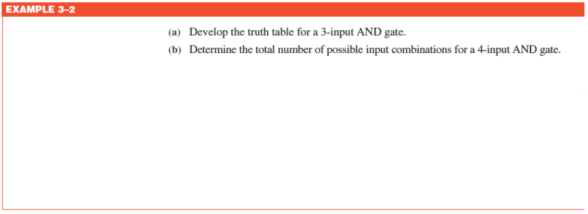
Engr.Hammad Munami

Slide 8
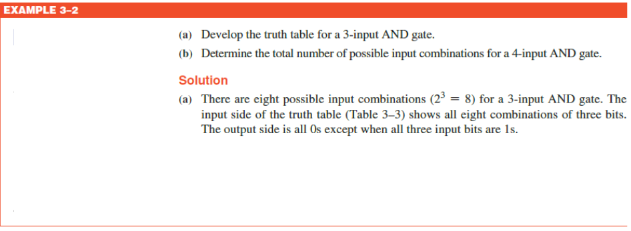
Engr.Hammad Munami

Slide 9
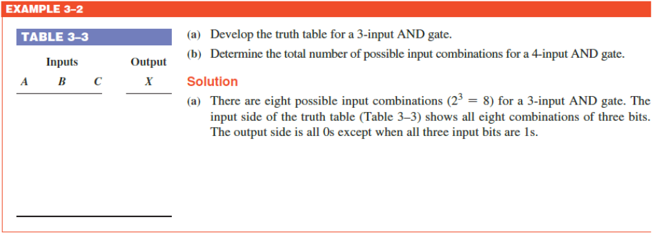
Engr.Hammad Munami

Slide 10
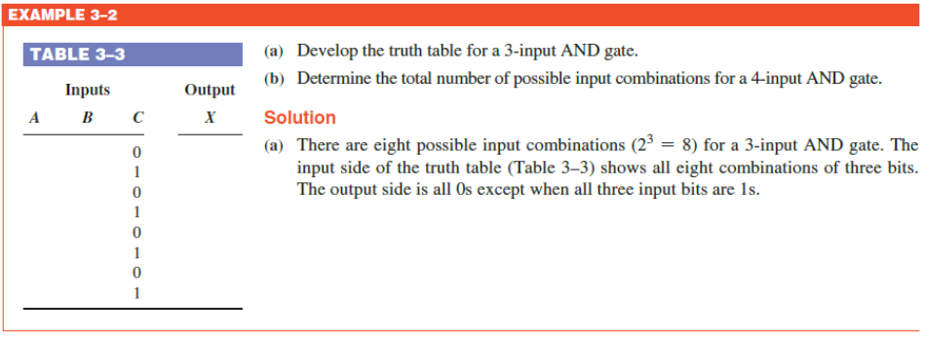
Engr.Hammad Munami

Slide 11
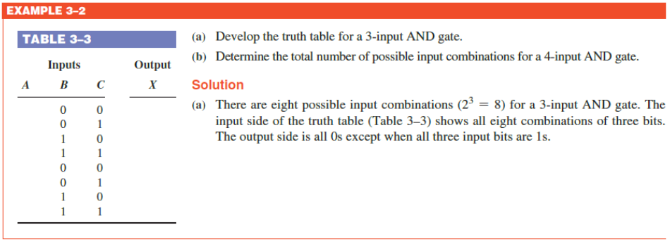
Engr.Hammad Munami

Slide 12
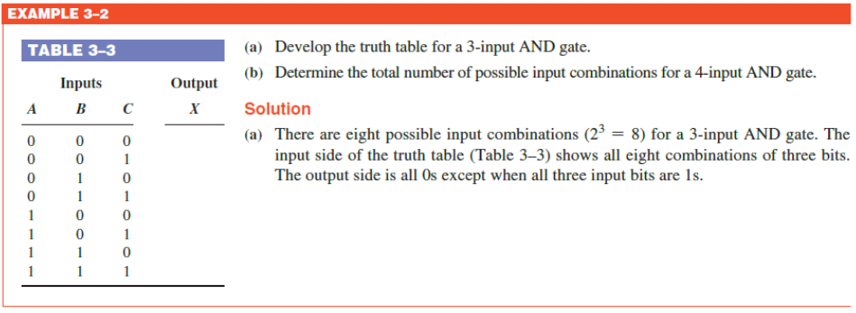
Engr.Hammad Munami

Slide 13
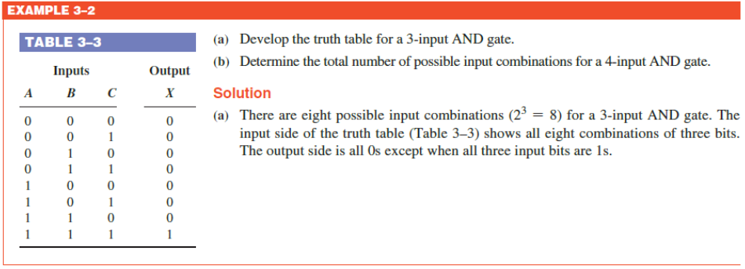
Engr.Hammad Munami

Slide 14
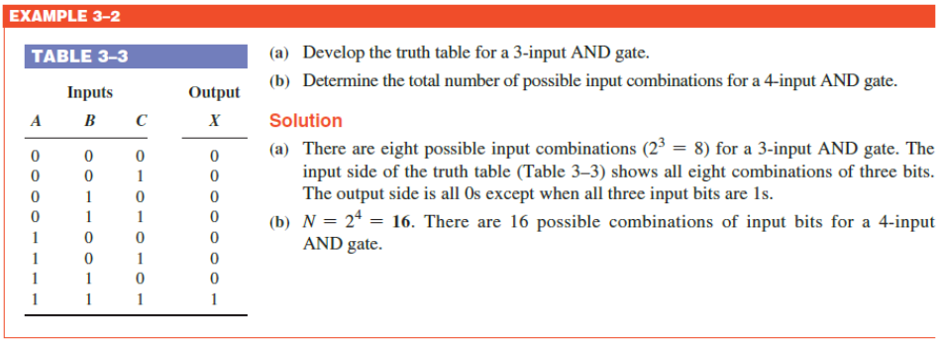
Engr.Hammad Munami

Slide 15
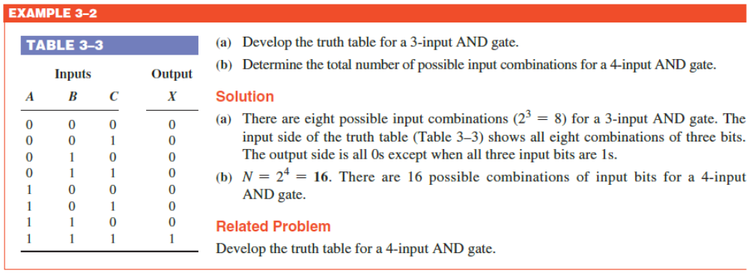
Engr.Hammad Munami

Slide 16
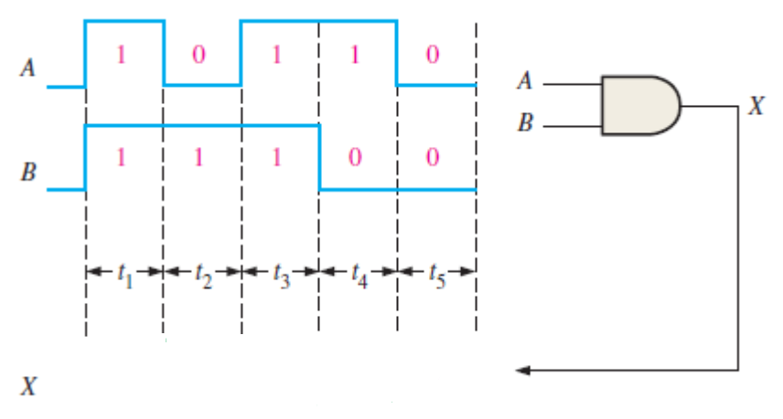
AND Gate Operation with Waveform Inputs (Timing Diagram)
Engr.Hammad Munami

Slide 17
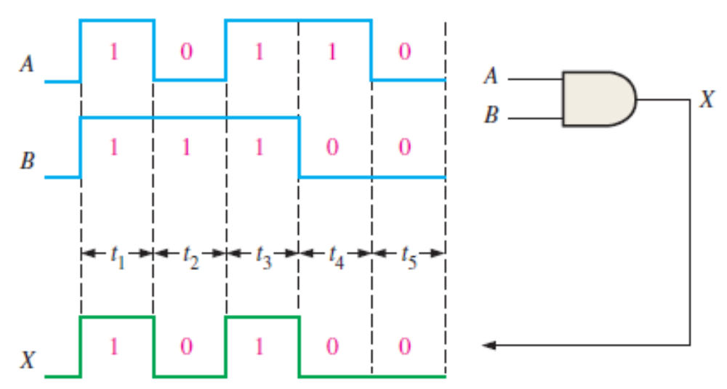
AND Gate Operation with Waveform Inputs (Timing Diagram)
Engr.Hammad Munami

Slide 18
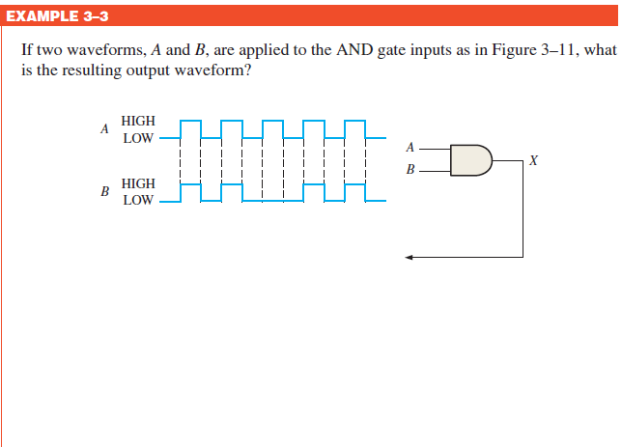
Engr.Hammad Munami

Slide 19
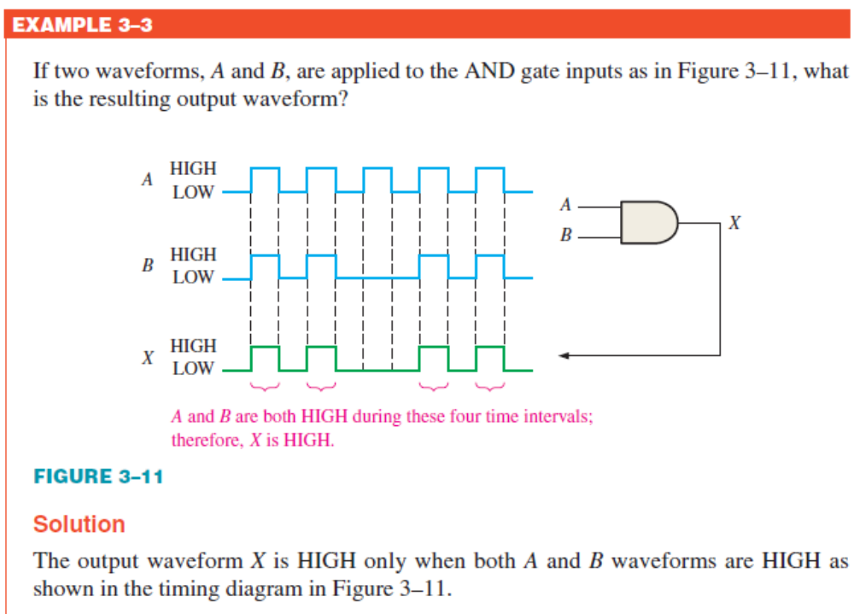
Engr.Hammad Munami

Slide 20
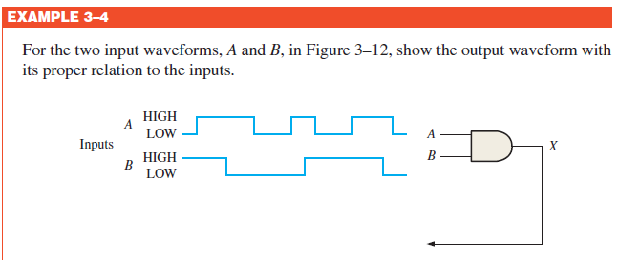
Engr.Hammad Munami

Slide 21
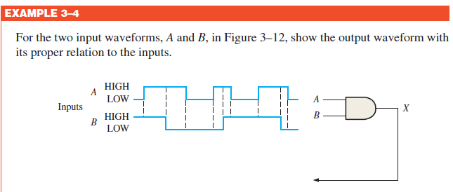
Engr.Hammad Munami

Slide 22
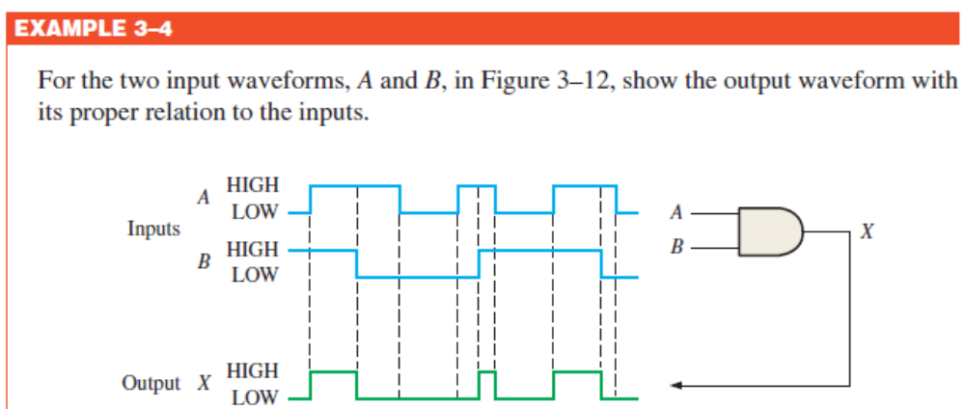
Engr.Hammad Munami

Slide 23
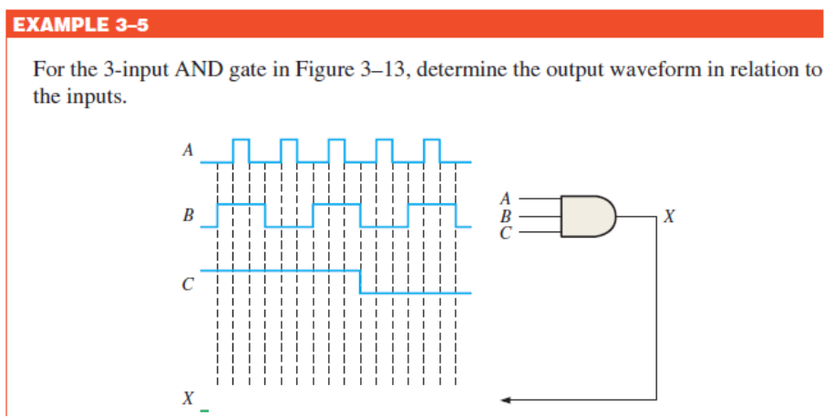
Engr.Hammad Munami

Slide 24
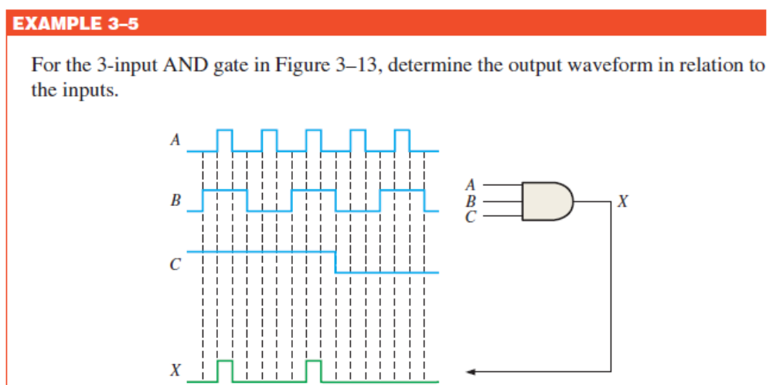
Engr.Hammad Munami

Slide 25
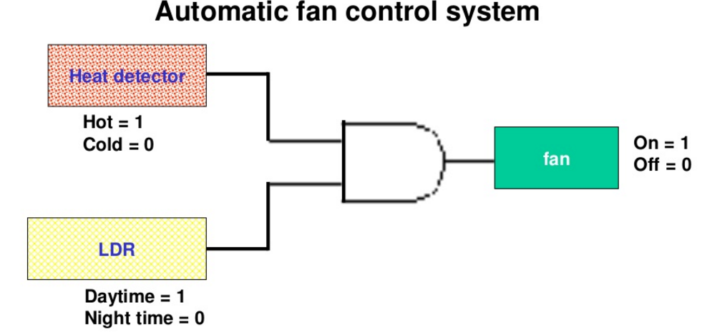
Application of AND Gate
Engr.Hammad Munami

Slide 26
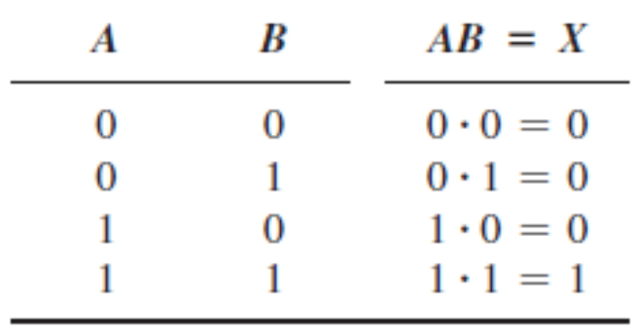
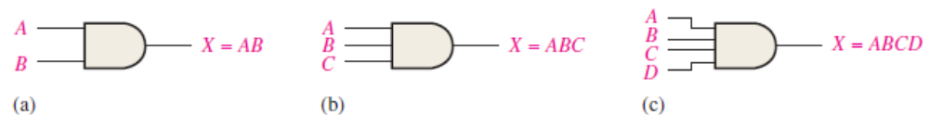
Logic Expressions for an AND Gate
If one input variable is A, if the other input variable is B, and if the output variable is X, then the Boolean (Logic) expression is:
X = AB or X = A●B
Engr.Hammad Munami

Slide 27
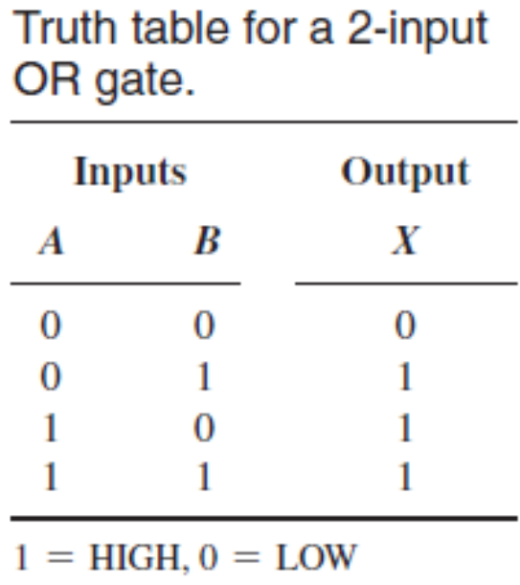
The OR Gate
An OR gate can have two or more inputs and performs what is known as logical addition.
An OR gate produces a HIGH on the output when any of the inputs is HIGH.
The output is LOW only when all of the inputs are LOW.
Therefore, an OR gate determines when one or more of its inputs are HIGH and produces a HIGH on its output
Engr.Hammad Munami

Slide 28
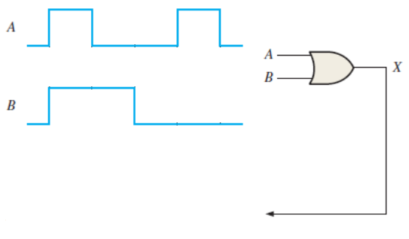
OR Gate Operation with Waveform Inputs
Engr.Hammad Munami

Slide 29
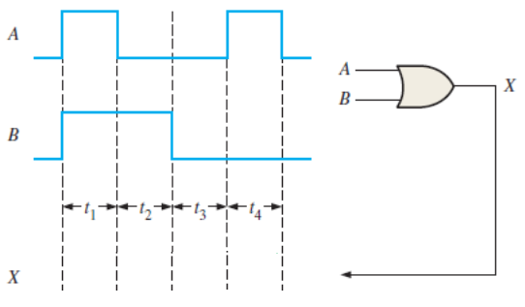
OR Gate Operation with Waveform Inputs
Engr.Hammad Munami

Slide 30
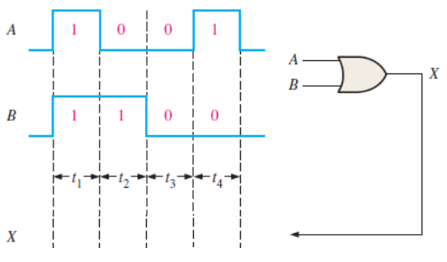
OR Gate Operation with Waveform Inputs
Engr.Hammad Munami

Slide 31
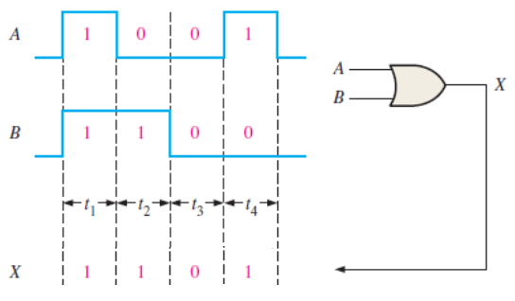
OR Gate Operation with Waveform Inputs
Engr.Hammad Munami

Slide 32
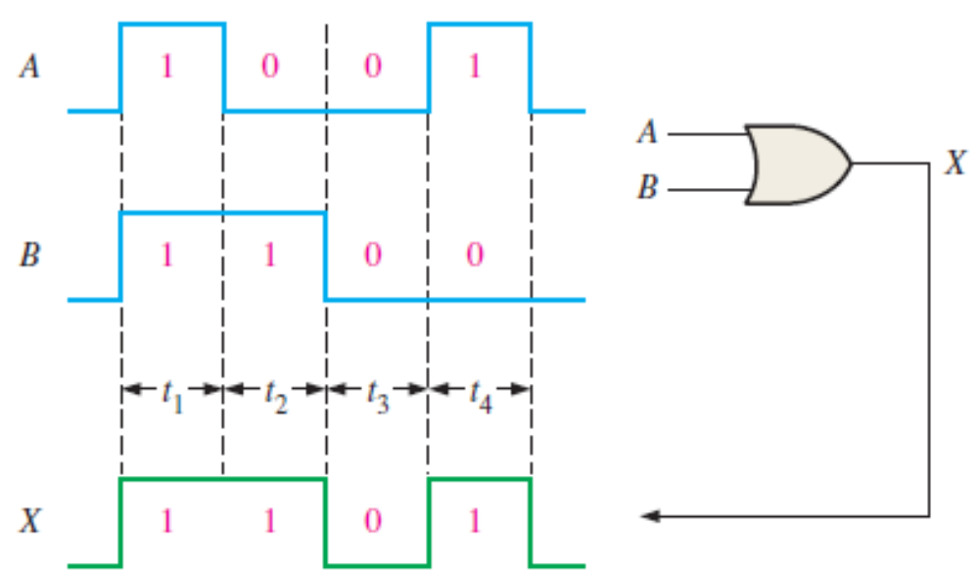
OR Gate Operation with Waveform Inputs
Engr.Hammad Munami

Slide 33
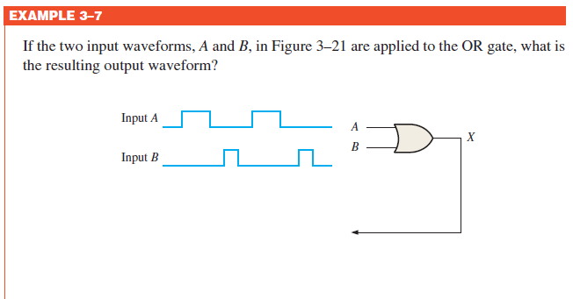
Engr.Hammad Munami

Slide 34
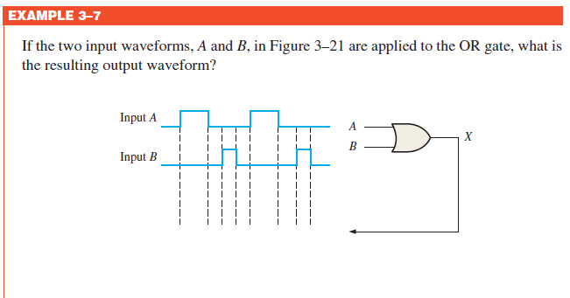
Engr.Hammad Munami

Slide 35
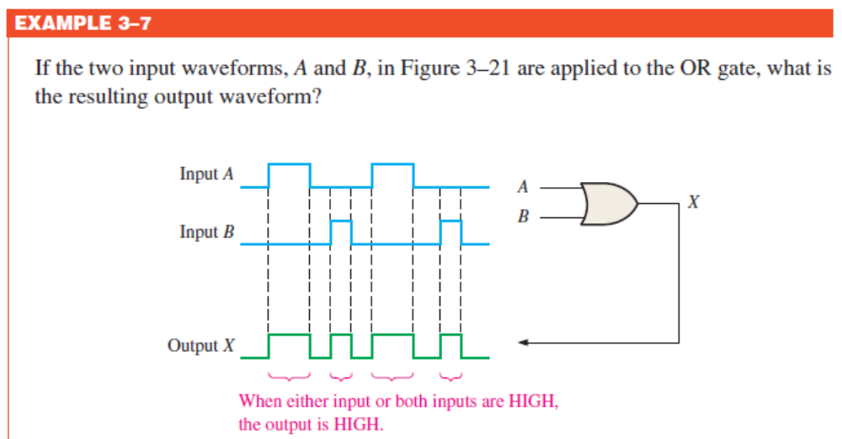
Engr.Hammad Munami

Slide 36
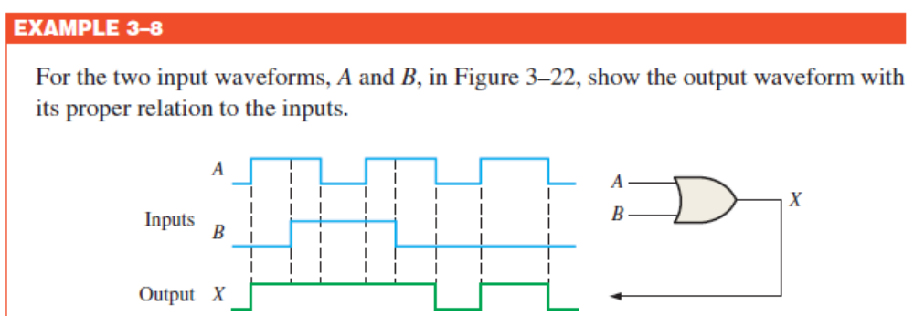
Engr.Hammad Munami

Slide 37
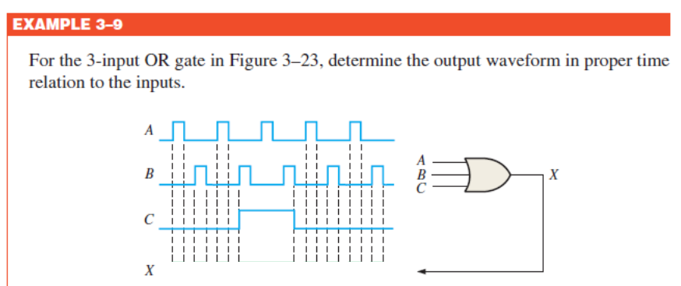
Engr.Hammad Munami

Slide 38
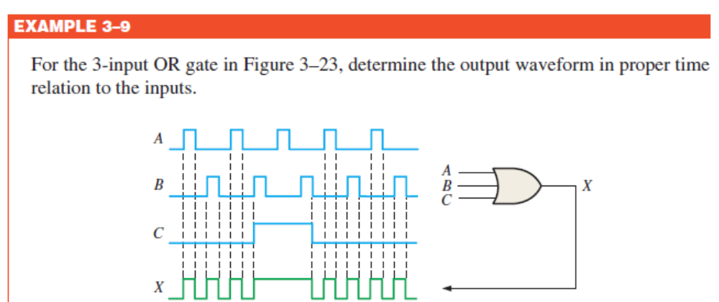
Engr.Hammad Munami

Slide 39
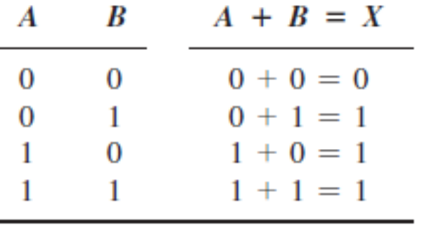
Logic Expressions for an OR Gate
If one input variable is A, if the other input variable is B, and if the output variable is X, then the Boolean (Logic) expression is;
X = A + B
Engr.Hammad Munami

Slide 40
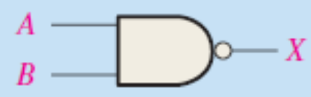
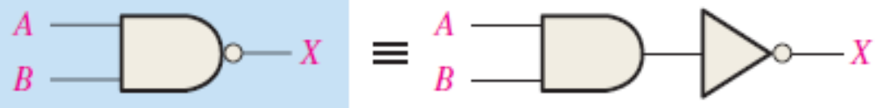
The NAND Gate
The NAND gate is a popular logic element because it can be used as a universal gate; that is, NAND gates can be used in combination to perform the AND, OR, and inverter operations.
The universal property of the NAND gate will be examined thoroughly later.
The NAND gate is the same as the AND gate except the output is inverted.
Engr.Hammad Munami

Slide 41
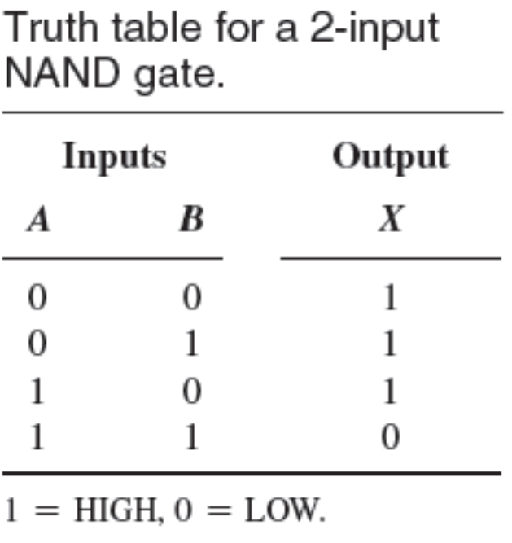
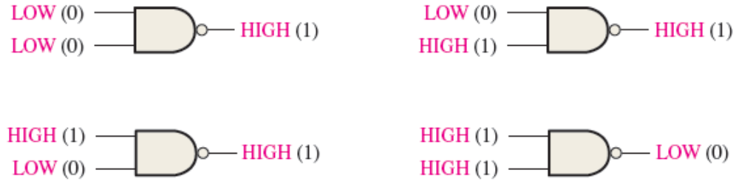
Operation of a NAND Gate
A NAND gate produces a LOW output only when all the inputs are HIGH.
When any of the inputs is LOW, the output will be HIGH.
Engr.Hammad Munami

Slide 42
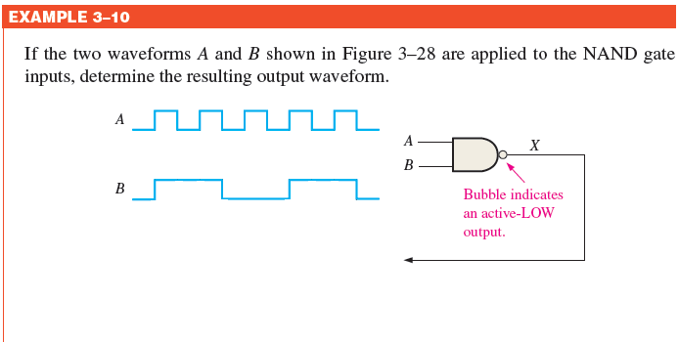
NAND Gate Operation with Waveform Inputs
Engr.Hammad Munami

Slide 43
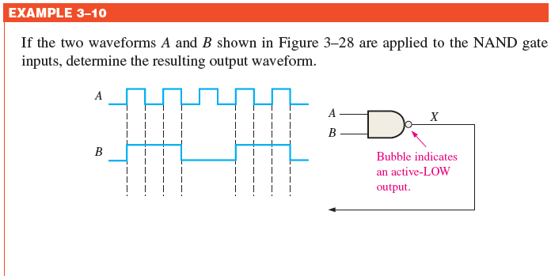
NAND Gate Operation with Waveform Inputs
Engr.Hammad Munami

Slide 44

NAND Gate Operation with Waveform Inputs
Engr.Hammad Munami

Slide 45

Engr.Hammad Munami

Slide 46

Engr.Hammad Munami

Slide 47

Engr.Hammad Munami

Slide 48

Negative-OR Equivalent Operation of a NAND Gate
For a 2-input NAND gate performing a ‘negative-OR operation’, output X is HIGH when either input A or input B is LOW, or when both A and B are LOW.
Engr.Hammad Munami

Slide 49

Engr.Hammad Munami

Slide 50

Application
Engr.Hammad Munami

Slide 51

Engr.Hammad Munami

Slide 52

Logic Expressions for a NAND Gate
The Boolean expression for the output of a 2-input NAND gate is:
X = AB
This expression says that the two input variables, A and B, are first ANDed and then complemented, as indicated by the bar over the AND expression.
Engr.Hammad Munami

Slide 53


The NOR Gate
The NOR gate, like the NAND gate, is a useful logic element because it can also be used as a universal gate; that is, NOR gates can be used in combination to perform the AND,OR, and inverter operations.
The universal property of the NOR gate will be examined thoroughly later.
The term NOR is a contraction of NOT-OR and implies an OR function with an inverted (complemented) output.
Engr.Hammad Munami

Slide 54


Operation of a NOR Gate
A NOR gate produces a LOW output when any of its inputs is HIGH.
Only when all of its inputs are LOW, the output is HIGH.
Engr.Hammad Munami

Slide 55

NOR Gate Operation with Waveform Inputs
Engr.Hammad Munami

Slide 56

NOR Gate Operation with Waveform Inputs
Engr.Hammad Munami

Slide 57

NOR Gate Operation with Waveform Inputs
Engr.Hammad Munami

Slide 58

NOR Gate Operation with Waveform Inputs
Engr.Hammad Munami

Slide 59

Negative-AND Equivalent Operation of the NOR Gate
For a 2-input NOR gate performing a negative-AND operation, output X is HIGH only when both inputs A and B are LOW.
Engr.Hammad Munami

Slide 60


Application
Engr.Hammad Munami

Slide 61

Logic Expressions for a NOR Gate
The Boolean expression for the output of a 2-input NOR gate can be written as
X = A + B
Above equation says that the two input variables are first ORed and then complemented, as indicated by the bar over the OR expression.
Engr.Hammad Munami

