Slide 1

CS123 Digital Logic Design
LECTURE 03
Logic Gates (Continues…)
Engr.Hammad Munami

Slide 2
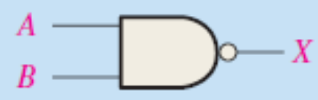
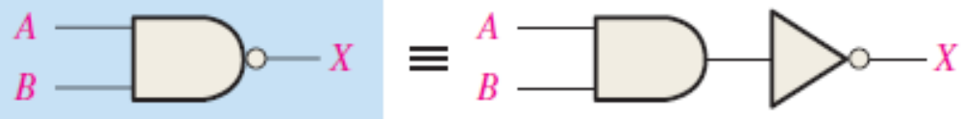
The NAND Gate
The NAND gate is a popular logic element because it can be used as a universal gate; that is, NAND gates can be used in combination to perform the AND, OR, and inverter operations.
The universal property of the NAND gate will be examined thoroughly later.
The NAND gate is the same as the AND gate except the output is inverted.
Engr.Hammad Munami

Slide 3
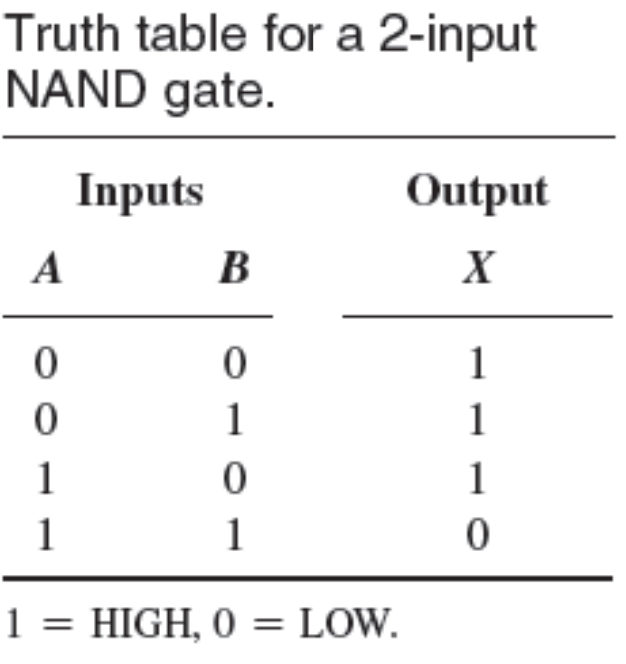
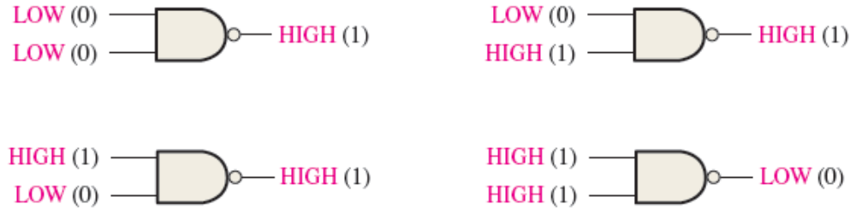
Operation of a NAND Gate
A NAND gate produces a LOW output only when all the inputs are HIGH.
When any of the inputs is LOW, the output will be HIGH.
Engr.Hammad Munami

Slide 4
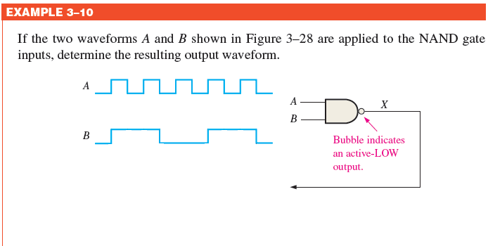
NAND Gate Operation with Waveform Inputs
Engr.Hammad Munami

Slide 5
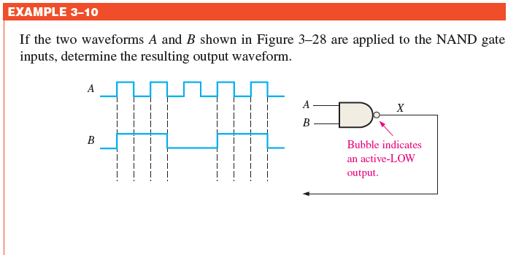
NAND Gate Operation with Waveform Inputs
Engr.Hammad Munami

Slide 6
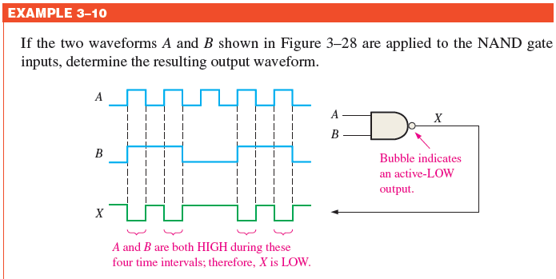
NAND Gate Operation with Waveform Inputs
Engr.Hammad Munami

Slide 7
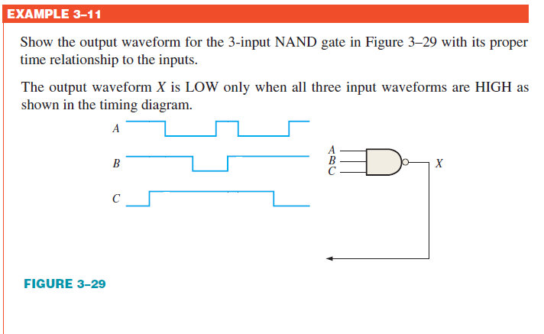
Engr.Hammad Munami

Slide 8
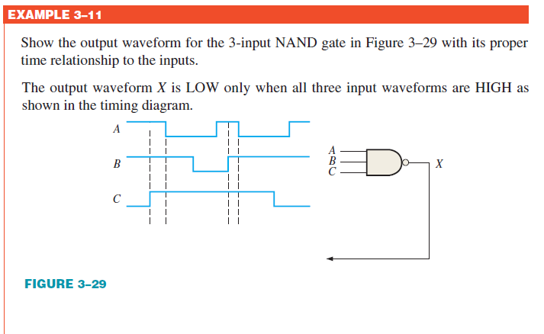
Engr.Hammad Munami

Slide 9
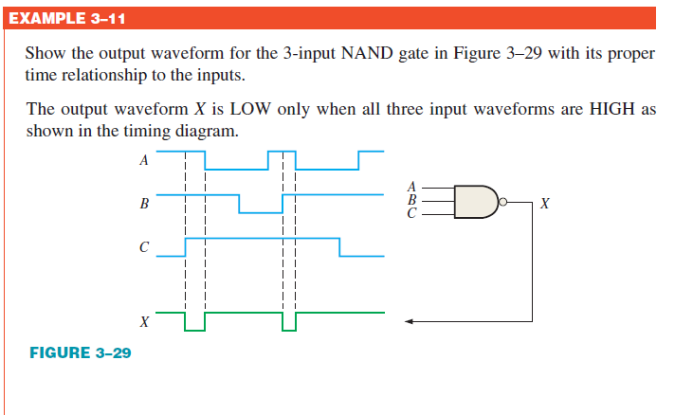
Engr.Hammad Munami

Slide 10
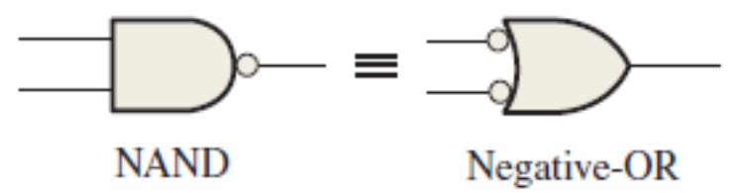
Negative-OR Equivalent Operation of a NAND Gate
For a 2-input NAND gate performing a ‘negative-OR operation’, output X is HIGH when either input A or input B is LOW, or when both A and B are LOW.
Engr.Hammad Munami

Slide 11
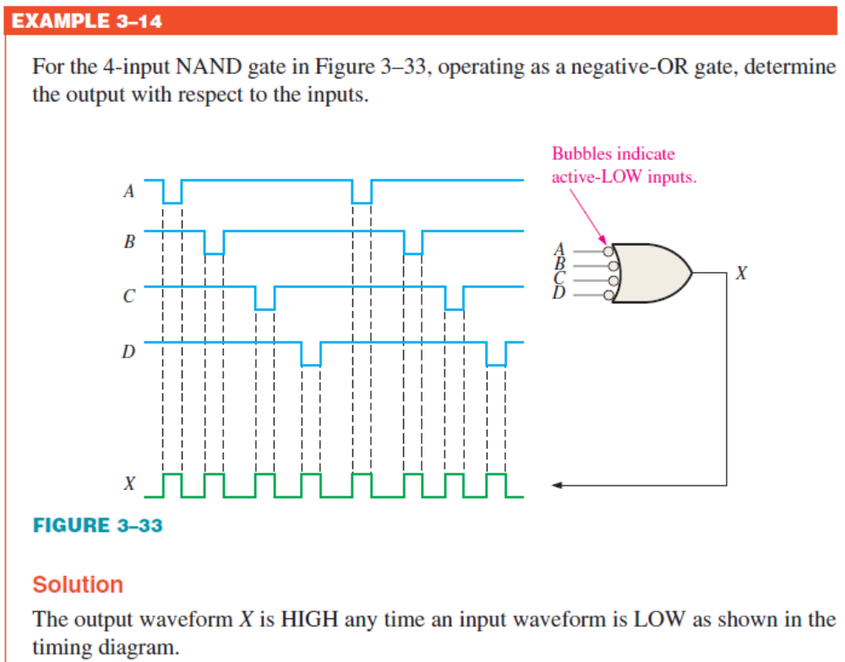
Engr.Hammad Munami

Slide 12
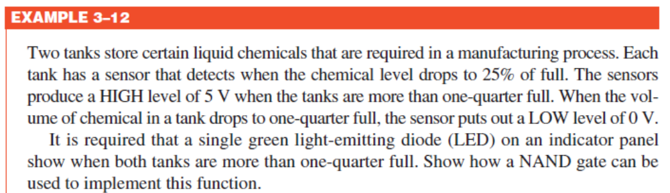
Application
Engr.Hammad Munami

Slide 13
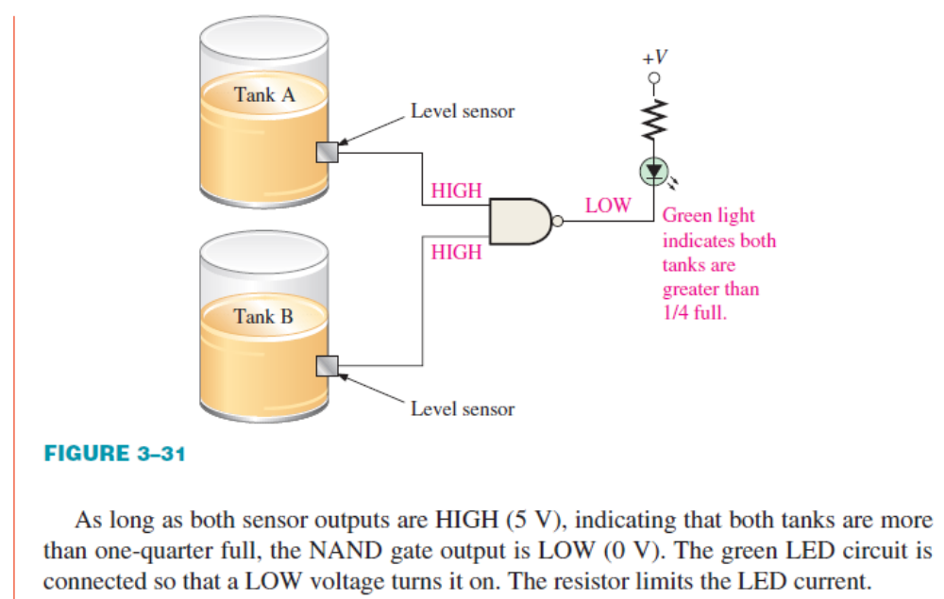
Engr.Hammad Munami

Slide 14
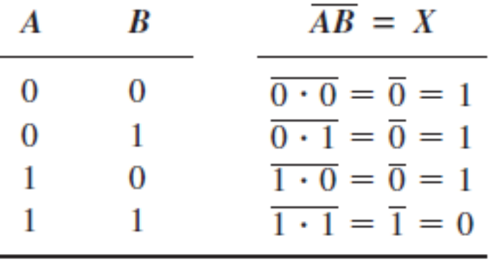
Logic Expressions for a NAND Gate
The Boolean expression for the output of a 2-input NAND gate is:
X = AB
This expression says that the two input variables, A and B, are first ANDed and then complemented, as indicated by the bar over the AND expression.
Engr.Hammad Munami

Slide 15
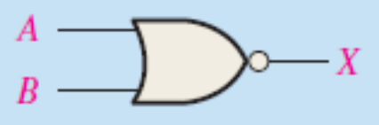
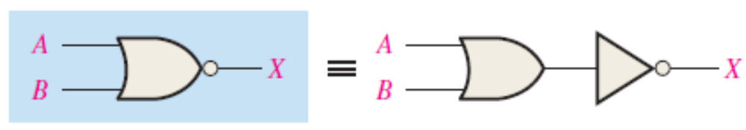
The NOR Gate
The NOR gate, like the NAND gate, is a useful logic element because it can also be used as a universal gate; that is, NOR gates can be used in combination to perform the AND,OR, and inverter operations.
The universal property of the NOR gate will be examined thoroughly later.
The term NOR is a contraction of NOT-OR and implies an OR function with an inverted (complemented) output.
Engr.Hammad Munami

Slide 16
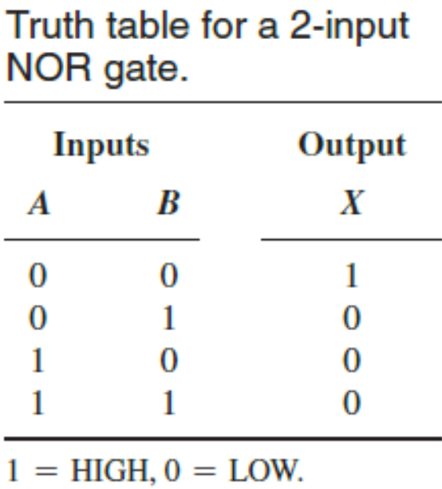
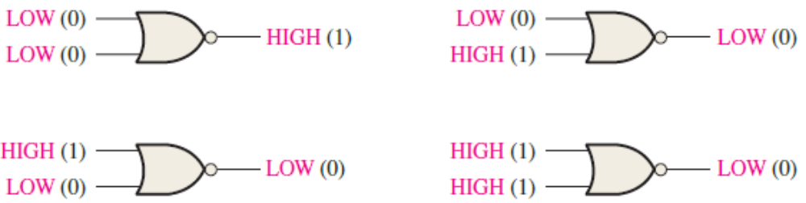
Operation of a NOR Gate
A NOR gate produces a LOW output when any of its inputs is HIGH.
Only when all of its inputs are LOW, the output is HIGH.
Engr.Hammad Munami

Slide 17
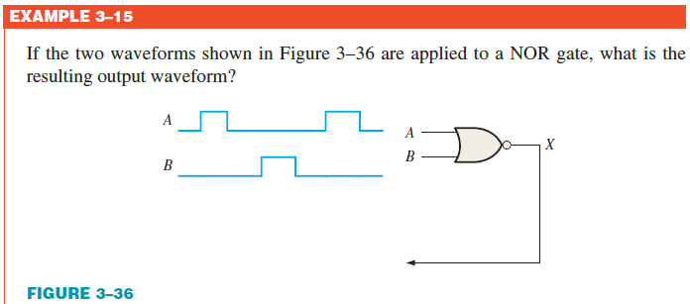
NOR Gate Operation with Waveform Inputs
Engr.Hammad Munami

Slide 18
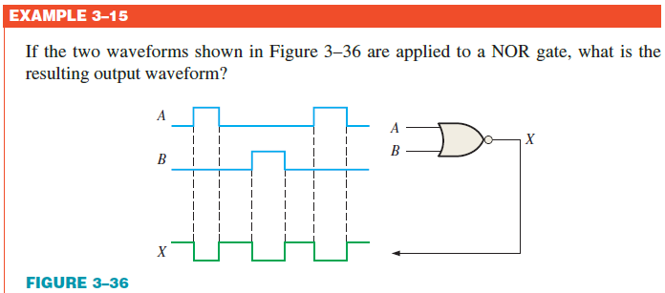
NOR Gate Operation with Waveform Inputs
Engr.Hammad Munami

Slide 19
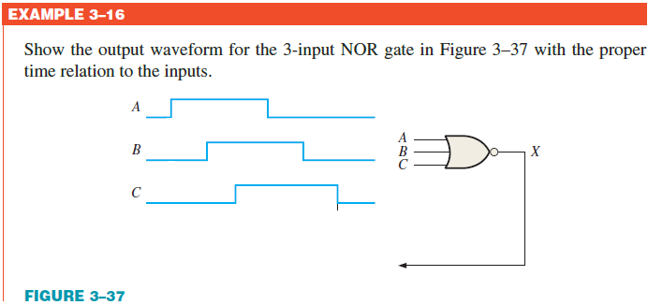
NOR Gate Operation with Waveform Inputs
Engr.Hammad Munami

Slide 20
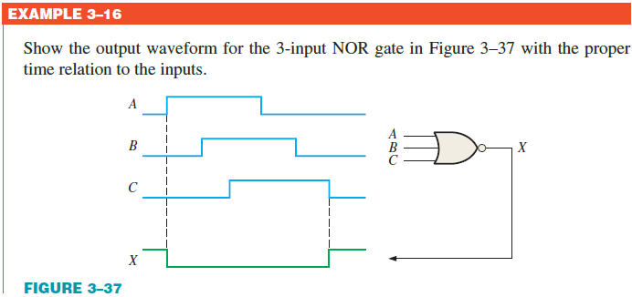
NOR Gate Operation with Waveform Inputs
Engr.Hammad Munami

Slide 21
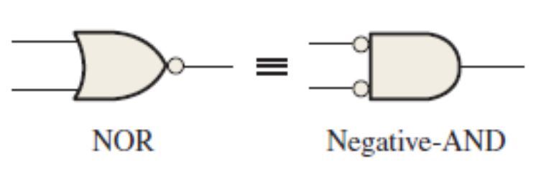
Negative-AND Equivalent Operation of the NOR Gate
For a 2-input NOR gate performing a negative-AND operation, output X is HIGH only when both inputs A and B are LOW.
Engr.Hammad Munami

Slide 22
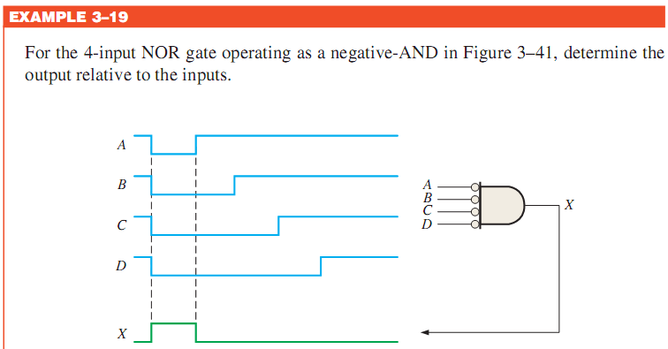
Engr.Hammad Munami

Slide 23
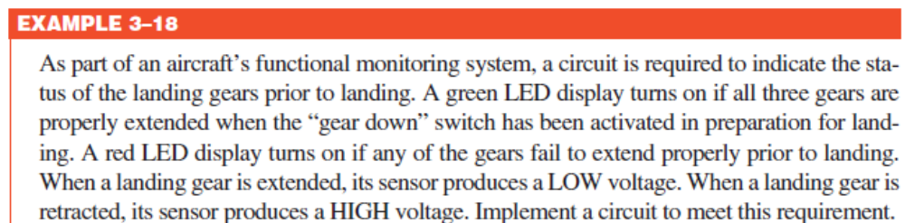
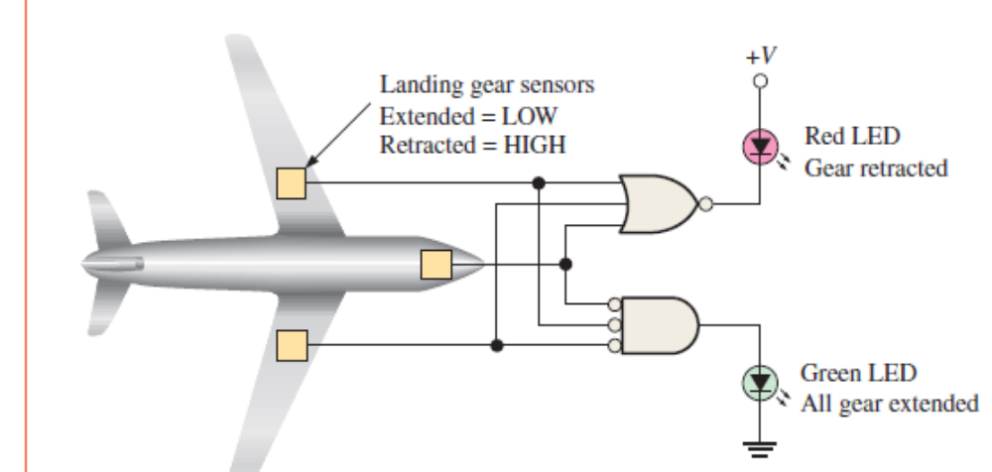
Application
Engr.Hammad Munami

Slide 24
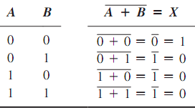
Logic Expressions for a NOR Gate
The Boolean expression for the output of a 2-input NOR gate can be written as
X = A + B
Above equation says that the two input variables are first ORed and then complemented, as indicated by the bar over the OR expression.
Engr.Hammad Munami

Slide 25
The Exclusive-OR and Exclusive-NOR Gates
Exclusive-OR and exclusive-NOR gates are formed by a combination of basic gates.
However, because of their fundamental importance in many applications, these gates are often treated as basic logic elements with their own unique symbols.
Engr.Hammad Munami

Slide 26

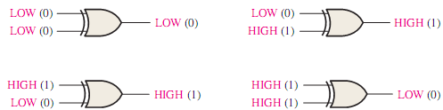
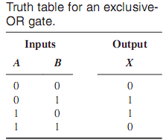
The Exclusive-OR Gate
The output of an exclusive-OR gate is HIGH only when the two inputs are at opposite logic levels.
The XOR gate has only two inputs.
Engr.Hammad Munami

Slide 27
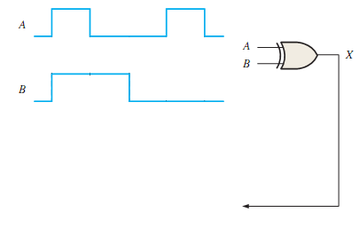
Operation with Waveform Inputs
Engr.Hammad Munami

Slide 28
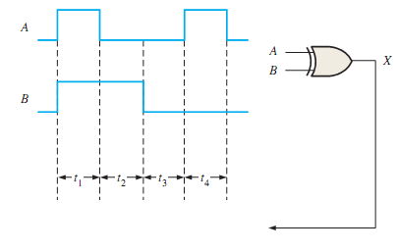
Operation with Waveform Inputs
Engr.Hammad Munami

Slide 29
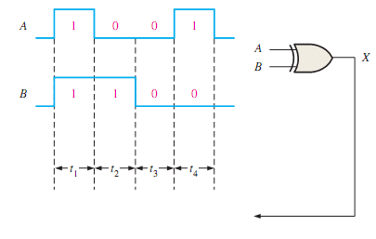
Operation with Waveform Inputs
Engr.Hammad Munami

Slide 30
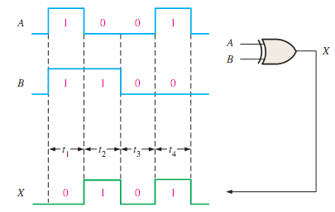
Operation with Waveform Inputs
Engr.Hammad Munami

Slide 31
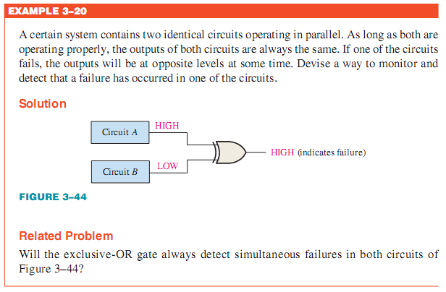
Application
Engr.Hammad Munami

Slide 32

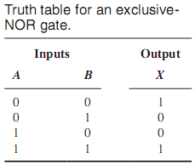
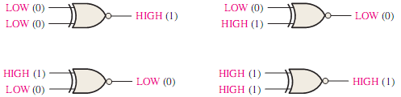
The Exclusive-NOR Gate
Like the XOR gate, an XNOR has only two inputs.
The bubble on the output of the XNOR symbol indicates that its output is opposite that of the XOR gate.
When the two input logic levels are opposite, the output of the exclusive-NOR gate is LOW.
The output is HIGH when the same level is on both inputs.
Engr.Hammad Munami

Slide 33
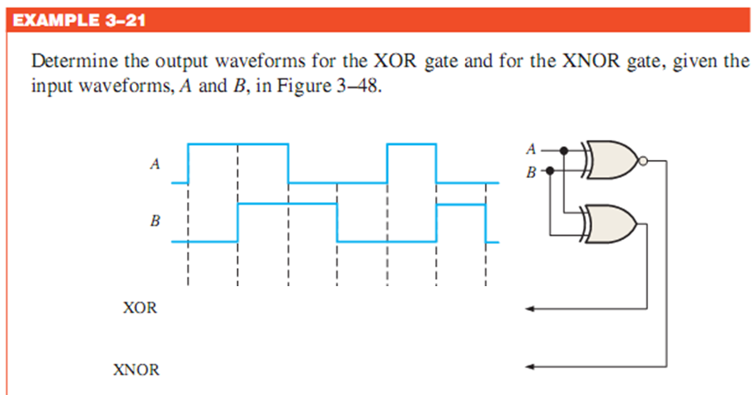
Engr.Hammad Munami

Slide 34
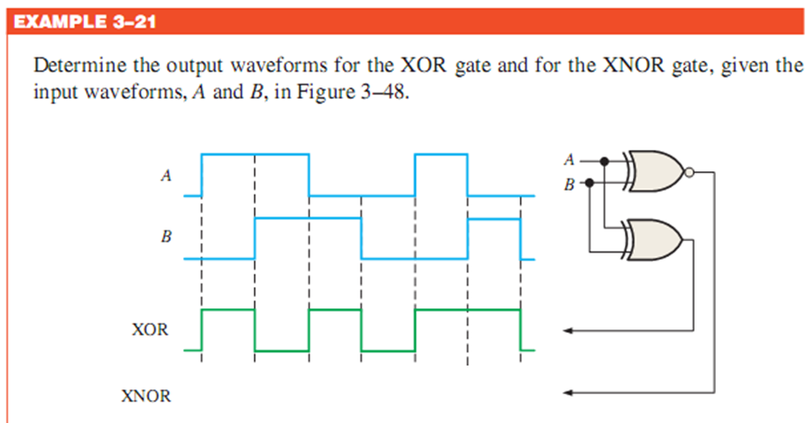
Engr.Hammad Munami

Slide 35
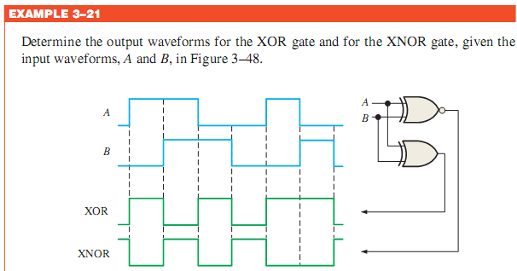
Engr.Hammad Munami

Slide 36

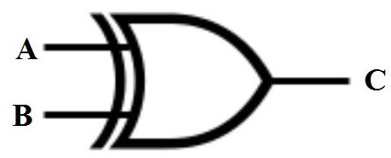


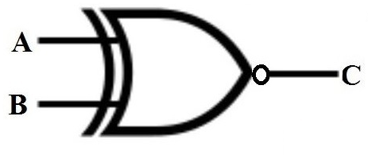

Logic Expression
Engr.Hammad Munami

Slide 37
Summary
What is Logic Gate?
“A logic gate is an idealized or physical electronic device implementing a logical operation performed on one or more binary (digital)inputs that produces a single binary (digital) output”
Engr.Hammad Munami

Slide 38
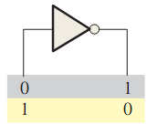
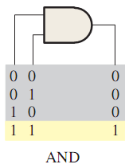
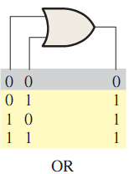
Summary
  The inverter (NOT gate) output is the complement of the input.
  The AND gate output is HIGH only when all the inputs are HIGH.
  The OR gate output is HIGH when any of the inputs is HIGH.
Engr.Hammad Munami

Slide 39
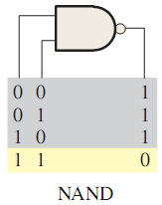
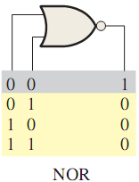
Summary
The NAND gate output is LOW only when all the inputs are HIGH.
The NOR gate output is LOW when any of the inputs is HIGH.
Engr.Hammad Munami

Slide 40
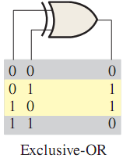
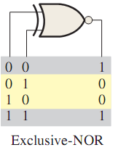
Summary
The Exclusive-OR gate output is HIGH when the inputs are not the same.
The Exclusive-NOR gate output is LOW when the inputs are not the same.
Engr.Hammad Munami

Slide 41
Review Questions (Logic Gates)
When a 1 is on the input of an inverter, what is the output?
When is the output of an AND gate HIGH?
When is the output of an AND gate LOW?
When is the output of an OR gate HIGH?
When is the output of an OR gate LOW?
Describe the operation of the inverter, the AND gate, and the OR gate.
When is the output of a NAND gate LOW?
When is the output of a NAND gate HIGH?
Engr.Hammad Munami

Slide 42
Review Questions (Logic Gates)
Describe the functional differences between a NAND gate and a negative-OR gate. Do they both have the same truth table?
Write the output expression for a NAND gate with inputs A, B, and C. When is the output of a NOR gate HIGH?
When is the output of a NOR gate LOW?
Describe the functional difference between a NOR gate and a negative-AND gate.
Do they both have the same truth table?
Engr.Hammad Munami

Slide 43
Review Questions (Logic Gates)
Write the output expression for a 3-input NOR with input variables A, B, and C.
Express the operation of NOT, AND, OR, NAND, and NOR gates with Boolean algebra.
When is the output of an XOR gate HIGH?
When is the output of an XNOR gate HIGH?
Engr.Hammad Munami

