Slide 1

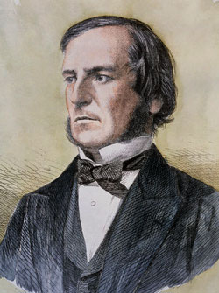
CS123 Digital Logic Design
LECTURE 05
Boolean Algebra
(Continues…)
Engr.Hammad Munami

Slide 2
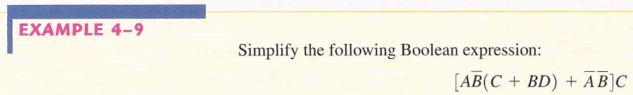
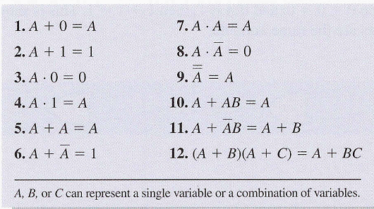
Expression Simplification
Engr.Hammad Munami

Slide 3
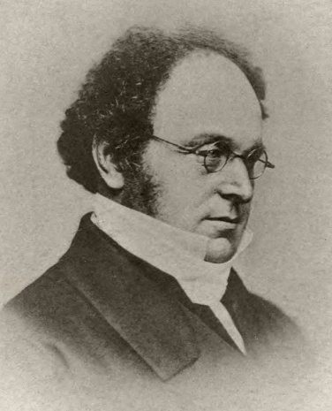
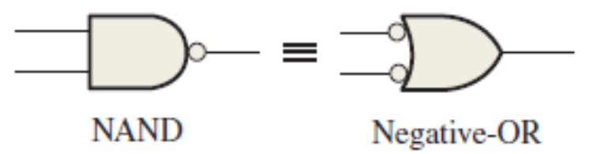
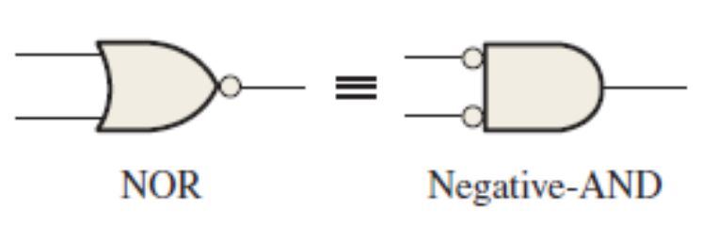
DeMorgan’s Theorems
DeMorgan, a mathematician who knew Boole, proposed two theorems that are an important part of Boolean algebra.
In practical terms, DeMorgan’s theorems provide mathematical verification of the equivalency of the NAND gate and negative-OR logic and the equivalency of the NOR gate and negative-AND logic.
Engr.Hammad Munami

Slide 4
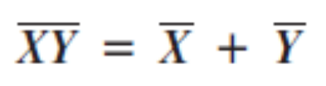
DeMorgan’s Theorems
DeMorgan’s first theorem is stated as follows:
“The complement of a product of variables is equal to the sum of the complements of the variables.”
Stated another way,
“The complement of two or more ANDed variables is equivalent to the OR of the complements of the individual variables.”
The formula for expressing this theorem for two variables is:
Engr.Hammad Munami

Slide 5
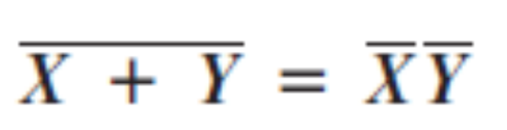
DeMorgan’s Theorems
DeMorgan’s second theorem is stated as follows:
“The complement of a sum of variables is equal to the product of the complements of the variables.”
Stated another way,
“The complement of two or more ORed variables is equivalent to the AND of the complements of the individual variables.”
The formula for expressing this theorem for two variables is:
Engr.Hammad Munami

Slide 6
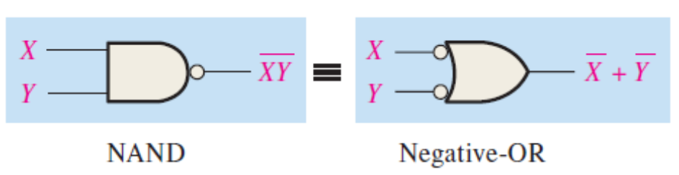
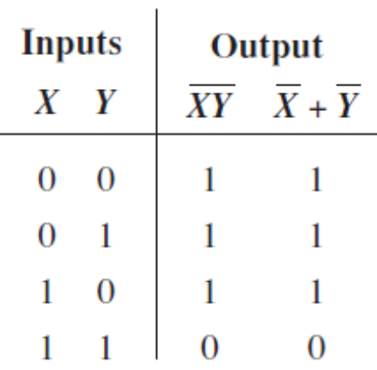
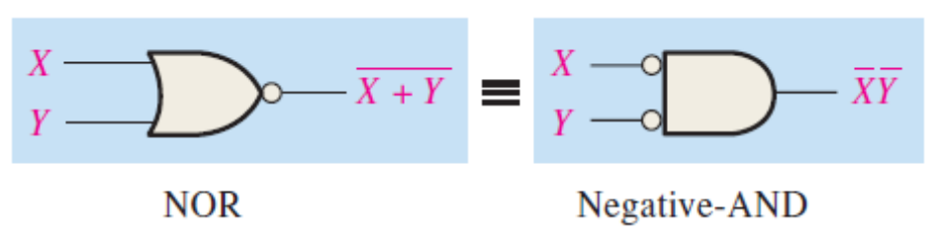
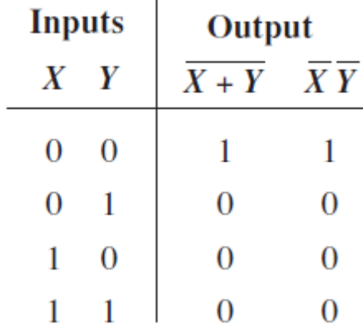
DeMorgan’s Theorems
Engr.Hammad Munami

Slide 7
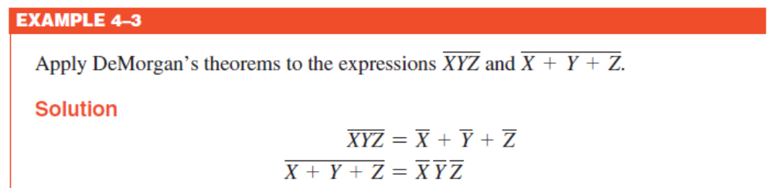
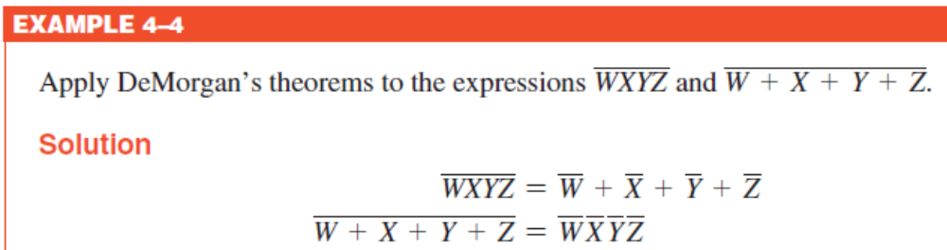
DeMorgan’s Theorems
Engr.Hammad Munami

Slide 8
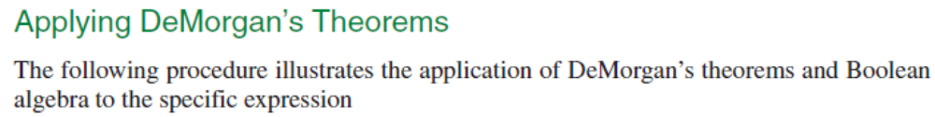
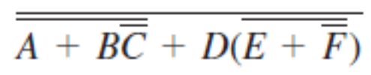
DeMorgan’s Theorems
Engr.Hammad Munami

Slide 9
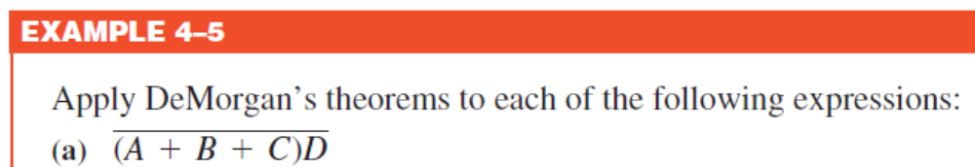





DeMorgan’s Theorems
Engr.Hammad Munami

Slide 10

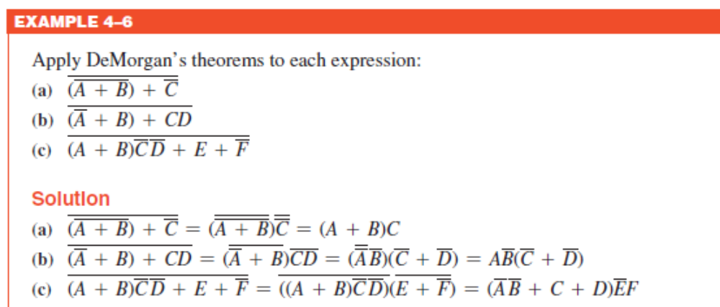
DIY
Engr.Hammad Munami

Slide 11
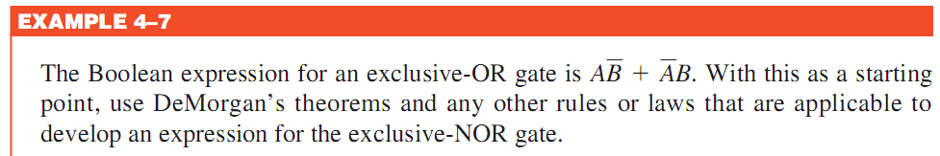
Engr.Hammad Munami

Slide 12
Engr.Hammad Munami

Slide 13
Engr.Hammad Munami

Slide 14
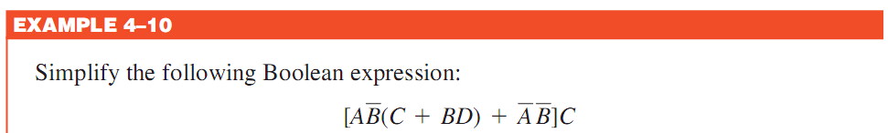

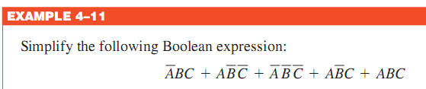

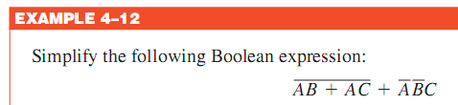

DIY
Engr.Hammad Munami

Slide 15
Standard Forms of Boolean Expressions
All Boolean expressions, regardless of their form, can be converted into either of two standard forms:
  the sum-of-products form (SOP) or
  the product-of-sums form (POS).
Engr.Hammad Munami

Slide 16
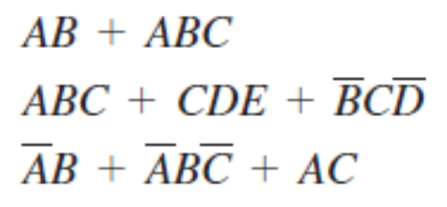


The Sum-of-Products (SOP) Form
When two or more product terms are summed by Boolean addition, the resulting expression is a sum-of-products (SOP).
An SOP expression can be implemented with one OR gate and two or more AND gates.
Some examples are:
In an SOP expression, a single overbar cannot extend over more than one variable; however, more than one variable in a term can have an overbar. For example, an SOP expression can have the term but not
Engr.Hammad Munami

Slide 17
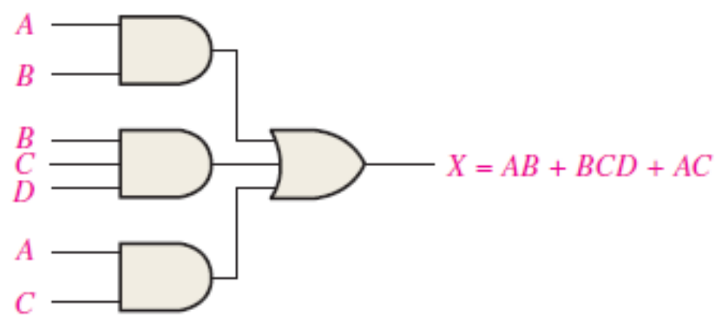
AND/OR Implementation of an SOP Expression
Implementing an SOP expression simply requires ORing the outputs of two or more AND gates.
A product term is produced by an AND operation, and the sum (addition) of two or more product terms is produced by an OR operation.
Therefore, an SOP expression can be implemented by AND-OR logic in which the outputs of a number (equal to the number of product terms in the expression) of AND gates connect to the inputs of an OR gate.
Engr.Hammad Munami

Slide 18
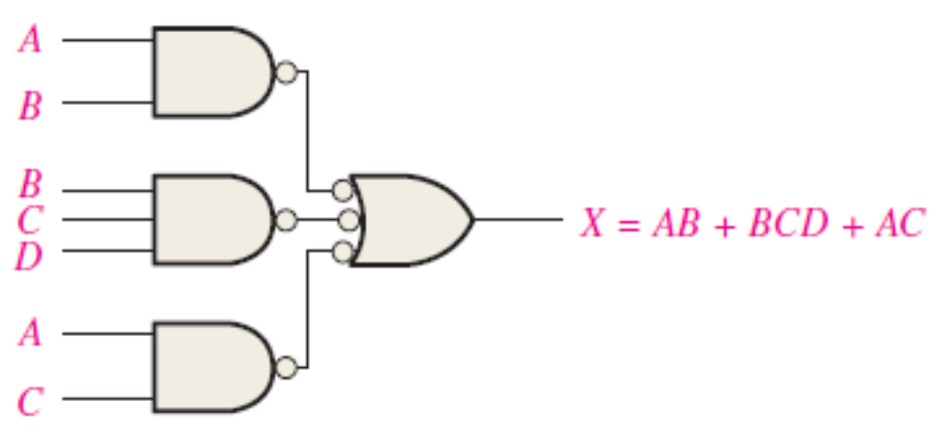
NAND/NAND Implementation of an SOP Expression
Engr.Hammad Munami

Slide 19
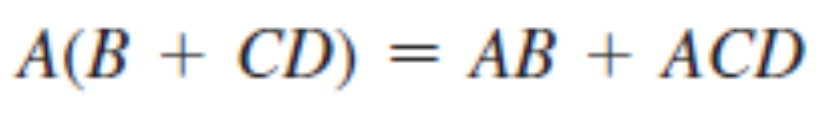
Conversion of a General Expression to SOP Form
Any logic expression can be changed into SOP form by applying Boolean algebra techniques.
For example, the expression A(B + CD) can be converted to SOP form by applying the distributive law:
Engr.Hammad Munami

Slide 20
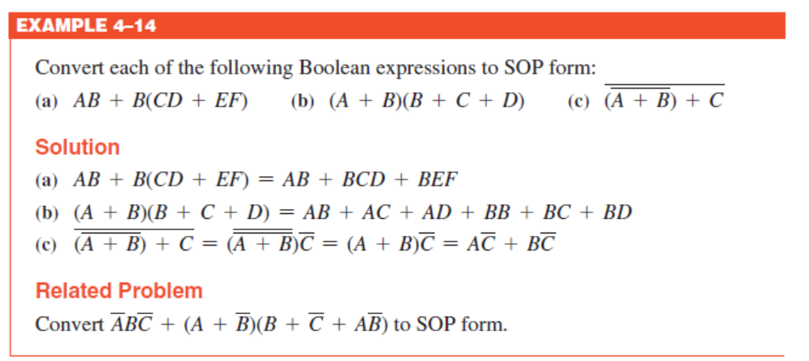
Conversion of a General Expression to SOP Form
Engr.Hammad Munami

Slide 21
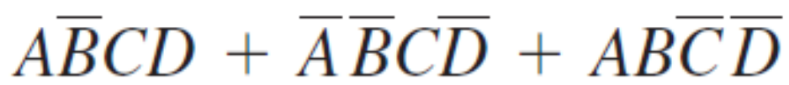
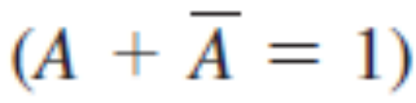
The Standard SOP Form
A standard SOP expression is one in which all the variables in the domain appear in each product term in the expression. For example:
Each product term in an SOP expression that does not contain all the variables in the domain can be expanded to standard form to include all variables in the domain and their complements.
As stated in the following steps, a nonstandard SOP expression is converted into standard form using Boolean algebra rule 6:
Engr.Hammad Munami

Slide 22
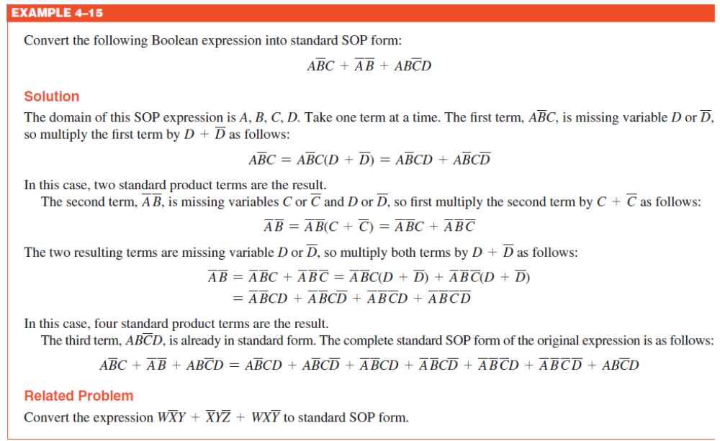
Engr.Hammad Munami

Slide 23
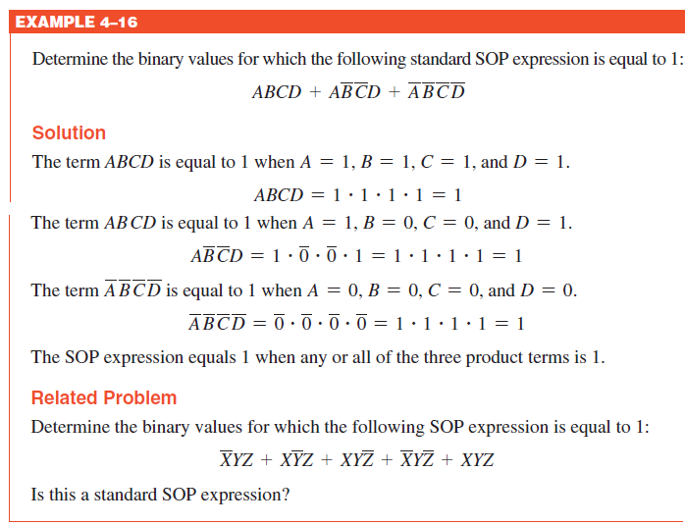
Binary Representation of a Standard Product Term
An SOP expression is equal to 1 only if one or more of the product terms in the expression is equal to 1.
Engr.Hammad Munami

Slide 24
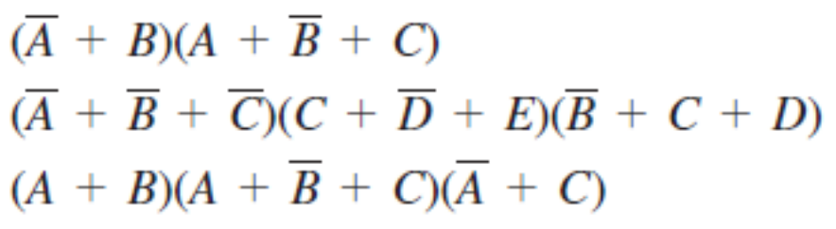

The Product-of-Sums (POS) Form
When two or more sum terms are multiplied, the resulting expression is a Product-of-Sums (POS).
Some examples are:
In a POS expression, a single overbar cannot extend over more than one variable; however, more than one variable in a term can have an overbar.
For example,
Engr.Hammad Munami

Slide 25
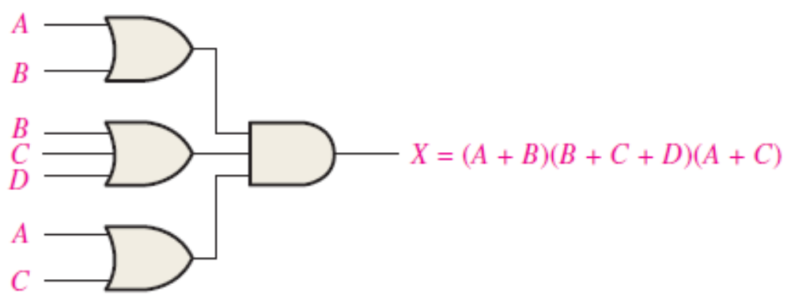
Implementation of a POS Expression
A POS expression can be implemented by logic in which the outputs of a number (equal to the number of sum terms in the expression) of OR gates connect to the inputs of an AND gate.
Engr.Hammad Munami

Slide 26
NOR/NOR Implementation of an POS Expression
F = (X+Z) (Y’+Z) (X’+Y+Z)
Being a POS expression, it is implemented in 2-levels as shown in the figure:
Engr.Hammad Munami

Slide 27

The Standard POS Form
A standard POS expression is one in which all the variables in the domain appear in each sum term in the expression.
For example,
Each sum term in a POS expression that does not contain all the variables in the domain can be expanded to standard form to include all variables in the domain and their complements.
A nonstandard POS expression is converted into standard form using Boolean algebra rule 8
Engr.Hammad Munami

Slide 28
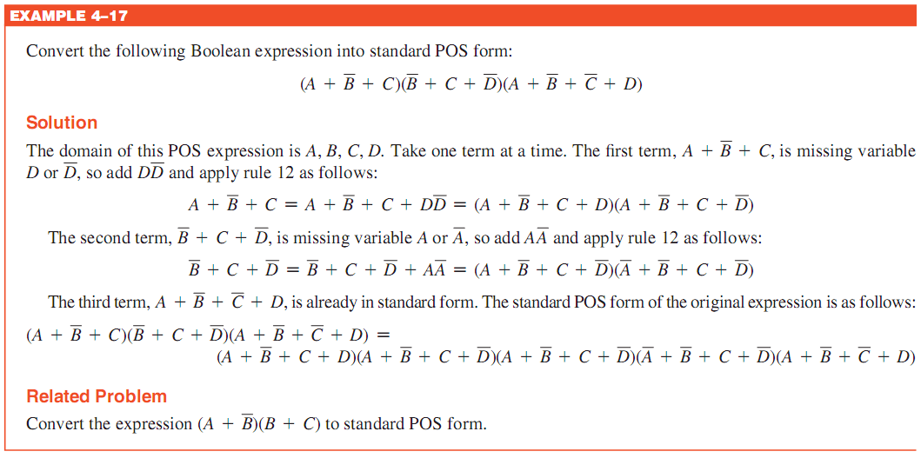
The Standard POS Form
Engr.Hammad Munami

Slide 29
Binary Representation of a Standard Sum Term
A POS expression is equal to 0 only if one or more of the sum terms in the expression is equal to 0.
Remember, a sum term is implemented with an OR gate whose output is 0 only if each of its inputs is 0.
Inverters are used to produce the complements of the variables as required.
For Example;
Engr.Hammad Munami

Slide 30
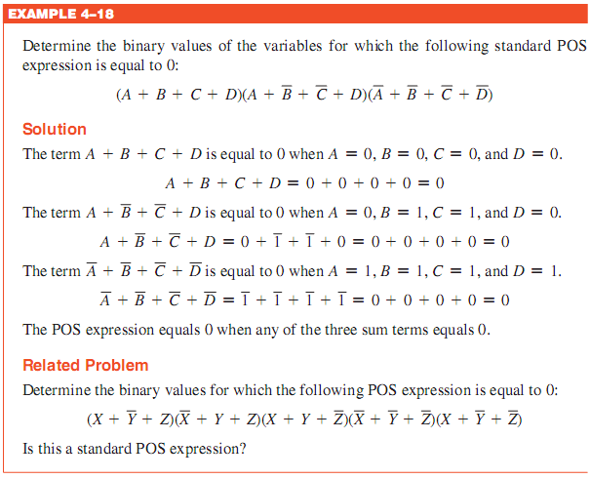
Engr.Hammad Munami

Slide 31
Converting Standard SOP to Standard POS
Step 1: Evaluate each product term in the SOP expression. That is, determine the binary numbers that represent the product terms.
Step 2: Determine all of the binary numbers not included in the evaluation in Step 1.
Step 3: Write the equivalent sum term for each binary number from Step 2 and express in POS form.
Using a similar procedure, you can go from POS to SOP.
Engr.Hammad Munami

Slide 32
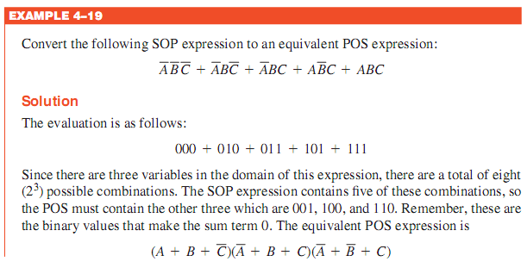

Engr.Hammad Munami

Slide 33
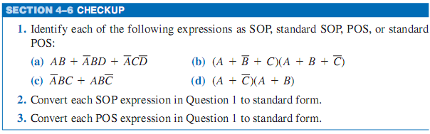
DIY
Engr.Hammad Munami

Slide 34
Converting SOP Expressions to Truth Table Format
A SOP expression is equal to 1 only if at least one of the product terms is equal to 1.
A truth table is simply a list of the possible combinations of input variable values and the corresponding output values (1 or 0).
The first step in constructing a truth table is to list all possible combinations of binary values of the variables in the expression.
Place a 1 in the output column (X) for each binary value that makes the standard SOP expression a 1 and place a 0 for all the remaining binary values.
Engr.Hammad Munami

Slide 35
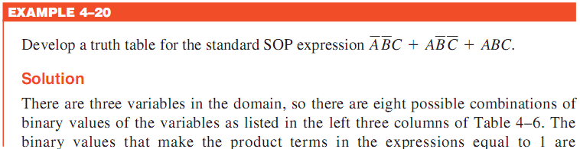
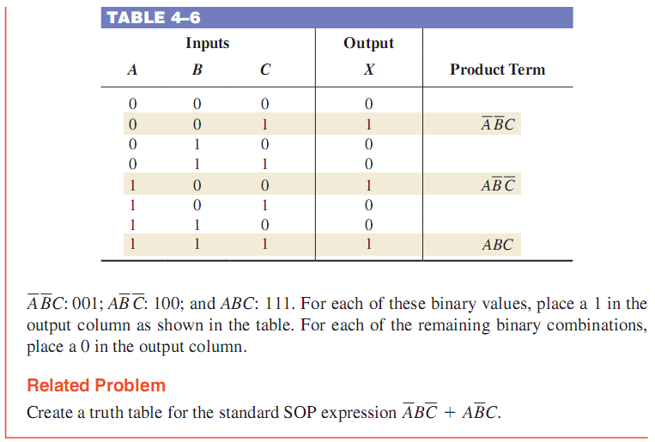
Converting SOP Expressions to Truth Table Format
Engr.Hammad Munami

Slide 36
Converting POS Expressions to Truth Table Format
A POS expression is equal to 0 only if at least one of the sum terms is equal to 0.
To construct a truth table from a POS expression, list all the possible combinations of binary values of the variables just as was done for the SOP expression.
Finally, place a 0 in the output column (X) for each binary value that makes the expression a 0 and place a 1 for all the remaining binary values.
Engr.Hammad Munami

Slide 37
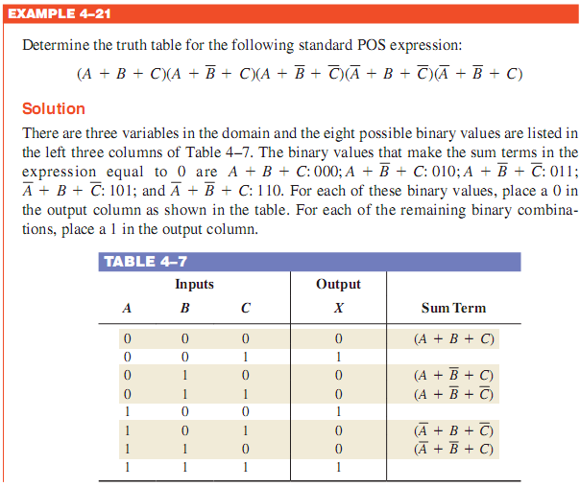
Converting POS Expressions to Truth Table Format
Engr.Hammad Munami

Slide 38
Determining Standard Expressions from a Truth Table
To determine the standard SOP expression represented by a truth table,
list the binary values of the input variables for which the output is 1.
Convert each binary value to the corresponding product term by replacing each 1 with the corresponding variable and each 0 with the corresponding variable complement.
Engr.Hammad Munami

Slide 39
Determining Standard Expressions from a Truth Table
To determine the standard POS expression represented by a truth table,
list the binary values for which the output is 0.
Convert each binary value to the corresponding sum term by replacing each 1 with the corresponding variable complement and each 0 with the corresponding variable.
Engr.Hammad Munami

Slide 40
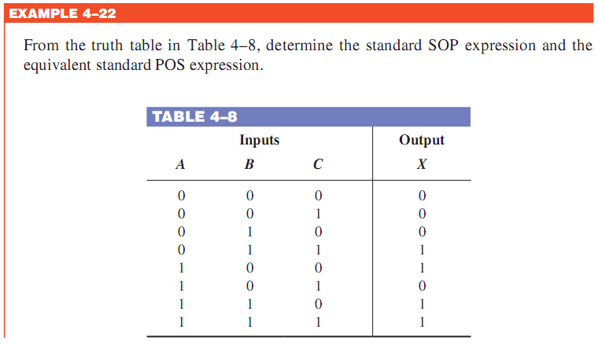
Engr.Hammad Munami

Slide 41
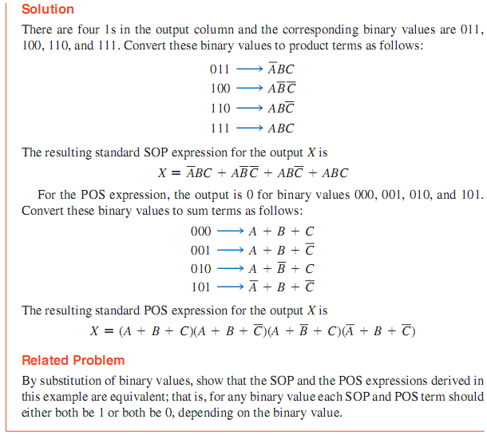
Engr.Hammad Munami

Slide 42
DIY
If a certain Boolean expression has a domain of five variables, how many binary values will be in its truth table?
In a certain truth table, the output is a 1 for the binary value 0110. Convert this binary value to the corresponding product term using variables W, X, Y, and Z.
In a certain truth table, the output is a 0 for the binary value 1100. Convert this binary value to the corresponding sum term using variables W, X, Y, and Z.
Engr.Hammad Munami

