Slide 1

Beginner's Tutorial
Engr. M. Asad Hussain

Slide 2
The Guide To Being A Logisim User
Educational tool for designing and simulating digital circuits.
Simple interface facilitate learning the most basic concepts.
Capacity to build larger circuits from smaller subcircuits.
Drag and drop of wires and components.
Designing and simulation of entire CPUs.
Used majorly across colleges and universities around the world.

Slide 3
Introduction
Welcome to Logisim!
Logisim allows you to design and simulate digital circuits.
It is intended as an educational tool, to help you learn how circuits work.
To practice using Logisim, let's build a XOR circuit - that is, a circuit that takes two inputs (which we'll call x and y) and outputs 0 if the inputs are the same and 1 if they are different.

Slide 4
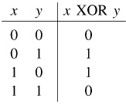
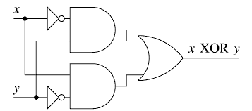
Introduction
The following truth table illustrates.
We might design such a circuit on paper.

Slide 5
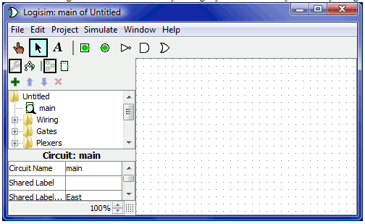
Step 0: Orienting Yourself
When you start Logisim, you'll see a window similar to the following.

Slide 6
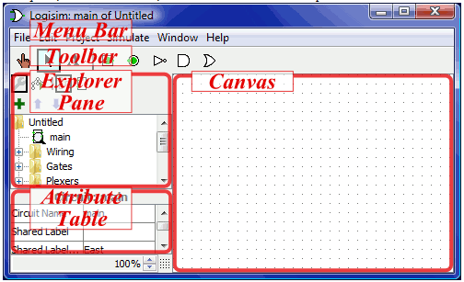
Step 0: Orienting Yourself
All Logisim is divided into three parts, called the explorer pane, the attribute table, and the canvas. Above these parts are the menu bar and the toolbar.

Slide 7
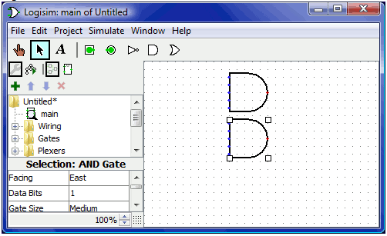
Step 1: Adding Gates

Slide 8
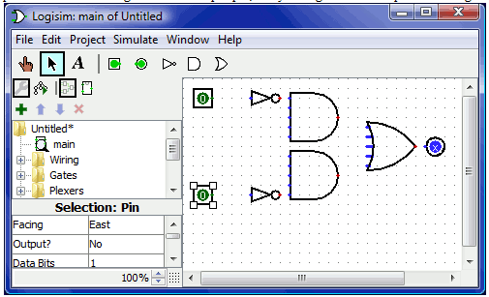
Step 1: Adding Gates

Slide 9
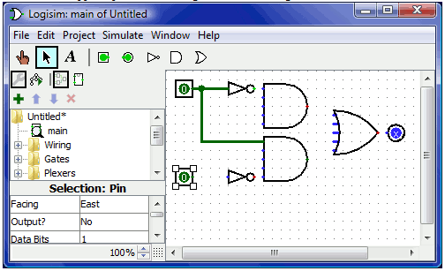
Step 2: Adding wires

Slide 10
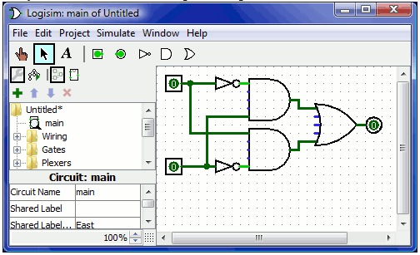
Step 2: Adding wires

Slide 11
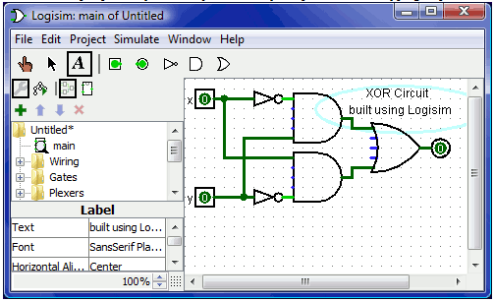
Step 3: Adding text

Slide 12
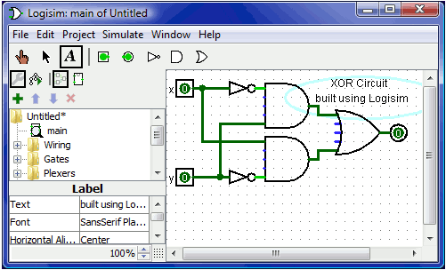
Step 4: Testing your circuit

Slide 13
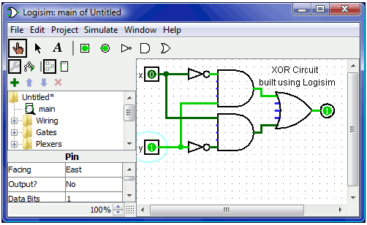
Step 4: Testing your circuit

