Slide 1

Digital Fundamentals
Tenth Edition
Floyd
Chapter 9

Slide 2
Outline
9-1 Basic Shift Register Operations
9-2 Serial In/Serial Out Shift Registers
9-3 Parallel In/Serial Out Shift Registers
9-4 Bidirectional Shift Registers
9-5 Shift Register Counters
9-6 Shift Register Applications

Slide 3
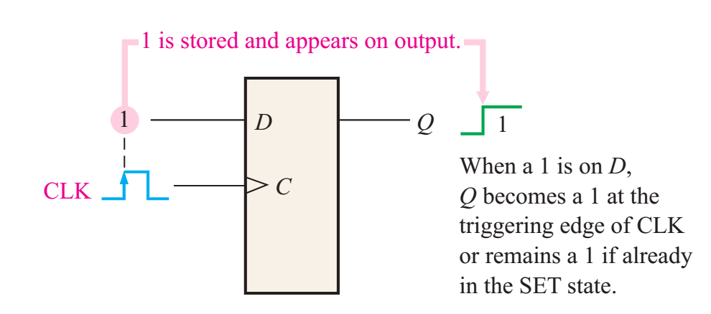
Register: Storage Capacity
Each stage (flip-flop) in a shift register represents one bit of storage capacity; therefore, the number of stages in a register determines its storage capacity.

Slide 4
Register: Shift Capability
permits the movement of data from stage to stage within the register or into or out of the register upon application of clock pulses
Basic Shift Register Operations
Data in
Data in
Data out
Data out
Data in
Data out
Serial in/shift right/serial out
Serial in/shift left/serial out
Parallel in/serial out
Data in
Data in
Data out
Data out
Serial in/parallel out
Parallel in/parallel out
Rotate right
Rotate left

Slide 5
Outline
9-1 Basic Shift Register Operations
9-2 Serial In/Serial Out Shift Registers
9-3 Parallel In/Serial Out Shift Registers
9-4 Bidirectional Shift Registers
9-5 Shift Register Counters
9-6 Shift Register Applications

Slide 6
Serial-in/Serial out Shift Register
Shift registers are available in IC form or can be constructed from discrete flip-flops
Each clock pulse will move an input bit to the next flip-flop.
1
1
1
1
1
1
CLK
CLK
CLK
CLK
CLK

Slide 7
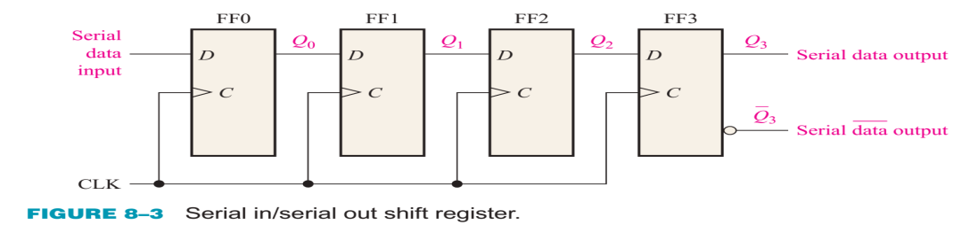
Serial-in/Serial out Shift Register

Slide 8
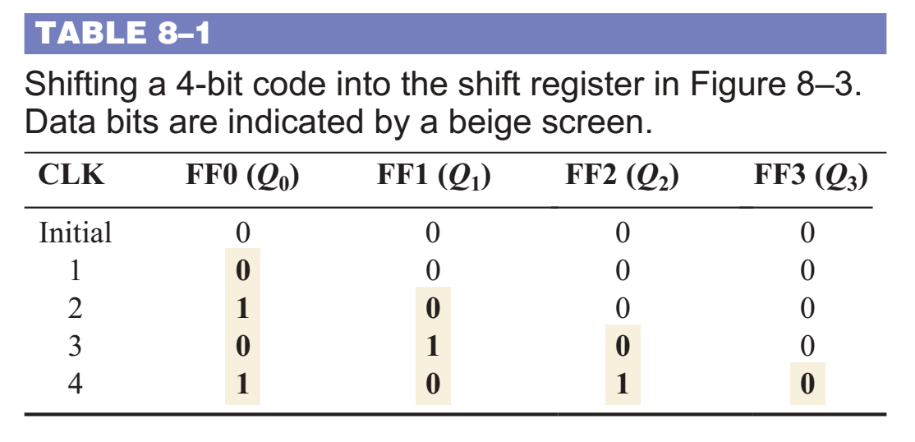
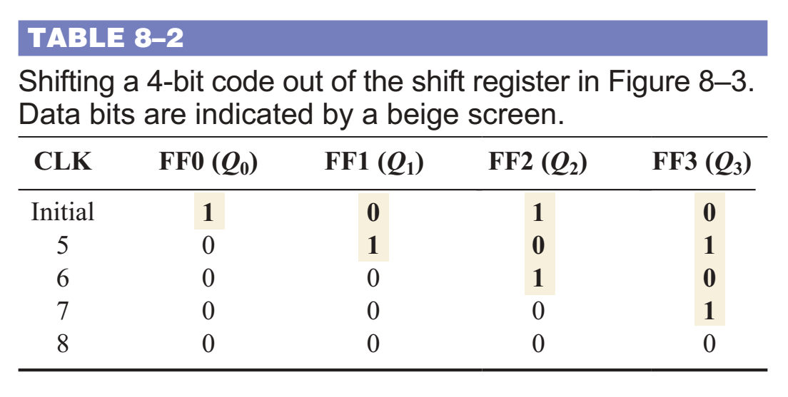
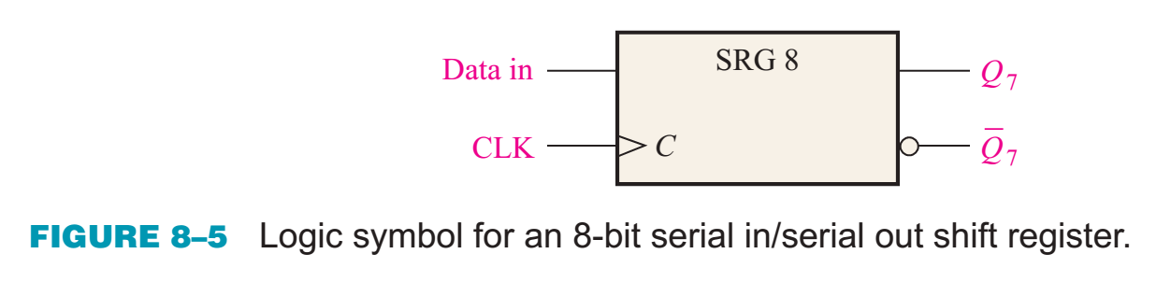
Serial-in/Serial out Shift Register

Slide 9
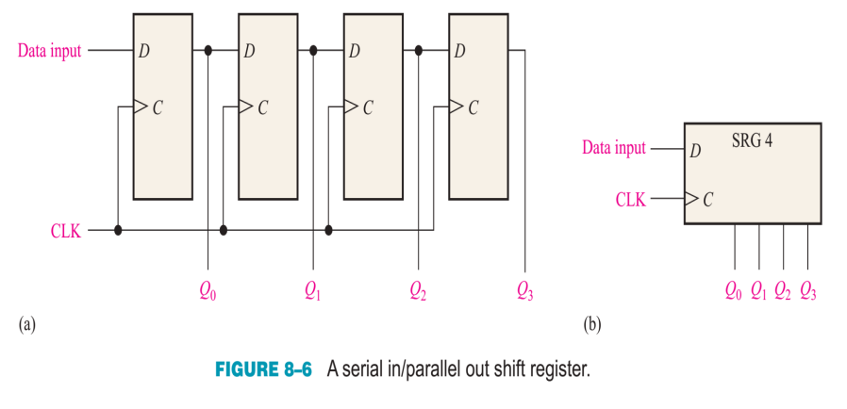
Serial-in/Parallel out Shift Register

Slide 10
A Basic Application of SISO -> to Form SIPO
For example, assume the binary number 1011 is loaded sequentially, one bit at each clock pulse.
After 4 clock pulses, the data is available at the parallel output.
CLK
CLK
CLK
CLK

Slide 11
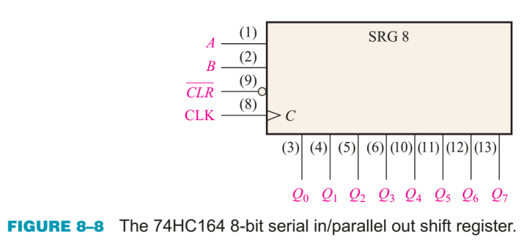
The 74HC164A Shift Register
The 74HC164A is a CMOS 8-bit serial in/parallel out shift register.
CLR
CLK
Serial inputs
A
B
Q₀
Q₁
Q₂
Q₃
Q₄
Q₅
Q₆
Q₇

Slide 12
Waveforms for the 74HC164A
B acts as an active HIGH enable for the data on A.
CLR
A
Serial inputs
B
CLK
Q₀
Q₁
Q₂
Q₃
Outputs
Q₄
Q₅
Q₆
Q₇
Clear
Clear

Slide 13
Outline
9-1 Basic Shift Register Operations
9-2 Serial In/Serial Out Shift Registers
9-3 Parallel In/Serial Out Shift Registers
9-4 Bidirectional Shift Registers
9-5 Shift Register Counters
9-6 Shift Register Applications

Slide 14
Parallel in/Serial out Shift Register
Shift registers can be used to convert parallel data to serial form.
Load: G1-G4; Shift: G5-G7
D₀
D₁
D₂
D₃
SHIFT/LOAD
Serial data out
Q₀
Q₁
Q₂
Q₃
CLK

Slide 15
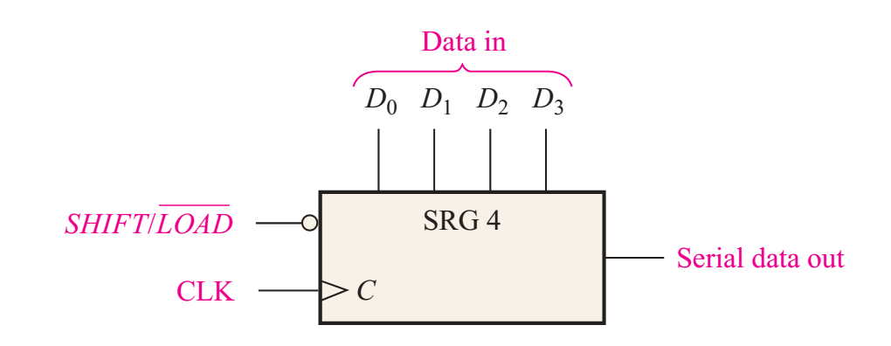
Parallel in/Serial out Shift Register
Shift registers can be used to convert parallel data to serial form.
Load: G1-G4; Shift: G5-G7

Slide 16
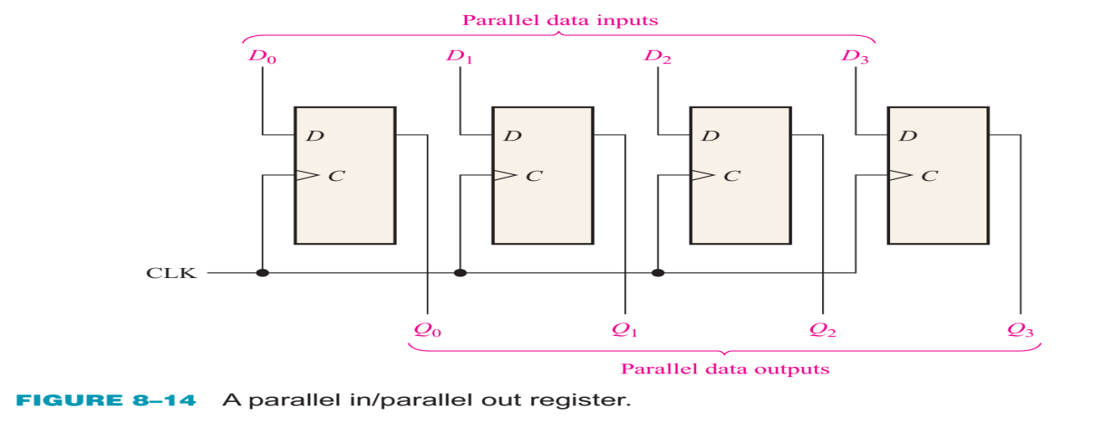
Parallel in/ Parallel out Shift Register
Shift registers can be used to convert parallel data to serial form.
Load: G1-G4; Shift: G5-G7

Slide 17
Outline
9-1 Basic Shift Register Operations
9-2 Serial In/Serial Out Shift Registers
9-3 Parallel In/Serial Out Shift Registers
9-4 Bidirectional Shift Registers
9-5 Shift Register Counters
9-6 Shift Register Applications

Slide 18
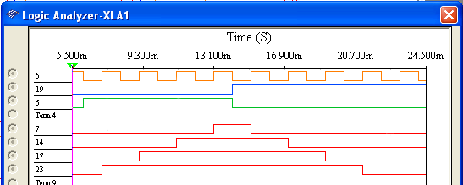
Bidirectional Shift Register
Bidirectional shift registers can shift the data in either direction using a RIGHT/LEFT input.
The logic analyzer simulation waveform
CLK
RIGHT/LEFT
Shift left
Shift right
Serial data in
Q₀
Q₁
Q₂
Q₃

Slide 19
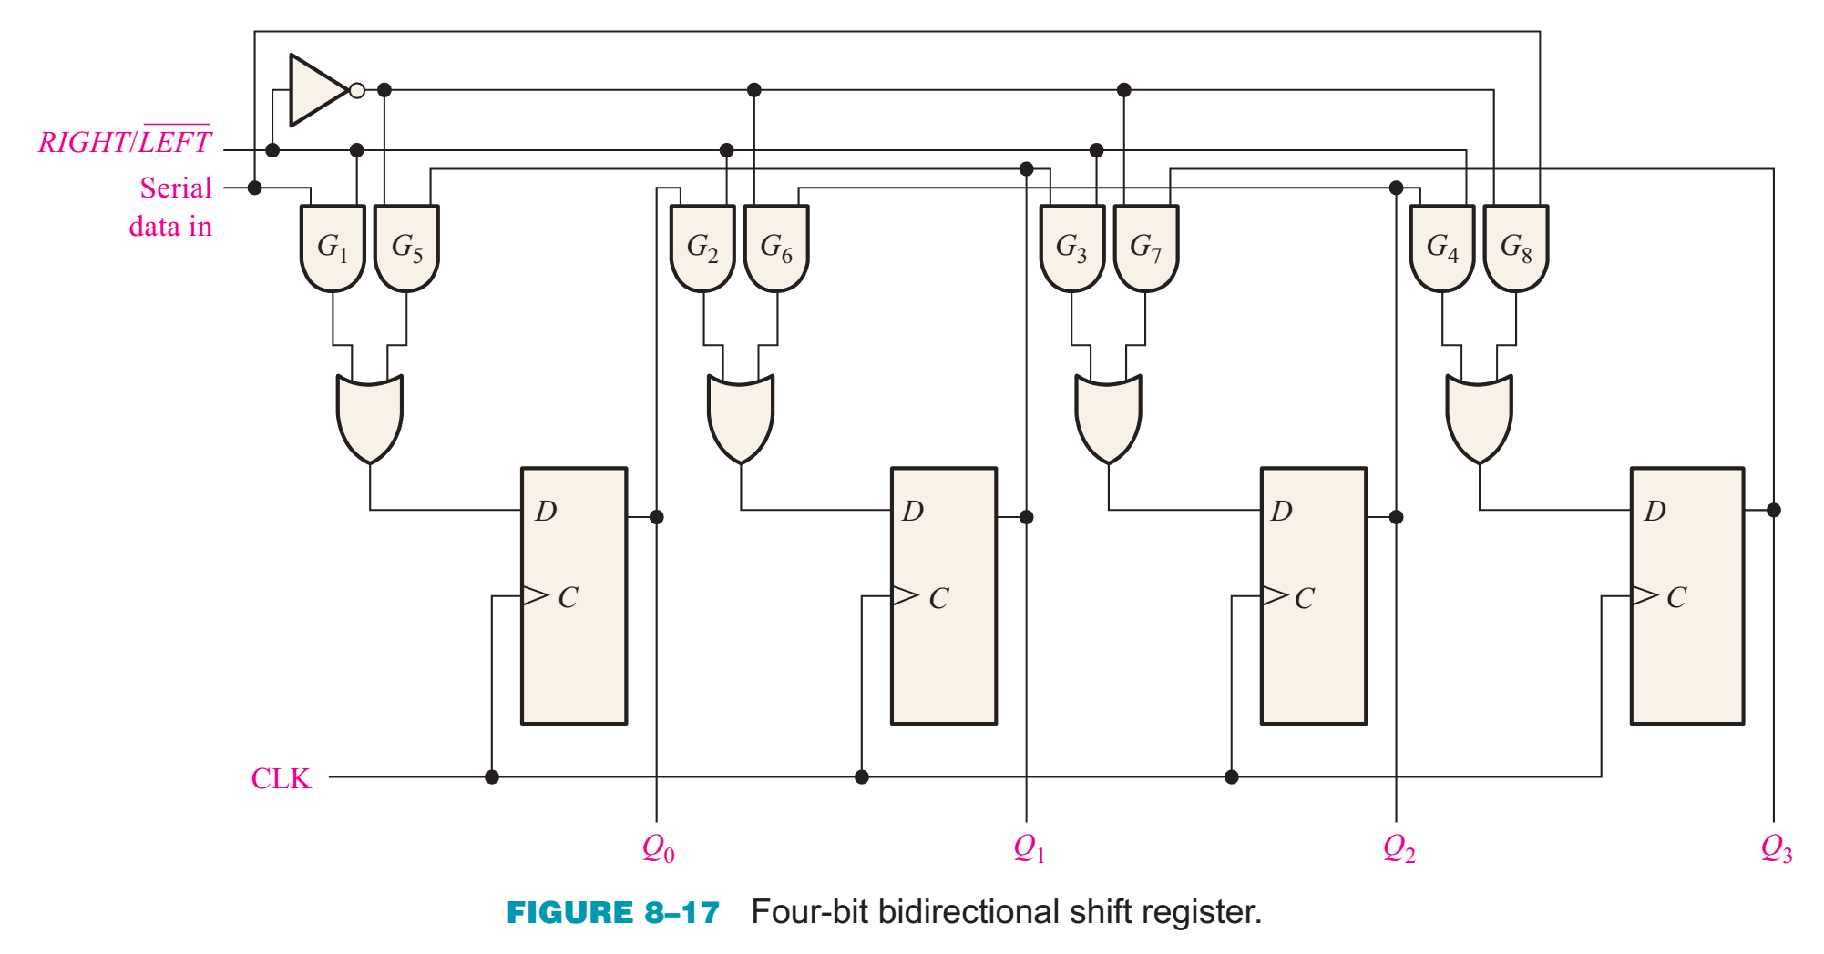
Bidirectional Shift Register
Bidirectional shift registers can shift the data in either direction using a RIGHT/LEFT input.

Slide 20
Bidirectional Shift Register
When the R/L control input is HIGH, G1-G4 are enabled When the R/L control input is LOW, G5-G8 are enabled

Slide 21
Universal Shift Register
has both serial and parallel input and output capability.
- Parallel loading: HIGH to the S0 and S1;
- Shift right: when S0 is HIGH and S1 is LOW. - Shift left: when S1 is HIGH and S0 is LOW.
D₀
D₁
D₂
D₃
CLR
Mode Control
S₀
S₁
74HC194
SL SER: Shift left serial input
SR SER: Shift right serial input
SR SER
SL SER
CLK
Q₀
Q₁
Q₂
Q₃

Slide 22
Universal Shift Register

Slide 23
Outline
9-1 Basic Shift Register Operations
9-2 Serial In/Serial Out Shift Registers
9-3 Parallel In/Serial Out Shift Registers
9-4 Bidirectional Shift Registers
9-5 Shift Register Counters
9-6 Shift Register Applications

Slide 24
Shift Register Counters
Shift registers can form useful counters by recirculating a pattern of 0’s and 1’s.
Two important shift register counters are the Johnson counter and the ring counter.

Slide 25
Johnson Counter
The Johnson counter is useful when you need a sequence that changes by only one bit at a time but it has a limited number of states (2n, where n = number of stages).
The first five counts for a 4-bit Johnson counter that is initially cleared are: CLK Q₀ Q₁ Q₂ Q₃
0
1
2
3
4
5
6
7
0 0 0 0
1 0 0 0
1 1 0 0
1 1 1 0
1 1 1 1
0 1 1 1
0 0 1 1
0 0 0 1

Slide 26
Shift Register Counters
The Johnson counter can be made with a series of D flip-flops
… or with a series of J-K flip flops. Here Q₃ and Q₃ are fed back to the J and K inputs with a “twist”.

Slide 27
Johnson Counter
Redrawing the same Johnson counter (without the clock shown) illustrates why it is sometimes called as a “twisted-ring” counter.
“twist”

Slide 28
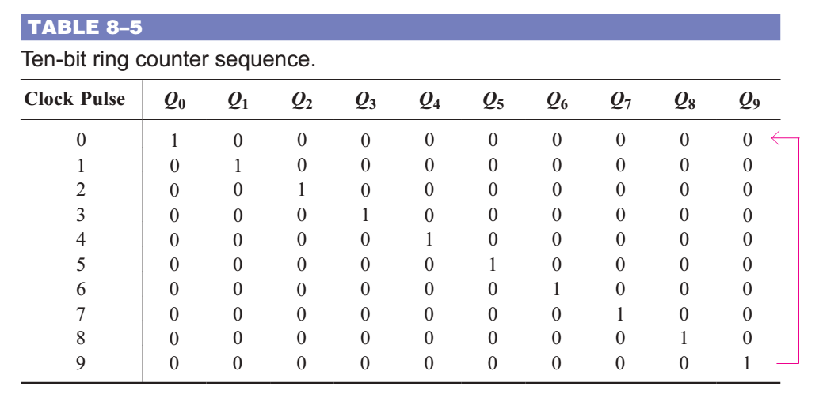
Ring Counter
utilizes one flip-flop for each state in its sequence. It has the advantage that decoding gates are not required

Slide 29
Ring Counter
The ring counter can also be implemented with either D flip-flops or J-K flip-flops.
4-bit ring counter constructed from D flip-flops.
implemented with J-K flip flops.

Slide 30
Ring Counter
Redrawing the Ring counter (without the clock shown) shows why it is a “ring”.
Disadvantage:
- must be preloaded with the desired pattern (usually a single 0 or 1)
- has even fewer states than a Johnson counter (n, where n = number of flip-flops.
Advantage:
being self-decoding with a unique output for each state.

Slide 31
Ring Counter
A common pattern for a ring counter is to load it with a single 1 or a single 0. The waveforms shown here are for an 8-bit ring counter with a single 1.

Slide 32
Outline
9-1 Basic Shift Register Operations
9-2 Serial In/Serial Out Shift Registers
9-3 Parallel In/Serial Out Shift Registers
9-4 Bidirectional Shift Registers
9-5 Shift Register Counters
9-6 Shift Register Applications

Slide 33
Shift Register Applications
- Time Delay
- Serial-to-Parallel Data Converter
- Universal Asynchronous Receiver Transmitter
- Keyboard Encoder

Slide 34
Shift Register Applications – Time Delay
can be used to delay a digital signal by a predetermined amount.
Example
An 8-bit serial in/serial out shift register has a 40 MHz clock. What is the total delay through the register?
Solution
The delay for each clock is 1/40 MHz = 25 ns
25 ns
The total delay is 8 x 25 ns = 200 ns
= 200 ns

Slide 35
Key Terms
Register
Stage
Shift
Load
Bidirectional
One or more flip-flops used to store and shift data.
One storage element in a register.
To move binary data from stage to stage within a shift register or other storage device or to move binary data into or out of the device.
To enter data in a shift register.
Having two directions. In a bidirectional shift register, the stored data can be shifted right or left.

Slide 36

Quiz
1. The shift register that would be used to delay serial data by
4 clock periods is
a. c.
b. d.

Slide 37
Quiz
2. The circuit shown is a
a. serial-in/serial-out shift register
b. serial-in/parallel-out shift register
c. parallel-in/serial-out shift register
d. parallel-in/parallel-out shift register

Slide 38
Quiz
3. If the SHIFT/LOAD line is HIGH, data
a. is loaded from D₀, D₁, D₂ and D₃ immediately
b. is loaded from D₀, D₁, D₂ and D₃ on the next CLK
c. shifted from left to right on the next CLK
d. shifted from right to left on the next CLK

Slide 39
Quiz
4. A 4-bit parallel-in/parallel-out shift register will store data for
a. 1 clock period
b. 2 clock periods
c. 3 clock periods
d. 4 clock periods

Slide 40
Quiz
5. The 74HC164 (shown) has two serial inputs. If data is placed on the A input, the B input
a. could serve as an active LOW enable
b. could serve as an active HIGH enable
c. should be connected to ground
d. should be left open
CLR
CLK
Serial inputs
A
B
Q₀
Q₁
Q₂
Q₃
Q₄
Q₅
Q₆
Q₇

Slide 41
Quiz
6. An advantage of a ring counter over a Johnson counter is that the ring counter
a. has more possible states for a given number of flip-flops
b. is cleared after each cycle
c. allows only one bit to change at a time
d. is self-decoding

Slide 42
Quiz
7. A possible sequence for a 4-bit ring counter is
a. … 1111, 1110, 1101 …
b. … 0000, 0001, 0010 …
c. … 0001, 0011, 0111 …
d. … 1000, 0100, 0010 …

Slide 43
Quiz
8. The circuit shown is a
a. serial-in/parallel-out shift register
b. serial-in/serial-out shift register
c. ring counter
d. Johnson counter

Slide 44
Quiz
9. Assume serial data is applied to the 8-bit shift register
shown. The clock frequency is 20 MHz. The first data bit
will show up at the output in
a. 50 ns
b. 200 ns
c. 400 ns
d. 800 ns

Slide 45
Quiz
Answers:
1. a
2. c
3. c
4. a
5. b
6. d
7. d
8. d
9. c

