Slide 1
BTAJI CREW · SESSION FIVE
SESSION
Running Your
First Experiment
05
From your plan to real results.
Five
HOSTED BY Muhammad Ibrahim Qasmi & Zulqarnain Ali
Free · Urdu · Beginner friendly
BASELINE → IMPROVE → MEASURE → FILL PAPER → YOUR TURN

Slide 2
RECAP
Where we have been
▪ Session 1: what research is, and how to read a paper.
▪ Session 2: find a gap, and write one clear research question.
▪ Session 3: prove the gap is real with a full search of the field.
▪ Session 4: plan the paper and the experiment.
▪ Today: turn the machine on and get real numbers.
BTAJI CREW · SESSION 05
2 / 22

Slide 3
TODAY
Three acts: fail, win, fill
▪ Act 1: the simple baseline fails, worse than noise.
▪ Act 2: the neural method wins, a big jump.
▪ Act 3: the real numbers fill the empty paper tables.
WHY THIS MATTERS
This is the arc of every project: a weak baseline, then improve, then measure, then write it up.
BTAJI CREW · SESSION 05
3 / 22

Slide 4
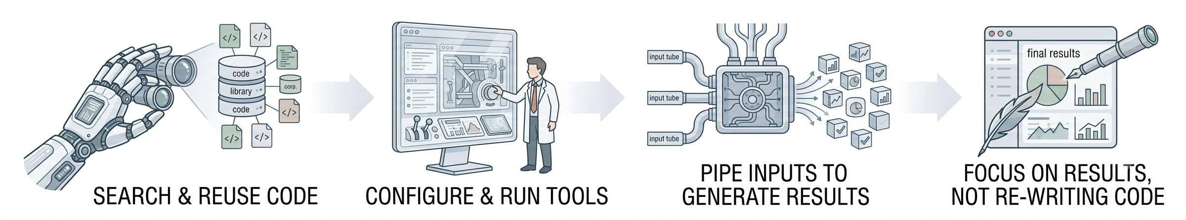
MYTH 1
You must write every line yourself
▪ Research is not about reinventing the tools.
▪ It is about asking a new question and using the right tools to answer it.
▪ Today we run code from the challenge winners. We read the results, not every line.
THE TRUTH
The best researchers did not write PyTorch. They used it. So can you.
BTAJI CREW · SESSION 05
4 / 22

Slide 5
PART
1
The baseline
Start simple, and let it fail honestly.
BTAJI CREW · SESSION 05
5 / 22

Slide 6
FROM SESSION 4
The plan we are running
▪ Baseline: the classical top-down sweep.
▪ Data: 977 ECGs, 9 damage types.
▪ Metric: SNR in dB, higher is better.
▪ Win: hold up for each type of damage.
THE DISCIPLINE
We run what we planned. No last minute changes. The data tells us what happened.
BTAJI CREW · SESSION 05
6 / 22

Slide 7
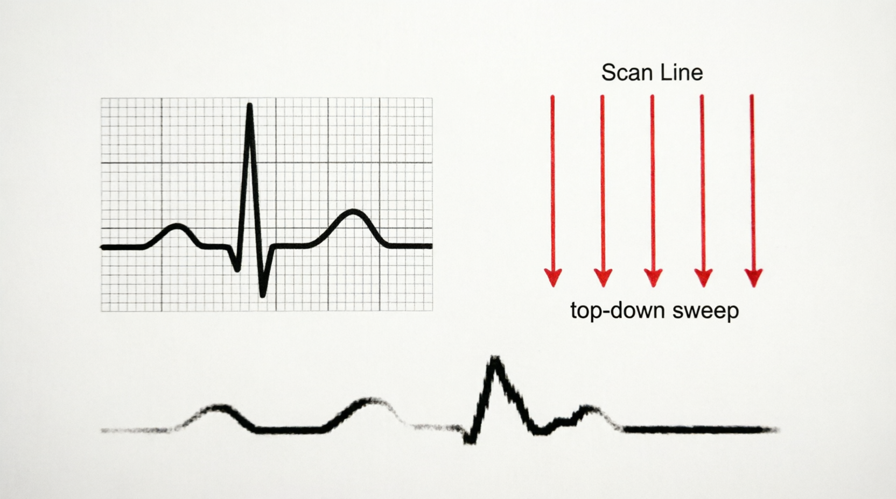
EXPERIMENT 1
The baseline setup
▶ Jump to code — Notebook 1 · Setup cells
▪ Classical image processing. No neural nets, no GPU.
▪ Convert to black and white, scan column by column, trace the line.
▪ We need a before picture to measure any improvement against.
BTAJI CREW · SESSION 05
7 / 22

Slide 8
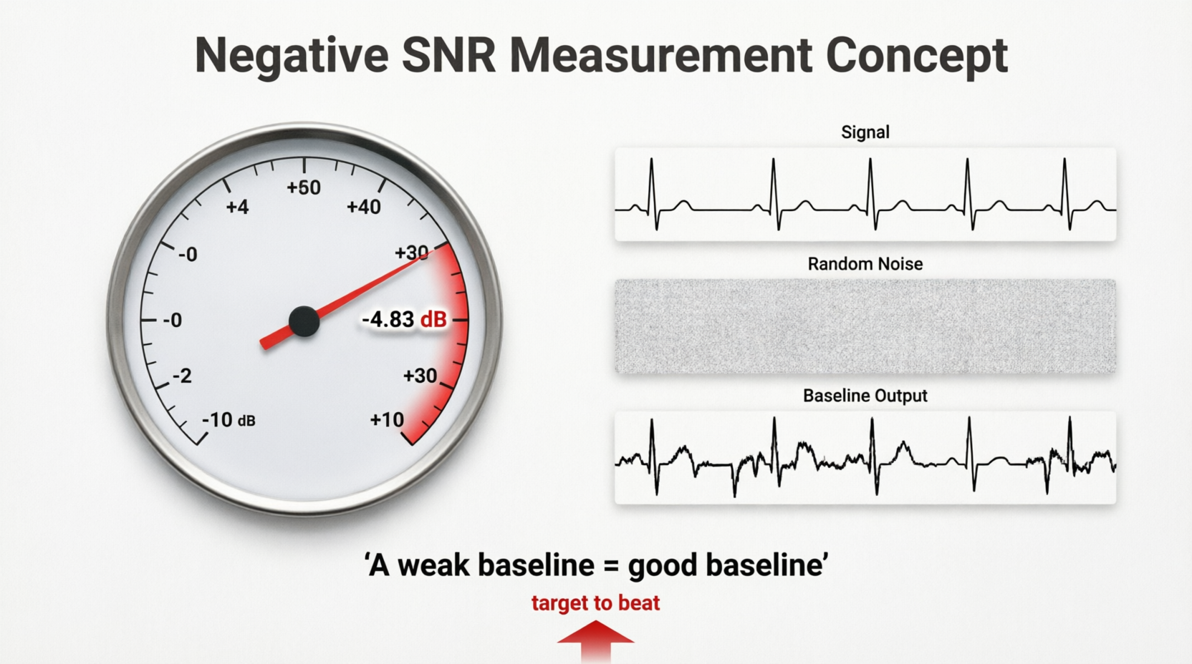
THE RESULT
The baseline fails, on purpose
▶ Jump to code — Notebook 1 · Section 6.2
▪ Overall SNR is negative 4.83 dB. Every damage type is negative.
▪ Negative means the output is worse than random noise.
▪ A weak baseline is a good baseline. Now we have a target to beat.
BTAJI CREW · SESSION 05
8 / 22

Slide 9
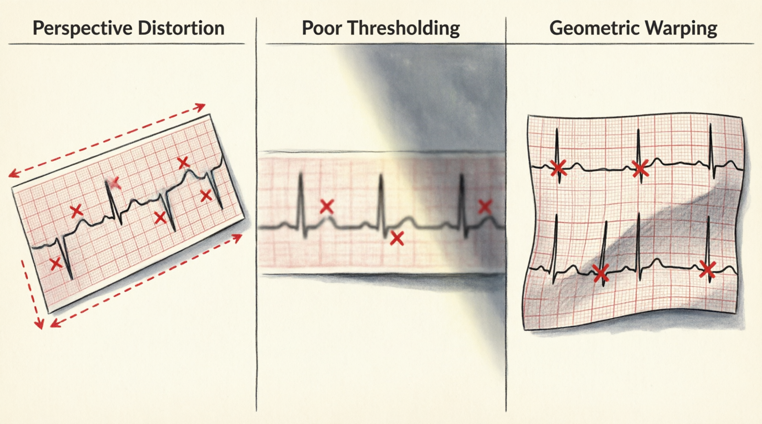
THE DIAGNOSIS
Why the baseline fails
✕ No perspective correction, so tilted photos break it.
✕ No grid rectification, it assumes one fixed layout.
✕ Naive thresholding dies on uneven light and stains.
✓ Each clue tells us exactly what a better method must do.
BTAJI CREW · SESSION 05
9 / 22

Slide 10
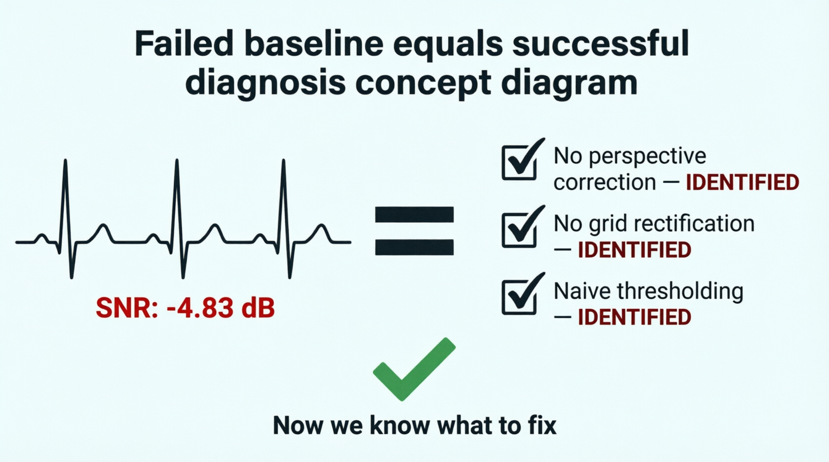
MYTH 2
A negative number means my code is broken
▪ Usually, the code is fine. The method is just not enough yet.
▪ The code ran, and it produced a number. That number tells you something.
▪ A failed baseline is a successful diagnosis.
BTAJI CREW · SESSION 05
10 / 22

Slide 11
PART
2
The climb
One honest change at a time, measured the same way.
BTAJI CREW · SESSION 05
11 / 22

Slide 12
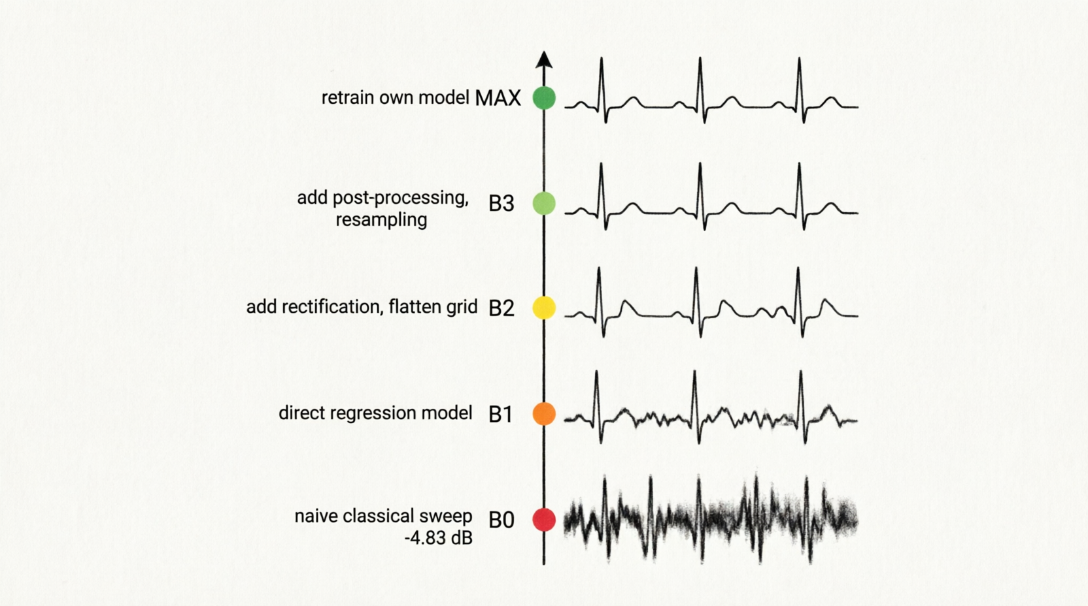
THE CLIMB
The baseline ladder
▪ B0 naive classical sweep, negative 4.83 dB, the motivation.
▪ B1 direct regression, a model reads the image, first positive.
▪ B2 add rectification, flatten the grid first, a big jump.
▪ B3 add post-processing, resampling and lead correction.
▪ MAX retrain our own model, versus the pretrained one.
BTAJI CREW · SESSION 05
12 / 22

Slide 13
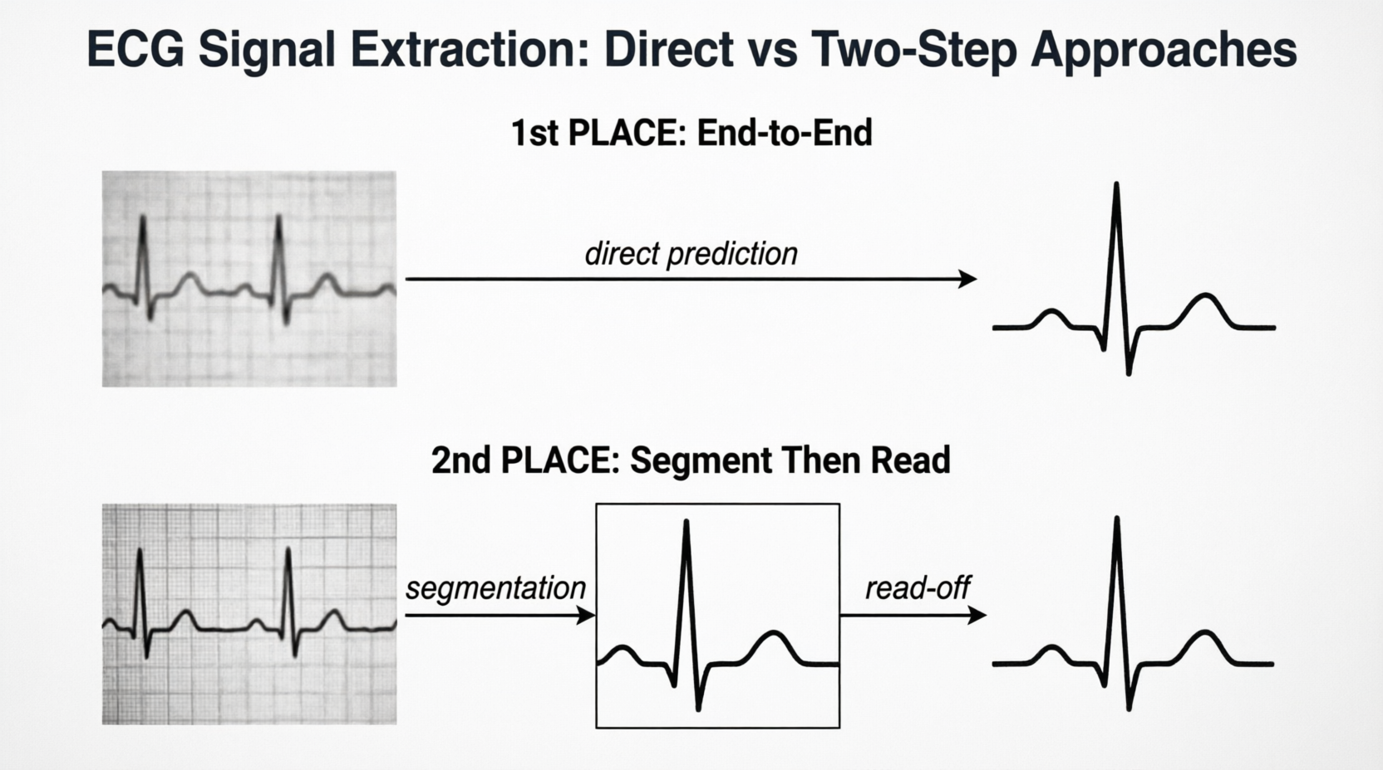
STAND ON SHOULDERS
Learn from the winners
We build our ladder from what actually won the competition.
BTAJI CREW · SESSION 05
13 / 22

Slide 14
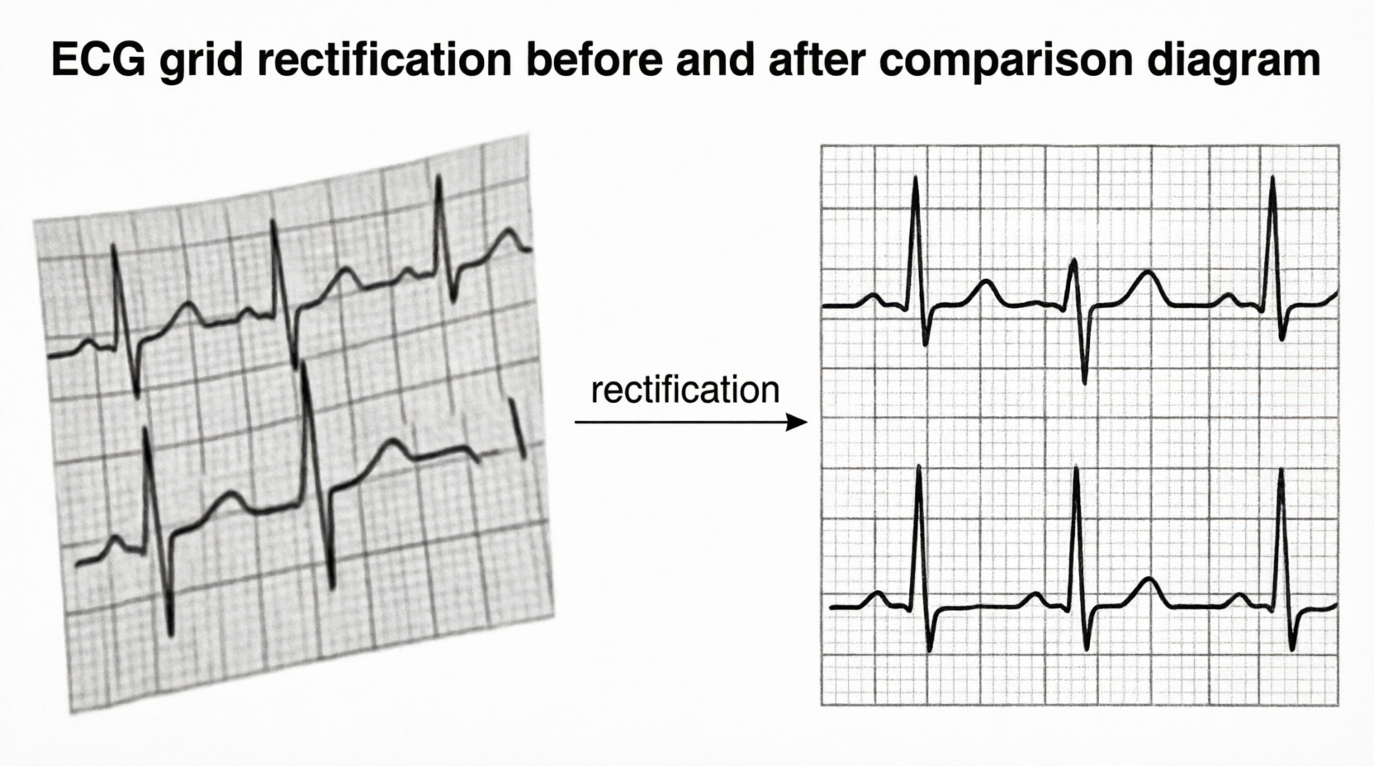
THE BIG LEVER
Rectify the image first
▪ Photos are tilted and warped, and the grid is bent.
▪ Detect the grid points, then warp the page back to flat.
▪ Both of the top teams depend on this one step.
BTAJI CREW · SESSION 05
14 / 22

Slide 15
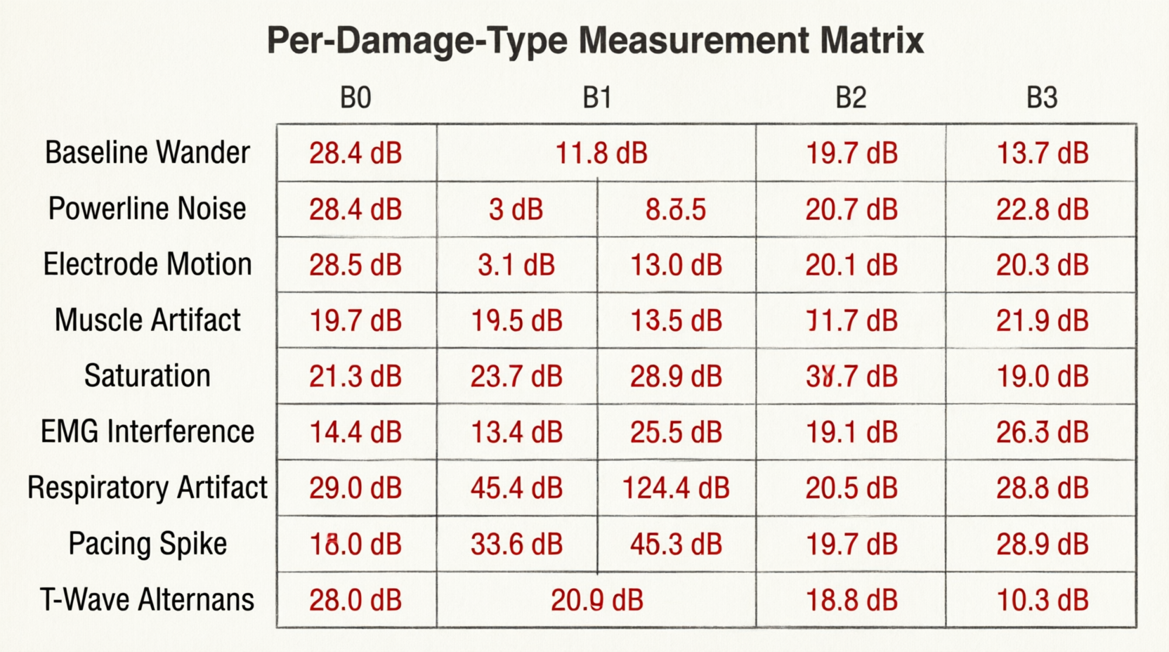
THE ABLATION
Measured for each damage type
▶ Jump to code — Notebook 2 · Ablation run
▪ We measure every rung on the same fixed test set.
▪ We report the score per damage type, not one overall number.
▪ The neural numbers come from Notebook 2 when it runs.
BTAJI CREW · SESSION 05
15 / 22

Slide 16
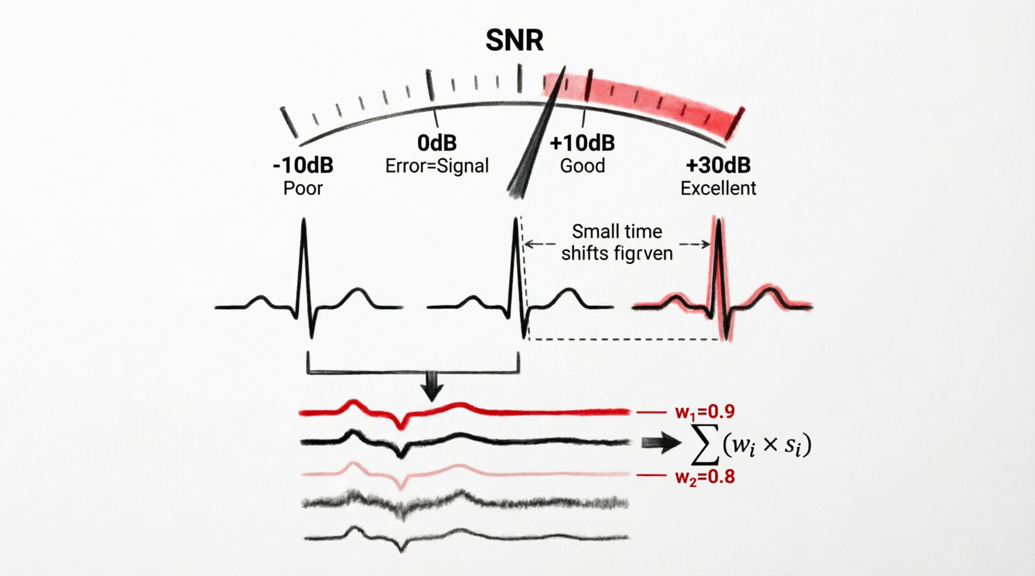
THE METRIC
SNR is sneaky
▪ It is in decibels. Zero means the error equals the signal.
▪ It is aligned first, so a small shift is forgiven.
▪ It averages in the linear domain, so your best images dominate.
▪ Push the good images higher, do not just rescue the worst.
BTAJI CREW · SESSION 05
16 / 22

Slide 17
LIVE
THE PAYOFF
Fill the paper, live
▪ Open the paper template with the empty result tables.
▪ Paste the real per-type numbers straight from the notebook.
▪ The skeleton becomes a paper with a results section.
open: research-paper-template.tex
BTAJI CREW · SESSION 05
17 / 22

Slide 18
PART
3
Your turn
You do not watch research. You run it.
BTAJI CREW · SESSION 05
18 / 22

Slide 19
HANDS-ON
YOUR TURN
Run it yourself
▪ Open Notebook 1, then click Copy and Edit on Kaggle.
▪ Keep the smoke test on, it runs in a few minutes.
▪ Watch the charts appear, then read the per-type table.
▪ You do not need every line. Watch the flow.
open: ecg-nb1-exploration.ipynb
BTAJI CREW · SESSION 05
19 / 22

Slide 20
THIS WEEK
Your task
▪ Run Notebook 1 on your own Kaggle account.
▪ Take a screenshot of your per-type SNR table.
▪ Write one sentence: my baseline scored X dB overall.
▪ Post it in the community group before next session.
Repo: slides, notebooks, notes
BTAJI CREW · SESSION 05
20 / 22

Slide 21
RECAP
What you learned today
▪ A weak baseline gives you a target to beat.
▪ A negative number is a diagnosis, not a bug.
▪ Report per type, the average hides the story.
▪ Research is running experiments and reading them, not typing code.
BTAJI CREW · SESSION 05
21 / 22

Slide 22
JOIN THE COMMUNITY
See you next time.
Run Notebook 1, then post your baseline number and a screenshot in the group. Next time we finish the paper.
chat.whatsapp.com/E29f5rozhAo8RbKjA00eSh

