Slide 1
BTAJI CREW · SESSION FOUR
SESSION
04
Planning Your Paper
From your research question to your experiment plan.
HOSTED BY Muhammad Ibrahim Qasmi & Zulqarnain Ali
Free · Urdu · Beginner friendly
Four
OUR GAP → OUR QUESTION → THE PAPER → THE PLAN → YOUR TURN

Slide 2
RECAP
Where we have been
▪ Session 1: what research is, and how to read a paper.
▪ Session 2: find a gap, and write one clear research question.
▪ Session 3: prove the gap is real with a full search of the field.
▪ Today: give all of that the shape of a paper, and a plan.
BTAJI CREW · SESSION 04
2 / 33

Slide 3
WHERE WE START
This was our gap
▪ After Sessions 1 to 3, we had one clear gap.
▪ A gap is a complaint: nobody has done X yet.
▪ Today we turn that complaint into a plan.
OUR GAP
Nobody checks how well ECG digitizers work for each type of image damage.
BTAJI CREW · SESSION 04
3 / 33

Slide 4
THE PATH
Idea, hypothesis, question
▪ Idea: something you are curious about.
▪ Hypothesis: your best guess at the answer.
▪ Research question: the one clear thing you will test.
▪ Same path as Session 2, now written down.
BTAJI CREW · SESSION 04
4 / 33

Slide 5
THE ONE QUESTION
Our research question
▪ One clear sentence you can actually test.
▪ Everything in the paper points to answering it.
OUR QUESTION
Does ECG digitization accuracy hold up for each type of image damage, method by method?
BTAJI CREW · SESSION 04
5 / 33

Slide 6
PART
1
The shape of the paper
Open it on screen, and walk the parts one by one.
BTAJI CREW · SESSION 04
6 / 33

Slide 7
THE SHAPE
A paper is just sections
▪ Every paper is the same set of parts: title, abstract, introduction, related work,
▪ methodology, experiments, results, discussion, conclusion.
▪ Once you see the shape, it stops being scary.
BTAJI CREW · SESSION 04
7 / 33

Slide 8
THE HEART
The literature review is the heart
▪ For a first paper, the literature review is the most important part.
▪ It shows you read the field and found a real, empty spot.
▪ This is the payoff of your Session 3 search.
BTAJI CREW · SESSION 04
8 / 33

Slide 9
LIVE
ON SCREEN
Open the paper
▪ I open the example paper and go part by part.
▪ Watch the shape, not every word. I say what each part does and why it is there.
open: ecg-literature-review.tex
BTAJI CREW · SESSION 04
9 / 33

Slide 10
LIVE
INSIDE THE PAPER
The literature review
▪ The review sorts the papers we found into a few groups.
▪ The comparison table sits here, in the paper, and shows the empty column, the gap.
▪ This is where we spend the most time today.
BTAJI CREW · SESSION 04
10 / 33

Slide 11
INSIDE THE PAPER
The question, at the end of the intro
▪ The research question sits at the end of the introduction, in a box, easy to find.
▪ Everything before it builds up to it. Everything after it answers it.
BTAJI CREW · SESSION 04
11 / 33

Slide 12
INSIDE THE PAPER
The rest are headings to fill
▪ Methodology, experiments, results, discussion: for now these are just named headings.
▪ The point: this is where each part goes. I will fill it in once the experiments are done.
BTAJI CREW · SESSION 04
12 / 33

Slide 13
REUSE IT
A template for any paper
▪ A second file explains what goes in each section, in plain words with an example.
▪ A third file is a color-coded example: red for the problem, green for the method.
▪ Copy them, and fill each part for your own topic.
open: research-paper-template.tex
BTAJI CREW · SESSION 04
13 / 33

Slide 14
PART 1 IN SHORT
What to remember
▪ A paper is just a set of sections.
▪ The literature review is the heart, and you already did it in Session 3.
▪ The rest are headings you fill in over time.
BTAJI CREW · SESSION 04
14 / 33

Slide 15
PART
2
The plan: your experiment
Now, what will you actually run?
BTAJI CREW · SESSION 04
15 / 33

Slide 16
THE PLAN
What an experiment plan is
▪ Before any code, you plan the experiment.
▪ It answers three things: what will you run, on what data, and measured how.
BTAJI CREW · SESSION 04
16 / 33

Slide 17
STEP 1
Get your data first
▪ We are in AI and ML, so first we need data.
▪ From your literature review, you already know the best dataset for your topic.
FOR ECG
I use the Kaggle physionet-ecg-image-digitization data: 977 ECGs, each in 9 damage types, each with the true signal.
BTAJI CREW · SESSION 04
17 / 33

Slide 18
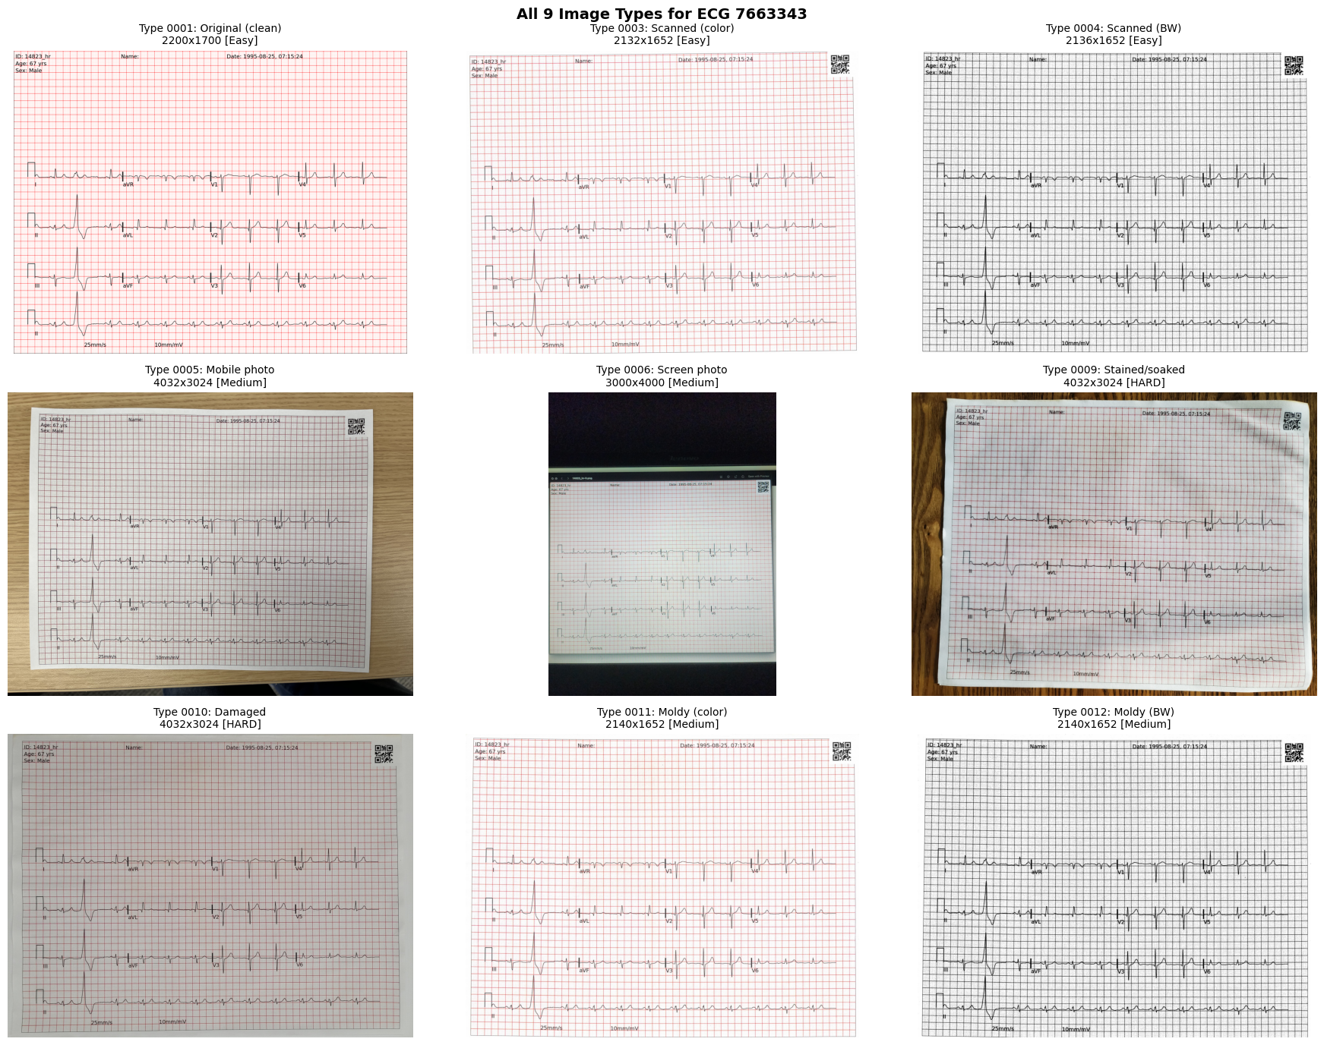
THE DATA
The 9 types of images we handle
One ECG, nine kinds of damage. A digitizer has to survive all of them.
BTAJI CREW · SESSION 04
18 / 33

Slide 19
STEP 2
The pipeline
▪ The steps that take a paper image and turn it into a clean signal.
▪ Draw it as boxes: the image goes in, a few steps in the middle, the signal comes out.
▪ If you can draw it, you understand it.
FOR ECG
Image in, straighten it, find the leads, trace the line, calibrate, signal out.
BTAJI CREW · SESSION 04
19 / 33

Slide 20
PILLAR 1
What are you beating?
▪ A result means nothing without something to compare against.
▪ Use a simple method, and a strong method that already exists.
▪ No competitor, no victory.
BTAJI CREW · SESSION 04
20 / 33

Slide 21
PILLAR 2
Dataset and split
▪ Which data you use, and how you split it into train and test.
▪ Split by patient or record, so the same one is never in both parts.
▪ The same item in train and test is leakage. It is the number one mistake.
BTAJI CREW · SESSION 04
21 / 33

Slide 22
PILLAR 3
Pick the right number
▪ Do not report one overall number. It hides where the method fails.
▪ Report the score for each type of damage.
▪ Your metric must match your gap.
BTAJI CREW · SESSION 04
22 / 33

Slide 23
PILLAR 4
Ablation
▪ Turn one part of your method off, then measure again.
▪ If the score drops, that part was doing real work.
▪ This is how you prove each piece earns its place.
BTAJI CREW · SESSION 04
23 / 33

Slide 24
CHECK IT WORKS
Smoke test first
▪ Run your pipeline on ONE image first, and look at the output.
▪ If it works on one, then scale up to the whole dataset.
▪ Do not run thousands of images before you know it even works.
BTAJI CREW · SESSION 04
24 / 33

Slide 25
THEN IMPROVE
Baseline, then improvement
▪ First get a simple pipeline that is correct end to end.
▪ Only then add training, fine-tuning, or a different model to push the score up.
▪ Correct first. Fancy later.
BTAJI CREW · SESSION 04
25 / 33

Slide 26
THE FULL PLAN
The detailed plan is a document
▪ Slides stay short. The full step-by-step plan, with tables, is a separate file.
▪ I open it and walk it, the same way as the paper.
open: ecg-experiment-plan.tex
BTAJI CREW · SESSION 04
26 / 33

Slide 27
PART 2 IN SHORT
What a plan needs
▪ Data, a pipeline, baselines, a safe split, the right metric per type, and one ablation.
▪ Test it small first, get it correct, then improve.
▪ A plan is what turns a question into a real experiment.
BTAJI CREW · SESSION 04
27 / 33

Slide 28
PUT IT TOGETHER
The whole thing, in order
▪ Idea, then research question, then the shape of the paper, then the experiment plan.
▪ That is a first paper, planned from start to end.
BTAJI CREW · SESSION 04
28 / 33

Slide 29

ONE SMALL STEP
Get your researcher ID
▪ Make a free ORCID iD. It is your permanent ID, and you do not need a university email.
▪ Later, you can post your paper as a preprint and get a link the world can cite.
FREE, TAKES 5 MINUTES
BTAJI CREW · SESSION 04
29 / 33

Slide 30
HANDS-ON
YOUR TURN
Try it now
▪ Write your one research question in a single sentence.
▪ Name the sections your paper will have.
▪ Say which section you will fill first (hint: the literature review).
▪ Paste it in the chat. We pick a few and react live.
BTAJI CREW · SESSION 04
30 / 33

Slide 31
THIS WEEK
Your task
▪ Make your ORCID iD.
▪ Fill the literature review for your own topic: 20 to 30 papers from your Session 3 search, every row a real link.
▪ Sketch your experiment plan on one page: pipeline, baselines, data, metric, ablation.
▪ Bring your one-page plan next time.
Repo: slides, template, notes
BTAJI CREW · SESSION 04
31 / 33

Slide 32
RECAP
The whole path in one line
▪ Gap, then question, then the shape of the paper, then the plan.
▪ You already did the hard parts. Today you gave them a shape.
▪ Next time: your plan becomes a running experiment.
BTAJI CREW · SESSION 04
32 / 33

Slide 33
JOIN THE COMMUNITY
Keep going.
Post your one research question and your ORCID iD in the group. Bring your plan next time.
chat.whatsapp.com/E29f5rozhAo8RbKjA00eSh

