Slide 1
BTAJI CREW · SESSION THREE
SESSION
03
Is Your Gap Real?
Where research ideas come from, and how to prove a gap is real.
HOSTED BY Muhammad Ibrahim Qasmi & Zulqarnain Ali
Free · Urdu · Beginner friendly
Three
IDEAS → SEARCH → SWEEP → VERIFY → VALIDATE

Slide 2
RECAP
Where we have been
▪ Session 1: what research is, and how to read a paper without drowning.
▪ Session 2: idea to hypothesis, literature review, and turning a limitation into a gap and a question.
▪ Today we scale that up, and add the step nobody teaches: proving the gap is actually empty.
BTAJI CREW · SESSION 03
2 / 40

Slide 3
TODAY
Two parts
▪ PART 1 Where research ideas come from. Stop staring at a blank page.
▪ PART 2 Prove your gap is real. A full worked example, live.
▪ By the end you will know where to find a problem, and how to check it is not already solved.
BTAJI CREW · SESSION 03
3 / 40

Slide 4
PART
1
Where do research ideas come from?
The blank page is the hard part. Go where the field already shows you what is active.
BTAJI CREW · SESSION 03
4 / 40

Slide 5
THE CORE MOVE
Do not invent a topic. Borrow one.
▪ Go where the field shows what is active, hands you a dataset, and gives a path to publish.
▪ Take a competition that just ended: grab its fresh dataset and a strong public solution.
▪ Reproduce the baseline, then add one honest new thing: a lighter model, a local data slice, a robustness check.
▪ Write it up as a short benchmark or technical report. That is a real first paper.
BTAJI CREW · SESSION 03
5 / 40

Slide 6

SOURCE 1
Kaggle
▪ The biggest home for ML competitions, free datasets, and shared notebooks. Free GPUs in the browser.
▪ Read Active and Recently Ended competitions. Each is a real problem with data, a metric, and a leaderboard.
▪ Beginner gold: take a just-ended comp, open the winners' write-ups, extend one thing, post a benchmark paper.
FOR EXAMPLE
A comp ended last month. Its dataset is fresh, the winning code is public. Reproduce it, add a Pakistani data slice, write it up.
kaggle.com
BTAJI CREW · SESSION 03
6 / 40

Slide 7

SOURCE 2
Solafune
▪ A free competition platform built only for satellite and Earth-observation problems.
▪ Far less crowded than Kaggle, so datasets are novel and your ranking and paper stand out more.
▪ Deforestation, farm fields, solar panels, super-resolution. A paper can come straight out of one competition.
FOR EXAMPLE
Less crowded means a few hundred competitors, not tens of thousands. Your result is easier to make notable.
community.solafune.com/competitions
BTAJI CREW · SESSION 03
7 / 40

Slide 8


LIVE
SOURCE 3
Grand Challenge and MICCAI
▪ Hundreds of medical-imaging challenges, many of them the official challenges of MICCAI, the top venue.
▪ Each page states the clinical problem, the metric, and the leaderboard. The research question is handed to you.
▪ Publish routes: enter and write a challenge paper, extend a closed challenge's public data, or co-author the overview paper.
https://miccai.org/index.php/
grand-challenge.org/challenges
BTAJI CREW · SESSION 03
8 / 40

Slide 9

LIVE
SOURCE 4
KAUST project search
▪ A searchable list of hundreds of faculty research projects, dozens in AI and ML, each written by a professor.
▪ Two uses: apply for the funded internship, OR mine the descriptions. A professor's open problem is a gap handed to you.
▪ This is where the idea for the LoRA forgetting study came from. Read what researchers are actually stuck on.
admissions.kaust.edu.sa/internship/search
BTAJI CREW · SESSION 03
9 / 40

Slide 10






MORE PLACES
A few more, then pick one and go deep
▪ Competitions: Zindi (Africa), DrivenData (social good), AIcrowd (research), Codabench, DREAM (biomedical).
▪ See what is hot: Hugging Face Papers, OpenReview (reviewers list every weakness), survey papers' future-work.
▪ Map a topic: Connected Papers, alphaXiv, Papers With Code trending.
▪ Do not use all of them. One source you are excited about beats ten you skim.
THE PLATFORMS
BTAJI CREW · SESSION 03
10 / 40

Slide 11
PART 1 TAKEAWAY
You picked a field. Now, is it real?
▪ You did not invent a topic. You borrowed an active problem that comes with data and a path to publish.
▪ But an idea is not a gap yet. The next question decides whether it is worth months of your life.
▪ So we switch to Part 2: prove the gap is real.
BTAJI CREW · SESSION 03
11 / 40

Slide 12
PART
2
Prove your gap is real
One worked example the whole way: turning a photo of a paper ECG into a clean signal.
BTAJI CREW · SESSION 03
12 / 40

Slide 13
THE HARDEST SKILL
Narrow until it is small enough
Research
-> Machine Learning
-> Deep Learning
-> ECG
-> ECG image digitization
-> robustness per damage type
-> THE GAP: nobody reports it per type
▪ "ECG" is a field, not a topic. "Which kind of damage breaks ECG digitization" is a topic.
BTAJI CREW · SESSION 03
13 / 40

Slide 14
THE MAP
ECG is not one thing
▪ Arrhythmia and disease classification. The oldest, most crowded branch.
▪ Foundation and self-supervised models. The 2025 to 2026 frontier.
▪ ECG image digitization. Our pick. Photo or scan of paper, back to a digital signal.
▪ Explainability, fairness, generalization. Does it hold up at another hospital?
▪ Other branches exist (denoising, generation, wearables). We narrow to one.
BTAJI CREW · SESSION 03
14 / 40

Slide 15
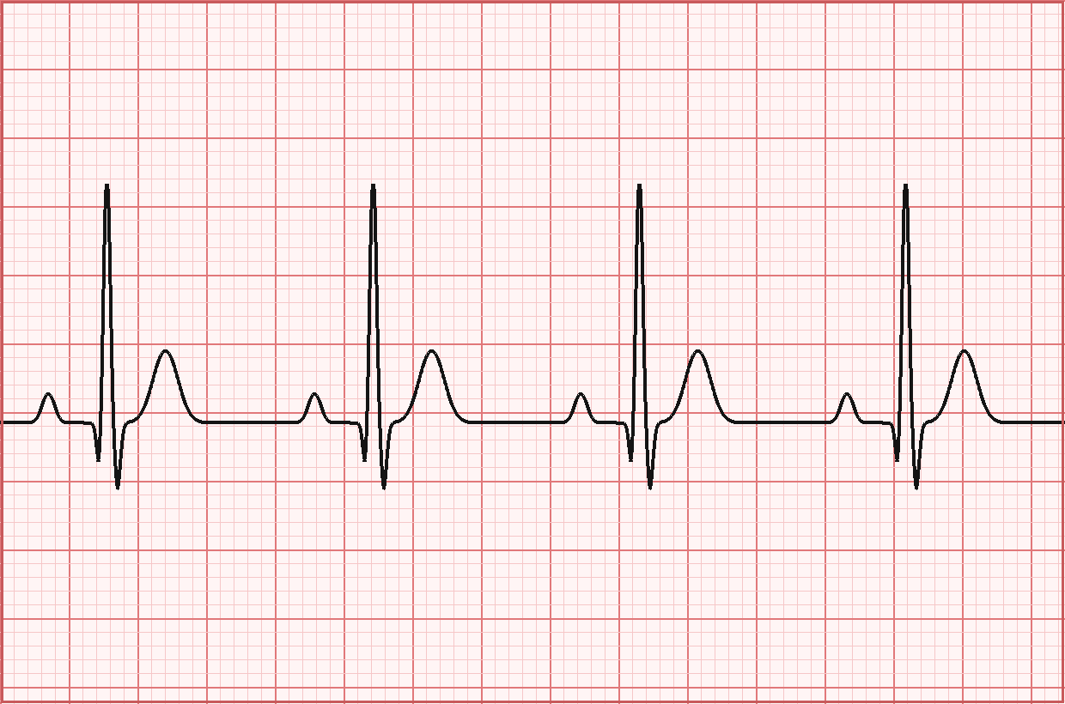
WHY THIS FIELD
I was reading, and found this
▪ Over 300 million 12-lead ECGs are recorded worldwide every year.
▪ Billions of them sit on paper. In Pakistan and most low-resource clinics, paper is still the norm.
▪ Those records are invisible to AI until someone digitizes them. Real problem, local angle.
PhysioNet 2024 Challenge ECG-Image-Kit Pakistan study (PMC)
BTAJI CREW · SESSION 03
15 / 40

Slide 16
NARROW TO ONE
ECG image digitization
▪ In: a phone photo or scan of a paper ECG. Out: a clean digital 12-lead signal.
▪ Benchmark: the PhysioNet 2024 Challenge. Metric: SNR in dB, higher is closer to the true signal.
▪ Free tooling means no hospital access needed: ECG-Image-Kit makes synthetic paper-ECG images.
▪ A doctor in Multan has a drawer of printed ECGs from 2015. To AI they do not exist yet.
SignalSavants winner, 12.15 dB
BTAJI CREW · SESSION 03
16 / 40

Slide 17

LIVE
START BY HAND
Google Scholar, the naive search
ECG
▪ Millions of results, 20 years deep, mostly irrelevant. A vague search feels like research but finds nothing.
BTAJI CREW · SESSION 03
17 / 40

Slide 18
LIVE
THE SMART QUERY
Synonyms, plus a date
("ECG digitization" OR "electrocardiogram digitization"
OR "paper ECG digitization" OR "scanned ECG digitization"
OR "ECG image digitization") after:2025
▪ Quotes force exact phrases. OR catches every naming variant. after:2025 keeps you on the frontier.
▪ Then use the sidebar: Since 2025, and Sort by date to see the newest first.
BTAJI CREW · SESSION 03
18 / 40

Slide 19

LIVE
SAVE AS YOU GO
Star, folder, cite, export
▪ Click the star to save a paper, and create a labelled folder, for example ECG digitization.
▪ Use the quote icon to get a ready citation, and BibTeX for your paper's reference list.
▪ Export the whole folder at once. Your reference list builds itself as you read.
BTAJI CREW · SESSION 03
19 / 40

Slide 20
OPEN VS CLOSED
Which papers can you actually use
▪ Open papers: read the whole thing, use them fully. Prefer the free version, arXiv abs or PMC.
▪ Closed papers: read the abstract. Cite it for background only if it truly aligns with your work.
▪ Never invent details you could not read behind a paywall.
BTAJI CREW · SESSION 03
20 / 40

Slide 21


SAME IDEA, MORE SOURCES
arXiv and Papers With Code
▪ arXiv: newest open preprints, often months ahead of journals. The same synonym queries work.
▪ Papers With Code: papers that ship code and sit on a leaderboard, so you see the current best and can reproduce it.
BTAJI CREW · SESSION 03
21 / 40

Slide 22
THE LIMIT OF BY HAND
You cannot see the whole field
▪ By hand you get 10 to 20 papers and one citation tree. Useful, but slow.
▪ You cannot see the whole field at once, the competitions, or a clean map of what is missing.
▪ So we let AI do the sweep, at scale. But with one hard rule on the next slide.
BTAJI CREW · SESSION 03
22 / 40

Slide 23
READ THIS FIRST
The AI Literature Rule
▪ AI invents papers. Deep-research tools hallucinate citations MORE than plain chat, and medical topics are the worst.
▪ Never ask AI to find you gaps or citations. It will make them up.
▪ Do ask it to gather and compress what is really out there. Then verify: no working link, no paper.
BTAJI CREW · SESSION 03
23 / 40

Slide 24
THE TOOL
One prompt, with placeholders
▪ A single strong prompt that sweeps a whole field: every recent paper, the competitions, and the empty space.
▪ It is built as a fill-in-the-blanks template. You swap the field, the time window, and the sub-areas.
▪ The full prompt lives in the file landscape-sweep-prompt.txt, ready to paste. We read it on screen.
BTAJI CREW · SESSION 03
24 / 40

Slide 25
FILL IT IN
Example: LLM tokenization
▪ Same prompt, filled for a different field, so you see how the placeholders work.
▪ Broad: NLP. Sub-area: large language models. Narrow: token cost and fairness across languages.
▪ This continues Session 2: does anyone measure token cost cleanly across many tokenizers for Urdu?
BTAJI CREW · SESSION 03
25 / 40

Slide 26
OUR VERSION
The same prompt, filled for ECG
▪ Broad: deep learning. Sub-area: medical signals. Narrow: ECG image digitization.
▪ The negative-space section asks the tool to report what nobody has measured, per damage type.
▪ This is the exact prompt we run for today's example.
BTAJI CREW · SESSION 03
26 / 40

Slide 27



DEMO
RUN IT WIDE
Three tools, run before the session
▪ Run the same prompt on Claude Research, ChatGPT Deep Research, Manus,Kimi,Genspark and Gemini. Each finds papers the others miss.
▪ I ran these already. Here are the saved answers, one file per tool.
BTAJI CREW · SESSION 03
27 / 40

Slide 28
DEMO
MERGE
One master file
▪ Paste all the tool answers into Claude Code and ask it to merge: dedupe by title, keep the best link, sort newest.
▪ Now the whole recent field is one table you can skim: problem, contribution, limitation, link.
▪ It does not matter if that is 30 papers or 300. The table makes it skimmable.
BTAJI CREW · SESSION 03
28 / 40

Slide 29
LIVE
THE SIGNATURE MOVE
Verify the papers are real
▪ Click 3 links from the table. Real papers open. Good.
▪ Click a 4th that turns out dead or a different paper. That is why we verify. Delete that row.
▪ The rule for the whole series: no working link, no row. A number with no source is a rumor.
BTAJI CREW · SESSION 03
29 / 40

Slide 30
HONESTY DEMO
The number that teaches the lesson
▪ Our own prep said the top score was about 23 dB, with a 16 dB baseline. We checked. Both are wrong.
▪ Verified: winner SignalSavants scored 12.15 dB on the hidden test. A 2025 method hits 19.65 dB on real scans.
▪ Even your hosts' brief had unverified numbers. Verify everything, including us.
BTAJI CREW · SESSION 03
30 / 40

Slide 31
FIND THE EMPTY SPACE
Read for absence, not presence
▪ Do not read every paper. Scan two columns: the limitation or future-work column, and the sparse sub-themes.
▪ For ECG digitization, one pattern jumps out: every method reports ONE overall SNR number.
▪ Nobody breaks it down per damage type, per method. That empty space is a candidate gap.
BTAJI CREW · SESSION 03
31 / 40

Slide 32
THE TEST
The Grandma Test
▪ A real gap has two parts you can say in one plain sentence: a Context and an Obstacle.
▪ Shape: Everyone did X, but nobody did Y, because of Z.
▪ If your sentence is just "I combine A and B", that is a hobby, not a gap.
BTAJI CREW · SESSION 03
32 / 40

Slide 33
OUR CANDIDATE GAP
State it honestly
▪ Context: quality is scored as one number.
▪ Obstacle: per-type behavior is hidden. A fix that helps blurry photos may hurt clean scans.
▪ We say per method, per type, so it survives the papers that already did part of it.
THE GAP
Everyone reports one overall SNR for ECG digitization, but nobody shows which damage types break each method, and which fix helps each type.
BTAJI CREW · SESSION 03
33 / 40

Slide 34
LIVE
THE STEP EVERYONE SKIPS
Validate before you commit
▪ Run a second, skeptical prompt whose job is to PROVE your gap is already solved.
▪ Run it fresh, ideally on a different tool, so it is not defending its own earlier answer.
▪ It returns a verdict: OPEN, PARTIALLY taken, or already DONE, with real papers as proof.
BTAJI CREW · SESSION 03
34 / 40

Slide 35
READ THE VERDICT
A pivot is normal
▪ OPEN: nobody did it. Go.
▪ PARTIAL: someone did part of it. Narrow your gap to the exact piece they left.
▪ DONE: it exists. Pick your next candidate and repeat. This is normal, it takes a few tries.
▪ A method that never rejects anything is not checking. It is flattering you.
BTAJI CREW · SESSION 03
35 / 40

Slide 36
TWO HONEST WAYS
Pure research, or competition as paper
▪ Way 1: sweep, find the empty space, build it. What we just did.
▪ Way 2: enter a challenge, build a solution, add a lit review, a benchmark, and one honest new finding.
▪ This ECG example is also a real competition. Way 2 is a fast, legitimate first paper.
BTAJI CREW · SESSION 03
36 / 40

Slide 37
HANDS-ON
YOUR TURN
Do it on your own field
▪ Pick a field you care about: eye disease, skin cancer, an LLM topic, anything.
▪ Narrow it with the tree until it is small. Name one candidate gap as a Context plus Obstacle sentence.
▪ Paste it in the chat. We will run the skeptic prompt on a few, live.
BTAJI CREW · SESSION 03
37 / 40

Slide 38
THIS WEEK
Your task
▪ Pick one field. Run the collection prompt on one free tool, Gemini free or Perplexity free.
▪ Verify by hand: click 5 links, delete any that do not open.
▪ Write one candidate gap as a Context plus Obstacle sentence, and run the validation prompt on it.
▪ Bring your verdict, OPEN, PARTIAL, or DONE, to the next session. A rejected gap counts as success.
Repo: slides, prompts, notes
BTAJI CREW · SESSION 03
38 / 40

Slide 39
RECAP
The whole path in one line
▪ Ideas to Search to Sweep to Verify to Validate
▪ Get an active problem with data. See the whole field. Prove the papers are real. Prove the gap is empty.
▪ A gap that survives a full sweep and a skeptic's attack is worth months. One from 3 papers is worth a weekend of doubt.
BTAJI CREW · SESSION 03
39 / 40

Slide 40
GET INVOLVED
Volunteer: teach us LaTeX
▪ LaTeX is how almost every research paper is typeset. It is worth learning early.
▪ We want one student to give a short guest session: setup, a paper template, equations, and references.
▪ The best way to learn something is to teach it, and it puts your name in front of the community.
BTAJI CREW · SESSION 03

Slide 41
GET INVOLVED
Volunteer: teach us Zotero
▪ Zotero is the free tool that organizes your papers and citations, the folders and BibTeX we saw today.
▪ We want one student to give a short guest session: saving papers, folders, cite as you write, and exporting BibTeX.
▪ A clean reference workflow saves you hours on every paper you write.
BTAJI CREW · SESSION 03

Slide 42
JOIN THE COMMUNITY
Keep going.
Post your validated gap and its verdict in the group. A rejected gap counts as success.
chat.whatsapp.com/E29f5rozhAo8RbKjA00eSh
Next time: turning your validated gap into a plan. Baseline, dataset, metric.

