Slide 1
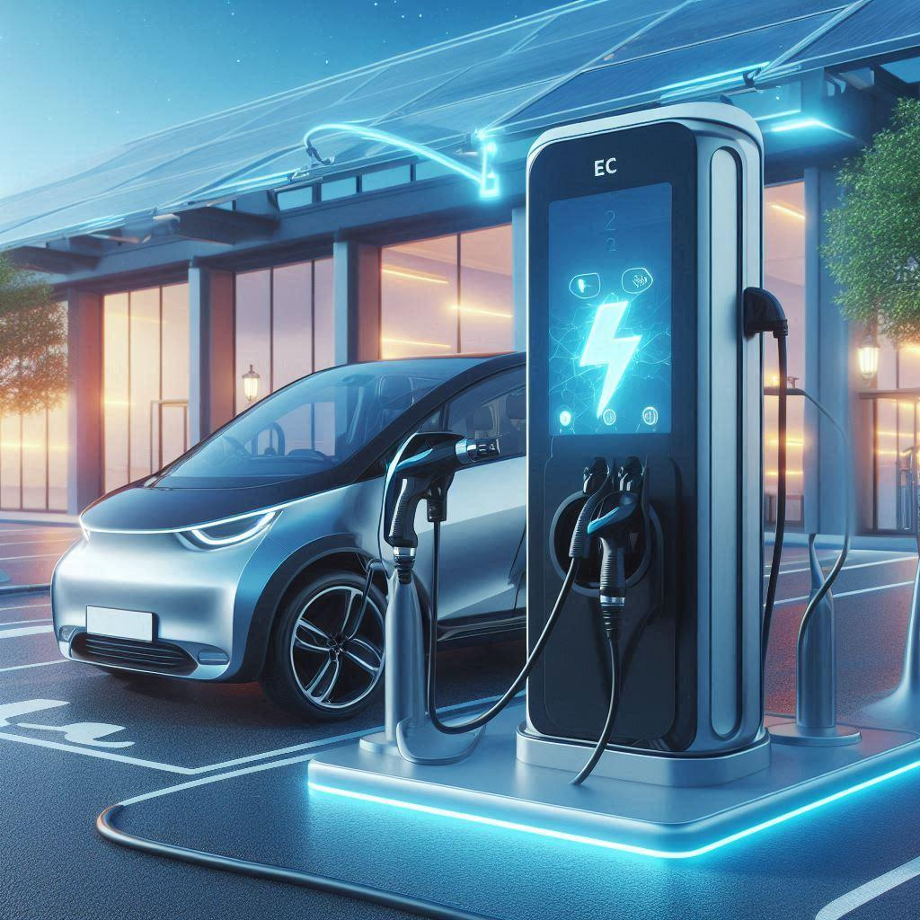
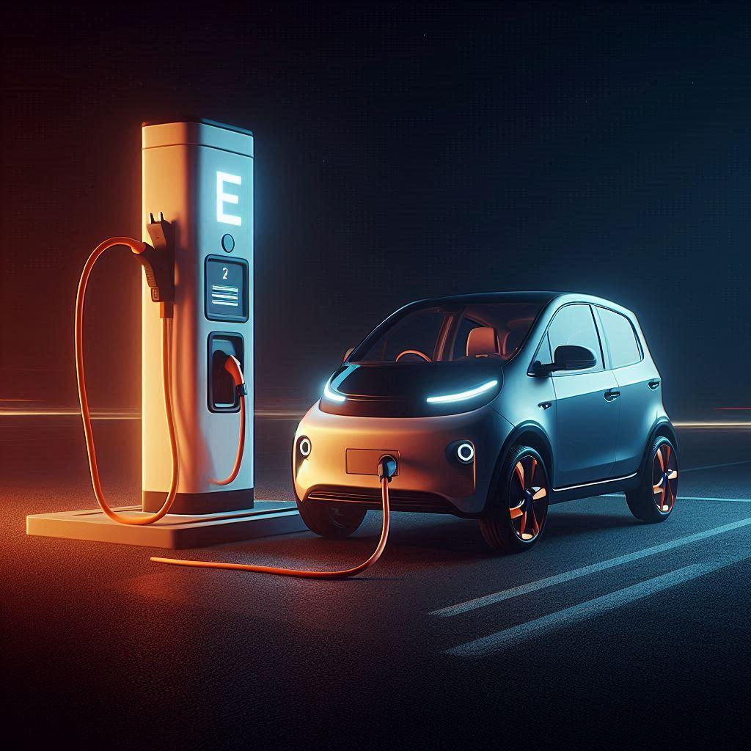

EV Charging Station Optimization in Connecticut
Utilizing Geospatial Data Science for Strategic Infrastructure Planning
Muhammad Iqbal
23/01/2025

Slide 2
Problem and Approach
Title: Identifying Optimal EV Charging Station Locations
Problem: Inefficient distribution of existing charging stations, leading to accessibility challenges and underserved areas.
Approach: Leverage geospatial data science and machine learning to identify optimal locations for new charging stations, maximizing accessibility and utilization.

Slide 3
Data and Preprocessing
Title: Data Foundation
Data Source: Electric_Vehicle_Charging_Stations.csv
Key Features: Station Name, City, Location (new georeference), EV Level1 EVSE Num, EV Level2 EVSE Num, EV DC Fast Count, EV Other Info.
Preprocessing: Data cleaning, geometry validation, feature engineering (station name, city, location (new georeference column ).

Slide 4
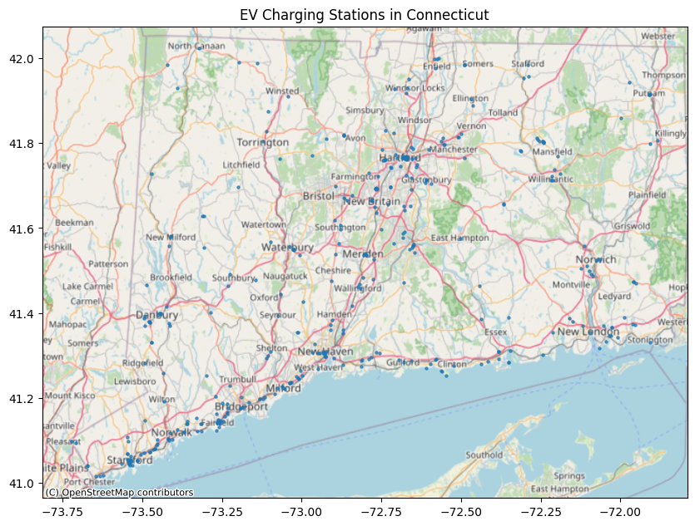
Clustering
Title: Identifying Demand Clusters
Algorithm: DBSCAN (Density-Based Spatial Clustering of Applications with Noise)
Purpose: Group charging stations based on geographic proximity to identify areas of high demand.
Visualization: Map highlighting clusters and station locations.

Slide 5
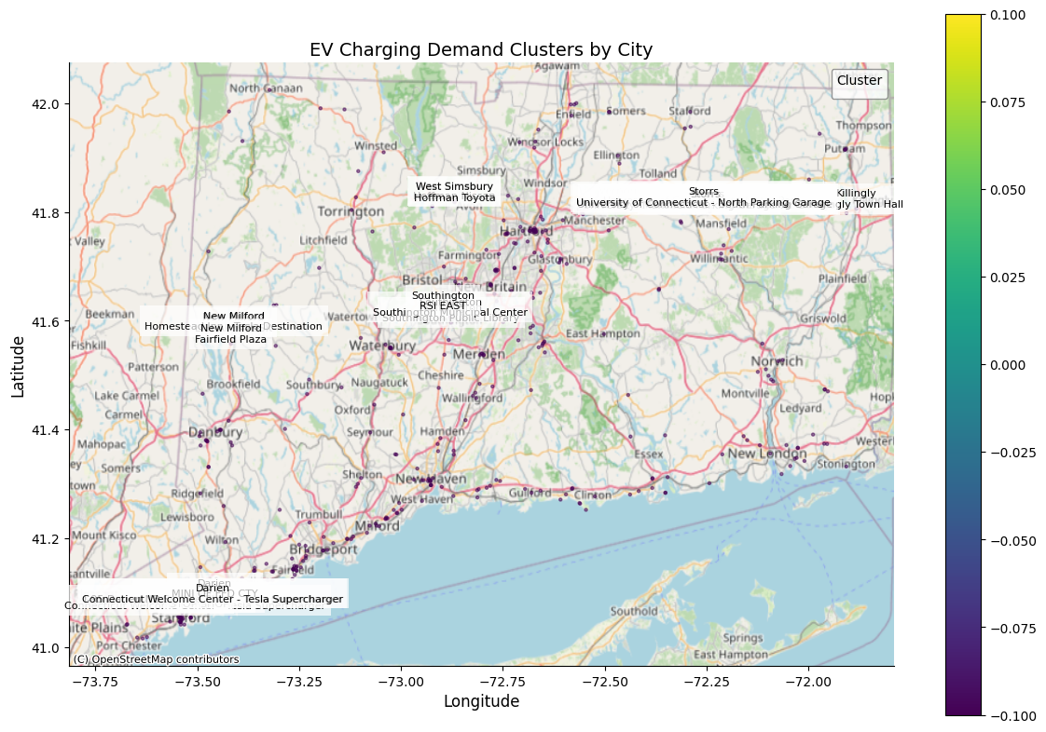
Predictive Modeling
Title: Predicting Charging Station Needs
Model: Random Forest Regression
Features: Station Name, City, New Georeference Column.
Target Variables: EV Level1 EVSE Num, EV Level2 EVSE Num, EV DC Fast Count, EV Other Info.
Evaluation Metric: Root Mean Squared Error (RMSE).

Slide 6
Model Insights and Recommendations
Title: Optimizing Infrastructure Investments
Key Findings: Clusters with higher population density and income predicted by station name, and city exhibit greater demand.
Recommendations:
  Prioritize high-demand clusters for new installations.
  Address underserved areas to ensure equitable access.
  Consider strategic placement near amenities and transportation routes.
  Data-driven decisions on the type and number of charging stations.

Slide 7
Limitations and Future Work
Title: Continual Improvement and Refinement
Limitations: Data availability, model refinement, spatial considerations, user feedback.
Future Work:
  Incorporate additional datasets (usage, traffic patterns, demographics).
  Explore alternative machine learning algorithms.
  Integrate detailed spatial considerations (land use, zoning).
  Gather user feedback for optimized placement.

Slide 8
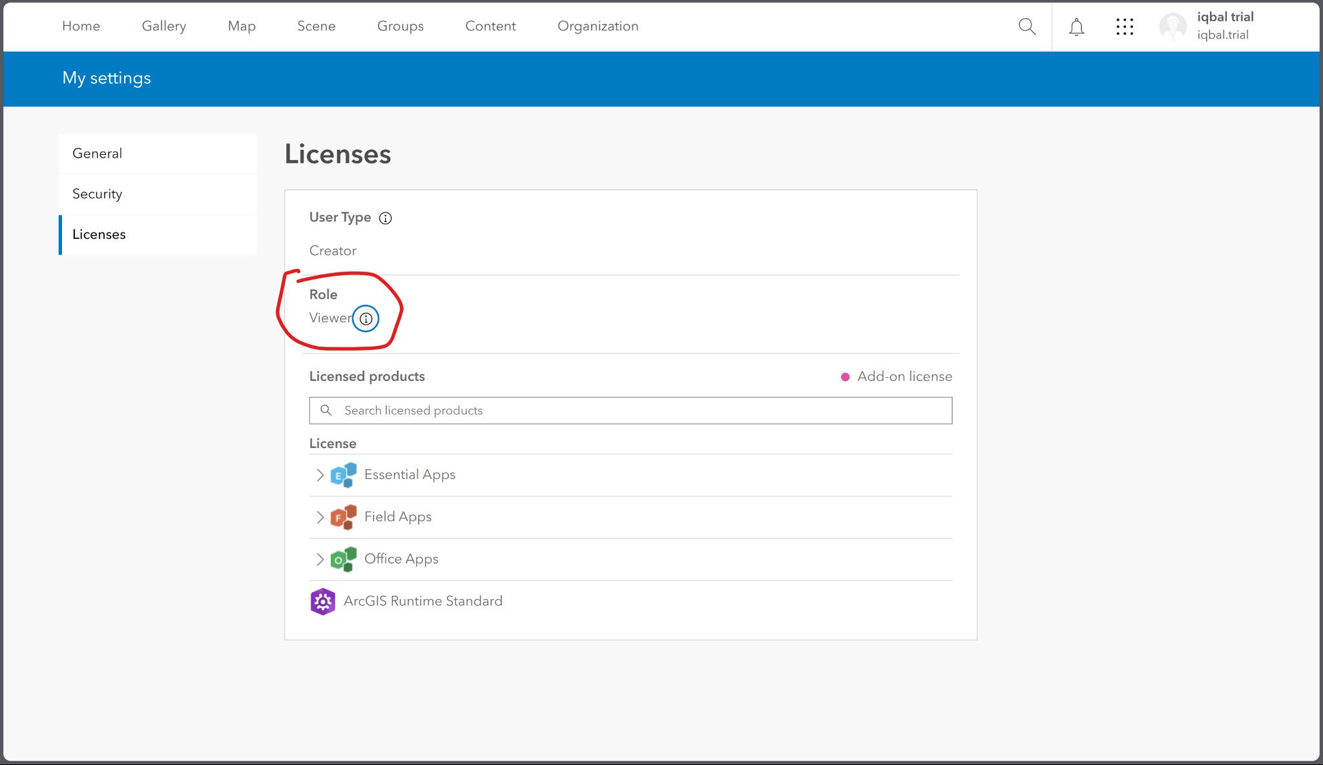
ArcGIS Integration
Title: Sharing and Collaboration
Purpose: Publish data and analysis results to ArcGIS Online for wider access and collaboration.
Benefits: Enhanced visualization, sharing with stakeholders, integration with other geospatial tools.
Limitation: Required the “publisher” role in the ArcGIS licenses. Currently the licences in the ArcGIS account provided is “viewer”. If the licenses is changed into the publisher role the integration will be successful.

Slide 9
Conclusion
Title: Driving EV Adoption through Strategic Infrastructure Planning
Summary: The project identified optimal locations by city for new EV charging stations in Connecticut: Darien (Connecticut Welcome Center - Tesla Supercharger), New Milford (Fairfield Plaza), Southington - (Southington Municipal Center), West Simsbury (Hoffman Toyota), Killingly (Killingly Town Hall), and Storrs (University of Connecticut - North Parking Garage).
Impact: Improved accessibility, utilization, and equitable distribution of charging infrastructure.
Next Steps: Implement recommendations, monitor performance, and refine strategies based on real-world data.

Slide 10
Sources:
Electric Vehicle Charging Connecticut

