Slide 1

Keylogger Project: Exploiting Windows 10 1507 Vulnerability
A Demonstration of System Vulnerabilities and Ethical Considerations
Group members:
Ahmed Owais (243394)
Abdul Rehman (242368)
Muhammad Maaz Abbasi (242308)
Syed Ahtsham Hussain Shah (242364)

Slide 2
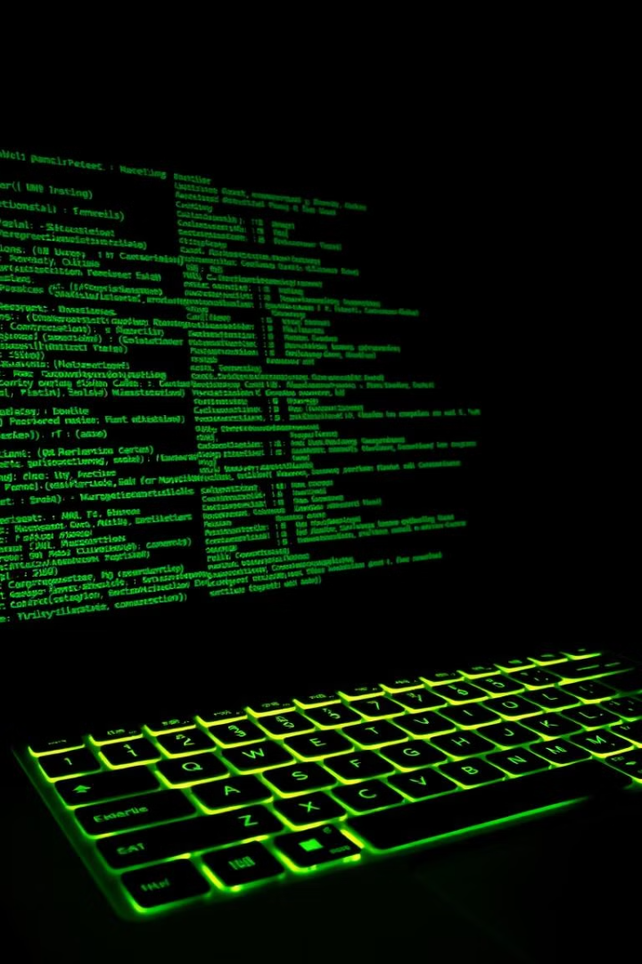
Introduction
Objective
Target System
Demonstrate exploitation of vulnerabilities in outdated systems using a keylogger application.
Windows 10 version 1507.
Purpose
Highlight the importance of system updates and user awareness in cybersecurity.

Slide 3
Delivery Mechanism
Email Delivery
Targeting Windows 1507
Keylogger disguised as a harmless executable file.
Exploits lack of modern security features like strict UAC and SmartScreen.
Delivered through phishing emails.
Demonstrates vulnerabilities in unsupported operating systems.

Slide 4
Demonstrating the Vulnerability
Outdated Security Mechanisms
Human Factors
Result
Social engineering ensures successful execution.
Successful logging of keystrokes and data transmission.
Weak executable verification.
No robust antimalware tools.

Slide 5
Project Components
Keylogger Application
Remote Server
Delivery Mechanism
Logs keystrokes and sends them to a remote server.
Flask-based application hosted on Azure to receive and store data.
Social engineering tactics used to distribute the keylogger to target systems.

Slide 6
Keylogger Details
Development
Functions
Decoy GUI
Python using the pynput library.
Logs keystrokes, storing them in a buffer.
Simple calculator application to appear legitimate.
Sends the buffer to a remote server periodically.
Operates as a background daemon thread.

Slide 7
Server Configuration
Platform
Framework
Security
Microsoft Azure Virtual Machine.
Flask application for receiving keystroke data.
Firewall rules to allow only authorized traffic.
JSON payload handling for keystroke data and timestamps.

Slide 8

Ethical Considerations
Purpose
Disclaimer
Educational and research purposes only.
Unauthorized access or exploitation of systems is illegal.
This knowledge should not be used maliciously.
Message
Highlights the risks of outdated systems and the importance of cybersecurity awareness.

Slide 9
Recommendations
Update Systems
1
Upgrade to supported versions with active security patches.
Enhance Awareness
2
Train users to recognize phishing attempts and avoid running unknown files.
Implement Security Tools
3
Use endpoint detection and response (EDR) systems for better protection.

Slide 10

Conclusion
Demonstration
Importance
Out-of-date systems are vulnerable to exploitation.
Regular updates.
User training.
Modern security tools.
Final Note
Serves as a reminder of the evolving landscape of cybersecurity threats.

