Slide 1
Amortized Loans
Lecture : 6

Slide 2
What is Amortized loan?
An amortized loan is a type of loan with scheduled, periodic payments that are applied to both the loan's principal amount and the interest accrued.
An amortized loan payment first pays off the relevant interest expense for the period, after which the remainder of the payment is put toward reducing the principal amount.
Common amortized loans include auto loans, home loans, and personal loans from a bank for small projects or debt consolidation.

Slide 3
Amortize
The word amortize comes from the Latin word amortize which means “bring to death”.
What we are saying is that we want to bring the debt to death! More gently it is retiring the debt.
The important factors related to an amortized loan are the principal, annual interest rate, the length of the loan and the monthly payment.
If we know any 3 of the above factors, the fourth can be found.

Slide 4
Why Is Amortization Important?
Amortization is important because it helps businesses and investors understand and forecast their costs over time.
In the context of loan repayment, amortization schedules provide clarity into what portion of a loan payment consists of interest versus principal.
This can be useful for purposes such as deducting interest payments for tax purposes. It is also useful for future planning to understand what a company's future debt balance will be in the future after a series of payments have already been made.

Slide 5
Cont.:
Amortizing intangible assets is important because it can reduce a business's taxable income, and therefore its tax liability, while giving investors a better understanding of the company’s true earnings. Intangible assets also have a finite useful life; over time, trademarks or patents may lose their value due to obsolescence.
Amortizing intangible assets is also a reflection of how a company has "used up" the benefit of these assets.

Slide 6
Amortizing Schedule Steps
GOAL: DIVIDE EACH PAYMENT (OF ANNUITY) INTO TWO PARTS-INTRESET AND PRINCIPAL
AMORTIZATION SCHEDULE: TABLE CONTANING THE FOLLOWING COLUMS.
PAYMENT
INTREST PART OF A PAYMENT
PRINCIPAL PART OF A PAYMENT
OUTSTANDING PRINCIPLES / PRINCIPLE AMOUNT

Slide 7
Textbook example: loan amortization
You borrowed $8,000 from a bank and promised to repay the loan in five equal annual payments. The first payment is at the end of the first year. The annual interest rate is 10%. Write down the amortization schedule for this loan.
Compute the annual payment ($2,110.38)

Slide 8
Textbook example: loan amortization
We separate each payment into two parts:
Interest payment
Repayment of principal
For a fixed payment loan:
Total payment is fixed
Interest payment decreases over time
Principal repayment increases over time

Slide 9
Amortization schedule table
Date | Beginning Balance | Total Payment | Interest (10%) | Principal | End Balance
0 |  |  |  |  | 8,000.00
1 | 8,000.00 | 2,110.38
2 |  | 2,110.38
3 |  | 2,110.38
4 |  | 2,110.38
5 |  | 2,110.38
Notes:
FI 3300 - Corporate Finance Y.C.Loon

Slide 10
loan amortization: solution
First year:
Beginning balance = 8,000
Interest payment = 8,000 x 0.1 = 800
Principal repayment = 2,110.38 – 800 = 1,310.38
New principal balance = 8,000 – 1,310.38
= 6,689.62

Slide 11
Amortization schedule
Date | Beginning Balance | Total Payment | Interest (10%) | Principal | End Balance
0 |  |  |  |  | 8,000.00
1 | 8,000.00 | 2,110.38 | 800 | 1,310.38 | 6,689.62
2 | 6,689.62 | 2,110.38
3 |  | 2,110.38
4 |  | 2,110.38
5 |  | 2,110.38
Notes:
FI 3300 - Corporate Finance Y.C.Loon

Slide 12
Finding a monthly payment
Many times we know the length of a loan, the annual interest rate and the amount of the loan. Can we afford to make the monthly payment??? This question is very important when considering a mortgage.
The monthly payment formula is basically derived from the equation future value of annuity = future value of loan amount.

Slide 13
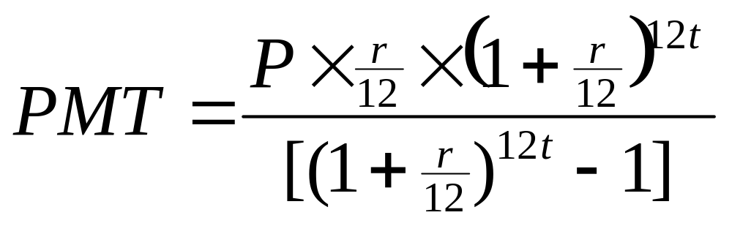
Payment formula
Let P be present value or full amount of loan, r is the annual interest rate, t is the length of the loan and PMT is the monthly payment.

Slide 14
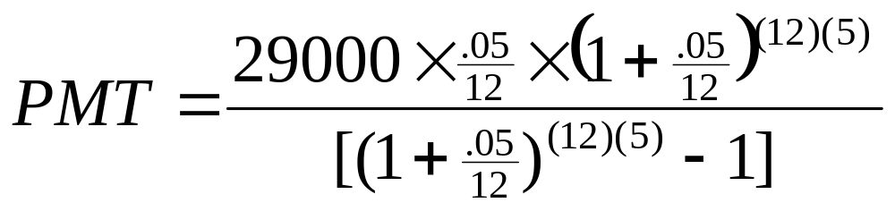
Example
What is the monthly payment for a loan of $29,000 for 5 years at an annual interest rate of 5%.
The monthly payment is $547.27
Note: If you follow this schedule, you will make 60 payments of $547.27 which in total is $32836.20. The amount of interest paid to the lender is $32836.20 - $29000 = $3836.20

Slide 15
Example using Table 1
Amortization tables have been created so that people don’t need to use the complicated payment formula.
For example, find the monthly payment for a $10000 loan at 10% annual interest for 5 years.
Looking at Table 1, this corresponds to the entry of $212.48.
Verify using the PMT formula. You may be off by a cent or two, that’s because rounding error was introduced into the table.

Slide 16
Another example using table 1
What would be the payment on a loan of $58,000 at 10% annual interest for 30 years?
$58000 = $50000 + 4 x $2000
We will use the entries for $50000 at 30 years and $2000 at 30 years.
The PMT = $438.79 + 4 x $17.56 = $509.03
Verify using the PMT formula. Rounding error has been introduced.

Slide 17
Table 1 - Amortization Table at 10%
Amount | 5 years | 10 years | 15 years | 20 years | 25 years | 30 years | 35 years | 40 years
100 | 2.13 | 1.33 | 1.08 | 0.97 | 0.91 | 0.88 | 0.86 | 0.85
200 | 4.25 | 2.65 | 2.15 | 1.94 | 1.82 | 1.76 | 1.72 | 1.70
500 | 10.63 | 6.61 | 5.38 | 4.83 | 4.55 | 4.39 | 4.30 | 4.25
1000 | 21.25 | 13.22 | 10.75 | 9.66 | 9.09 | 8.78 | 8.60 | 8.50
2000 | 42.50 | 26.44 | 21.50 | 19.31 | 18.18 | 17.56 | 17.20 | 16.99
5000 | 106.24 | 66.08 | 53.74 | 48.26 | 45.44 | 43.88 | 42.99 | 42.46
10000 | 212.48 | 132.16 | 107.47 | 96.51 | 90.88 | 87.76 | 85.97 | 84.92
20000 | 424.95 | 264.31 | 214.93 | 193.01 | 181.75 | 175.52 | 171.94 | 169.83
50000 | 1062.36 | 660.76 | 537.31 | 482.52 | 454.36 | 438.79 | 429.84 | 424.58
100000 | 2124.71 | 1321.51 | 1074.61 | 965.03 | 908.71 | 877.58 | 859.68 | 849.15

Slide 18
Example Using Table 2
Recall that we calculated the monthly payment of a $29000 loan for 5 years at 5% annual interest to be $547.27.
Let’s use table 2.
The entry that corresponds to 5% for 5 years is $18.871234.
Since this is a $1000 table, and the loan amount is for $29000, we multiply the $18.871234 by 29 to get a monthly payment of $547.265786 or properly $547.27. The same as we computed using the formula.

Slide 19
Table 2 - Amortization Table for $1000 Loan
Percent | 5 years | 10 years | 15 years | 20 years | 25 years | 30 years
5 | 18.871234 | 10.60552 | 7.907936 | 6.599557 | 5.845900 | 5.368216
6 | 19.332802 | 11.102050 | 8.438568 | 7.164311 | 6.443014 | 5.995505
7 | 19.801199 | 11.610848 | 8.988283 | 7.752989 | 7.067792 | 6.653025
8 | 20.276394 | 12.132759 | 9.556521 | 8.364401 | 7.718162 | 7.337646
9 | 20.758355 | 12.667577 | 10.142666 | 8.997260 | 8.391964 | 8.046226
10 | 21.247045 | 13.215074 | 10.746051 | 9.650216 | 9.087007 | 8.775716
11 | 21.742423 | 13.775001 | 11.365969 | 10.321884 | 9.801131 | 9.523234
12 | 22.244448 | 14.347095 | 12.001681 | 11.010861 | 10.532241 | 10.286126
13 | 22.753073 | 14.931074 | 12.652422 | 11.715757 | 11.278353 | 11.061995
14 | 23.268251 | 15.526644 | 13.317414 | 12.435208 | 12.037610 | 11.848718
15 | 23.789930 | 16.133496 | 13.995871 | 13.167896 | 12.808306 | 12.644440

Slide 20
Annuity, find the PMT
You are trying to borrow $200,000 to buy a house on a conventional 30-year mortgage with monthly payments.
The monthly interest rate on this loan is 0.70%. What is the monthly payment on the loan?
Notes:
FI 3300 - Corporate Finance Y.C.Loon

Slide 21
Annuity, find the PMT: Challenge
You plan to retire in 30 years. Then you will need $200,000 a year for 10 years (first withdrawal at t=31). Ten years later you expect to go to a retirement home where you will stay for the rest of your life. To enter the retirement home, you will have to make a single payment of $1,000,000. You can start saving for your retirement in an account that pays 9% interest a year. Therefore, starting one year from now (end of the first year: t =1), you will make equal yearly deposits into this account for 30 years. In 30 years (on date t=30), you expect a deposit of $500,000 to your retirement account from your cash value insurance policy. What should be your yearly deposit into the retirement account?
Notes:
FI 3300 - Corporate Finance Y.C.Loon
This question is from Spring 2000 exam.
In this question, there cash flow stream is made up of two annuities!
Answer=$52,652.54
Draw time line.
Find the FV of the 35-payment annuity at t=35. This FV will be the amount you invest in the 20-payment annuity. Using the information about the 20-payment annuity, compute the annual payment of the annuity.
Part 1:
Find FV of 35-payment annuity at t= 35.
PV=0, PMT=-3000, I/Y=8, N=35, F=?
F = 516,950.41
Part 2:
Find PMT of the 20-payment annuity.
PV=-516,950.41, N=20, FV=0, I/Y=8, PMT=?
PMT=52,652.54
FV=1,000,000, PMT= 0, N=10, I/Y=9, PV₁=? (422,410.81)
FV=0, PMT= 200,000, N=10, I/Y=9, PV₂=? (1,283,531.54)
PV₁ + PV₂₋ - 500,000 = 1,205,942.35
FV= 1,205,942.35, PV =0, N=30, I/Y=9, PMT=? (8,847.22)

Slide 22
loan amortization: solution
Second year:
Beginning balance = 6,689.62
Interest payment = 6,689.62 x 0.1 = 668.96
Principal repayment = 2,110.38 – 668.96
= 1,441.42
New principal balance = 6,689.62 – 1,441.42
= 5,248.20

Slide 23
solution of textbook Amortization schedule
Date | Beginning Balance | Total Payment | Interest (10%) | Principal | End Balance
0 |  |  |  |  | 8,000.00
1 | 8,000.00 | 2,110.38 | 800.00 | 1,310.38 | 6,689.62
2 | 6,689.62 | 2,110.38 | 668.96 | 1,441.42 | 5,248.20
3 | 5,248.20 | 2,110.38 | 524.82 | 1,585.56 | 3,662.64
4 | 3,662.64 | 2,110.38 | 366.26 | 1,744.12 | 1,918.53
5 | 1,918.53 | 2,110.38 | 191.85 | 1,918.53 | 0.00
Notes:
FI 3300 - Corporate Finance Y.C.Loon

