Slide 1
Accounting
“ Accounting is simply the means by which we measure and describe the result of economic activities”
Often Called
“ the Language of Business”

Slide 2
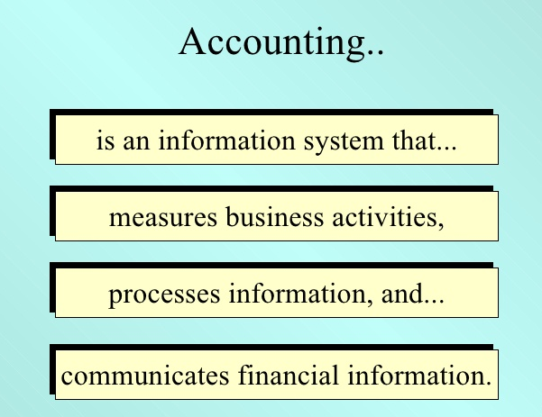

Slide 3
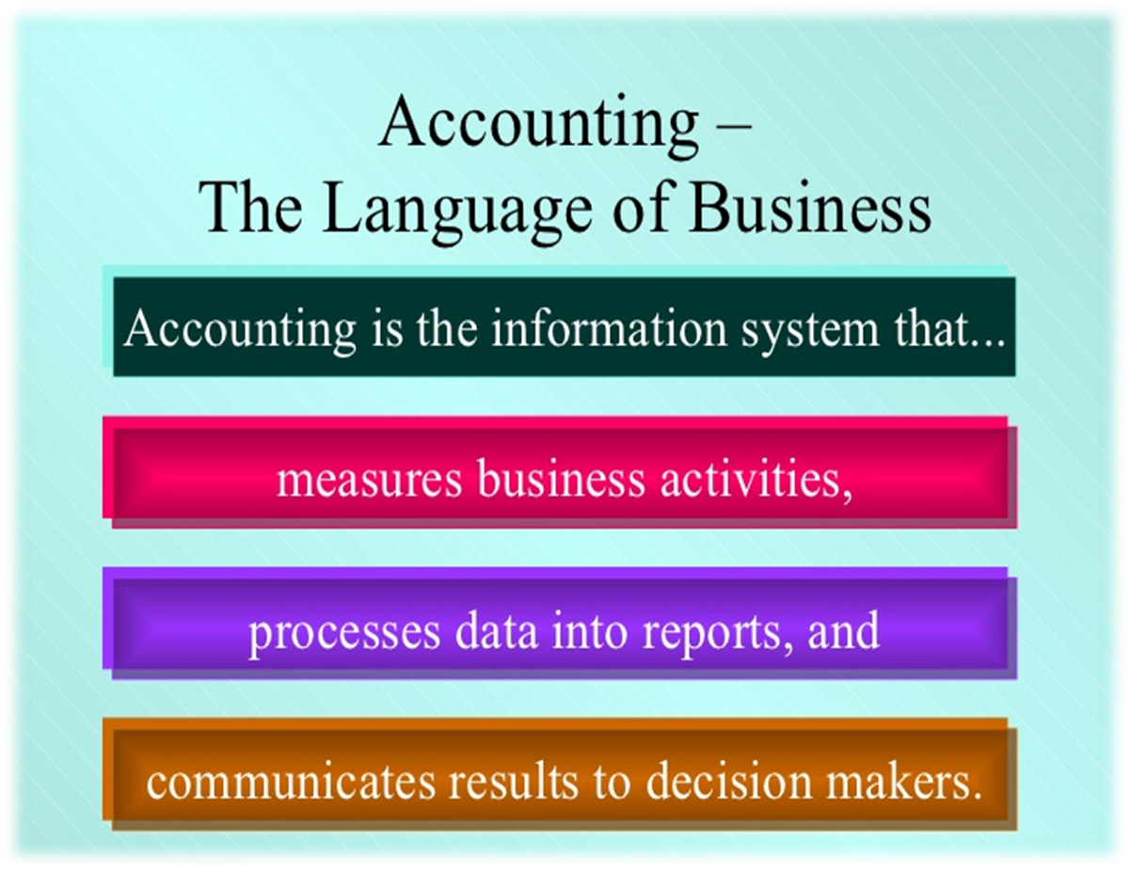

Slide 4
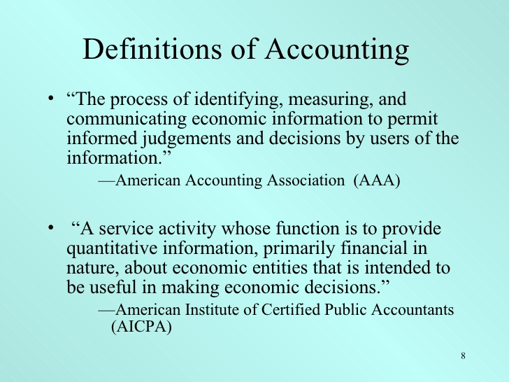

Slide 5
Purpose of Accounting
The basic purpose of accounting is to provide decision makers with information useful in making economic decisions.

Slide 6
Accounting from a User’s Perspective
Individual need to understand:
The nature of economic activities that accounting information describes
The assumption and measurement techniques involved in developing accounting information
The accounting information that is most relevant for various types of decisions

Slide 7
The Accounting Process
Accounting links decision makers with economic activities ⎯ and with the results of their decisions.
Accounting
Information
Economic Activities
Reported Results of Actions (decisions)
Decision Makers
Actions (decisions)
Notes:
Not all transactions entered into by a business entity are capable of being recorded. The first task for accountants is to identify those economic events that can be recorded in the accounting system.
Once the necessary economic information has been accumulated in a readable format, decision makers use this information to improve the decision-making process.
Decisions made will impact future economic activities which will then find their way into the data accumulation process.

Slide 8

Types of Accounting Information
Financial
Tax
Management
Notes:
Broadly speaking, accounting information can be placed into one of three categories: financial, management, and tax. Financial accounting refers to information describing the financial resources, obligations, and activities of an economic entity (either an organization or an individual). Financial accounting information is designed primarily to assist investors and creditors in deciding where to place their scarce investment resources. Management (or managerial) accounting involves the development and interpretation of accounting information intended specifically to assist management in operating the business. A company’s managers and employees constantly need information to run and control daily business operations. Much management accounting information is financial in nature but is organized in a manner relating directly to the decision at hand. Tax accounting is a specialized field within accounting and focuses on the preparation of income tax returns and tax planning strategies.

Slide 9

Basic Functions of an Accounting System
Interpret and record business transactions.
Classify similar transactions into useful reports.
Summarize and communicate information to decision makers.
Notes:
The first step in the accounting process is to identify and record business transactions. Often, the identification of economic events that can be recorded by accountants is a difficult process.
After the economic information is gathered and recorded, similar transactions must be classified so they appear on the proper financial reports. Chapter 2 will spend a significant amount of time on mastering the preparation of the basic financial statements.
Once the information has been properly grouped, the results may be communicated to users of the information. If the information is to have meaning, it must impact the decisions of an informed user.

Slide 10
Branches of Accounting
Financial Accounting
Cost Accounting
Managerial or Management Accounting
Notes:
FA: It is the original form of accounting. It is mainly confined to the preparation of financial statements for the use of outsiders like creditors, banks and financial institutions etc. The chief purpose of financial accounting is to calculate profit or loss made by the business during the year and exhibit financial position of the business as on a particular date.
CA: Function of cost accounting is to ascertain the cost of the product and to help the management in the control of cost.
MA :It is accounting for management. i.e., accounting which provides necessary information to the management for discharging its functions. It is the reproduction of financial accounts in such a way as will enable the management to take decisions and to control various business activities.

Slide 11
Financial Accounting Information
Financial Accounting Provides information about Financial resources, obligation, and activities of an enterprise.
Financial Position
Obligation at point in time
Result of Operations

Slide 12



External Users of Accounting Information
Owners
Creditors
Potential investors
Labor unions
Governmental agencies
Suppliers
Customers
Trade associations
General public
Notes:
External users of accounting information are individuals and other enterprises that have a current or potential financial interest in the reporting enterprise, but that are not involved in the day-to-day operations of that enterprise. External users of financial information may include the following: owners, creditors, potential investors, labor unions, governmental agencies, suppliers, customers, trade associations, and the general public.

Slide 13
The primary financial statements.
Balance Sheet
Income Statement
Statement of Cash Flows
Notes:
There are three basic financial statements that we will study in this course. These three include the balance sheet, income statement, and statement of cash flows.
The balance sheet is often referred to as the statement of financial position because it shows the resources of a business and the claims against those resources.
The income statement is often referred to as the statement of operations. This financial statement measures the revenues earned by a company during a period of time and the expenses incurred to generate those revenues.
The statement of cash flows provides information about how a company receives its cash and where it spends its cash during a period of time.

Slide 14
Management Accounting Information
Create and use internal accounting information not only for exclusive use inside the organization but also to share with external decision makers.
Example:
A producer may design an accounting information system for suppliers detailing its production plan.

Slide 15
Internal Users of Accounting Information
Owners
Board of Director
CEO & CFO
Vice-presidents (information services, human resources, ethics and so forth)
Business unit managers
Plant managers
Store managers
Line supervisors

Slide 16

Careers in Accounting
Public Accounting
Management Accounting
Governmental Accounting
Accounting Education
Notes:
Careers in accounting can follow many paths.
Certified public accountants (CPAs) offer a variety of accounting services to the public. The work consists primarily of auditing financial statements, income tax work, and management advisory services. To become a CPA, a person must meet several criteria, including an extensive university education requirement, passing the CPA examination, and meeting a practice experience requirement.
The management accountant works for one enterprise and develops and interprets accounting information designed specifically to meet the various needs of management.
Governmental agencies use accounting information in allocating their resources and in controlling their operations. Therefore, the need for management accountants in governmental agencies is similar to that in business organizations.
Some accountants, including your instructor and the authors of this textbook, have chosen to pursue careers in accounting education. A position as an accounting faculty member offers opportunities for teaching, research, consulting, and an unusual degree of freedom in developing individual skills.

