Slide 1
Lecture:4 Financial statement: Cash flow statement

Slide 2
Agenda
Three major financial statements are required for external reports, which are
Income statement (statement of comprehensive income)
Balance Sheet (statement of financial position) and
Cash Flow statement (statement of cash flows)

Slide 3
Cash Flow Statement
The purpose of the cash flow statement is to highlight the major activities that directly and indirectly impact cash flows and hence affect the overall cash balance.
In summaries a firm’s cash receipts and cash payments during a period of time. Statements of cash flow classified into three sections:
Operating Activities, Investing Activities and Financing Activities

Slide 4
Operating Activities
Following steps are used to calculate cash flow from operating activities
Start with net profit.
Add non-cash expenses, such as depreciation, amortization and depletion that are already included in net income.
Less non-cash gains, such as gain on sale of assets.

Slide 5
Add or Less changes in working capital excluding short term borrowing (not payable and like nature) and cash equivalents (cash in hand, cash at bank and marketable securities). Working capital is current assets and current liabilities.
Inflow of cash is any decrease in non-cash current asset or any increase in current liability. Outflow of cash is any increase in non-cash current asset or any decrease in current liability:

Slide 6
Investing Activities
Investing activities generally involve in the cash flows of non-current assets which are long term investment and fixed assets. Important accounts for investing activities show below:
Sales of machinery
Payment for long term investment
Cash paid to buy plant and equipment
Cash received from selling a building

Slide 7
Financing Activities
Financing activities involve cash flow of short term borrowing (not payable and like nature), long term liabilities shareholder’s equity and dividend.
e.g
Issued preferred stock
Repurchased of its own common stock
Borrowed from a bank issuing a 5–year not

Slide 8
Steps for cash flow statement
Pdf ,lecture:4 ppt-8

Slide 9
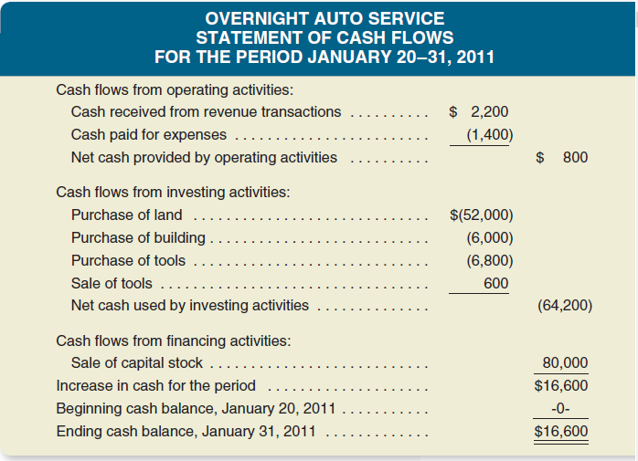
Demonstration

Slide 10
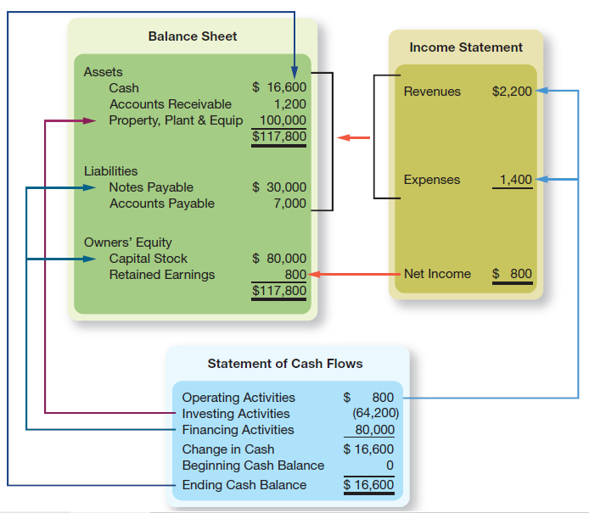
FINANCIAL STATEMENT ARTICULATION

