Slide 1
CRYPTOGRAPHY AND IT’S TYPES
Made By:
Muhammad Mubashir

Slide 2
S NO | CONTENT
1 | Who is the father of Cryptography
2 | Cryptography
3 | What is cryptography used for
4 | Types of Cryptography & Diagram

Slide 3
Who is the father of Cryptography?
Claude Shannon. Claude E. Shannon is considered by many to be the father of mathematical cryptography. Shannon worked for several years at Bell Labs, and during his time there, he produced an article entitled "A mathematical theory of cryptography".

Slide 4
CRYPTOGRAPHY
Cryptography is the study of secure communications techniques that allow only the sender and intended recipient of a message to view its contents. The term is derived from the Greek word kryptos, which means hidden.

Slide 5
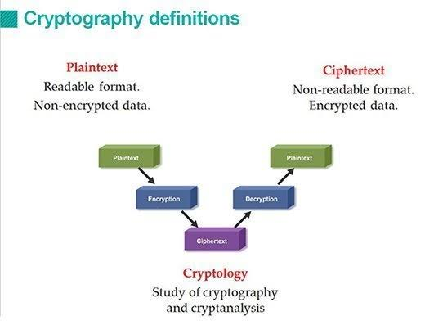
Cryptography

Slide 6
What is Cryptography Used For?
Cryptography provides for secure communication in the presence of malicious third-parties known as adversaries. Encryption uses an algorithm and a key to transform an input (i.e., plaintext) into an encrypted output (i.e., ciphertext).

Slide 7
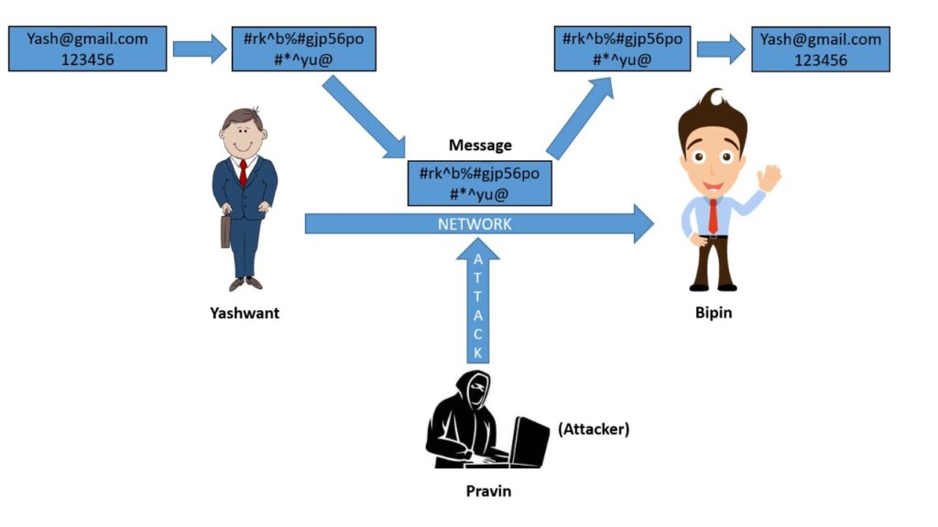
Continue..

Slide 8
Types Of Cryptography
There are three types of Cryptography
Secret Key Cryptography (Symmetric)
Public Key Cryptography (Asymmetric)
Hash Function Cryptography

Slide 9
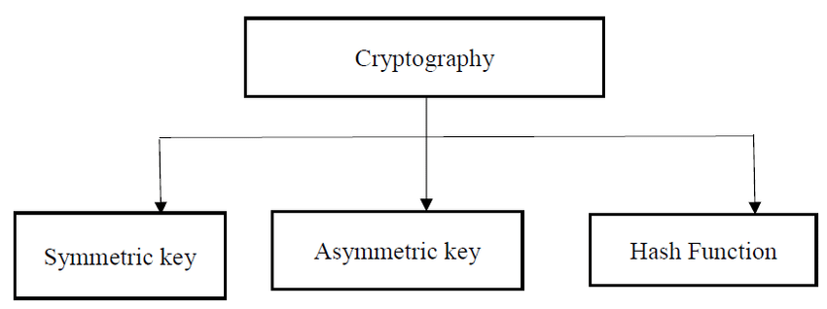
Types

Slide 10
Thank you for Patiently Listening!

