Slide 1
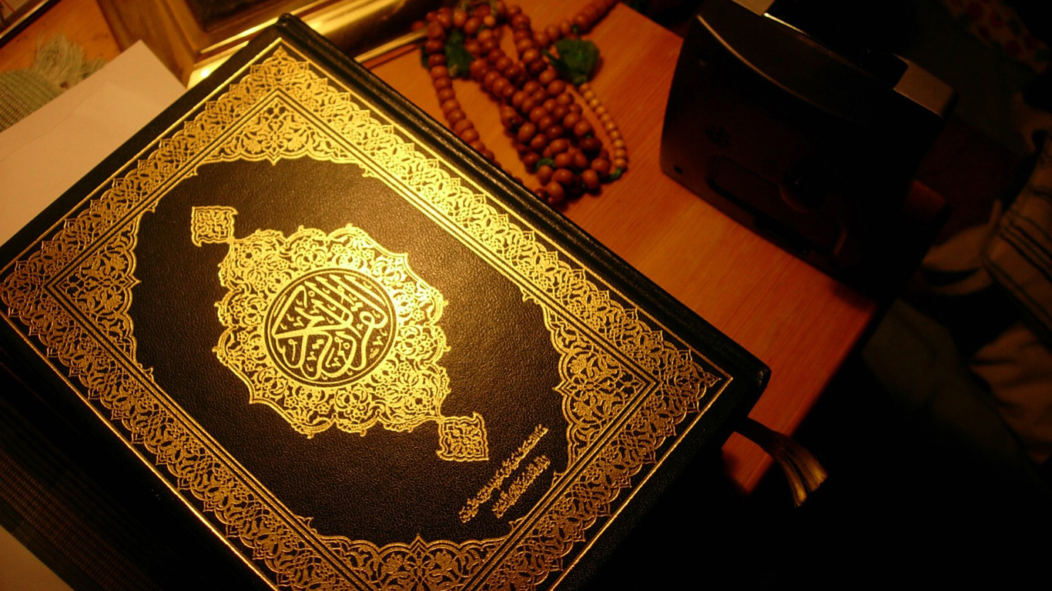
ISLAMIC LAW AND JURIPRUDENCE

Slide 2
ISLAMIC JURISPRUDENCE
Fiqh (Arabic: فقه‎ [fiqh]) is Islamic jurisprudence.
Fiqh is an expansion of the code of conduct (Sharia) expounded in the Quran, often supplemented by tradition (Sunnah) and implemented by the rulings and interpretations of Islamic jurists.
Fiqh deals with the observance of rituals, morals and social legislation in Islam.

Slide 3
ISLAMIC LAW
Sharia (Arabic: شريعة‎ also قانون إسلامي ) is the moral code and religious law of Islam.
Sharia deals with many topics addressed by secular law, including crime, politics, and economics, as well as personal matters such as hygiene, diet, prayer, and fasting.
Islamic religious law that governs not only religious rituals, but aspects of day-to-day life in Islam. Sharia, literally translated, means "the way."

Slide 4
In islamic law
Hygiene and purification
Prayer
Funeral prayer
Taxes
Fasting
Pilgrimage
Trade
Inheritance
Marriage
Divorce
Justice Family relations
Crime and punishment
Inheritance and disposal of property
The economic system
External and other relations

Slide 5
HISTORY AND IMPORTANT OF ISLAMIC LAW AND JURISPRUDENCE
The origin of sharia is the Qur'an, believed by Muslims to be the word of God, and traditions gathered from the life of the Islamic Prophet Muhammad (born ca. 570 CE in Mecca)
caliphs Abu Bakr (632–34)
HazratUmar (634–44)
Hazrat Ali 656 CE to 661 CE
Abu Sufyan ibn Harb, ca. 662 CE
early Muslim jurist Muhammad ibn Idris ash-Shafi'i (767–820)

Slide 6
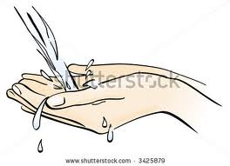
BASIC LAW OF ISLAMIC LAW AND JURISPRUDENCE
Hygiene and purification
In Islam, purification has a spiritual dimension and a physical one
impure animals
Muslims use water for purification
wudhu or ghusl
Muslims' cleaning of dishes, clothing and homes

Slide 7
BASIC LAW OF ISLAMIC LAW AND JURISPRUDENCE
Economic laws
must pay an annual alms, known as zakat.
Islamic law recognizes private and community property
interest on loans is prohibited
division of property
Theological obligations
must attempt a visit to the Holy Places of Islam located in Mecca
pilgrimage, known as the Hajj
to pray five times each day

Slide 8
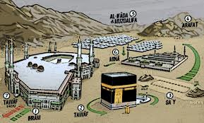
Theological obligations

Slide 9
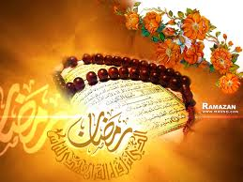
BASIC LAW OF ISLAMIC LAW AND JURISPRUDENCE
Dietary laws
month of Ramadan
pure foods and drinks.
Swine, blood, the meat of already dead animals and animals slaughtered in the name of someone other than God.
Slaughtering an animal in any other way except the prescribed manner of tazkiyah (cleansing) by taking God's name,
Intoxicants

Slide 10

BASIC LAW OF ISLAMIC LAW AND JURISPRUDENCE
Criminal jurisprudence
The concept of justice embodied in sharia is different from that of secular Western law
Crime in Islam is sin. one must ultimately answer to God on the Day of Judgement.
human rights.
crimes of adultery
Blasphemy
Apostasy
Homosexuality
crime of theft
public intoxication.

Slide 11
BASIC LAW OF ISLAMIC LAW AND JURISPRUDENCE
Muhammad is reported to have said: "He who plays with dice is like the one who handles the flesh and blood of swine." Abd-Allah ibn Amr reported that Muhammad prohibited all games of chance and card playing that caused financial gain or loss.

Slide 12
BASIC LAW OF ISLAMIC LAW AND JURISPRUDENCE
Penalties
The punishment depends on whether the criminal was convicted of qesas, hudud or tazir.
In accordance with the Quran and several hadith, theft is punished by imprisonment or amputation of hands. Several requirements are in place for the amputation of hands, they are:
There must have been criminal intent to take private (not common) property.
The theft must not have been the product of hunger, necessity, or duress.
The goods stolen must: be over a minimum value, not haraam, and not owned by the thief's family.
Goods must have been taken from custody (i.e., not in a public place).
There must be reliable witnesses.
All of these must be met under the scrutiny of judicial authority.^{[Quran 5:38}
Rape is punishable by death in sharia law

Slide 13
BASIC LAW OF ISLAMIC LAW AND JURISPRUDENCE
Customs and behaviour
Saying "Bismillah" (in the name of God) before eating and drinking.
Using the right hand for drinking and eating.
Saying "As-Salaam Alaikum" (peace be upon you) when meeting someone and answering with "Wa 'alaikumus salam" (and peace be upon you).
Saying "Alhamdulillah" (all gratitude is for only God) when sneezing and responding with "Yarhamukallah" (God have mercy on you).
Saying the "Adhan" (prayer call) in the right ear of a newborn and the Iqama in its left.
In the sphere of hygiene, it includes:
Clipping the moustache
Cutting nails
Circumcising the male offspring
Cleaning the nostrils, the mouth, and the teeth and
Cleaning the body after urination and defecation
Burial rituals include funeral prayer of bathed and enshrouded body in coffin cloth and burying it in a grave.

Slide 14
BASIC LAW OF ISLAMIC LAW AND JURISPRUDENCE
Rituals
There are two festivals that are considered Sunnah.
Eid ul-Fitr
Eid al-Adha
Rituals associated with these festivals:
Sadaqah (charity) before Eid ul-Fitr prayer.
The Prayer and the Sermon on Eid day.
Takbirs (glorifying God) after every prayer in the days of Tashriq. (Normally these days are considered to be the ones in which pilgrims stay at Mina once they return from Muzdalifah i.e., the 10th, 11th, 12th and 13th of Dhu al-Hijjah.)
Sacrifice of unflawed, four legged grazing animal of appropriate age after the prayer of Eid al-Adha in the days of Tashriq.

Slide 15
BASIC LAW OF ISLAMIC LAW AND JURISPRUDENCE
Dress codes
The rule for men has been ordained before the women: “say to the believing men to lower their gaze and preserve their modesty, it will make for greater purity for them and Allah is well aware of all that they do.”^{[Quran 24:30]}
The text continues, “And say to the believing women that they cast down their looks and guard their private parts and do not display their ornaments except what appears thereof, and let them wear their khumūr over their bosoms, and not display their ornaments except to their husbands...”^{[24:31]}
Men have a more relaxed dress code: the body must be covered from knee to waist.
women are required to cover all of their bodies except hands and face.
headscarf, or hijab

Slide 16
SOURCE OF ISLAMIC LAW AND JURIPRUDENCE

Slide 17
SOURCE OF ISLAMIC LAW AND JURIPRUDENCE
QURAN
SUNNAH
SECONDARY SOURCES

Slide 18
SOURCE OF ISLAMIC LAW AND JURIPRUDENCE
QURAN
The Qur'an is the first and most important source of Islamic law.

Slide 19
SOURCE OF ISLAMIC LAW AND JURIPRUDENCE
Sunnah
The Sunnah is the next important source

