Slide 1
FLIGHT CENTRE TRAVEL GROUP · TEAM 62 (SIGNAL SIX), QUT
Being the answer:
Generative Engine Optimisation for FC.com
Why agentic commerce changes where customers find us, what the published evidence and our own controlled test show, and what FC.com should change first.
Senior leadership briefing · 25 October 2026 · 25 minutes + Q&A
Evidence: peer-reviewed and preprint GEO research (2024–2026); Google, OpenAI and Bing documentation; live checks of flightcentre.com.au and competitors (25 Oct 2026); Semester 1 website audit (May 2026); controlled sandbox experiment, 290 answers per version (Aug–Sep 2026).
Notes:
[0:00–0:30] Open with one sentence: 'Customers are starting to ask an assistant instead of a search box, and today the assistant rarely names Flight Centre unless the customer does. We measured why, we fixed one part of it in a controlled test, and we have a programme to do the rest.'
Then go straight to slide 2.

Slide 2
WHY · WHAT · HOW · WHAT IF
The AIM: how FC can become easier to find and cite
1. Understand the whole customer journey
2. Turn the evidence into an plan
Explore how customer journey is changing
GOOGLE -> Browse websites -> compare and book
AI streamlines the process into one conversation thread
Show where FC fits into that journey currently
- Our completed experiment tests whether improved FC pages receive more citations once the model reads them.
- We will show the page changes, the answers and the results, then finish with implementation owners and business measures.
2
Notes:
Presentation timing: 00:25-01:00 (35 seconds).
Transition: First, the change in customer behaviour.
Two priorities: improve discovery coverage and improve the content an engine can read. The selected saved-source comparison increased citation inclusion from 116 to 152 of 290 answers. This is exploratory evidence, not a live business forecast. Implementation owners are proposals.

Slide 3
PART 1 · WHY
Travel discovery is moving into the assistant, and Flight Centre had gaps in the sampled unbranded answers
External signals on agentic commerce, and what our audits found on FC.com.
• How customers now start a trip, in the US and in Australia
• Who is already inside the chat
• Where FC.com stands today, layer by layer
3

Slide 4
FLIGHT CENTRE GEO
External signals
Why AI discovery matters to Flight Centre
+28.8%
+119%
of Australian travellers used generative AI to find deals, research destinations or build itineraries (Compare the Market survey, 2026)
year-on-year growth in AI-referred visits to travel websites, July 2026; they convert within 1% of other traffic (Adobe Digital Insights)
Local Statistics: Australian market
Global Statistic: US market
- In Australia, almost 29% of travellers surveyed have already used generative AI to find deals
Business Opportunity : we want to make sure Flight Centre is one of the businesses they discover and consider when planning their holidays.
- US travel websites experienced a 119% increase in traffic coming from AI platforms compared to the previous year.
- Indication of how AI is becoming another way for customers to discover travel agencies.
Sources: Phocuswright, The AI Surge (2026) as reported by ITB Berlin and Travel Weekly; Compare the Market Australian traveller survey (2026, via ITBrief); Adobe Digital Insights AI Traffic Trends (19 Aug 2026); Chapekis & Lieb, Pew Research Center (22 Jul 2025); FCTG FY26 ASX results (26 Aug 2026).
3
Notes:
Presentation timing: 01:00-02:05 (65 seconds).
Transition: Here is how that customer question turns into an answer.
The Phocuswright 56% figure refers to reported use on at least one trip in the preceding 12 months, not solely during H1 2026. Adoption and referral studies use different populations and denominators. Pew measures observed click differences, not our causal effect. Sources: https://www.phocuswright.com/Travel-Research/Research-Updates/2026/The-fastest-shift-in-travel-behavior-just-became-the-default ; https://business.adobe.com/resources/sdk/ai-traffic-trends-report-august-2026.html

Slide 5
THE CUSTOMER JOURNEY
How a travel question becomes an AI answer
“Give me a package for a family holiday to Bali”
1 Understand
2 Find information
3 Read and compare
4 Write the answer
5 Help the customer act
Identify the traveller’s need.
Some engines issue related searches.
Search indexed pages, or use
an available app / data service.
Select relevant evidence.
Content access varies by engine.
Choose facts and sources to cite.
A citation is not a recommendation.
Visit a site, request a quote,
contact an expert or book.
*Our experiment tests only steps 3 & 4 after the sources have been supplied. It does not test this whole journey.
Conceptual map, not a universal engine specification. Sources: Google Search Central; OpenAI crawler and app documentation.
Notes:
Presentation timing: 02:05-03:35 (90 seconds).
Transition: Now map FC evidence to this journey.
Sources checked 25 October 2026: https://developers.google.com/search/docs/appearance/ai-features ; https://developers.openai.com/api/docs/bots ; https://developers.openai.com/plugins . Google documents query fan-out; behaviour varies across engines. An assistant may answer without browsing. The arrows simplify the web-grounded case. Apps are an alternative information/action route, not proof that a website is bypassed every time.

Slide 6
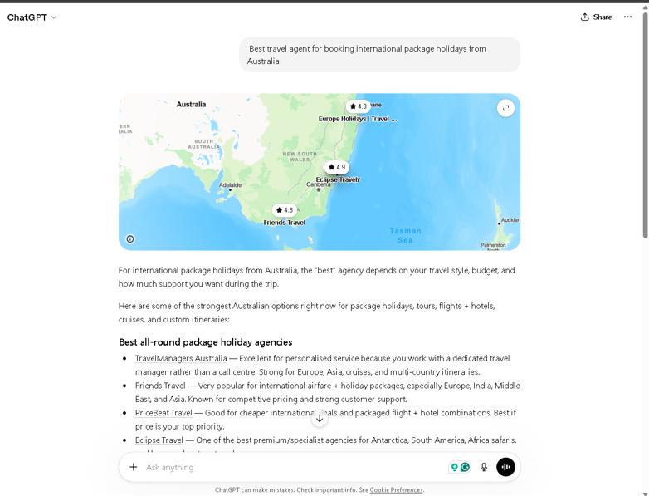
FLIGHT CENTRE GEO
Semester 1 audit (May 2026)
Live check 25 Oct 2026
How AI-Ready Is Flight Centre's Website?
Type of customer question | FC impression score | Key Findings
Comparing travel providers | 2.34% | Highest visibility among unbranded questions tested
Finding a nearby travel agency | 1.75% | Limited visibility in a small sample
Researching travel information | 0.00% | FC did not appear in the tested answers
Looking to book travel | 0.00% | FC did not appear in the tested answers
Searching specifically for Flight Centre | ~100% | Strong visibility when customers state the brand
Live check, 25 Oct 2026 (no JavaScript) | Found
Route pages (Melbourne–London, Brisbane–Bali): FAQ text and one JSON-LD block (FAQPage, Flight, Offer) | Yes
Route pages: dated deal cards (airline, dates, cabin, price) in the HTML | No
Holiday pages (Bali, Fiji): any JSON-LD (FAQ questions are now in the text, an improvement since August) | No
/llms.txt (Expedia publishes one; Google ignores it) | 404
robots.txt allows AI search and training bots (wildcard Allow, plus GPTBot, PerplexityBot, AnthropicBot named) | Yes
ChatGPT, May 2026: 'Best travel agent for booking international package holidays from Australia'. Agencies named; Flight Centre absent; sources were forums and review sites.
Sources: Pillar 2 audit §10.3 (impression score = FC-related words as % of answer words; single run per cell; directional). Live fetches of flightcentre.com.au 25 Oct 2026 with JavaScript off (counts of application/ld+json, FAQPage, 'Available between'). Brave Search AU snapshot, Aug 2026 (fc_search_rank = best rank across three wordings; questions Q23–Q30). Not 'zero everywhere': a documented subset.
5
Notes:
Presentation timing: 03:35-04:45 (70 seconds).
Transition: Start with access and readable information.
These are dated samples, not proof of universal brand absence. The May score is a word-share measure, not our answer-level citation metric. Best rank across query wordings is not an organic production ranking. Robots permissions do not establish successful crawler access.

Slide 7


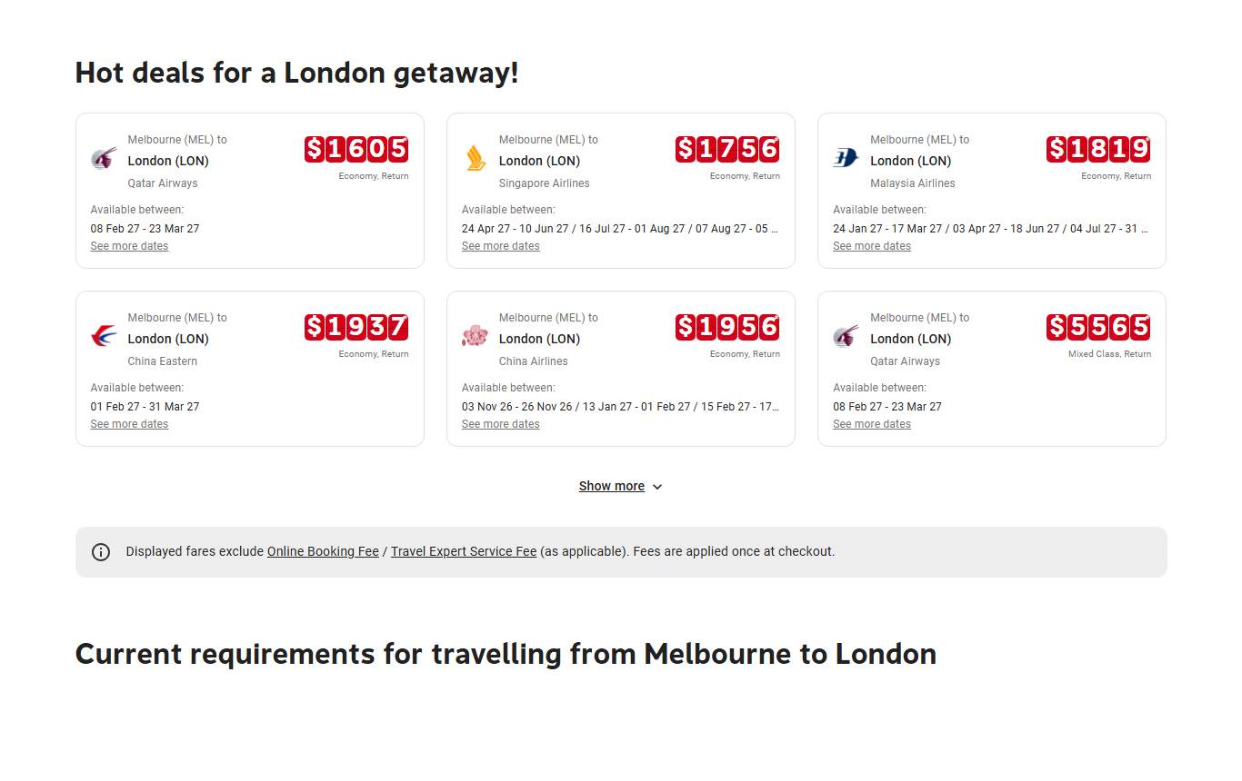
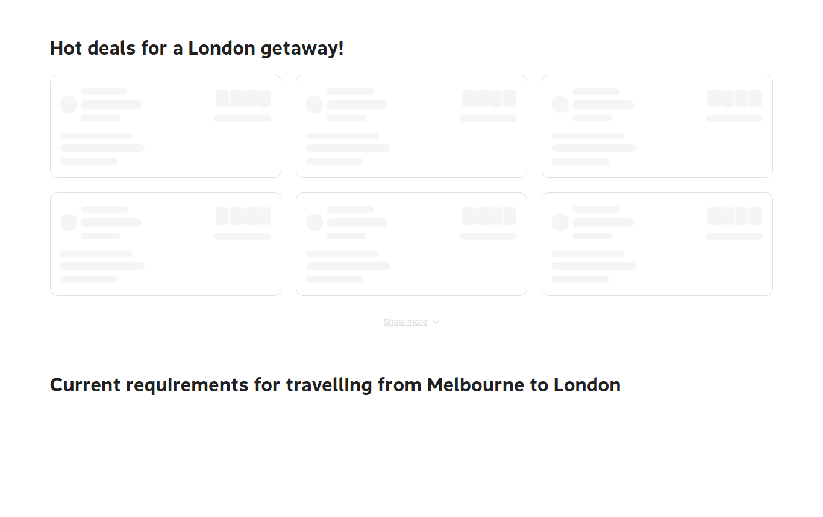


Without JavaScript, FC’s deals disappear
WHY · WHAT AI NEEDS FROM FC
1 READ
2 FIND
3 ANSWER
4 TRUST
5 ACT
What a customer sees
What a text-only AI reader gets
6 dated deals with prices
0 deals, dates or prices
Same Melbourne–London page, live check 25 Oct 2026. Many AI crawlers don’t run JavaScript (Vercel, Dec 2024).
FC ACTION Put deals, prices and FAQs in the page’s HTML, the same as customers see
Notes:
Presentation timing: 04:45–06:15 (90 seconds).
SCRIPT
“I’ll cover five things that decide whether an AI answer can use Flight Centre: can it read the page, can it find it, does the page answer the question, can it trust the facts, and can the customer act.” [Point to the five labels at the top right.]
“First, reading. On the left is FC’s Melbourne–London page as a customer sees it, with six dated deals. On the right is the same page with JavaScript switched off, which is how many AI tools read a page. The deal cards are empty: no airlines, no dates, no prices. If an AI can’t read the deals, it can’t mention them.”
“The fix is well understood: put the deals, prices and FAQs into the page’s HTML, the same content customers see.”
TRANSITION: “Being readable only helps if the page is found in the first place.”
IF ASKED
• Do all AI crawlers skip JavaScript? No. Google renders JavaScript, and capabilities differ by engine and change over time. That is why we say “many”.
• Is FC blocking AI bots? No. robots.txt allows the main AI search bots. CDN and firewall rules can still block access, so confirm real crawler visits in the server logs.
• Holiday pages show the same pattern: the Bali page has 14,107 characters of visible text with JavaScript and 6,483 without.
SOURCES: live captures of flightcentre.com.au with JavaScript on and off, 25 Oct 2026; Vercel/MERJ AI crawler study (Dec 2024); OpenAI crawler documentation.

Slide 8



FC is missing from “why use an agent?” searches
WHY · WHAT AI NEEDS FROM FC
1 READ
2 FIND
3 ANSWER
4 TRUST
5 ACT
0 of 8
How can a travel agent save me money on my trip?
1
2
“Why use a travel agent?” questions had a Flight Centre page in the top 10 search results
3
4
5
6
7
8
9
Brave Search Australia snapshot, Aug 2026: 8 questions (Q23–Q30), best result across three wordings of each.
10
Flight Centre: not in the top 10
FC ACTION Publish useful pages that answer these questions, link them well and check indexing
Notes:
Presentation timing: 06:15–07:20 (65 seconds).
SCRIPT
“Second, finding. We looked at eight questions people ask about whether to use a travel agent at all, like ‘How can a travel agent save me money on my trip?’ These are the questions where Flight Centre should be the answer. In our August search snapshot, a Flight Centre page didn’t appear in the top 10 results for any of the eight.”
“If an AI search tool doesn’t find the page, it can’t cite it, however good the page is. The fix is ordinary search work done well: useful pages that genuinely answer these questions, linked from relevant route, destination and store pages, and checked for indexing problems.”
TRANSITION: “Once a page is found, it has to answer the question.”
IF ASKED
• The eight questions (Q23–Q30): Why consult a travel professional instead of booking online? · What unique services do travel consultants offer that DIY sites can’t match? · How can a travel agent save me money on my trip? · What makes a travel agency worth its service fee? · When is it most beneficial to engage a professional agency versus self-booking? · What questions should I ask a travel agent before booking? · Who provides expert guidance on visas, health, and entry requirements? · Why hire an agent for luxury or specialty travel?
• Does this mean FC has no suitable pages? No. It is a dated snapshot; suitable pages may exist but were not in the top 10.
• Does ranking higher guarantee an AI citation? No. Ranking and citation are different (see the hidden backup slide “Ranking is not the same as being cited”).
• Technical checks: canonical URLs, sitemaps, accidental noindex rules, notifying indexes of genuine changes (IndexNow), page speed and mobile usability. These are standard SEO work, not effects we measured.
SOURCES: Brave Search AU snapshot, Aug 2026 (FC’s best rank across three wordings of each question); Google AI features and JavaScript SEO guidance; Bing IndexNow guidance.

Slide 9







Competitor destination pages answer more questions
WHY · WHAT AI NEEDS FROM FC
1 READ
2 FIND
3 ANSWER
4 TRUST
5 ACT
NAMED ENTITIES IN THE PAGE HTML (MAY 2026 AUDIT, APPROX.)
DEDICATED BALI PAGE FOR EACH TRAVELLER NEED?
Budget
Family
Honeymoon
Luxury
Packages
FLIGHT CENTRE
EXPEDIA
Yes
Partly
No
FC ACTION Answer real traveller questions on destination pages, from one approved fact store
Notes:
Presentation timing: 07:20–08:25 (65 seconds).
SCRIPT
“Third, answering. AI answers are built from specific facts: places, prices, durations. In our May audit, Expedia’s Bali page named about three times as many specific entities as Flight Centre’s, and Booking.com’s about six times as many.”
“Expedia also has a dedicated Bali page for every traveller need we checked: budget, family, honeymoon, luxury and packages. Flight Centre fully covers one, packages, and partly covers two.”
“The fix is to answer real traveller questions on destination pages, such as ‘Do Australians need a visa to visit Bali?’, built from one approved fact store where every fact has an owner, a source and a review date.”
TRANSITION: “Answers also depend on whether the facts can be trusted.”
IF ASKED
• Entities = specific named things on the page, counted in the raw HTML (approximate). Counts: Bali ~9 / ~28 / ~55; Dubai ~12 / ~32 / ~65+ (FC / Expedia AU / Booking.com).
• Prices with currency on the Bali page: FC 0 (alt text only), Expedia 2, Booking.com 3+. Quantitative facts: FC 1, Expedia 3, Booking.com 8+.
• Booking.com coverage: budget and luxury yes; family and honeymoon partly; packages yes.
• Proposed build: fact store → question templates → generator → page text plus FAQ structured data. Answer rule: sentence one answers; sentence two adds named places, durations and currency; sentence three says how an FC expert helps.
• Verify official travel requirements before publishing any answer.
SOURCES: Pillar 2 audit §8.2 and §10.2 (entity density and intent coverage, captured 10–15 May 2026); Pillar 3 audit §11 (programmatic FAQ design).

Slide 10



AI trusts consistent facts and outside proof
WHY · WHAT AI NEEDS FROM FC
1 READ
2 FIND
3 ANSWER
4 TRUST
5 ACT
1
CONSISTENT PRICES
2
OUTSIDE PROOF
FC Melbourne → London page, 25 Oct 2026
AI answers lean on what others say about a brand
Page heading
$1,342
Data for machines
$1,342
Reviews
Forums
Wikipedia
Cheapest deal card
$1,605
Economy return, Feb–Mar 2027
27,355
Trustpilot reviews naming FC consultants: an asset FC already has
Which price should an AI quote?
May 2026: ChatGPT’s answer on travel agencies drew on forums and review sites, and didn’t name FC.
Both can be valid, but the page doesn’t say what each price covers.
FC ACTION One approved record behind every price; keep reviews, Wikipedia and listings accurate
Notes:
Presentation timing: 08:25–09:40 (75 seconds).
SCRIPT
“Fourth, trust. AI tools repeat what they can rely on, and that comes from two places.”
“One is consistent facts. On 25 October, the Melbourne–London page’s heading and its data for machines both said $1,342, while the cheapest deal card said $1,605. Both can be valid, because they may cover different dates, but the page doesn’t say so, so an AI quoting it has to guess. One approved fare record, with its dates, cabin and fees, should feed every price on the page.”
“The other is outside proof: what reviews, forums and Wikipedia say. The ChatGPT agency answer we showed earlier drew on forums and review sites and didn’t name Flight Centre. FC already has a strong asset here, with 27,355 Trustpilot reviews naming its consultants. Keep these sources accurate and respond to genuine reviews, but never manufacture endorsements.”
TRANSITION: “Finally, helping the customer act, where apps are a new route.”
IF ASKED
• Is the $1,605 vs $1,342 difference an error? Not necessarily. Compare equivalent dates, cabin, fees and availability first. The heading fare also changed over time: $1,434 (Aug capture), $1,272 (23 Oct), $1,342 (25 Oct).
• “Data for machines” = the JSON-LD Offer on the page (price 1342 on 25 Oct).
• Expert and store path: make booking, store and expert options explicit in page text, and keep store names, addresses and hours consistent across listings.
• Wikipedia and Wikidata entries for FC are already mature (May 2026 audit). Edits must follow Wikipedia’s conflict-of-interest and sourcing rules.
SOURCES: live fares 23–25 Oct 2026 (page heading, JSON-LD Offer and deal cards); Pillar 3 audit §12 (Wikipedia, Wikidata, Trustpilot, 15 May 2026); ChatGPT answer captured May 2026; Google guidance on inauthentic mentions; ACCC guidance on false or misleading claims.

Slide 11



Travel brands are already inside ChatGPT
WHY · WHAT AI NEEDS FROM FC
1 READ
2 FIND
3 ANSWER
4 TRUST
5 ACT
SINCE OCTOBER 2025
Oct 2025
Early 2026
Mar 2026
May 2026
Jun 2026
Expedia and Booking.com launch apps
Skyscanner, Accor and Lighthouse follow
ChatGPT moves checkout into apps
Google names hotel booking next
Virgin Australia: first Australian airline
HOW A TRAVEL APP WORKS IN CHATGPT
Customer asks in the chat
The brand’s app shows live prices and options
Booking finishes on the brand’s own site
FC ACTION Pick one customer task, such as reaching an FC expert, and test it before building an app
Notes:
Presentation timing: 09:40–10:50 (70 seconds).
SCRIPT
“Fifth, acting. Travel brands are already inside ChatGPT. Expedia and Booking.com launched the first travel apps in October 2025, Skyscanner and Accor followed, and in June Virgin Australia became the first Australian airline there.”
“This is how it works: the customer asks in the chat, the brand’s app shows live prices and options, and the booking finishes on the brand’s own site. ChatGPT has moved checkout into apps, so the contest is for the discovery step inside the conversation.”
“For Flight Centre, an app is a separate decision from the website work. We suggest picking one customer task, such as connecting a customer with an FC travel expert, and testing the business case before building.”
TRANSITION (hand over to the next presenter): “We then tested the content step in a controlled setting.”
IF ASKED
• Is Expedia’s app available in Australia? Australia was not among Expedia’s listed markets at last check. Availability varies by market, so verify before quoting externally.
• Google: its Universal Commerce Protocol named hotel booking as the next vertical (19 May 2026); travel packages are not eligible for checkout.
• What an FC app would need: a clear use case, reliable data, customer consent and a booking or enquiry hand-off. Having internal MCP capability does not mean a public app is available or automatically chosen by the assistant.
SOURCES: OpenAI “Apps in ChatGPT” announcement (6 Oct 2025); Expedia in ChatGPT product page; PhocusWire and Skift on OpenAI checkout changes (5–6 Mar 2026); Executive Traveller and Point Hacks on Virgin Australia (10 Jun 2026); Skift on Google UCP (19 May 2026).

Slide 12
PART 2 · WHAT
What we did: a frozen sandbox where only the Flight Centre page changes
The evidence base we assembled, how we tested, and what moved.
• What the published research and the platforms themselves say works
• The sandbox and its fairness rules
• Six methods one at a time, then the final page, 40.0% → 52.4%
• What did not work, and what is still unproven
8

Slide 13
WHAT
Our experiment
How we tested: a frozen copy of the web where only Flight Centre's page changes
1
2
3
4
5
6
7
Questions
Search snapshot
Capture pages
Change FC's page
AI answers
Citation check
Statistics
50 travel questions; 29 flight questions with FC in the saved pool form the main test
Brave Search AU, Aug 2026; top 10 used; frozen and fingerprinted
953 pages fetched without JavaScript; scripts and menus stripped
Baseline = as captured. Optimised = final page (52 FC pages). Competitors never change
OpenAI gpt-5.6-luna; cites sources by number
Does any [n] point to an FC source? Counted offline, no AI call
Paired bootstrap over questions; fairness checks; offline recount
Where the 290 answers come from
Kept honest
29
×
2
×
5
=
290
Model, prompt and settings locked; drift stops a run
Results are write-once
All 290 pairs matched on question, sources, order and competitor text
questions
source orders
repeats
answers per version
290 answers are not 290 independent questions: the analysis resamples the 29 questions. An interval that crosses zero leaves the direction uncertain.
Source: Technical Report and Handover Guide v1.1, Sections 5–6 and Figure 1. Reportable runs use OpenAI or Anthropic only; offline mode is for dry runs.
13
Notes:
The pipeline controlled saved source content and order; the model chose wording and citations. The 290 answers are grouped within 29 questions, so they are not 290 independent trials.

Slide 14
WHAT
Our experiment
Result: answers citing Flight Centre rose from 40.0% to 52.4%
116 → 152
+12.4 pts
of 290 answers cited FC
95% interval +5.2 to +20.0
Question by question: 21 up, 6 down, 2 unchanged
About 4 in 10 answers cited FC before, about 5 in 10 after. 52.4% is a rate, not a 52% improvement (relative gain 31%).
Exploratory: refined on these questions, reused baseline, different capture dates. First same-page run: 49.3%. Not a live ranking, a booking or a revenue forecast.
Source: Technical Report v1.1, Table 9; Independent_Repeat_Analysis.json; paired bootstrap over questions, 20,000 resamples, seed 20261018. Both totals reproduce offline with no AI call (verify_public_counts.py).
14
Notes:
116 of 290 versus 152 of 290: +12.4 points, about 31% relative. The interval is exploratory. A reused baseline, capture differences and iterative selection limit causal claims. First same-page run was 143 of 290 (49.3%).

Slide 15
WHAT
Our experiment
Published research
One at a time: structure and facts helped, AI rewriting hurt
Method and what it changes on FC's page
Change vs original (points)
−5.5 pts
Source position (test only)
+18.3
Moves FC's unchanged page to the top of the AI's source list
AI rewriting (interval −10.0 to −1.4). C-SEO Bench agrees; Google and Bing warn about manipulative or low-value content, not all AI writing.
Structured facts
+7.6
Existing facts as labelled fields: route, fare, fees
Grounded FAQ
+6.9
Q&A built only from facts already on the page
Rendered content + cleanup
+6.6
Page after JavaScript runs, so deals become text; tidier order
Schema + visible structure
+6.2
Adds missing schema fields plus a matching visible layout
What to take from it
Demand evidence before buying rewriting; our result does not judge every service.
The final page combines four changes; gains do not add.
Intervals are exploratory.
edit
Automatic AI rewriting
−5.5
AI rewrites the page; rewrites adding a new number rejected
Clear gain
Uncertain (crosses zero)
Decline
Source order (test only)
Reached rendering, coverage, off-site authority
Read facts present in the text received
Cited what our experiment tested, once read
Sources: Technical Report v1.1, Table 7 and Section 8.1 (each method tested on its own vs the same original pages, 114 of 290 citing; intervals exploratory); Puerto et al., C-SEO Bench (2025); Google (May 2026); Bing (Feb 2026).
15
Notes:
Point estimates are not all conclusive. Rendered content and external facts have intervals crossing zero. Source position is a diagnostic, not something FC can force. The rewrite result applies to the tested implementation only; the final page is not the sum of the single estimates.

Slide 16
WHAT
Our experiment
The page changes and the answer that followed
BEFORE · Melbourne–London as captured (Aug 2026)
AFTER · the final page (releases r4 + r5, Sep 2026)
Flights from Melbourne to London $1,434 + fee notice, expert tip
1
Six dated deal cards as text
No dated deal cards
They render only after JavaScript runs, so the saved capture has none.
China Eastern $1387*
08 Feb – 11 Mar 27
Singapore Airlines
Royal Brunei
+ 3 more
2
One labelled fact block
FAQ: answers present, questions missing
The questions sat inside accordion buttons, which text extraction strips.
Departure MEL · Destination LON · Starting fare stated on page: from $1,386 · Fees: the page's own fee notice
3
FAQ questions back beside their answers
'Why should I book a flight through Flight Centre?' · 'Does Flight Centre have a loyalty program?'
8,435 characters reach the model
9,909 characters reach the model
2 → 8 of 10
Same question, same eight sources. 'i'm looking for flights from melbourne to london'
Original: fares AU$1,096–AU$1,342, credited to Expedia and Skyscanner [5][8]. FC [7] never appears.
Improved: return fares up to A$1,386 [1][7][8]: FC's stated fare, and FC cited again for connections [2][3][7] and airports [1][4][7].
A citation links to the page; it does not show the sentence is fully supported, or that a customer would book with FC.
answers cited FC for this question, original vs improved page
Fares differ ($1,434 vs $1,386) because the copies were captured on different dates, so the gain cannot be put down to formatting alone. The fact block applied to 27 of 52 pages. Only FC's own saved text was used; these questions were used in development.
Source: Q06 source [7] flightcentre.com.au/flights/au-vic-melbourne/gb-eng-london; final_release.py (r4), flight_first_refinement.py (r5); saved answer Q06_fixed_s2_r4 (unedited apart from trimming). Technical Report v1.1, Section 7.2.
16
Notes:
Real before and after pages. Different capture dates explain the fare difference. The joint block applied to 27 of 52 pages. A citation links to a page; it does not establish support for every claim, or a booking.

Slide 17
PART 3 · HOW
How FC.com should change: five areas of work, in order
Each has a concrete change, its evidence, a test and a proposed owner.
• Access and rendering: what the fetchers receive
• Structure and content: what each page should state
• Authority: outside proof and a visible expert
• Measure first; then implement and monitor real customer outcomes
17
Notes:
The programme is five areas of work, in order, after a first step of measuring. Each has a concrete change, the evidence behind it, a test FC can run and a proposed owner.

Slide 18
HOW
Proposed
How FC.com should change: five areas of work, each with a change and a test
Area
FC today (25 Oct 2026)
Change
Done when
Owner
Measure first
Ongoing monitoring not verified
Question panel, platform reports, bot logs; save dated examples
Dated metrics and a named reporting owner
Marketing analytics
0
Access
Bots allowed in robots.txt
Keep path rules; check CDN and firewall rules
Logs: AI search bots fetch pages, status 200
Platform eng.
1
Rendering
Deals: 6 with JavaScript, 0 without
Deals, fees, FAQ answers and expert path in the HTML
A no-JavaScript fetch returns those facts
Web eng.
2
Structure
Route has JSON-LD; holiday pages none
JSON-LD from the same record as the page text
Schema validates and matches visible facts
SEO + eng.
3
Content
Tested in our experiment
Clear opening, dated deals, fact block, page FAQs, FC differentiators in text
Approved facts live; citations monitored
Content + product
4
Authority
Strong assets; absent from sampled answer
Accurate listings, answered reviews, citable research; expert and store path in page text
Accurate listings; mentions monitored; expert path checked
PR, brand, retail
5
Workstreams are not universal prerequisites; owners are role suggestions. The 52% is not attributable to schema, llms.txt or bot access: none was in the tested treatment.
18
Notes:
These are workstreams, not mandatory stages: first measure, then five areas of work. Special AI schema and llms.txt are not requirements. Owners are role suggestions. Do not attribute the 52% to schema, llms.txt or bot access.

Slide 19
HOW
Live check 25 Oct 2026
Proposed
AI is allowed in, but it can't see our deals
The five areas:
1 Access
2 Rendering
3 Structure
4 Content
5 Authority
What a customer sees: 6 dated deals
What most AI fetchers receive: 0 deals
✓
Access is already open
robots.txt allows GPTBot, Google-Extended, PerplexityBot, AnthropicBot and Applebot, and every other bot by default.
Allowed is not proof they fetch. Logs must show AI search bots reading route and holiday pages (status 200).
Flight Centre Melbourne–London page, 25 Oct 2026: with JavaScript (left) and without (right). Holiday pages (Bali, Fiji) show the same gap.
THE PROBLEM
THE FIX
HOW WE'LL KNOW
Deal cards appear only after JavaScript runs: 6 with it, 0 without. Most AI fetchers don't run it, so they see an empty page.
Put dated deals, the fee rule, FAQ answers and the expert path in the page's first HTML, the same facts customers see. No AI-only page versions.
Turn JavaScript off and reload: the deals must still be there. Today: 0 of 6.
Sources: live fetches 25 Oct 2026 (Playwright, JavaScript on and off); OpenAI crawler documentation; Vercel/MERJ (Dec 2024, historical: capabilities vary by fetch path); Pillar 1 audit §2 (May 2026).
19
Notes:
Two separate questions. Can the bots get in? Yes: robots.txt allows them, though logs must confirm they actually fetch. Can they read the deals? No: the deal cards appear only after JavaScript runs. The evidence is a JavaScript-dependent difference in sampled browser captures. The acceptance test is a plain one: turn JavaScript off and check the deals are still in the page. A command-line fetch labelled as OAI-SearchBot is a diagnostic only, not proof of a real bot request.

Slide 20
HOW
Our experiment
Published research
Proposed
Every route page should state six things plainly
The five areas:
1 Access
2 Rendering
3 Structure
4 Content
5 Authority
flightcentre.com.au/flights/melbourne-london
Open with the answer
A
research
Flights Melbourne to London from [live fare]
Fee rule stated · Next step: quote, store or expert
Route, starting fare with date and conditions, fee rule and next step.
A
B
Show dated deals as text
+6.6 tested
Airline, cabin, dates and price in the page itself, not loaded by script.
B
[Airline] [cabin]
[dates] [price]
[Airline] [cabin]
[dates] [price]
[Airline] [cabin]
[dates] [price]
C
Label the key facts
+7.6 tested
Departure, destination, starting fare, fees, last updated: stated once, plainly.
Departure
MEL
Destination
LON
D
Put FAQ questions beside answers
+6.9 tested
C
Starting fare
[live fare]
Add the route questions customers ask: airports, flight time, flexibility.
Fees
[fee notice]
Last updated
[date]
E
State what only FC offers
research
Q How long is the flight from Melbourne to London?
A [approved answer from the page's facts]
Fee transparency, named expert, stores and quotes, World360.
D
F
Make the hidden data match
+6.2 (mixed)
E
Talk to a Flight Centre Travel Expert · stores · quotes
JSON-LD built from the same live record. Flight markup only for a real itinerary.
F
Behind the page: data labels match the text above
Green = points gained when tested alone in our experiment. Grey = published research, not tested by us. Gains don't add up.
A design, not a result: experiment pages used old fares and are not for publishing; FC builds these blocks from live approved data. Sources: Technical Report v1.1 Table 7 and §8.1; Pillar 2 audit §8.3–8.4 (May 2026); Google: structured data must match visible text.
20
Notes:
This is what a route page should give an assistant, drawn as a page. Green badges are points gained when that change was tested on its own (labelled facts +7.6, grounded FAQ +6.9, deals as text +6.6); they cannot be added together. Blocks A and E come from published research and were not tested by us. The experiment pages used saved copies with old fares; they are evidence, not pages to publish. LON is a city code; use Flight schema only for a real itinerary.

Slide 21
HOW
Semester 1 audit (May 2026)
Proposed
Holiday pages tell AI far less than competitors do
The five areas:
1 Access
2 Rendering
3 Structure
4 Content
5 Authority
The fix: one fact store feeds every destination page
1
2
3
4
Fact store
Question bank
Generator
Live page
each fact: owner, source, review date
one customer question each
short, fact-based answers
visible FAQ + matching data
Each answer follows one rule: one question, three sentences
Do Australians need a visa to visit Fiji?
Does the Bali page have a dedicated page for each type of traveller?
1
Answer it
sentence 1: the direct answer, from the approved fact
Flight Centre
Expedia
Booking
Budget
No
Yes
Yes
2
Add specifics
sentence 2: named places, durations, currency
Family
Partial
Yes
Partial
Honeymoon
No
Yes
Partial
3
Show the expert
sentence 3: how an FC expert helps, without turning into an advert
Luxury
Partial
Yes
Yes
Verify visa rules and travel facts before publishing, and record the real review date. Facts shown are illustrative.
Bali prices with a currency: FC 0, Expedia 2, Booking 3+. Quantitative facts: FC 1, Expedia 3, Booking 8+.
Sources: Pillar 2 audit §8.2, §10.2 (captured 10–15 May 2026; Dubai: Booking 65+); Pillar 3 audit §11. Expedia builds intent pages per destination; FC's structure varies by region.
21
Notes:
The competitive audit is dated May 2026. FC's Bali page states about 9 named facts against 28 for Expedia and about 55 for Booking.com, and has no dedicated budget or honeymoon page. The fact store is a content governance design: every fact has an owner, a source and a review date, and the same record produces the visible FAQ and the matching data. It is not ready-to-publish travel advice.

Slide 22
HOW
Semester 1 audit (May 2026)
Published research
Proposed
Authority: outside proof and a visible expert
The five areas:
1 Access
2 Rendering
3 Structure
4 Content
5 Authority
1 Outside proof
2 A visible expert
THE ISSUE
THE ISSUE
Where ChatGPT's citations come from
"Talk to a Flight Centre Travel Expert, in 300+ stores or by phone"
Reddit
16.8%
Wikipedia
7.0%
FC's real edge is a human expert, a store and a quote. We have not yet checked that each page says so in text an assistant can quote.
Tripadvisor (the only travel site)
1.5%
In our May 2026 sample of an unbranded agency question, ChatGPT named other agencies and cited forums and review sites, not fc.com, despite FC's Wikipedia entity and 27,355 Trustpilot reviews.
CHECK ON EVERY ROUTE AND HOLIDAY PAGE
Expert named?
Store details?
Quote path?
THE FIX
THE FIX
Keep Wikipedia and Wikidata accurate, answer reviews, and publish citable research such as fare calendars and destination data. No paid posts: Google says inauthentic mentions don't help.
Check each page, then state it in text with consistent store name, address and hours. Start with priority stores. A later app or MCP connector would route here.
Evidence: Ahrefs citation study (Sep 2026) and one dated sample; not tested in our experiment.
Evidence: a proposed check; page-level coverage has not been audited.
Sources: Ahrefs most-cited domains (Sep 2026); Pillar 3 audit §12 (15 May 2026); arXiv 2605.25517; Google on inauthentic mentions.
22
Notes:
Authority has two parts. Outside proof: ChatGPT leans on forums, review sites and Wikipedia; in our single May 2026 sample FC was not named although it has real assets, so keep those accurate and earn coverage honestly, with no paid posts. A visible expert: FC's differentiator is a human expert, a store and a quote. We have not audited whether each page states it in text an assistant can quote, so the first step is a check, then state it consistently. Neither part was tested in our experiment.

Slide 23
HOW
Proposed
The plan: three steps, and three decisions for today
The five areas:
1 Access
2 Rendering
3 Structure
4 Content
5 Authority
1 Assign ownership
2 Implement
3 Monitor and maintain
Output: an owned backlog
Output: templates with consistent facts
Output: regular reporting
Choose the priority route and holiday templates
Name engineering, content and commercial owners
Record today's position: reports, referrals, bot logs
Put offers, dates, fees and FAQ questions in page text
Generate structured data from the same approved record
Keep booking, store and expert paths; normal legal checks
Track citations and mentions with visits, enquiries, quotes
Check cited sentences are supported and offers current
Review over time: seasonality also moves results
Three decisions we ask for today
1
Start measuring
this month
2
Name owners
for a bounded build
3
Review outcomes
then decide investment
Analytics owns platform reports, referrals and dated answer examples.
Readable deals, fact block and FAQ text on some route pages; two holiday templates.
Judge vendors and app or API integrations on their own business cases.
FC does not need to reproduce our experiment to do this. Monitoring shows business progress, not causation. Vendor scores use different denominators and are not comparable with 52.4%.
23
Notes:
Three steps, three asks. This replaces an earlier experimental pilot: the completed sandbox is our evidence, and FC can prioritise templates, publish approved facts and monitor business outcomes through normal processes. No frozen control group is needed. On vendors and agencies: use their checklists as a work list, build the question panel in-house first, and if buying, demand the formula, raw answers and denominator; their scores are not comparable with our citation measure.

Slide 24
WHAT IF
Our experiment
External signals
What if we invest, and what if we wait
If FC invests
If FC waits
THE EVIDENCE
THE EVIDENCE
116 → 152
Evidence that clearer content helps. Not a forecast of live uplift or revenue.
0 of 8
+119%
of 290 answers cited FC in our experiment
'why use a travel agent' questions returned an FC page
AI referrals to travel sites in a year; FC's share unmeasured
WHAT FC GETS
WHAT FC RISKS
Deals and fees every assistant can read
A monthly read of AI visibility, not anecdotes
Expert path ready for a later app or MCP connector
Vendor spend judged against a real baseline
Aggregators and forums keep answering unbranded questions
Deals stay invisible to fetchers without JavaScript
Rivals keep building habits inside ChatGPT
The window is real, but it won't stay open
Readable, useful content gives FC a stronger opportunity to be cited.
40.0%
52.4%
Measure
Make facts fetchable
Apply the tested pattern
Outside proof
original pages
improved pages
Show the expert
Monitor outcomes
Sources: Technical Report v1.1 §8.4; Brave snapshot Aug 2026 (Q23–Q30); Adobe Digital Insights (Aug 2026); competitor launches on slide 11.
24
Team 62 (Signal Six), QUT · github.com/muhammadmubbashar/GEO--Generative-Engine-Optimisation · The research handover is separate and not for publishing. Hidden backups follow.
Notes:
The 36 extra citing answers are an observation in our selected comparison; do not extrapolate them into traffic, citations or revenue. The opportunity is supported, the business value must still be measured. The risk of waiting is not a measured loss: competitors are already inside ChatGPT, AI referrals are growing, and FC's share of them is unmeasured. Readability improves the opportunity to be cited; it does not guarantee selection or a booking.

Slide 25
BACKUP (HIDDEN) · FOR Q&A
Our experiment
Backup: experiment statistics
Quantity | Value
Snapshot | Brave Search AU, August 2026; 50 questions × 3 wordings; top 20 captured, top 10 analysed; 953 pages, 688 usable
Main (fixed) setup | 29 eligible flight questions with FC in the saved source pool; whole page text up to 24,000 characters per source; 2 source orders × 5 repeats = 290 answers per version
Model and prompt | OpenAI gpt-5.6-luna, provider defaults; GEO-paper prompt ('cite using [index]'); no internet access during answering
Original pages | 116 / 290 = 40.0%
Optimised pages | 152 / 290 = 52.4%; +12.4 points; 95% interval +5.2 to +20.0; 21 up / 6 down / 2 same
Individual methods (vs 114 / 290) | Structured facts +7.6; FAQ +6.9; rendered +6.6; schema + visible +6.2; external facts +3.4; AI rewrite −5.5; position benchmark +18.3
Secondary (reindexed) setup | 26 / 400 → 27 / 400 (6.50% → 6.75%): no discovery gain; this was the pre-declared primary measure
Reworded questions (9 Oct 2026) | 199 → 223 / 290 (+8.3 points; interval −1.0 to +17.9; p = 0.12)
Future sample size | Estimate from pilot variance and the smallest worthwhile effect; 29 questions limit precision
Fairness checks | All 290 headline pairs matched URLs, order and unchanged competitor text; offline recount reproduces 116 and 152
Source: Technical Report v1.1, Sections 6, 8 and 10; Offline_Verification.json PASS.
25
Notes:
These are saved experimental statistics. Individual and selected-combined baselines differ (114 versus 116). Matching checks establish record integrity, not truth, citation entailment or causal identification.

Slide 26
BACKUP (HIDDEN) · FOR Q&A
Live check 25 Oct 2026
Backup: live inspection, 25 October 2026 (headless Chromium, JavaScript on and off; curl)
Check | Result
flightcentre.com.au/robots.txt | 200. Allow / for *; explicit Allow for GPTBot, Google-Extended, PerplexityBot, AnthropicBot, Applebot, Google-CloudVertexBot; SEO crawlers (Semrush, Ahrefs, MJ12) disallowed; 8 sitemaps; no OAI-SearchBot, ChatGPT-User or Claude-SearchBot lines; no crawl-delay (the May 2026 audit's crawl-delay and GPTBot block are no longer present)
webjet.com.au/robots.txt | 200. '# AI Search Bots': OAI-SearchBot, Claude-SearchBot, PerplexityBot Allow. '# AI Training Bots': GPTBot, ClaudeBot Disallow
expedia.com.au | robots.txt '# Allow Agentic Search' block (OAI-SearchBot, ChatGPT-User, PerplexityBot, Perplexity-User, Claude-User, Claude-SearchBot); GPTBot not named; /llms.txt HTTP 200, 6,642 characters, including a 'Directions for AI Systems' section
/llms.txt elsewhere | Flight Centre 404 (/llm.txt also 404); Webjet, Qantas, Skyscanner redirect (no file); Booking.com 404
FC route Melbourne–London | JSON-LD: FAQPage (8 questions), Flight, Offer (price 1342), Airport, BreadcrumbList. Deal cards ('Available between'): 6 with JavaScript, 0 without. FAQ questions present without JavaScript. Heading fare $1,342 (was $1,272 on 23 Oct, $1,434 in Aug capture); cheapest deal card $1,605
FC route Brisbane–Bali | 521 KB; 1 JSON-LD block with FAQPage; no deal-card text; title fare $626
FC holiday Bali and Fiji | 0 JSON-LD blocks; FAQ questions present as text without JavaScript; deal tiles empty without JavaScript; Bali visible text 14,107 characters with JavaScript, 6,483 without
Qantas, Skyscanner, Booking.com robots.txt | No AI-bot-specific lines found (wildcard rules apply)
Webjet Melbourne–London | 17,728 visible characters with JavaScript, 17,527 without; seven dated fares each marked 'Last updated'; fee amounts stated in page text
Expedia, Skyscanner route pages | Expedia HTTP 429 (rate-limited); Skyscanner bot challenge; not compared
Method: Playwright (Chromium) with JavaScript on and off and curl, desktop Chrome user agent; files in evidence/. Paired browser captures show a rendering difference in this sample; HTTP status alone does not establish crawler readability.
26
Notes:
Engineering Q&A.

Slide 27
BACKUP (HIDDEN) · FOR Q&A
Published research
Official documentation
Backup: research and documentation sources used in this briefing
Source | What it contributes
Aggarwal et al., GEO: Generative Engine Optimization, KDD 2024 | Benchmark and prompt we reuse; statistics, quotations and structure raised visibility up to ~40% on its benchmark; keyword stuffing did not
Puerto et al., C-SEO Bench, NeurIPS 2025 Datasets & Benchmarks | Most conversational-SEO rewrites ineffective or negative; traditional SEO more effective; gains shrink as more actors adopt (zero-sum)
'What Gets Cited: Competitive GEO in AI Answer Engines', arXiv 2605.25517 (2026) | 252,000 trials, six LLMs, 18 factors: relevance and position dominate; explicit price and recent timestamp help consistently; formatting-only edits have little impact
'Optimizing Visibility in Generative Engines: A Critical Survey (2023–2026)', arXiv 2607.14035 | 45 studies: content gains hold only when the source is already in a fixed context; no durable cross-platform effect on organic discoverability shown; measure repeatedly
'From Citation Selection to Citation Absorption', arXiv 2604.25707 (2026) | 602 prompts, 21,143 citations across ChatGPT, Google, Perplexity: high-influence pages are longer, structured, with definitions, numbers, comparisons
'Structural Feature Engineering for GEO', arXiv 2603.29979; AgentGEO, arXiv 2603.09296 (2026) | +17.3% citation rate from document structure across six engines; targeted repairs beat generic rewriting; generic optimisation can harm long-tail content
Liu et al., 'Lost in the Middle', TACL 2024; Gao et al., ALCE, EMNLP 2023 | Position effects in long contexts; citing a source and being supported by it are separate questions
Google Search Central (10 Dec 2025; 15 May 2026); OpenAI crawler docs; Bing Webmaster Guidelines (27 Feb 2026) | No special files or schema; still SEO; non-commodity content; OAI-SearchBot controls ChatGPT search; GEO does not guarantee citations; NOARCHIVE removes Copilot use
Vercel/MERJ (Dec 2024); Ahrefs (Jun, Sep 2026); Profound (2025) | Sampled AI crawlers had limited JavaScript rendering; llms.txt rarely fetched; which domains engines cite
Phocuswright The AI Surge (2026); Adobe (Aug 2026); Pew (Jul 2025); Compare the Market AU (2026); FCTG FY26 | Adoption, referral growth, click behaviour, Australian usage, FC's own digital trajectory
Full references with URLs are in the Technical Report and Handover Guide v1.1. Preprints are not peer-reviewed; vendor studies are directional.
27
Notes:
Sources Q&A.

Slide 28
BACKUP (HIDDEN) · FOR Q&A
Proposed
Backup: GEO services on the market, what they operate, and how FC should use each
Service type | Examples (offers, not proof of lift) | What they operate | FC decision
Agencies / consultancies | Intender, Luminary, 23 Digital (AU); iPullRank, Seer, Cited, Demand Local | Audit → content, technical and PR work → monitoring retainer. Intender: 'Can you really influence what ChatGPT says? Not directly.' | Use their checklists as a work list; require clear scope, evidence and reporting
Visibility software | Profound, Otterly, Ahrefs Brand Radar, Semrush AI Toolkit, Peec | Prompt panels across engines; mention, citation, share of voice, sentiment. Scores are conditional and vendor-specific; not comparable to our 40% / 52% | Build the panel in-house first; if buying later, demand formula, raw answers and denominator
Execution / entity platforms | Scrunch (Sitecore), Optimizely, AirOps, Yext Scout | Publish or serve content; listings and knowledge graph; Scrunch can serve a simplified page to bots (AXP) | Yext-style listings for stores is relevant; AI-only page variants deferred unless facts are bitwise identical
Connectors | Expedia and Booking.com ChatGPT apps; Virgin Australia app; Google UCP; MCP | Inventory inside the chat; checkout on merchant | Options paper only; FC's routable asset is the expert/store path, not OTA inventory
Controlled experiment | This project | Frozen sources, repeated answers, question-level statistics | Completed research evidence; FC can implement the findings without reproducing the sandbox
Sampled 14–24 Oct 2026 from public service pages. Public pages say what a company sells; they do not prove the service will move Flight Centre citations or bookings.
28
Notes:
Vendor Q&A.

Slide 29
BACKUP (HIDDEN) · FOR Q&A
Backup: glossary
Term | Meaning in this briefing
GEO / AEO / AI SEO | Making a brand findable, readable, citable and (where possible) actionable inside AI-generated answers
Citation inclusion | Share of answers with at least one numbered reference to a Flight Centre source; several references count once
Percentage point vs relative | 40.0% → 52.4% is +12.4 points and +31% relative; it is not a 52% improvement
Retrieved / cited / absorbed | Page in the model's source list / page referenced in the answer / page's facts actually used in the answer text
Fixed vs reindexed setup | Main test: same whole pages given to the model in both versions. Secondary: the retrieval pipeline selects passages from the indexed usable corpus
SSR / CSR | Content present in the first HTML response vs content that appears only after JavaScript runs in a browser
OAI-SearchBot / GPTBot / ChatGPT-User | ChatGPT search crawler / training crawler / fetcher acting for a user (may ignore robots.txt)
JSON-LD, FAQPage, Offer | Structured-data formats restating visible facts for machines; must match the visible text
llms.txt | Vendor-promoted Markdown map for AI systems; Google ignores it; rarely fetched
MCP / ACP / UCP | Agent-connection protocol (Anthropic), OpenAI's Agentic Commerce Protocol, Google's Universal Commerce Protocol
Fingerprint (SHA-256) | A code computed from a file; changes if a single character changes
29
Notes:
Glossary.

