Slide 1
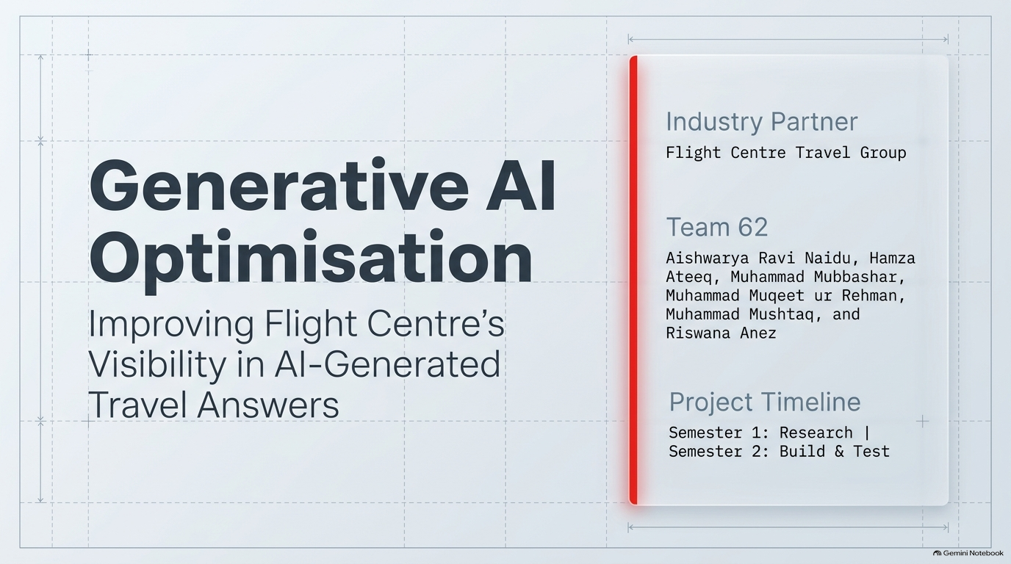

Slide 2
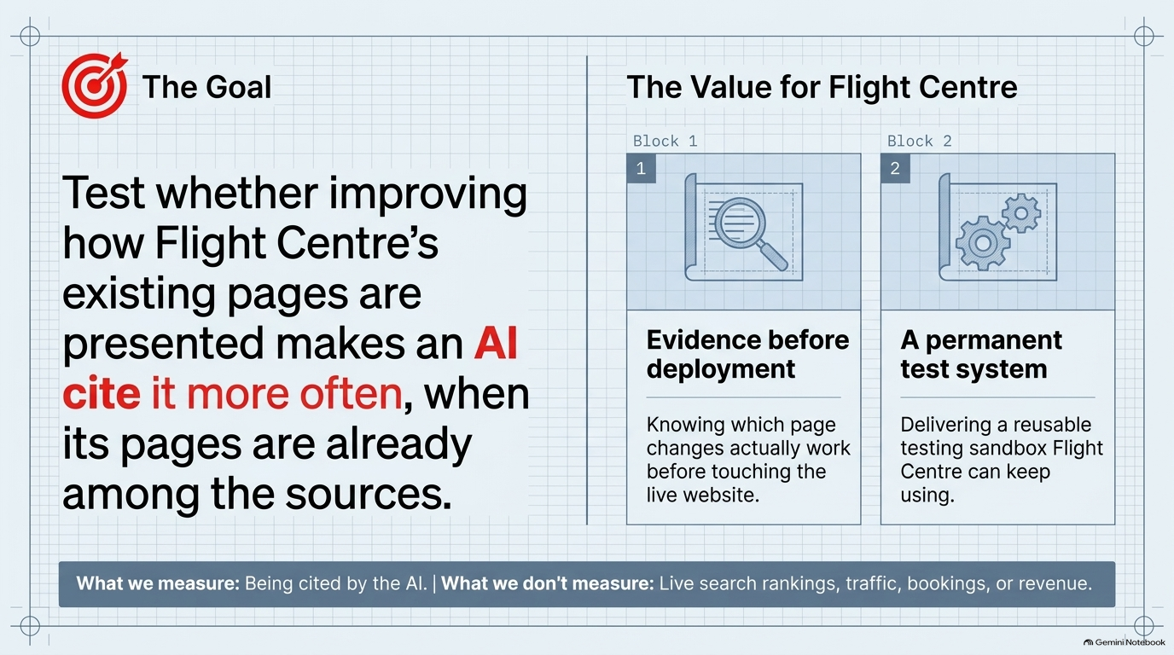

Slide 3


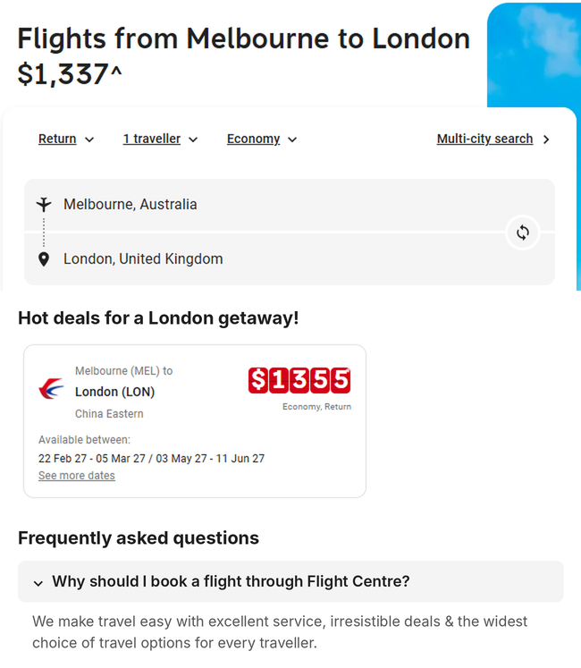
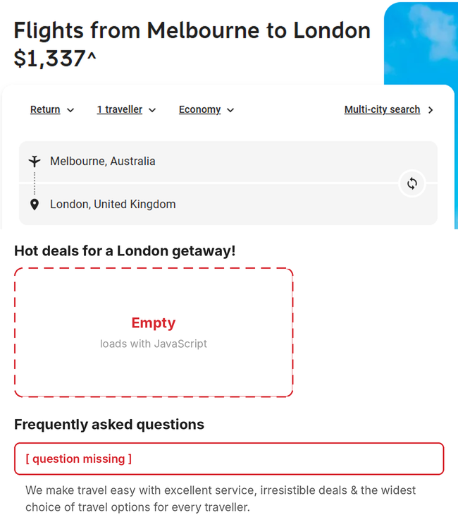

Why the AI misses Flight Centre’s most useful content
A person sees the full page. Many AI tools read only its text, without running JavaScript or clicking buttons.
What a person sees
What the AI reads
Live page, October 2026
The same page as text, as saved in our sandbox
read as text
Notes:
On the left is Flight Centre's live Melbourne to London page, as a person sees it: the price, the search box, the deal cards with airline, dates and fare, and the FAQ. On the right is the same page as an AI tool reads it, taken from the page text our sandbox saved. The deal cards are empty because they only load with JavaScript, and the FAQ answer is still there but its question is missing, because the question sat inside a clickable button. Fees and other facts are buried in sentences, so they are hard to pick out. Our methods fix each of these: Expose, Organise and Connect. Note: the screenshots are from October 2026; the saved text is from the August capture, and the right-hand view is a reconstruction for illustration.

Slide 4
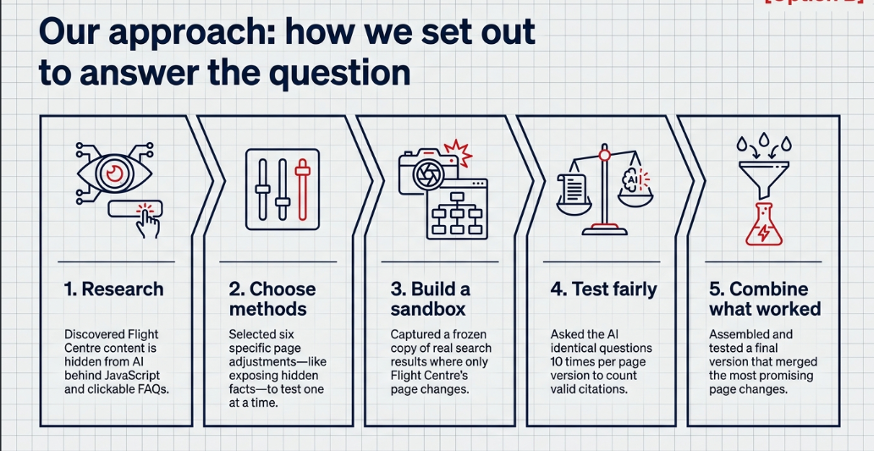

Slide 5
Our sandbox: a controlled saved-source answer experiment
ChatGPT (live)
Our sandbox (lab copy)
✎ New chat
Cheap flights from Melbourne to London?
Same travel question
Today
1
◎ Searched the web
Most flights from Melbourne to London stop once, usually in Dubai, Singapore or Doha. Return fares often start around…
2
Frozen copy of real search results
vs
travel site A
travel site B
airline
Luna model (via OpenAI API)
Sources
3
+ Ask anything
4
Cites its sources: Flight Centre?
↑
Illustration of the ChatGPT layout – not an actual answer
The web changes every day
Pages never change
We can’t see what it read
We see every page it read
We can’t change Flight Centre’s page
Only Flight Centre’s page is swapped
Why: matched inputs improve comparison; historical controls and capture differences still limit causality.
Option A
Notes:
Both work the same way: a question goes in, pages are found, an AI writes an answer and cites sources. ChatGPT uses the live web, which changes daily; we cannot see what it read or swap Flight Centre's page. Our sandbox uses a frozen copy of real Brave search results (50 questions, 953 pages), the Luna model (gpt-5.6-luna) through the OpenAI API, and swaps only Flight Centre's page between original and improved. So any change in citations comes from our page changes.

Slide 6
TECHNICAL DESIGN
How the sandbox is built
Six stages, each with its own tool. Every page and answer is saved.
01
02
03
04
05
06
Search snapshot
Capture & clean
Page changes
Source pack
Answer engine
Citation check
Brave Search API
Python · BeautifulSoup
Our transformation code
Experiment runner
OpenAI API · gpt-5.6-luna
Evaluation scripts
Real search results, frozen
Pages turned into plain text
Improved Flight Centre pages only
5–10 numbered pages per question
Writes an answer citing [n]
Did any [n] point to Flight Centre?
Team 62 · Generative AI Optimisation for Flight Centre
Notes:
This is how the sandbox is built. Stage 1 freezes Brave Search results through its API. Stage 2 downloads each page without running JavaScript and turns it into plain text with Python and BeautifulSoup. Stage 3 is our own code that builds the improved Flight Centre pages, with automated tests for each change. Stage 4 builds the source pack: 5 to 10 numbered pages per question, in two shuffled orders. Stage 5 sends the question and pages to the OpenAI API, model gpt-5.6-luna, which must cite sources by number. Stage 6 maps each citation back to its page and records whether Flight Centre was cited. Everything is saved and fingerprinted. Performance: each page is capped at 24,000 characters; each comparison is 580 paid API answers; failed API calls resume without losing results; and every result can be recounted offline.

Slide 7
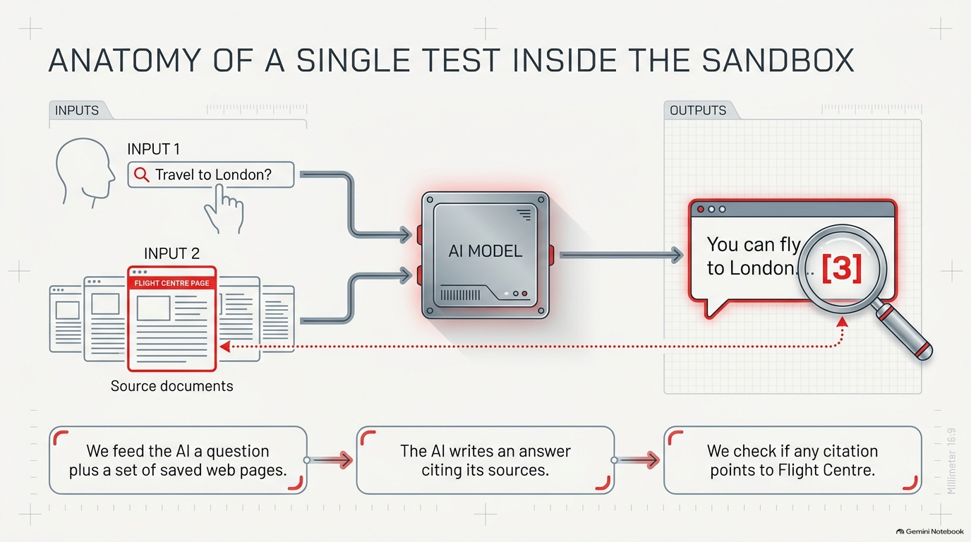
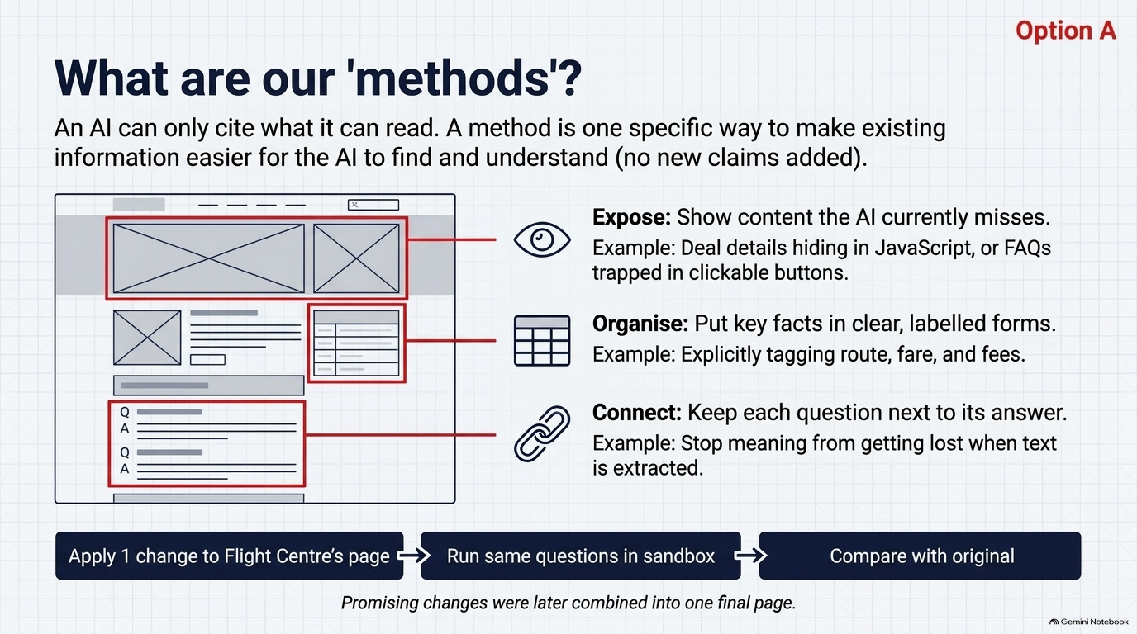
Here we illustrate the selected stack: making saved FC information readable and useful. External facts were tested separately and were not included in this stack.

Slide 8
What we change on Flight Centre’s pages
An AI can only cite what it can read. We don’t add new claims; we make existing information easier to read.
Original page
Improved page
Flights from Melbourne to London
Flights from Melbourne to London
Deal details
only load with JavaScript, so the AI sees a blank
Deal details now visible
Airline · Trip type · Travel dates · Fare
1
2
Fare… fees apply… return… airline… dates vary… conditions…
Departure
Melbourne
2
Destination
London
Starting fare
as stated on page
Fees
as stated on page
▸ [question hidden in a button]
Q: Why book with us?
A: …the original answer, now beside its question
3
▸ [question hidden in a button]
Answers survive, but lose their question
Illustration
Combine the ms promising changes into one final page
Notes:
An AI can only cite what it can read. Our methods do not add new claims; they make Flight Centre's existing information easier for the AI to find, read and understand. They work in three ways. Expose: some deal details only load with JavaScript, and FAQ questions sit inside clickable buttons, so a tool reading the page text misses them; we make them visible. Organise: key facts such as route, starting fare and fees are put in clear labelled fields. Connect: each FAQ question is kept beside its answer, so the answer keeps its meaning. Each change was tested on its own against the original page, and the most promising ones were combined into one final page.

Slide 9
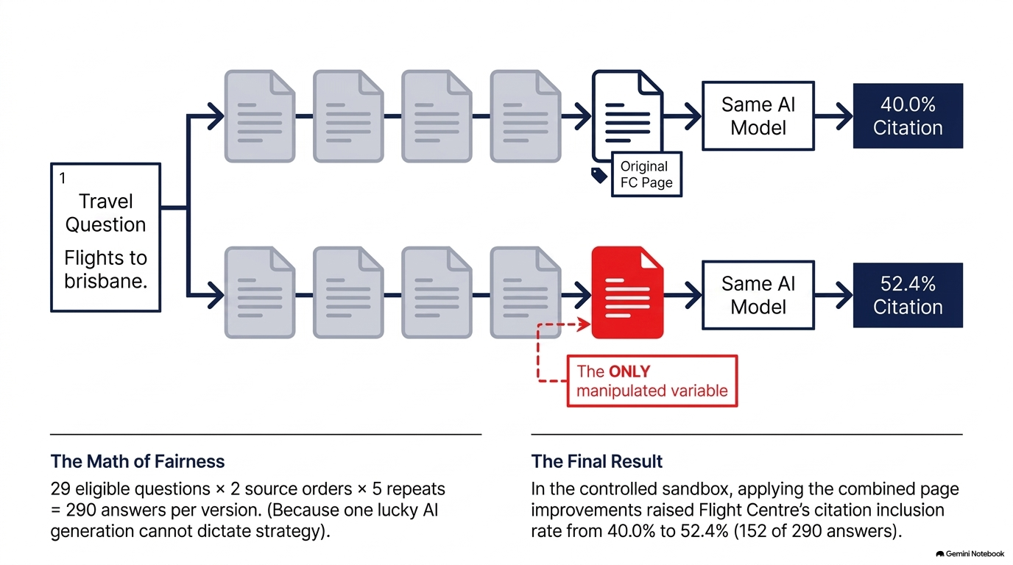
How we make it a fair test
Illustration: 40.0% and 52.4% are aggregate rates across 29 questions. Historical controls and capture differences limit causality.
Notes:
Both versions get the same question, the same competitor pages in the same order, and the same AI model. The only difference is whether Flight Centre's page is the original or the improved one. AI answers vary from run to run, so each question is answered 10 times: 2 source orders times 5 repeats. Across the 29 questions where Flight Centre had a page in the results, that gives 290 answers per version. We count how many answers cite Flight Centre in each version and compare them. The AI is never told to cite Flight Centre.

Slide 10

METHOD 1 · USED IN THE FINAL PAGE
Show the hidden deals
The deals load with JavaScript, so the AI never saw them.
BEFORE
AFTER what the AI read
People see:
Melbourne (MEL) to London (LON)
China Eastern
$1387* Economy, Return
08 Feb 27 – 11 Mar 27
→
The AI reads:
The same deal, now as text the AI can read.
no deals
39.3% → 45.9%
of answers cited Flight Centre · +6.6 points (gain not certain)
Team 62 · Generative AI Optimisation for Flight Centre
Notes:
Problem: Flight Centre's deal cards only appear after JavaScript runs. Many AI tools read a page without running JavaScript, so in the text the AI received, the "Hot deals" heading was followed by nothing. What we did: we opened each Flight Centre page in a real browser so the JavaScript ran, saved that version, removed menus and clutter, and fixed prices that came out as single digits (for example "$ 1 3 8 7 *" became "$1387*"). Only Flight Centre pages were swapped; competitors stayed as captured. Result: citations rose from 39.3% to 45.9% of 290 answers, +6.6 percentage points. The 95% range is -0.3 to +14.1, so the gain is not certain. On the Melbourne to London question alone, citations went from 0 to 7 out of 10. The screenshot is from October and our capture from August, so the fares differ.

Slide 11
METHOD 2 · USED IN THE FINAL PAGE
Label the key facts
The route, fare and fees were jumbled into one line.
BEFORE what the AI read
AFTER what the AI read
Cheap Flights from Melbourne (MEL) to London (LON) from $1,434 Flights from Melbourne to London $1,434 ^ Hot deals for a London getaway! Displayed fares exclude Online Booking Fee & Merchant Fee. Fees are applied once at checkout.
Departure
Melbourne (MEL)
Destination
London (LON)
→
Starting fare
from $1,434
Fees
applied once at checkout
Values copied from the same page. Nothing new added.
39.3% → 46.9%
of answers cited Flight Centre · +7.6 points
Team 62 · Generative AI Optimisation for Flight Centre
Notes:
Problem: on route pages, the route, a repeated price, a caret symbol, the deals heading and the fee notice were all jumbled into one line of text. What we did: our code matched this line against a strict pattern and copied each value into labelled fields: departure, destination, starting fare stated on the page, and fees (the full fee wording, "Displayed fares exclude Online Booking Fee & Merchant Fee. Fees are applied once at checkout."). The fields were added as a "Product facts" section at the end of the page; the original text stayed. Nothing was guessed: no currency, dates or trip type, and any page that did not match the pattern exactly was left unchanged. Result: citations rose from 39.3% to 46.9%, +7.6 percentage points, with a 95% range of +2.8 to +13.1, so above zero. On the Melbourne to London question, 0 to 3 out of 10.

Slide 12
METHOD 3 · USED IN THE FINAL PAGE
Answer it as a question
People ask AI questions, so we turned the page’s own facts into one.
BEFORE what the AI read
AFTER what the AI read
Cheap Flights from Melbourne (MEL) to London (LON) from $1,434 Flights from Melbourne to London $1,434 ^ Hot deals for a London getaway! Displayed fares exclude Online Booking Fee & Merchant Fee. Fees are applied once at checkout.
What fare and fees does this page state for flights from Melbourne to London?
→
“Cheap Flights from Melbourne (MEL) to London (LON) from $1,434 … Fees are applied once at checkout.”
The answer is an exact quote from the same page.
39.3% → 46.2%
of answers cited Flight Centre · +6.9 points
Team 62 · Generative AI Optimisation for Flight Centre
Notes:
Problem: people ask AI assistants questions, but the page gives its facts as plain text with nothing linking them to a question. What we did: fixed rules (not the questions we test with) wrote a specific question from the page's own facts, and the answer is an exact quote from the same page, so nothing new is claimed. The rules skipped sales lines like "40 years in the business" and facts about the wrong country. Result: citations rose from 39.3% to 46.2%, +6.9 percentage points, with a 95% range of +1.0 to +13.1, so above zero. On the Melbourne to London question, 0 to 3 out of 10.

Slide 13
FINAL PAGE · TWO FAQ FIXES
Fix the FAQ section
Questions were hidden in buttons, and the FAQ sat below a long travel guide.
BEFORE order of the page
AFTER order of the page
Hot deals
Hot deals
Explore [destination] · long travel guide
FAQ
→
Why should I book a flight through Flight Centre?
We make travel easy with excellent service…
FAQ
question missing
Explore [destination] · long travel guide
We make travel easy with excellent service…
40.0% → 49.3% / 52.4%
whole final page, two runs · these fixes were not tested on their own
Team 62 · Generative AI Optimisation for Flight Centre
Notes:
Two final fixes to the FAQ section. First, each FAQ question sat inside a clickable button, and text extraction throws buttons away, so the AI got the answers without their questions. Our code turned each button into plain text with the same words; checks confirmed only the questions were added and every answer was unchanged (429 question labels across the saved pages). Second, on 9 pages the FAQ sat below a long "Explore" travel guide, so we moved the whole FAQ section above it, with every word unchanged. These fixes were never tested on their own, so they have no separate result. They are part of the final page, which raised citations from 40.0% to 49.3% on the first run and 52.4% on the repeat run, both with 95% ranges above zero.

Slide 14
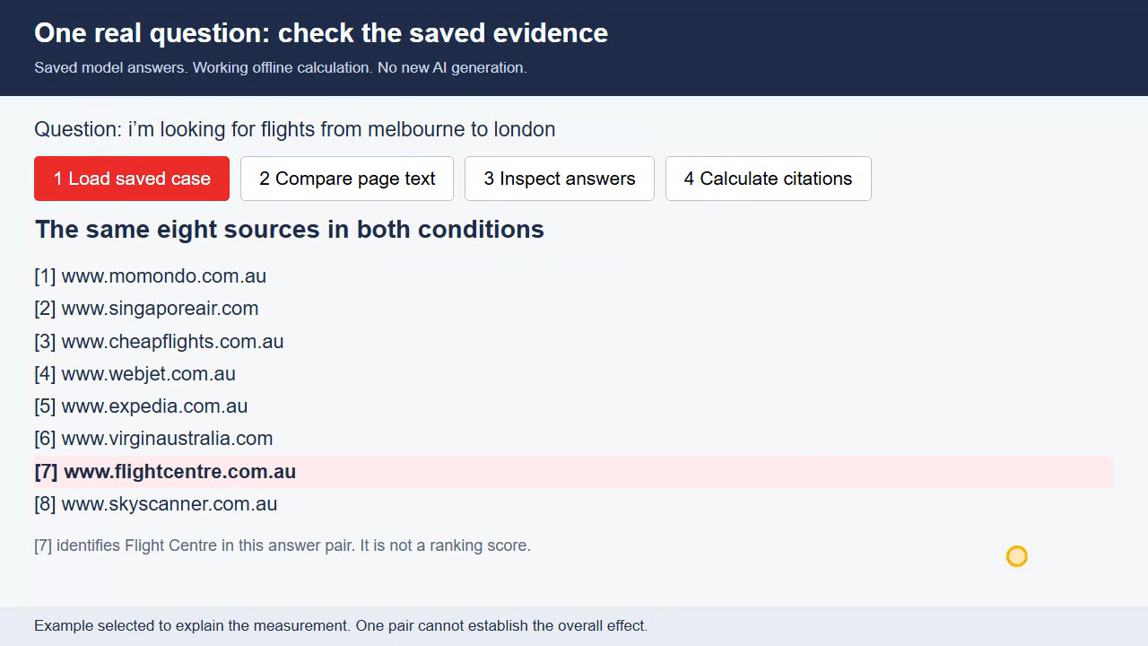
Working demo: checking one saved answer pair
Notes:
Play the embedded recording automatically in Slide Show. This is a genuine browser screen recording: the buttons load original saved evidence, compare an FAQ excerpt, open complete answers and compute inclusion from all citation markers. It is an offline calculation, not new model generation. Source: 04_evidence/selected/{baseline,optimised}/Q06_fixed_s2_r4.json.

Slide 15
MEASUREMENT
What the demonstration verifies
The model supplied the answer. Our code checks its source references.
The counting rule
What the checks establish
Read every [number] in the complete answer.
Both answers received the same question and the same source URLs in the same order.
Match that number to the saved source list.
Competitor text stayed unchanged. Flight Centre page text changed.
Count 1 if any valid reference identifies Flight Centre. Otherwise count 0.
The score measures citation visibility. It does not verify advice quality or a booking recommendation.
The example illustrates scoring. It cannot prove that one page edit caused the difference.
Team 62 · Generative AI Optimisation for Flight Centre
Notes:
Scoring matches the selected-record verifier: regex bracketed integer citations, valid source index, brand flightcentre, binary inclusion per answer. Comparison checks use complete source text. The page captures differ in other content including fares; this is not an isolated FAQ experiment. The unchanged-source checks are recorded by the working demo.

Slide 16
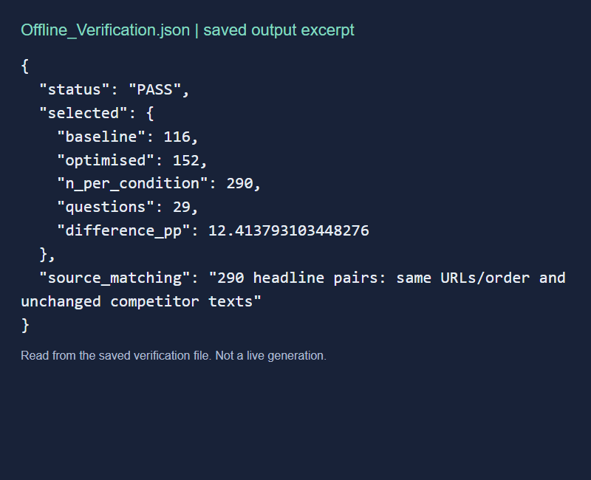
RESULT VERIFICATION
Saved-record verification of the final result
The full comparison contains 29 questions and 290 answers per condition
BASELINE
116 / 290
40.0%
OPTIMISED
152 / 290
52.4%
36 more citing answers
12.4 percentage-point difference
Team 62 · Generative AI Optimisation for Flight Centre
Notes:
Actual saved Offline_Verification.json excerpt shown, not a simulated terminal. Source script: 03_code/verify_results.py. Selected historical comparison; baseline116 and optimised152 of290. Question bootstrap95 interval5.17 to20.00pp. Record checks do not establish truth, citation entailment or causal identification. Interpretation and broader limitations follow in the later slides.

Slide 17
METHODS
Methods at a glance
Each change tested alone against the same original page (39.3%).
Label the key facts
+7.6
Kept
FINAL PAGE
Kept changes + 2 FAQ fixes
Answer it as a question
+6.9
Kept
40.0%
Show the hidden deals*
+6.6
Kept
49.3% / 52.4%
Schema + visible text
+6.2
Not used
two runs of the same pages
Outside facts + source*
+3.4
Not used
+9 to +12 points
AI rewriting
−5.5
Not used
* gain not certain (95% range includes zero) · points can’t be added together
Team 62 · Generative AI Optimisation for Flight Centre
Notes:
A summary of all six methods, each tested on its own against the same original page, where 39.3% of answers (114 of 290) cited Flight Centre. Kept: labelled facts +7.6 points (46.9%), question and answer +6.9 (46.2%), showing hidden deals +6.6 (45.9%, range includes zero). Not used: schema code plus a visible sentence +6.2 (45.5%; both changed together, and Google says no special markup is needed for its AI features), outside facts +3.4 (42.8%, range includes zero), AI rewriting -5.5 (33.8%, range entirely below zero). The kept changes were refined and combined with two FAQ fixes into the final page, which raised citations from 40.0% to 49.3% and 52.4% across two runs. The final page used refined versions, so the individual gains cannot be added together.

Slide 18


RESULTS
Is +9 to +12 points enough?
It depends on the question we ask of it.
WHAT WE OBSERVED
WHAT IT DOESN’T PROVE YET
Positive estimates
Not live
Both exploratory 95% ranges exceed zero
No live AI engines, traffic or bookings yet
Mixed across questions
Not discovery
21 of 29 questions improved
No clear gain when retrieval selected passages
Behaves like the research
Below our target
Position (+18) and AI rewriting (−5.5) match published studies
Best run 52.4%, against a 60% goal
Verdict: supports content improvement; live business gains remain unproven.
Team 62 · Generative AI Optimisation for Flight Centre
Notes:
Is the increase enough? It is enough to show the page changes worked inside our sandbox, but not enough yet to prove the business outcome.
What supports it: both runs of the final page beat the original with 95% ranges above zero (+3.1 to +15.9 and +5.2 to +20.0 points). The gain is larger than the gap between two runs of identical pages (+3.1 points, range -2.8 to +8.3). In the repeat run, 21 of 29 questions improved, 6 declined and 2 stayed the same. In relative terms, 23% and 31% more answers cited Flight Centre. Our sandbox also reproduced two effects that published research reports: moving Flight Centre's source to the top of the list added 18.3 points, matching the position effects in Lost in the Middle (TACL 2024) and C-SEO Bench (NeurIPS 2025); and automatic AI rewriting lowered citations, matching C-SEO Bench's finding that many rewriting methods hurt. That suggests the sandbox behaves the way independent studies say answer engines behave. (The GEO paper's "up to 40%" uses a different measure, the share of answer words, so we do not compare it directly.)
What it does not prove: we have not tested live AI engines, traffic or bookings. In the open-contest check, where the system picks its own sources, citations barely changed (6.50% to 6.75%). Our aspirational target was 60%; the best run reached 52.4%. The final page was also chosen after development, and the baseline was historical, so the result is likely somewhat optimistic. Our design could only reliably detect gains of about 9 to 11 points or more.
So the decision is a governed live pilot, not a full rollout.

Slide 19





RESULTS
What we learned
These findings apply to the saved model, pages and questions.
AI can only cite what it can read
The combined representation received more citations.
Vercel, 2024
Substance beats style
Real, labelled facts helped. AI rewriting hurt (−5.5).
Google guidance, 2026
Getting into the list matters most
Position alone added +18 points. Discovery is the next step.
C-SEO Bench, 2025
Measure how often, not where
Answers can vary, so evaluate repeated outputs.
SparkToro, 2026
Re-test when models change
Future studies should generate matched fresh controls.
Our sandbox
Team 62 · Generative AI Optimisation for Flight Centre
Notes:
What we learned. Exact percentages will change as models change, but five lessons should hold.
1. AI can only cite what it can read. Deals that load with JavaScript and FAQ questions inside buttons were invisible in the text the AI received; making them readable helped. Vercel found the AI crawlers from OpenAI, Anthropic and Perplexity do not run JavaScript.
2. Substance beats style. Adding real, labelled facts and question-and-answer structure helped (+7.6 and +6.9 points), while automatic AI rewriting lowered citations (-5.5). Google's May 2026 guidance also says content does not need to be rewritten for AI, and C-SEO Bench found many stylistic rewrites do not help.
3. Getting into the list matters most. Moving Flight Centre's source to the top added 18.3 points with the text unchanged, the largest effect we saw, and when the system picked its own sources there was no gain. So the next lever is discovery: classic SEO that gets Flight Centre's pages retrieved in the first place.
4. Measure how often, not where. The same question gave different answers each run, so we counted the share of ten answers citing Flight Centre. SparkToro found the same: how often a brand appears is far more stable than its position.
5. Re-test when models change. Our sandbox can swap models and recapture search results, so a fresh, fair re-test is cheap.

Slide 20




VALUE FOR FLIGHT CENTRE
What Flight Centre gets from us
The selected saved-source comparison improved citation inclusion; evidence is handed over.
THE RESULT
The sandbox
Detailed report
Visibility = how often AI answers cite Flight Centre
Before
Test any page change safely before it goes live.
Our methods, findings, limits and how to rerun them.
40%
After
49–52%
52 improved pages
Results pack
Each method alone: up to +7.6 points
Selected stack: +9 to +12 points, in two runs
Before-and-after examples your team can copy.
Every answer and count, checkable without an API key.
Handed over through our GitHub repository and an evidence package.
Team 62 · Generative AI Optimisation for Flight Centre
Notes:
The result in plain terms. We define visibility as how often AI answers cite Flight Centre. With the original pages, about 4 in 10 answers cited Flight Centre (40%). With our improved pages, about 5 in 10 did: 49% on the first run and 52% on the repeat. Each method on its own raised visibility by up to 7.6 percentage points, and combined into one final page they raised it by 9 to 12 points. Both runs beat the original, so the gain was not luck. This was measured in our sandbox, not yet on live AI search traffic or bookings.
What Flight Centre gets from us:
1. The sandbox (GEO Experiment and Optimisation Software): the code for the page changes, the experiments and the checking tools, so Flight Centre can test any page change safely before it goes live, using its own API keys.
2. A detailed report (Technical Report and Handover Guide): how the system works, our methods, findings and limitations, and step-by-step instructions to rerun everything.
3. 52 improved pages (Optimised Travel Page Demonstrator): the saved before-and-after page versions, which show exactly what changed and can guide Flight Centre's own page updates.
4. The results pack (Experimental Results and Reproducibility Pack): every saved AI answer, its sources and the counts, with scripts that recheck the numbers offline, without an API key.
We also hand over this presentation with speaker notes. Code, slides and summary numbers are in our public GitHub repository; the full evidence comes as a separate package.

