Slide 1
Presentation

Slide 2
Introduction
We are given to design an online system for the management of a theatre. Theatre has three types of events (Live Music, Stand Up Comedy and Film).
I have used OOAD approach to implement this project.
I have created an Event class which is the parent class for three types of events in the theatre.
I have designed three separate classes for the three event types (LiveMusicClass, StandUpComedyClass and FilmClass). Three of these classes are child classes for the Event class.
A main class is used to implement all the functionalities of Event, LiveMusicClass, StandUpComedyClass and FilmClass.

Slide 3
Classes Used
Event Class
LiveMusic Class
StandUpComedy Class
Film Class

Slide 4
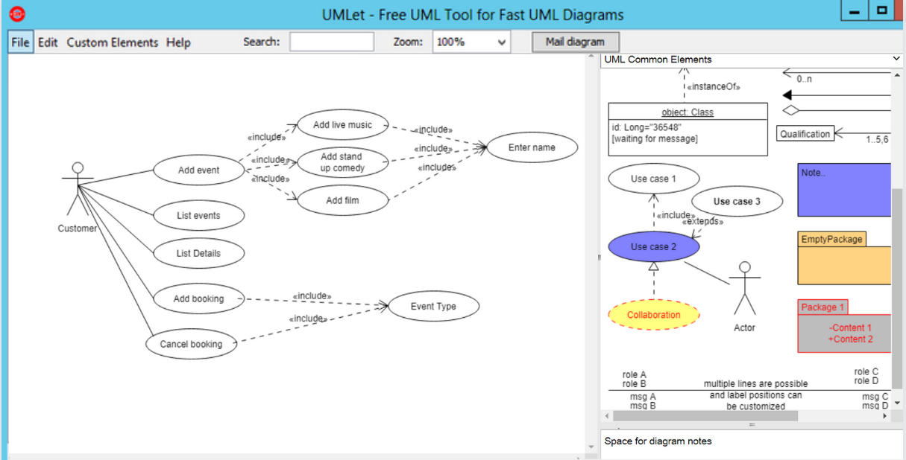
Use Case Diagram

Slide 5
Use Case Diagram
At first, a menu is displayed to the user.
User has to select one of the displayed options.
List event and List details options just prints the events and the details of the events.
Booking and cancellation options has include relationship.
Enter name is an included event for the booking and cancellation.
To add a new option, a new menu is included. Then, user must input the name of the event to be added.

Slide 6
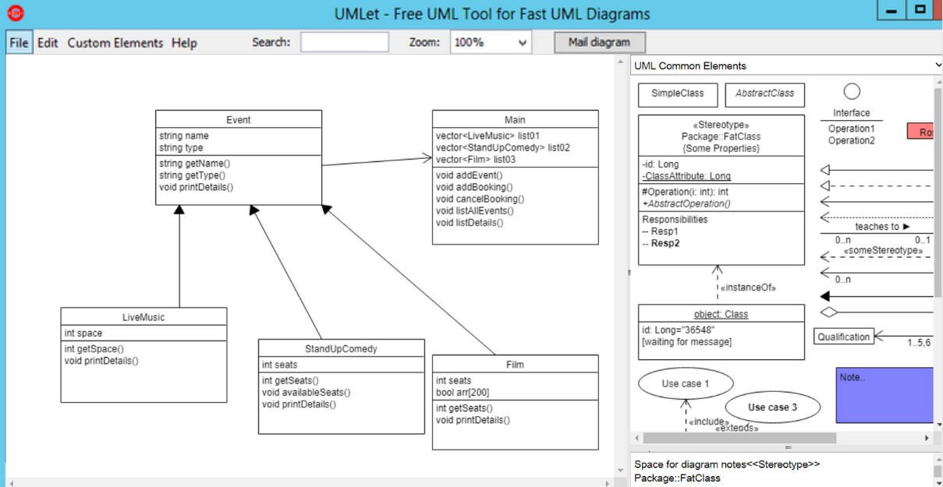
Class Diagram

Slide 7
Class Diagram
Four classes are used in this project.
LiveMusicClass handles the operations of live music event.
StandUpComedylass handles the operations of stand up comedy event.
Film class handles the operations of film event.
Event class is used to operate all these three classes.
A main class is used to implement all the functionalities of the other classes.

Slide 8
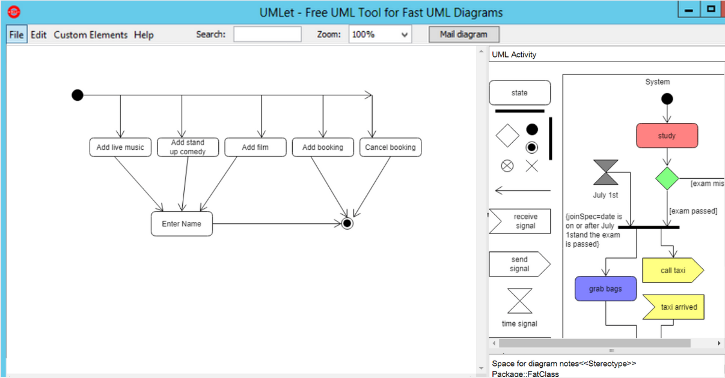
Activity Diagram

Slide 9
Activity Diagram
User first selects an option from the main menu.
For adding an event, there are three options for the event type.
After the selection of adding event, user needs to input the event name to be added.
Then, there are two options for booking or cancelling tickets.

Slide 10
Implementation and Testing
- A main class is used here which acts as the integrator for othr three classes.
- Main class holds all the operations to be performed.
An event class is used as the base class which holds the common attributes and functionalities.
- Live music, stand up comedy and film classes are the derived classes which for the event class which implements the specific attributes and functionalities of the event types.
- A makefile is used in this project to compile and execute the project. It contains the object files of all the implemented classes which are used in this project.

Slide 11
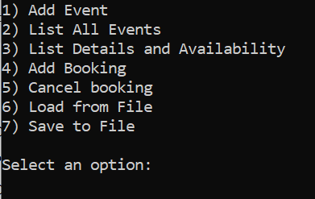
Testing
Displaying Menu:

Slide 12
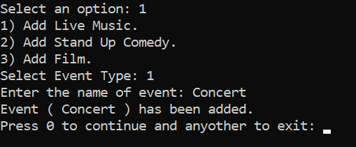
Testing
Adding Event:

Slide 13
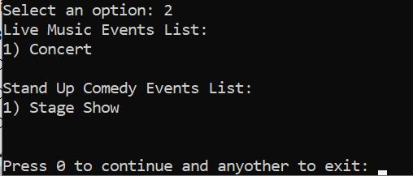
Testing
List Events:

Slide 14
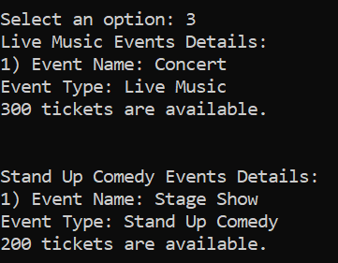
Testing
List Details:

Slide 15
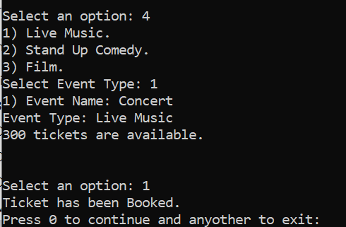
Testing
Booking:

Slide 16
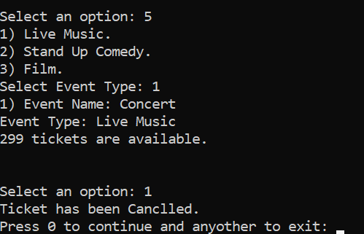
Testing
Cancelling:

Slide 17
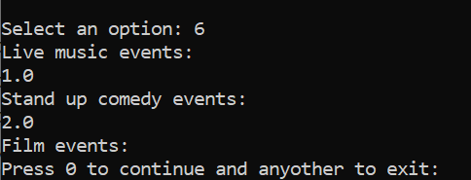
Testing
Loading:

Slide 18

Testing
Saving:

Slide 19
Description of Approach
I have used a main class in this project which manages all the events.
A menu is displayed at first and the user selects an option from that menu to perform the action.
The menu option user selects to perform interacts with the methods in the relevant class.
The action is performed by the class of relevant event type.
At the end, this cycle repeat itself by the user choice.

Slide 20
Conclusion
It is a console based project.
No pictorial interface is used for this project.
In future, I will add up some more functionalities in this project and will update it with iconic interface.

