Slide 1
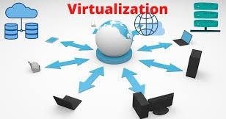
VIRTUALISATION AND CONTAINERS
1
2
3
4
5
6
7
20MCA168
8
9

Slide 2
1
2
VIRTUALISATION AND CONTAINERS
3
4
5
6
7
8
20MCA168
9

Slide 3
Module 1
01
04
02
05
03
06
1
2
Physical and virtual machines
Need, Applications and Limitations
Tools and technologies
3
07
4
5
Traditional and virtual computing
Simulations and Emulations
Types of Hypervisors
08
6
7
8
Understanding virtualization
Challenges in Virtualized environment
Hypervisor architecture
09
9

Slide 4
Understanding Virtualization
We are in the midst of a substantial change in the way computing services are provided.
As a consumer, you surf the Web on your cell phone, get directions from a GPS device, and stream movies and music from the cloud.
At the heart of these services is virtualization—the ability to abstract a physical server into a virtual machine.

Slide 5
DESCRIBING VIRTUALIZATION
Consider virtualization to be the act of abstracting the physical boundaries of a technology.
For example, workstations and servers no longer need dedicated physical hardware such as a CPU or motherboard in order to run as independent entities. Instead, they can run inside a virtual machine (VM).

Slide 6
DESCRIBING VIRTUALIZATION
In running as a virtual machine, a computer’s hardware is emulated and presented to an operating system as if the hardware truly existed. With this technology, you have the ability to remove the traditional dependence that all operating systems had with hardware.
In being able to emulate hardware, a virtual machine can essentially run on any x86-class host system, regardless of hardware makeup.
Furthermore, you can run multiple VMs running different operating systems on the same system at the same time!

Slide 7
DESCRIBING VIRTUALIZATION
A virtual machine (VM) can virtualize all of the hardware resources, including processors, memory, storage, and network connectivity.
A virtual machine monitor (VMM), which today is commonly called a hypervisor, is the software that provides the environment in which the VMs operate.

Slide 8
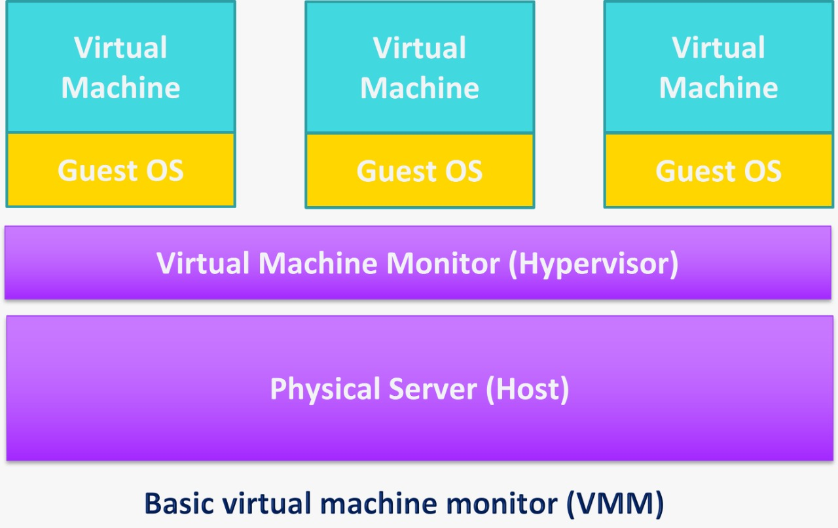
DESCRIBING VIRTUALIZATION

Slide 9
PHYSICAL AND VIRTUAL MACHINES
A physical server refers to a hardware server with the motherboard, CPU, memory and IO-controllers. It's considered a bare-metal server because its hardware is used directly by an OS instead of a virtualization platform.
A physical server is used to run a single instance of an OS. It runs Windows, Linux or another OS and, very often, it's used to run a single application.

Slide 10
PHYSICAL SERVER
A physical server, also known as a ‘bare-metal server,’ is a single-tenant computer server, meaning that a specific physical server is designated to a single user.
The resources and components of a physical server are not shared between multiple users. Each physical server includes memory, processor, network connection, hard drive, and an operating system (OS) for running programs and applications.
A bare-metal server is large in size due to the powerful processing components that it contains.

Slide 11
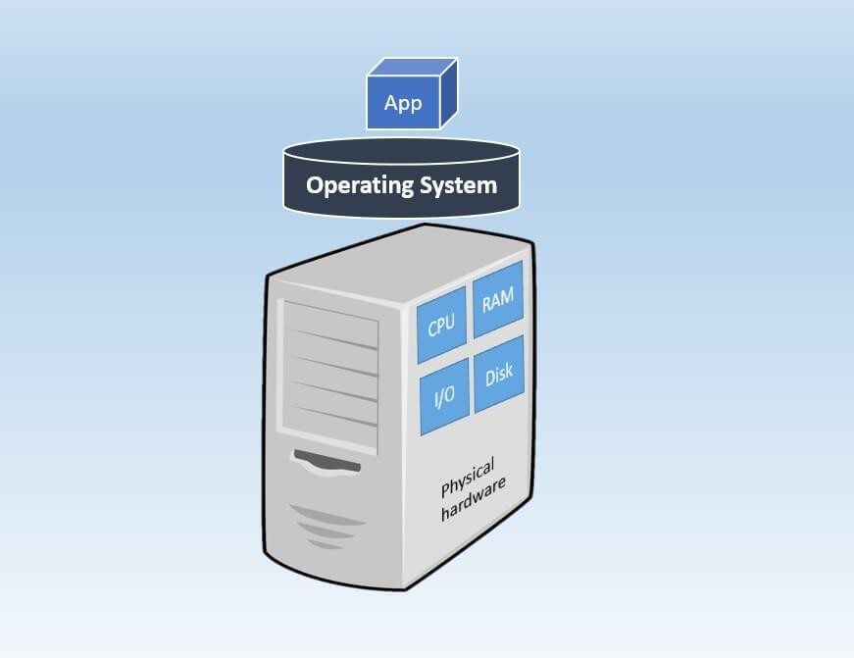
PHYSICAL SERVER

Slide 12
VIRTUAL MACHINE
A virtual machine (VM) is a software computer used as emulation of an actual physical computer. A virtual server operates in a “multi-tenant” environment, meaning that multiple VMs run on the same physical hardware.
In this case, the computing resources of a physical server are virtualized and shared among all VMs running on it.
The architecture of a virtual server is a little more complex than that of a physical server. Thus, a hypervisor, such as VMware vSphere or Microsoft Hyper-V, is installed on top of physical hardware.

Slide 13
VIRTUAL MACHINE
A hypervisor is then used to create and manage VMs, which have their own virtual computing resources.
After that, you can load multiple guest OSes and server applications on top of the virtual hardware.
Thus, virtual servers allow you to run several OSes and applications on the basis of the shared physical hardware, which makes it a more cost-effective option than a physical server.

Slide 14
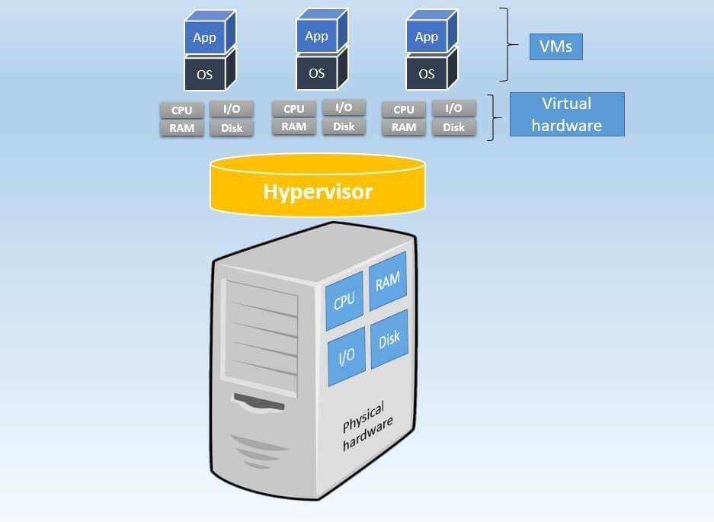
VIRTUAL MACHINE

Slide 15
TRADITIONAL AND VIRTUAL COMPUTING
Traditional Computing, as name suggests, is a possess of using physical data centers for storing digital assets and running complete networking system for daily operations. In this, access to data, or software, or storage by users is limited to device or official network they are connected with.
Virtualization uses software to create an abstraction layer over computer hardware that allows the hardware elements of a single computer—processors, memory, storage and more—to be divided into multiple virtual computers, commonly called virtual machines (VMs).

Slide 16
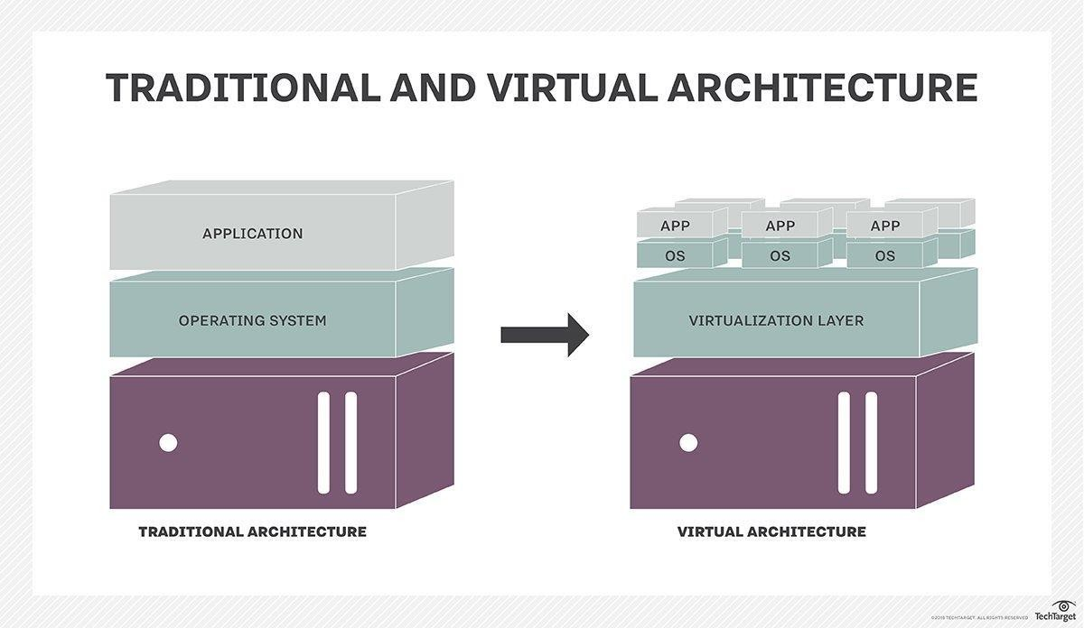

Slide 17
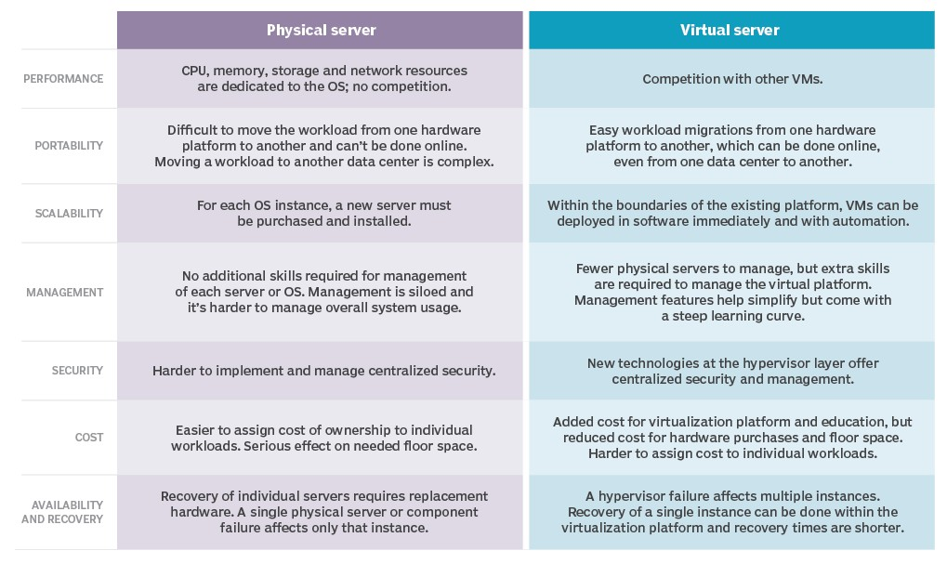

Slide 18
THE BENEFITS OF VIRTUALIZATION
One of the big drivers for virtualization adoption was server consolidation. Where originally 10 or 15 servers were needed, a single physical server could run 10 or 15 VMs. This is still one of the main advantages of virtualization and consolidation ratios have increased over the years.
Another benefit of virtualization is that relocating a VM to different hardware, performing a restore or Disaster Recovery and failover is much simpler. When VMware introduced vMotion technology to live-migrate workloads to another hardware platform, the benefits increased even more. Admins can replace hardware without service interruption and balance workloads on all available hardware, eliminating bottlenecks.

Slide 19
UNDERSTANDING VIRTUALIZATION
According to Popek and Goldberg, a VMM needs to exhibit three properties in order to correctly satisfy their definition:
Fidelity: The environment it creates for the VM is essentially identical
to the original (hardware) physical machine.
Isolation or Safety: The VMM must have complete control of the system resources.
Performance: There should be little or no difference in performance between the VM and a physical equivalent.

Slide 20
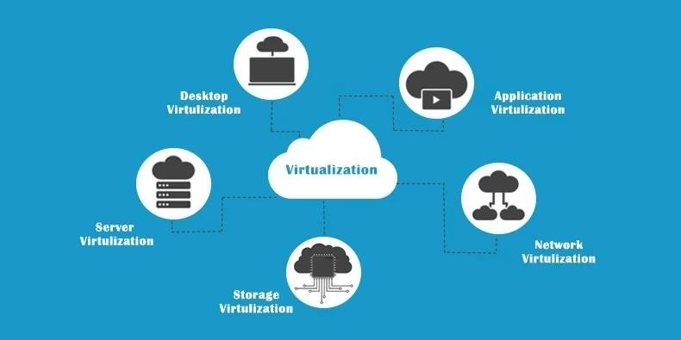
TYPES OF VIRTUALIZATION

Slide 21
TYPES OF VIRTUALIZATION
Desktop virtualization
It is when the host server can run virtual machines using a hypervisor (a software program). A hypervisor can directly be installed on the host machine or over the operating system (like Windows, Mac, and Linux).
Virtualized desktops don’t use the host system’s hard drive; instead, they run on a remote central server. This type of virtualization is useful for development and testing teams who need to develop or test applications on different operating systems.
Two types - Virtual Desktop Infrastructure(VDI) and Local Desktop Virtualization.

Slide 22
TYPES OF VIRTUALIZATION
Desktop virtualization
Creating a virtual desktop infrastructure, or VDI, makes it possible to work and store files in locations that everyone in your team can easily access no matter where they work.
Desktop virtualization allows people to access multiple applications and operating systems (OS) on a single computer because the applications and OSs are installed on virtual machines that run on a server in the data center.
A virtual machine (VM) is essentially a physical computer, like at your desk, but in software form. VMs are organized using hypervisors, which help the physical computer and the VMs run as intended.
When it comes to desktop virtualization, there are two main methods: local and remote. Local and remote desktop virtualization are both possible depending on the business needs. However, local desktop virtualization has many limitations, including the inability to use a mobile device to access the network resources. Remote desktop virtualization is more robust and popular in the marketplace, with users running operating systems and applications accessed from a server located inside a secure data center.
For enterprise-level businesses, virtualizing desktops allows employees to log in remotely in case of a natural disaster or health issue that keeps them from coming into the office to work.
Having a virtual desktop setup can be a vital part of the business disaster recovery plan or response to any unexpected event that stops workers from coming into the office. Top solutions providers in this space include VMware and Citrix.

Slide 23
TYPES OF VIRTUALIZATION
Application virtualization
The process of installing an application on a central server (single computer system) that can virtually be operated on multiple systems is known as application virtualization.
For end users, the virtualized application works exactly like a native application installed on a physical machine. With application virtualization, it’s easier for organizations to update, maintain, and fix applications centrally.
Admins can control and modify access permissions to the application without logging in to the user’s desktop.
Another benefit of application virtualization is portability. It allows users to access virtualized applications even on non-Windows devices, such as iOS or Android. This helps save user’s time invested in application installations and load operations.

Slide 24
TYPES OF VIRTUALIZATION
Application virtualization
Through application virtualization, users can access a remote version of an application that isn’t installed on their individual machine.
App virtualization is a key part of enabling remote work on a large scale, as seen during the Covid-19 pandemic, along with desktop virtualization.
Virtualizing an app allows for seamless use for the end-user, making it possible for the employee to work remotely with the same key programs installed in the office.
When virtualized, apps work in what is called a sandbox, an environment that runs separately from the operating system. While operating in this sandbox, any changes will appear to run in the operating system, though the app is pulling operating power from the sandbox.
There are two distinct kinds of application virtualization: Remote and Streaming
Remote applications run on a server that mimics the user desktop and can be accessed by authorized users regardless of their location.
Streaming apps run just one instance on the server and provide local access to the app.
Remote app streaming is the more popular approach, thanks to the extended reach it grants.
With just one instance of the app to manage and fix, an organization’s IT professionals can save time and effort through app virtualization compared to installing the app on each user’s computer.
Any patches or updates only have to be done once instead of potentially hundreds or thousands of times. Large enterprises can find the savings generated by app virtualization substantial as employees can access virtualized apps through cost-effective computers.

Slide 25
TYPES OF VIRTUALIZATION
Server Virtualization
Server virtualization is a process of partitioning the resources of a single server into multiple virtual servers. These virtual servers can run as separate machines.
Server virtualization allows businesses to run multiple independent OSs (guests or virtual) all with different configurations using a single (host) server.
The process also saves the hardware cost involved in keeping a host of physical servers, so businesses can make their server infrastructure more streamlined.

Slide 26
TYPES OF VIRTUALIZATION
Server Virtualization
Virtualizing a server allows for a better division of resources, as it lets the administrator divide one physical server into multiple virtual servers. These virtual servers can then be used to run a distinct operating system and any applications needed. By doing this, businesses can decrease operational costs while enjoying faster deployment times and better application performance.
Virtual servers share CPU, memory, storage, and networking capabilities, which are pulled from the hypervisor of the physical server the virtual one is built on.
Among the types of virtualization discussed here, server virtualization has the highest adoption rate in the current landscape. Over 90% of businesses have already moved to a virtual server in place of a physical one. This virtual server typically includes a virtual machine equipped with CPU, RAM, and virtual hardware to mimic a traditional server in the cloud.
Virtualization allows the system administrator to quickly add more virtual machines, eliminating the time and cost associated with the traditional method of purchasing a new physical machine.

Slide 27
TYPES OF VIRTUALIZATION
Network Virtualization
Network virtualization blends the physical and virtual network, using components from both to create an environment that is much easier to administrate than a strictly physical one.
Using software, network virtualization disconnects the virtual network from the physical hardware, making it possible to use switches to direct network traffic and manage resources through traffic surges.
Network virtualization is key to developing new programs and apps. By testing newly developed apps on a virtual network before releasing them to the public, developers can catch any potential flaws or bugs and optimize the performance of the app based on how it performs in the virtual environment.

Slide 28
TYPES OF VIRTUALIZATION
Storage Virtualization
Storage virtualization is the process of pooling physical storage of multiple network storage devices so it looks like a single storage device. Storage virtualization facilitates archiving, easy backup, and recovery tasks. It helps administrators allocate, move, change and set up resources efficiently across the organizational infrastructure.

Slide 29
TYPES OF VIRTUALIZATION
Storage Virtualization
Storage virtualization is a game-changer for companies that create a lot of data daily. Instead of using physical storage space, virtual storage uses software to store the data in the cloud. All of a company’s storage disk arrays are placed in the same virtual pool, made into virtual disks, and sent to the host server for storage.
With the data remotely stored, you can pull from any of the virtual storage sources within the data center and group them together, customizing how and when key data is stored. The pooling of storage resources into one virtual area allows for one administrator to manage them remotely.
There are two kinds of storage virtualization: Internal and External
Internal storage virtualization is only available within a vendor’s software, limiting the reach of the data. External storage virtualization is typically also powered by a vendor but has fewer limitations on where data can be pulled from and stored.

Slide 30
TYPES OF VIRTUALIZATION
Data virtualization
It is an approach to data management that allows an application to retrieve and manipulate data without requiring technical details about the data, such as how it is formatted at source, or where it is physically located, and can provide a single customer view of the overall data.
Data virtualization tools integrate data from heterogeneous data sources, instead of extracting and loading them directly onto a single platform.

Slide 31
ADVANTAGES
Lower costs: Virtualization reduces the amount of hardware servers necessary within a company and data center. This lowers the overall cost of buying and maintaining large amounts of hardware.
Easier disaster recovery: Disaster recovery is very simple in a virtualized environment. Regular snapshots provide up-to-date data, allowing virtual machines to be feasibly backed up and recovered. Even in an emergency, a virtual machine can be migrated to a new location within minutes.

Slide 32
ADVANTAGES
Easier testing: Testing is less complicated in a virtual environment. Even if a large mistake is made, the test does not need to stop and go back to the beginning. It can simply return to the previous snapshot and proceed with the test.
Quicker backups: Backups can be taken of both the virtual server and the virtual machine. Automatic snapshots are taken throughout the day to guarantee that all data is up-to-date. Furthermore, the virtual machines can be easily migrated between each other and efficiently redeployed.

Slide 33
ADVANTAGES
Improved productivity. Fewer physical resources results in less time spent managing and maintaining the servers. Tasks that can take days or weeks in a physical environment can be done in minutes. This allows staff members to spend the majority of their time on more productive tasks, such as raising revenue and fostering business initiatives.

Slide 34
Benefits
Virtualization provides companies with the benefit of maximizing their output.
Additional benefit for both businesses and data centers include the following:
Single-minded servers. Virtualization provides a cost-effective way to separate email, database and web servers, creating a more comprehensive and dependable system.
Expedited deployment and redeployment. When a physical server crashes, the backup server may not always be ready or up-to-date. There also may not be an image or clone of the server available. If this is the case, then the redeployment process can be time- consuming and tedious. However, if the data center is virtualized, then the process is quick and fairly simple. Virtual backup tools, such as Veeam, are available to expedite the process to minutes.

Slide 35
Benefits
Reduced heat and improved energy savings. Companies that use a lot of hardware servers risk overheating their physical resources. The best way to prevent this from happening is to decrease the number of servers used for data management, and the best way to do this is through virtualization.
Better for the environment. Companies and data centers that utilize copious amounts of hardware leave a large carbon footprint; they must take responsibility for the pollution they are generating. Virtualization can help reduce these effects by significantly decreasing the necessary amounts of cooling and power, thus helping clean the air and the atmosphere. As a result, companies and data centers that virtualize will improve their reputation while also enhancing the quality of their relationship with customers and the planet.

Slide 36
Benefits
Easier migration to the cloud. Virtualization brings companies closer to experiencing a completely cloud-based environment. Virtual machines may even be deployed from the data center in order to build a cloud-based infrastructure. The ability to embrace a cloud-based mindset with virtualization makes migrating to the cloud even easier.
Lack of vendor dependency. Virtual machines are agnostic in hardware configuration. As a result, virtualizing hardware and software means that a company does not need to depend on a vendor for these physical resources.

Slide 37
Limitations
Before converting to a virtualized environment, it is important to consider the various upfront costs. The necessary investment in virtualization software, as well as hardware that might be required to make the virtualization possible, can be costly.
If the existing infrastructure is more than five years old, an initial renewal budget will have to be considered. Fortunately, many businesses have the capacity to accommodate virtualization without spending large amounts of cash.

Slide 38
Limitations
Furthermore, the costs can be offset by collaborating with a managed service provider that provides monthly leasing or purchase options.
There are also software licensing considerations that must be taken into account when creating a virtualized environment. Companies must ensure that they have a clear understanding of how their vendors view software use within a virtualized environment. This is becoming less of a limitation as more software providers adapt to the increased use of virtualization.

Slide 39
Limitations
Converting to virtualization takes time and may come with a learning curve. Implementing and controlling a virtualized environment demands each IT staff member to be trained and possess expertise in virtualization. Furthermore, some applications do not adapt well when brought into a virtual environment. The IT staff will need to be prepared to face these challenge and should address them prior to converting.

Slide 40
Limitations
There are also security risks involved with virtualization. Data is crucial to the success of a business and, therefore, is a common target for attacks. The chances of experiencing a data breach significantly increase while using virtualization.
Finally, in a virtual environment, users lose control of what they can do because there are several links that must collaborate to perform the same task. If any part is not working, then the entire operation will fail.

Slide 41
NEED OF VIRTUALIZATION
The most important function of virtualization is the capability of running multiple operating systems and applications on a single computer or server.
Virtualization can usually improve overall application performance due to technology that can balance resources, and provide only what the user needs.
There are many reasons why your company might consider using virtual machines.
VMs allow for reduced overhead, with multiple systems operating from the same console at the same time. VMs also provide a safety net for your data, as they can be used to enable rapid disaster recovery and automatic backups.

Slide 42
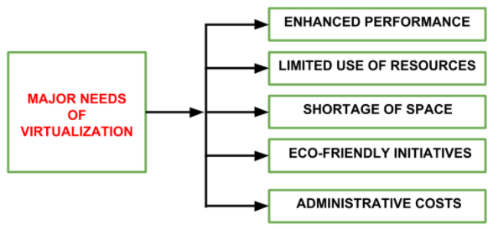
NEED OF VIRTUALIZATION

Slide 43
NEED OF VIRTUALIZATION
ENHANCED PERFORMANCE- Currently, the end user system i.e. PC is sufficiently powerful to fulfill all the basic computation requirements of the user, with various additional capabilities which are rarely used by the user. Most of their systems have sufficient resources which can host a virtual machine manager and can perform a virtual machine with acceptable performance so far.

Slide 44
NEED OF VIRTUALIZATION
LIMITED USE OF HARDWARE AND SOFTWARE RESOURCES- The limited use of the resources leads to under-utilization of hardware and software resources. As all the PCs of the user are sufficiently capable to fulfill their regular computational needs that’s why many of their computers are used often which can be used 24/7 continuously without any interruption. The efficiency of IT infrastructure could be increase by using these resources after hours for other purposes. This environment is possible to attain with the help of Virtualization.

Slide 45
NEED OF VIRTUALIZATION
SHORTAGE OF SPACE- The regular requirement for additional capacity, whether memory storage or compute power, leads data centers raise rapidly. Companies like Google, Microsoft and Amazon develop their infrastructure by building data centers as per their needs. Mostly, enterprises unable to pay to build any other data center to accommodate additional resource capacity. This heads to the diffusion of a technique which is known as server consolidation.

Slide 46
NEED OF VIRTUALIZATION
ECO-FRIENDLY INITIATIVES- At this time, corporations are actively seeking for various methods to minimize their expenditures on power which is consumed by their systems. Data centers are main power consumers and maintaining a data center operations needs a continuous power supply as well as a good amount of energy is needed to keep them cool for well-functioning. Therefore, server consolidation drops the power consumed and cooling impact by having a fall in number of servers. Virtualization can provide a sophisticated method of server consolidation.

Slide 47
NEED OF VIRTUALIZATION
ADMINISTRATIVE COSTS- Furthermore, the rise in demand for capacity surplus, that convert into more servers in a data center, accountable for a significant increase in administrative costs. Hardware monitoring, server setup and updates, defective hardware replacement, server resources monitoring, and backups are included in common system administration tasks. These are personnel-intensive operations. The administrative costs is increased as per the number of servers. Virtualization decreases number of required servers for a given workload, hence reduces the cost of administrative employees.

Slide 48
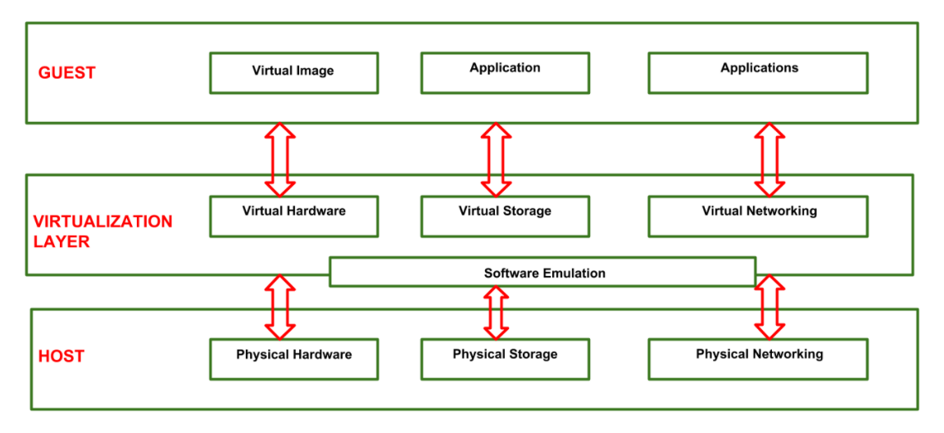
VIRTUALIZATION REFERENCE MODEL

Slide 49
VIRTUALIZATION REFERENCE MODEL
GUEST: The guest represents the system component that interacts with the virtualization layer rather than with the host, as would normally happen. Guests usually consist of one or more virtual disk files, and a VM definition file. Virtual Machines are centrally managed by a host application that sees and manages each virtual machine as a different application.

Slide 50
VIRTUALIZATION REFERENCE MODEL
HOST: The host represents the original environment where the guest is supposed to be managed. Each guest runs on the host using shared resources donated to it by the host. The operating system, works as the host and manages the physical resource management, and the device support.

Slide 51
VIRTUALIZATION REFERENCE MODEL
3. VIRTUALIZATION LAYER: The virtualization layer is responsible for recreating the same or a different environment where the guest will operate. It is an additional abstraction layer between a network and storage hardware, computing, and the application running on it. Usually it helps to run a single operating system per machine which can be very inflexible compared to the usage of virtualization.

Slide 52
Applications of virtualization
Server Consolidation:
Virtual machines are used to consolidate many physical servers into fewer servers.
Each physical server is reflected as a virtual machine “guest”. They reside on a virtual machine host system.
This is also known as “Physical-to-Virtual” or ‘P2V’ transformation.

Slide 53
Applications of virtualization
Disaster Recovery:
Virtual machines can be used as “hot standby” environments for physical production servers.
Virtual storage can be replicated and transferred to another location. Virtualization is very useful in planning for disaster recovery.

Slide 54
Applications of virtualization
Testing and Training:
Virtualization can give root access to a virtual machine.
This can be very useful such as in kernel development and operating
system courses.
Portable Workspaces:
Recent technologies have used virtualization to create portable
workspaces on devices like iPods and USB memory sticks.

Slide 55
Applications of virtualization
Portable Applications:
Portable applications are needed when running an application from a removable drive, without installing it on the system’s main disk drive.
Virtualization can be used to store temporary files, windows registry entries and other information in the application’s installation directory and not within the system’s permanent file system.

Slide 56
SIMULATIONS AND EMULATIONS
Often the terms simulation and emulation are used interchangeably. But, there is a distinct difference between emulators vs. simulators. Both mimic the real thing in a virtual environment. However, the differences between emulation vs. simulation are quite big when it comes to mobile automation.
Emulation vs Simulation
A simulator creates an environment that mimics the behavior and configurations of a real device. On the other hand, an emulator duplicates all the hardware and software features of a real device.

Slide 57
What Are Simulators?
A simulator mimics the basic behavior of a device.
Simulators mean you're copying things from the real world into a virtual environment to give an idea about how that thing would work. It simulates the basic behavior but doesn’t necessarily follow all the rules of the real environment.
A simulator in mobile testing is also a virtual device. It allows you to test your app by simulating behavior of a real device.

Slide 58
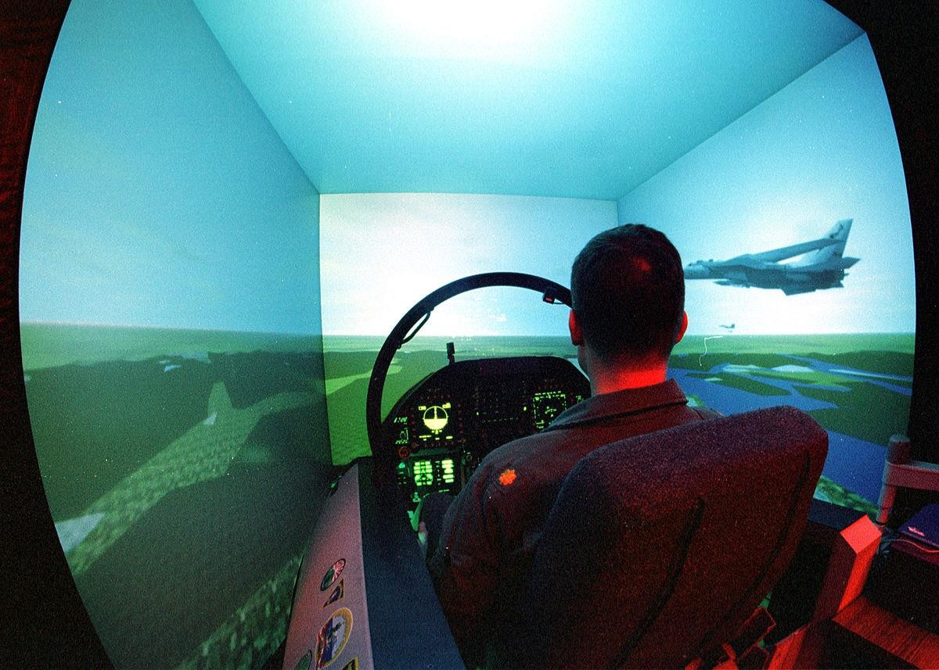
Flight Simulators
Purpose of a flight simulator is to help the pilot to achieve, test and maintain proficiency in handling airplane operation without involving any risk to property or lives, and at a much lower cost than training in the air

Slide 59
What Are Emulators?
An emulator duplicates the thing exactly as it exists in real life.
Emulation means basically a complete imitation of the real thing. It just operates in a virtual environment instead of the real world.
An emulator in mobile testing is a virtual device. It allows you to test your app by emulating a real device. A device emulator mimics the hardware or OS of the device.

Slide 60
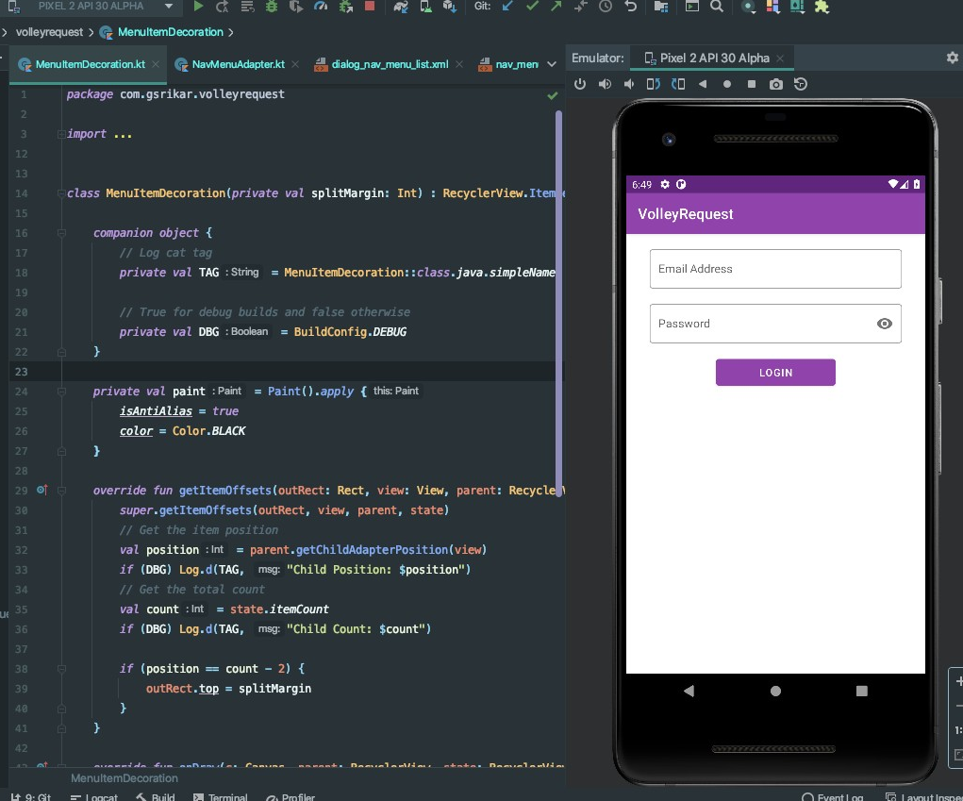
Android Emulator
It is a software application that allows your mobile to imitate Android OS features into your PC.

Slide 61
Simulator-based testing | Emulator based testing
Simulator's objective is to simulate the internal state of an object as close as possible to the internal state of an object. | The emulator aims at emulating or mimicking as close as possible the outer behavior of an object
Simulators are preferable whenever the testing team needs to test the mobile's internal behavior like its internal hardware, firmware, and so forth. | Emulators are preferable whenever the testing team needs to test the mobile's external behavior like calculating, making transactions, and so forth.
Simulators are written in high-level languages. | Emulators are written in machine-level assembly languages.
The simulators can be difficult in terms of debugging purpose. | Emulators are more suitable when it comes to debugging purpose
A simulator is just a partial re-implementation of the original software. | An emulator comes as a complete re-implementation of the original software.

Slide 62
CHALLENGES IN VIRTUALIZED ENVIRONMENT
Virtualization - the use of software to emulate the functionality of hardware for servers, networks and data storage - has become the prevalent way for businesses to operate in today's corporate culture.
There are many advantages to virtualization, including cost savings, fast and easy scalability, and often less downtime and better functionality than traditional hardware-based systems.
Virtualization management does create some challenges that businesses must address, however.

Slide 63
CHALLENGES IN VIRTUALIZED ENVIRONMENT
Resource Distribution
The way virtualization partitions systems can result in varied ways - some might function well, and others might not provide users access to enough resources to meet their needs. Resource distribution problems often occur in the shift to virtualization and can be fixed by working on capacity planning with your service provider.

Slide 64
CHALLENGES IN VIRTUALIZED ENVIRONMENT
VM Sprawl
The ability to create as many virtual machines as you want can lead to more VMs than are needed for the company to function. VM sprawl may seem harmless, but it can exacerbate resource distribution problems by diverting resources to VMs that aren't even being used while those that are used and needed see reduced functioning. Companies can avoid VM sprawl by sticking to the number of VMs that are needed and adding more when the time comes.

Slide 65
CHALLENGES IN VIRTUALIZED ENVIRONMENT
Backward Compatibility
Many companies use legacy systems that can cause problems with newer virtualized software and programs. Compatibility issues can be time-consuming and difficult to resolve, but vendors may be aware of these difficulties and be able to suggest upgrades or workarounds to make sure everything functions the way it should.

Slide 66
CHALLENGES IN VIRTUALIZED ENVIRONMENT
Performance Monitoring
Virtualized systems don't lend themselves to the same kind of performance monitoring as hardware like mainframes and hard drives do. New tools like VM-Mark can create benchmarks that measure performance on virtual networks and make it possible to monitor performance and resource usage.

Slide 67
CHALLENGES IN VIRTUALIZED ENVIRONMENT
Backup
In a virtualized environment, there is no actual hard drive on which data and systems can be backed up. This means frequent software updates can make it difficult to access backup at times. Software programs like Windows Server Backup tools can make this process easier and allow backups to be stored in one place for easier tracking and access.

Slide 68
CHALLENGES IN VIRTUALIZED ENVIRONMENT
Security
Virtual systems could be vulnerable when users don’t keep them secure and apply best practices for passwords or downloads. The isolation of each VM by the system can mitigate security risks and prevent systems from getting breached or compromised.

Slide 69
CHALLENGES IN VIRTUALIZED ENVIRONMENT
Licensing Compliance
Using existing licensed software in a virtual environment can lead to compliance issues if more VMs are created than the company is licensed to use the software on. It's important to keep track of how licensed software is being used and to be sure compliance is maintained as the virtual environment grows.

Slide 70
TOOLS AND TECHNOLOGIES IN VIRTUALIZED ENVIRONMENTS
Top 6 virtualization tools for Developers.
VirtualBox
Microsoft Hyper-V
Vagrant
4. RedHat Virtualization 5.VMware Workstation
6.VMware Fusion

Slide 71
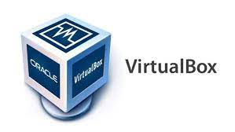
TOOLS AND TECHNOLOGIES
1. VirtualBox
Oracle VM VirtualBox is cross-platform virtualization software. It allows users to extend their existing computer to run multiple operating systems including Microsoft Windows, Mac OS X, Linux, and Oracle Solaris, at the same time.
While VirtualBox itself is free to use and is distributed under an open-source license the VirtualBox Extension Pack is licensed under the VirtualBox Personal Use and Evaluation License (PUEL). Personal use is free but commercial users need to purchase a license.

Slide 72
TOOLS AND TECHNOLOGIES
Features
Snapshots of the RAM and storage allows reverting to a prior state.
Screenshots and screen video capture facility.
Shared clipboard & shared folders through "guest additions" software
Ability to specify amount of shared RAM, video memory, and CPU execution cap.
Command line interaction (in addition to the GUI)

Slide 73
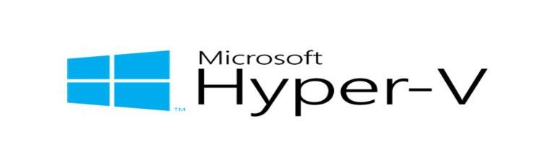
TOOLS AND TECHNOLOGIES
2. Microsoft Hyper-V
Microsoft released Hyper-V in 2016. Hyper-V is virtualization software that, well, virtualizes software. It can not only virtualize operating systems but also entire hardware components, such as hard drives and network switches.
Unlike other virtualization tools, Hyper-V is not limited to the user’s device. You can use it for server virtualization, too.

Slide 74
TOOLS AND TECHNOLOGIES
Features
Hardware virtualization.
It can run multiple virtual machines.
These virtual machines can be used with Azure. Thus, we can say that Microsoft Hyper-V supports a cloud-based platform

Slide 75
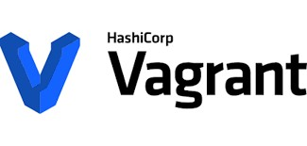
TOOLS AND TECHNOLOGIES
3. Vagrant
Vagrant is an open-source virtualization tool which developed by Hashicorp and written in Ruby, but it can be used in projects written in other programming languages such as PHP, Python, Java, C#, and JavaScript.
This tool which works on command-line that provides a framework and configuration format for creating, managing and distributing virtualized development environments.

Slide 76
TOOLS AND TECHNOLOGIES
Features
Creates virtual machine based on an operating system of your choice.
Modifies the physical properties of this virtual machine (e.g., RAM, number of CPUs etc.)
Establishes network interfaces so that you can access your virtual machine from your own computer, another device on the same network, or even from another virtual machine.
Sets up shared folders so we can continue editing files from both.

Slide 77

TOOLS AND TECHNOLOGIES
4. Red Hat Virtualization
This system was developed by Red Hat Software. It is written in Java. Its first version was released in June 2010. Red Hat Enterprise Virtualization, or RHEV, provides a RHEL-based centralized management server with a web-based interface for managing virtual machines (VMs) called the RHEV Manager.
Red Hat Enterprise Virtualization is based on open standards and works with Linux and Windows, as well as enterprise applications like SAP and Oracle.

Slide 78
TOOLS AND TECHNOLOGIES
Features
Applications run fast in virtualization as well. Hence in the top features, they promise improved performance.
It is an open-source system. So, we can make it, to integrate with the systems as per your requirement.
It is easy to setup, use and manage.

Slide 79
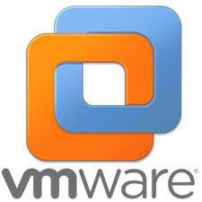
TOOLS AND TECHNOLOGIES
5. VMware Workstation
With the help of this system, you can run multiple OS. This system is for Linux or Windows OS users.
This system is specially developed for IT professionals and developers. It will help developers to develop the software to be compatible for multiple OS/platform.

Slide 80
TOOLS AND TECHNOLOGIES
Features
It supports multiple OS that can be run on Linux or Windows PC.
This system can work with the cloud - vSphere Connectivity (VMware vSphere is a cloud-based platform for virtualization).
It will allow you to keep different privacy settings and network configurations for another PC that is virtual.
Transferring data to and from the virtual machine to your PC is easier.
Helpful Snapshot feature helps in software testing.

Slide 81
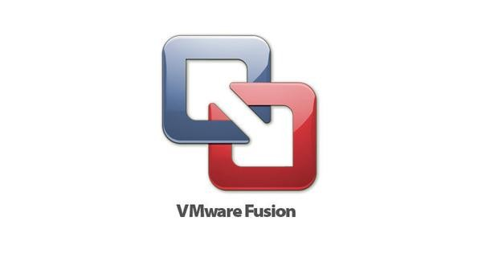
TOOLS AND TECHNOLOGIES
6. VMware Fusion
VMware Fusion is an easy-to-use application that gives you the possibility to set up and use a virtual machine of the Windows operating system on your Intel-based Mac.
VMware Fusion gives Mac users the power to run Windows on Mac along with hundreds of other operating systems side by side with Mac applications, without rebooting. Fusion is simple enough for home users and powerful enough for IT professionals, developers and businesses.

Slide 82
TOOLS AND TECHNOLOGIES
Features
It provides solutions for IT professionals, developers, and businesses.
You can use multiple applications on different OS at the same time. There will be no need to reboot.
Fusion Pro provides facility to integrate with many development tools.
VMware Fusion can be connected with VMware vSphere. vSphere provides a cloud-based platform for virtualization.

Slide 83
Technologies in Virtualized Environment
1. Hardware Virtualization
Hardware virtualization is done by abstracting the physical hardware part by using VMM (virtual machine monitor) or hypervisor. Hypervisor relies on command set extensions in the processors to accelerate common virtualization tasks for improving the performance.
It provides a significant performance gain over software virtualization by running some guest code directly on the host hardware with limited or none assistance from the host system

Slide 84
The hypervisor software does the task of managing the shared physical hardware resources between the guest operating system and the host operating system. The hardware that is abstracted is indicated as actual hardware.
The main task that is performed by the hypervisor is to process monitoring, memory, and hardware controlling. When hardware virtualization is done, different operating systems can be installed, and different applications can run on it.

Slide 85
Technologies in Virtualized Environment
Types of Hardware Virtualization
Full virtualization
In full virtualization, the hardware architecture is completely simulated. Guest software doesn’t require any change to run applications.
Emulation virtualization
In this, the virtual machine simulates the hardware, and the guest operating system does not require any hardware.
Para-virtualization
In Para-virtualization, the hardware is not simulated; rather the guest software runs its isolated system.

Slide 86
Technologies in Virtualized Environment
Advantages of Hardware Virtualization
Efficient resource virtualization
In hardware virtualization, physical resources can be shared among virtual machines. In this, if there is needed for unused resources allocated by one virtual machine can be used by another virtual machine.
Increase IT flexibility
By using virtualization, the fast development of hardware resources became possible.

Slide 87
Technologies in Virtualized Environment
Advantages of Hardware Virtualization
Low cost
Due to server consolidation, the cost is low, and multiple operating systems can exist in a single hardware.
Advanced hardware virtualization features
With the advancement of modern hypervisor, more difficult operations maximize the abstraction of hardware and ensure maximum

Slide 88
Technologies in Virtualized Environment
2. Software Virtualization
Software virtualization is also called application virtualization. Software virtualization is the same as virtualization but can abstract the software installation procedure and create virtual software installations.
Examples: VMware software, virtual box, etc.

Slide 89
Technologies in Virtualized Environment
2. Software Virtualization
Most of the applications and their distributions became difficult tasks for IT firms and departments. The mechanism for installing an application varies. So, to solve this type of problem, virtualized software is introduced, which is an application that will be installed into its self-contained unit and provide software virtualization.

Slide 90
Technologies in Virtualized Environment
2. Software Virtualization
The host system needs to completely emulate guest's platform. The advantage is that host and guest platforms are independent. The disadvantage is that this approach is very slow and resource consuming (since we have to emulate everything).

Slide 91
Technologies in Virtualized Environment
Advantages of Software Virtualization
Client deployment became easier
We can easily install virtual software by copying a file to a workstation or linking a file in a network.
Easy to manage
Software virtualization is easy to maintain. You only need to update at one place and deploy the virtual update application to all cloud.

Slide 92
Technologies in Virtualized Environment
Advantages of Software Virtualization
Software migration
Without software virtualization, moving from one software platform to another platform takes more time for deploying and impact on an end-user system with the support of virtualized software environment support the– migration became easier.

Slide 93
Architecture of Hypervisors
The first virtualization was performed on IBM mainframes. The code that was developed solved a particular issue by managing available memory resources more effectively, and that code is an ancestor to the much more sophisticated descendants we rely on today.
The first virtual machine monitors were used for the development and debugging of operating systems because they provided a sandbox for programmers to test rapidly and repeatedly, without using all of the resources of the hardware.

Slide 94
Architecture of Hypervisors
Soon they added the ability to run multiple environments concurrently, carving the hardware resources into virtual servers that could each run their own operating system. This model is what evolved into today’s hypervisors.
Without a hypervisor, an operating system communicates directly with the hardware. Disk operations go directly to the disk subsystem, and memory calls are fetched directly from the physical memory. When more than one operating system want simultaneous control of the hardware, which would result in chaos.

Slide 95
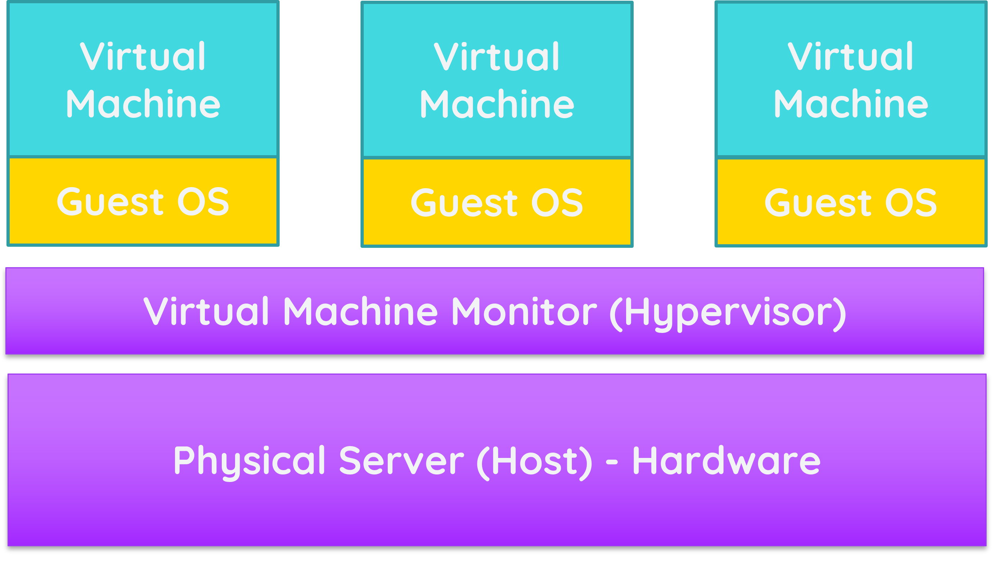
Architecture of Hypervisors
The structure of a VMM is simple. It consists of a layer of software that lives between the hardware, or host, and the virtual machines that it supports. These virtual machines, or VMs are also called guests. Figure below is a simple illustration of the virtual machine monitor architecture.

Slide 96
Architecture of Hypervisors
At the highest level, a hypervisor is an arbiter of resources. It is software that sits between the physical resources on a physical server and the virtual machines that run on that server.
In addition
to resource for those
allocation, hypervisors provide a virtual workloads, enable virtual networks for
environment
communication between workloads and to the outside world, and offer
various forms of clustering for high availability.

Slide 97
The original virtual machine monitor (VMM) was created to solve a specific problem. However, VMMs have evolved into something quite different, so much so that the term virtual machine manager has fallen out of favor and has been replaced with the term hypervisor.
Today’s hypervisors allow us to make better use of the ever-faster processors that regularly appear in the commercial market and to more efficiently use the larger and denser memory offerings that come along with those newer processors.

Slide 98
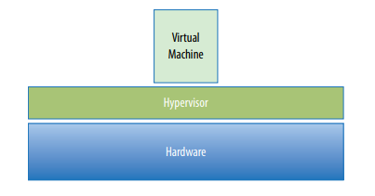
Hypervisor is a layer of software that resides below the virtual machines and above the hardware.

Slide 99
Without a hypervisor, an operating system communicates directly with the hardware beneath it. Disk operations go directly to the disk subsystem, and memory calls are fetched directly from the physical memory.
Without a hypervisor, more than one operating system from multiple virtual machines would want simultaneous control of the hardware, which would result in chaos. The hypervisor manages the interactions between each virtual machine and the hardware that the guests all share.

Slide 100
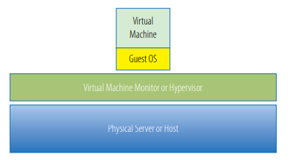
The structure of a VMM is fairly simple. It consists of a layer of software that lives between the hardware, or host, and the virtual machines that it supports. These virtual machines, or VMs are also called guests. Figure below is a simple illustration of the virtual machine monitor architecture.

Slide 101
UNDERSTANDING HYPERVISORS
There are two types of hypervisors: Type 1 and Type 2 hypervisors.
Both hypervisor varieties can virtualize common elements such as CPU, memory and networking, but based on its location in the stack, the hypervisor virtualizes these elements differently.

Slide 102
Aside from having better performance characteristics, Type 1 hypervisors are also considered to be more secure than Type 2 hypervisors.
Guest operations are handed off and, as such, a guest cannot affect the hypervisor on which it is supported.
A virtual machine can damage only itself, causing a single guest crash, but that event does not escape the VM boundaries. Other guests continue processing, and the hypervisor is unaffected as well.
Less processing overhead is required for a Type 1 hypervisor, which means that more virtual machines can be run on each host.

Slide 103
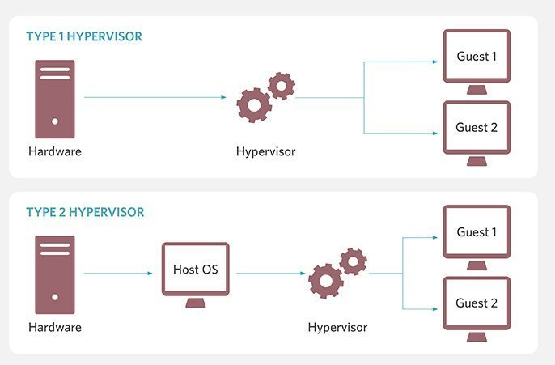

Slide 104
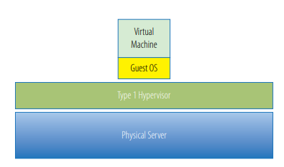
TYPE 1 HYPERVISORS
Figure illustrates a simple architecture of a Type 1 hypervisor.

Slide 105
Type 1 hypervisors
A Type 1 hypervisor runs directly on the host machine's physical hardware, and it's referred to as a bare-metal hypervisor. It doesn't have to load an underlying OS and have a direct access to the underlying hardware. So, type 1 hypervisors are regarded as the most efficient and best-performing hypervisors available for enterprise computing.

Slide 106
Type 1 hypervisors
Hypervisors that run directly on physical hardware are also highly secure. Virtualization mitigates the risk of attacks that target security flaws and vulnerabilities in OSes because each guest has its own OS. This ensures an attack on a guest VM is logically isolated to that VM and can't spread to others running on the same hardware.
Developers might use a Type 1 hypervisor to create VMs for testing.

Slide 107
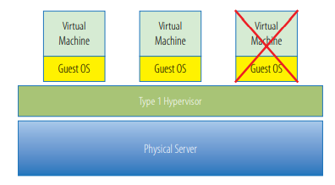
TYPE 1 HYPERVISORS
Figure illustrates a guest failure in a Type 1 hypervisor.

Slide 108
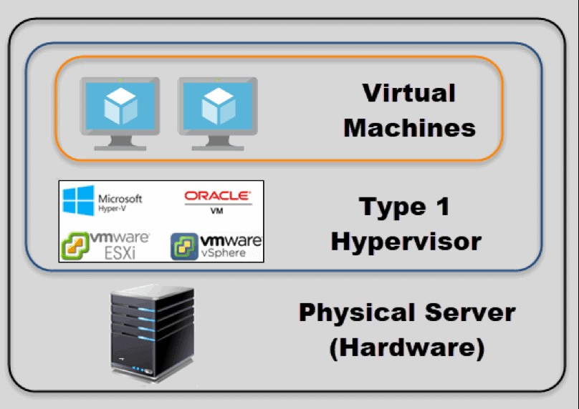
TYPE 1 HYPERVISORS

Slide 109
Type 2 hypervisors
A Type 2 hypervisor is typically installed on top of an existing OS. It is sometimes called a hosted hypervisor because it relies on the host machine's preexisting OS to manage calls to CPU, memory, storage and network resources.
Type 2 hypervisors are generally not used for data center computing and are reserved for client or end-user systems (sometimes called client hypervisors) where performance and security are lesser concerns.

Slide 110
Type 2 hypervisors
They also come at a lower cost than Type 1 hypervisors and make an ideal test platform compared to production virtualized environments or the cloud.
IT organizations typically use Type 1 hypervisors to create virtual desktops.

Slide 111
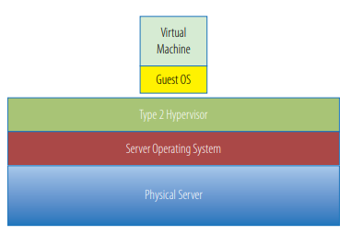
TYPE 2 HYPERVISORS

Slide 112
TYPE 2 HYPERVISORS
One benefit of this model is that it can support a large range of hardware because that is inherited from the operating system it uses.
Often Type 2 hypervisors are easy to install and deploy because much of the hardware configuration work, such as networking and storage, has already been covered by the operating system.
Type 2 hypervisors are not as efficient as Type 1 hypervisors because of this extra layer between the hypervisor itself and the hardware.

Slide 113
TYPE 2 HYPERVISORS
Type 2 hypervisors are also less reliable because there are more points of failure: anything that affects the availability of the underlying operating system also can impact the hypervisor and the guests it supports.
For example, standard operating system patches that require a system reboot would also force reboots of all the virtual machines on that host.
A Type 2 hypervisor deployment uses more physical resources than a Type 1 hypervisor from the standpoint that the underlying operating system consumes system resources in addition to those consumed by the hypervisor’s activities.

Slide 114
TYPE 2 HYPERVISORS
Type 2 hypervisors are typically used in desktop development environments when a single developer is working on one or more virtual machines in building an application.
In this case, the hypervisor is actually just an additional desktop application for that developer. Contrast this with a Type 1 hypervisor deployment where the sole function of the physical server is the hosting of virtual machines and no other applications need to run on that hardware.

Slide 115
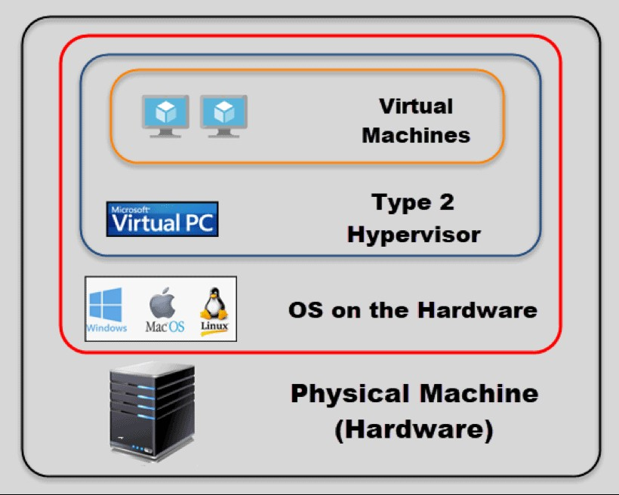
TYPE 2 HYPERVISORS

Slide 116
HYPERVISORS
Hardware support
Hardware acceleration technologies are widely available for virtualization's tasks. Such technologies include Intel Virtualization Technology extensions for Intel processors and AMD Virtualization extensions for AMD processors.
Both Type 1 and Type 2 hypervisors use hardware acceleration support, but to varying degrees.

Slide 117
HYPERVISORS
Hardware support
Type 1 hypervisors rely on hardware acceleration technologies and typically don't function without those technologies available and enabled through the system's BIOS.
Type 2 hypervisors are generally capable of using hardware acceleration technologies if those features are available, but they can typically fall back on software emulation in the absence of native hardware support.

Slide 118
Type 1 hypervisor vendors
Microsoft Hyper-V
Oracle VM
VMware vSphere
Citrix Hypervisor
KVM (Kernel-based Virtual Machine)
Xen hypervisor

Slide 119
Type 2 hypervisor vendors
Oracle VM VirtualBox
VMware Workstation Pro
VMware Fusion
QEMU (Quick Emulator)
Parallels Desktop

Slide 120
DIFFERENCE BETWEEN VIRTUALIZATION AND VIRTUAL COMPUTING.
Virtualization is technology that lets you create useful IT services using resources that are traditionally bound to hardware. It allows you to use a physical machine’s full capacity by distributing its capabilities among many users or environments.
Virtual computing refers to the use of a remote computer from a local computer where the actual computer user is located.

Slide 121
DIFFERENCE BETWEEN VIRTUALIZATION AND VIRTUAL COMPUTING.
Virtual computing makes one computer act and perform like many computers. Through virtual computing providers, users can download and use more than one operating system and perform a multitude of functions at the same time through a single mouse click and receive all the benefits of additional programs and hardware without having to purchase or install them on their own computer.
Executives can check their company e-mail on the road, students can take classes from home and managers can keep up with documents stored on internal servers from anywhere in the world.

Slide 122
DIFFERENCE BETWEEN VIRTUALIZATION AND VIRTUAL COMPUTING.
Virtual computing makes one computer act and perform like many computers. Through virtual computing providers, users can download and use more than one operating system and perform a multitude of functions at the same time through a single mouse click and receive all the benefits of additional programs and hardware without having to purchase or install them on their own computer.
Executives can check their company e-mail on the road, students can take classes from home and managers can keep up with documents stored on internal servers from anywhere in the world.

