Slide 1
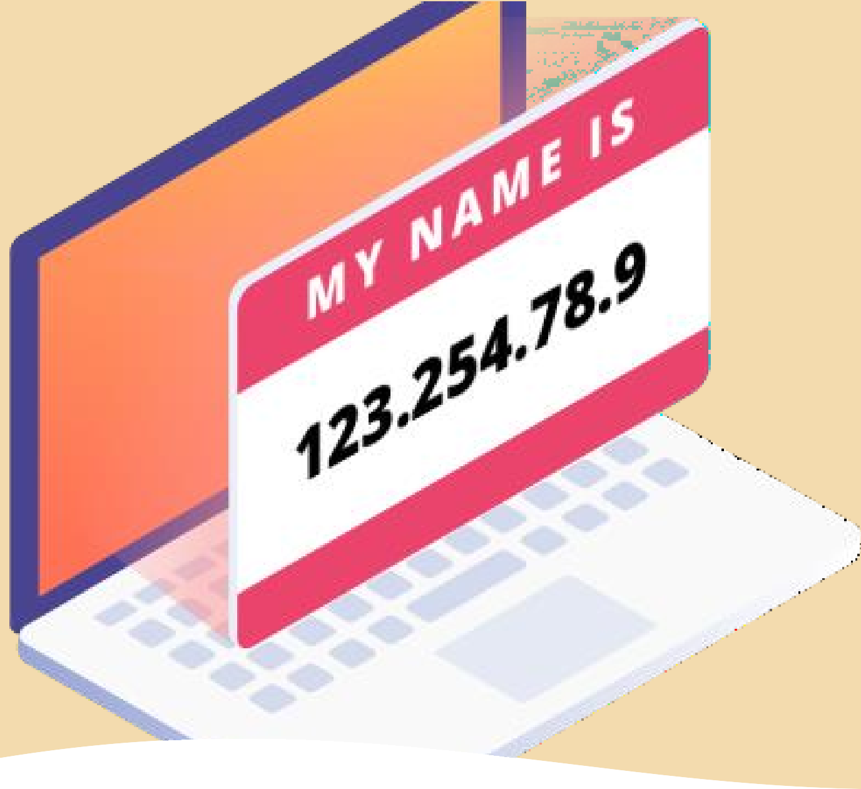

IP Addressing
Module 2

Slide 2

Module-2 Syllabus
IP addressing - Private address, Public address, virtual LAN, Memory
addressing, Paging, Memory mapping, virtual memory, complexities and solutions of memory virtualization.
IP addressing
Private & Public Addresses
Virtual LAN
Memory addressing
Paging
Memory mapping
Virtual memory
Complexities and solutions of memory virtualization

Slide 3

IP addressing
It is a unique address that identifies a device on the internet or a local network.
The IP (Internet Protocol) is the fundamental protocol for communications on the Internet.
It specifies the way information is packetized, addressed, transferred, routed, and received by networked devices.

Slide 4
IP history
Its development began in 1974, led by computer scientists Bob Kahn and Vint Cerf. It is frequently used in conjunction with the Transmission Control Protocol, or TCP. Together they are referred to as TCP/IP.
The first major version of the Internet Protocol was version 4, or IPv4. In 1981, it was formally defined in RFC 791 by the Internet Engineering Task Force, or IETF.
The successor to IPv4 is IPv6, which was formalized by the IETF in 1998. It was designed to eventually replace IPv4. As of 2018, IPv6 governs approximately 20% of all Internet traffic.

Slide 5

IP addressing
An IP address is a number identifying of a computer or another device on the Internet. It is similar to a mailing address, which identifies where postal mail comes from and where it should be delivered. IP addresses uniquely identify the source and destination of data transmitted with the Internet Protocol.

Slide 6
IPv4 and IPv6 addresses
IPv4 addresses are 32 bits long (four bytes).
An example of an IPv4 address is 216.58.216.164.
₂32,
The maximum value of a 32-bit number is or
4,294,967,296. So the maximum number of IPv4 addresses, which is called its address space, is about 4.3 billion.
In the 1980s, this was sufficient to address every networked device, but scientists knew that this space would quickly become exhausted.
Technologies like NAT(Network Address Translation) have delayed the problem by allowing many devices to use a single IP address, but a larger address space is needed to serve the modern Internet.

Slide 7

A major advantage of IPv6 is that it uses 128 bits of data to store an address, permitting 2¹²⁸ unique addresses, or 340,282,366,920,938,463,463,374,607,431,768,211,456. The size of IPv6's address space — 340 duodecillion — is much, much larger than IPv4.

Slide 8
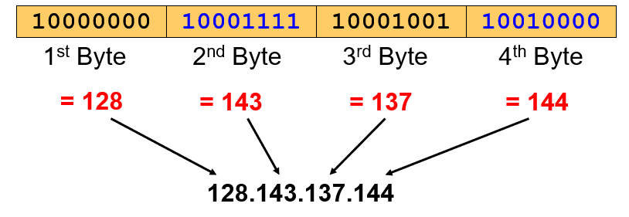

Dotted Decimal Notation
IP addresses are written in a so-called dotted decimal notation.
Each byte is identified by a decimal number in the range [0...255]
Example: IPV4

Slide 9
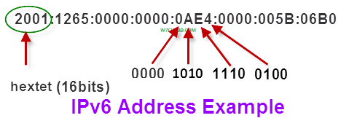
Hexadecimal Notation
In computing, a hextet, or a chomp, is a sixteen-bit aggregation, or four nibbles. As a nibble typically is notated in hexadecimal notation, a hextet consists of 4 hexadecimal digits. A hextet is the unofficial name for each of the 8 blocks in an IPv6 address.

Slide 10
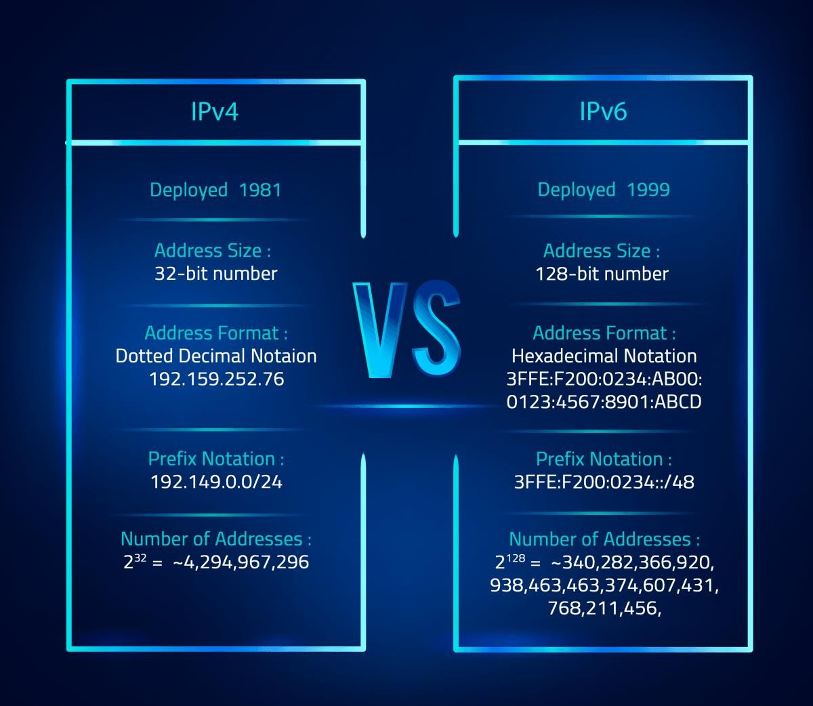

Slide 11

IP address classes
Class | Address range | Supports
Class A | 1.0.0.1 to 126.255.255.254 | Supports 16 million hosts on each of 127 networks.[Large size organization]
Class B | 128.1.0.1 to 191.255.255.254 | Supports 65,000 hosts on each of 16,000 networks. [Medium size organization]
Class C | 192.0.1.1 to 223.255.254.254 | Supports 254 hosts on each of 2 million networks. [Small size organization]
Class D | 224.0.0.0 to 239.255.255.255 | Reserved for multicast groups.
Class E | 240.0.0.0 to 254.255.255.254 | Reserved for future use, or research and development purposes.
With an IPv4 IP address, there are five classes of available
IP ranges: Class A,
C,
Class B, Class
Class D and Class E, while only A, B, and C are commonly used. Each class allows for
a range of
valid IP addresses, shown in
the following table.

Slide 12
Ranges 127.x.x.x are reserved for the loopback or localhost.
For example, 127.0.0.1 is the loopback address.
Packets sent to this address never reach the network but are looped through the network interface card only. This can be used for diagnostic purposes to verify that the internal path through the TCP/IP protocols is working.
The loopback address is an IP address that specifies the local computer.
127.0.0.1 is known as a loopback address, but you may see it under the name "localhost." When you point your browser to 127.0.0.1, it tries to connect to the computer you're using right now. This is handy when you want to connect to a server on your own computer.
Range 255.255.255.255 broadcasts to all hosts on the local network.

Slide 13
Subnet Mask
Every device has an IP address with two pieces: the client or host address and the server or network address.
The subnet mask splits the IP address into the host and network addresses, thereby defining which part of the IP address belongs to the device and which part belongs to the network.
A subnet mask is a 32-bit number created by setting host bits to all 0s and setting network bits to all 1s. In this way, the subnet mask separates the IP address into the network and host addresses.

Slide 14
Class A subnet mask reflects the network portion in the first octet and leaves octets 2, 3, and 4 for the network manager to divide into hosts and subnets as needed. Class A is for networks with more than 65,536 hosts.
Class B subnet mask claims the first two octets for the network, leaving the remaining part of the address, the 16 bits of octets 3 and 4, for the subnet and host part. Class B is for networks with 256 to 65,534 hosts.
In a Class C subnet mask, the network portion is the first three octets with the hosts and subnets in just the remaining 8 bits of octet 4. Class C is for smaller networks with fewer than 254 hosts.

Slide 15
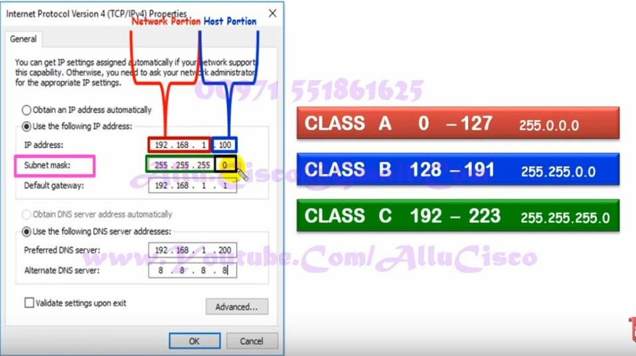

Slide 16
Class A, B, and C networks have natural masks, or default subnet masks:
Class A: 255.0.0.0
Class B: 255.255.0.0
Class C: 255.255.255.0
You can determine the number and type of IP addresses any given local network requires based on its default subnet mask.
An example of Class A IP address and subnet mask would be the Class A default submask of 255.0.0.0 and an IP address of 10.20.12.2.

Slide 17
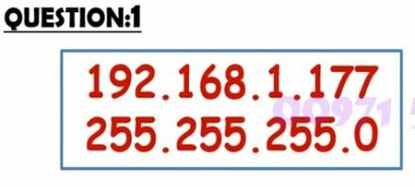


Slide 18

Private and Public IP addresses
Private IP address of a system is the IP address which is used to communicate within the same network. Using private IP data or information can be sent or received within the same network.
Public IP address of a system is the IP address which is used to communicate outside the network. Public IP address is basically assigned by the ISP (Internet Service Provider).

Slide 19
Private IP address
Private IP address (Internal) is only used by devices communicating to each other on the same network.
Devices with private IP addresses cannot connect to the Internet directly. Likewise, computers or other devices outside the local network cannot connect directly to a device with a private IP.
An IP address is considered private if the IP number falls within one of the IP address ranges reserved for private networks such as a Local Area Network (LAN).

Slide 20
The Internet Assigned Numbers Authority (IANA) has reserved the following three blocks of the IP address space for private networks (local networks):
Class A: 10.0.0.0 — 10.255.255.255
Class B: 172.16.0.0 — 172.31.255.255
Class C: 192.168.0.0 — 192.168.255.255
These might not seem like wide ranges, but they don’t really need to be. Because these IP addresses are reserved for private network use only, they can be reused on different private networks all over the world — without consequence or confusion.

Slide 21

Public IP address
A Public IP address (External) is assigned to every device that connects to the Internet and each IP address is unique. Therefore, there cannot exist two device with the same public IP address.
This addressing scheme makes it possible for the devices to “find each other” online and exchange information.
A user has no control over the public IP address that is assigned to the device. The public IP address is assigned to the device by the Internet Service Provider(ISA) as soon as the device is connected to the Internet.

Slide 22
IP Address Terminology
A public IP address can be static, dynamic or shared.
Static means the IP address never changes as long as you stay with the same provider or same server.
Dynamic means the IP address can change from time-to-time.
Public means the IP address can be reached via the Internet from any computer in the world.
Private means the IP address can only be reached by other devices on the same network.
Shared means other people besides you use your IP address for their connection.
Dedicated means no one else uses your IP address for their connection.

Slide 23
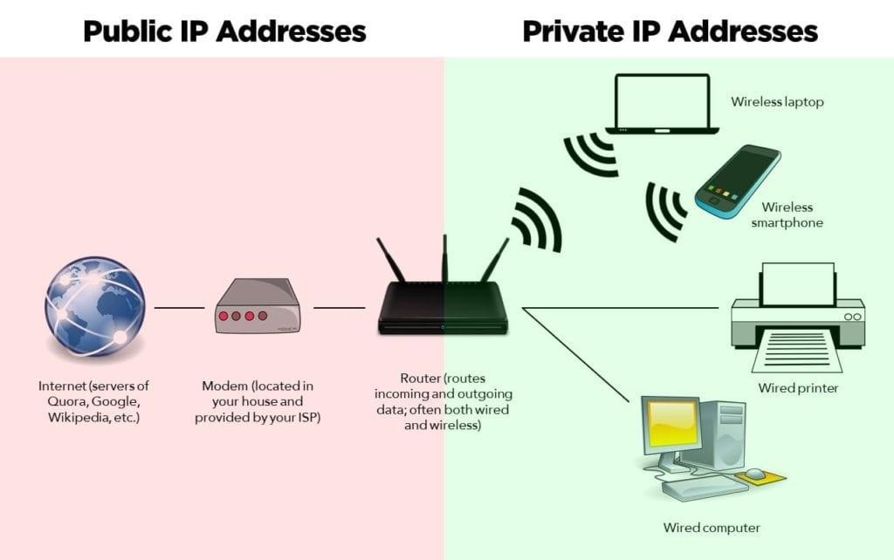

Slide 24
PRIVATE IP ADDRESS | PUBLIC IP ADDRESS
Scope is local. Used with LAN or Network. | Scope is global. Used on Public Network.
It is used to communicate within the network. Not recognized over Internet. | It is used to communicate outside the network. Recognized over Internet.
Unique only in LAN. | Unique Globally.
Assigned by LAN Administrator. | Assigned by Service Provider / IANA
It is available in free of cost. | It is not free of cost.
Private IP can be known by entering “ipconfig” on command prompt. | Public IP can be known by searching “what is my ip” on google.
Range:10.0.0.0 – 10.255.255.255, 172.16.0.0 – 172.31.255.255, 192.168.0.0 – 192.168.255.255 | Range: Besides private IP addresses, rest are public.
Example: 192.168.1.10 | Example: 17.5.7.8

Slide 25
Virtual LAN
VLANs, logically segment switched networks based on the functions, project teams, or applications of the organization regardless of the physical location or connections to the network.
All workstations and servers used by a particular workgroup share the same VLAN, regardless of the physical connection or location.
Virtual LANs are a logical group of computers that appear to be on the same LAN irrespective of the configuration of the underlying physical network.

Slide 26
Virtual LAN
Network administrators partition the networks to match the functional requirements of the VLANs so that each VLAN comprise of a subset of ports on a single or multiple switches or bridges.
This allows computers and devices in a VLAN to communicate in the simulated environment as if it is a separate LAN.

Slide 27
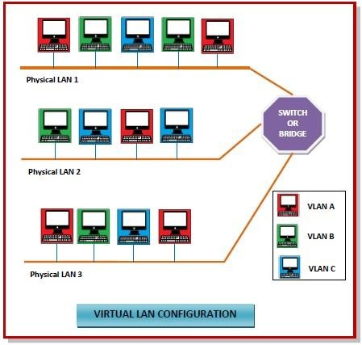

Slide 28
Features of VLANs
A VLAN forms sub-network grouping together devices on separate physical LANs.
VLAN's help the network manager to segment LANs logically into different broadcast domains.
VLANs function at layer 2, i.e. Data Link Layer of the OSI model.
There may be one or more network bridges or switches to form multiple, independent VLANs.
Using VLANs, network administrators can easily partition a single switched network into multiple networks depending upon the functional and security requirements of their systems.

Slide 29
Features of VLANs
VLANs eliminate the requirement to run new cables or reconfiguring physical connections in the present network infrastructure.
VLANs help large organizations to re-partition devices aiming improved traffic management.
VLANs also provide better security management allowing partitioning of devices according to their security criteria and also by ensuring a higher degree of control connected devices.

Slide 30
Features of VLANs
VLANs are more flexible than physical LANs since they are formed by logical connections.
This aids is quicker and cheaper reconfiguration of devices when the logical partitioning needs to be changed.

Slide 31
Virtual LAN (VLAN) is a concept in which we can divide the
devices logically on layer 2 (data link layer).
Generally, layer 3 devices divides broadcast domain but broadcast domain can be divided by switches using the concept of VLAN.
A broadcast domain is a network segment in which if a device
broadcast a packet then all the devices in the same broadcast domain will receive it.

Slide 32
The devices in the same broadcast domain will receive all the
broadcast packet but it is limited to switches only as routers don’t forward out the broadcast packet.
To forward out the packets to different VLAN (from one VLAN to
another) or broadcast domain, inter-Vlan routing is needed.
Through VLAN, different small size sub networks are created which are comparatively easy to handle.

Slide 33
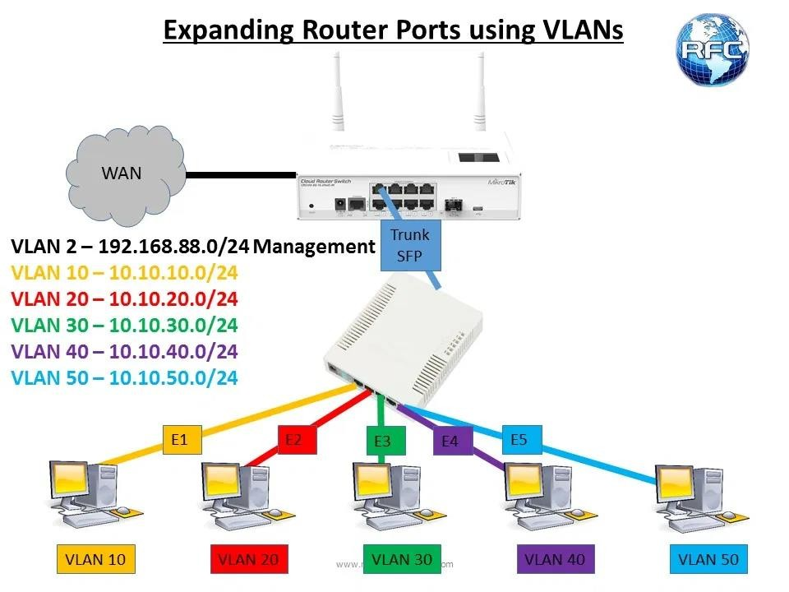
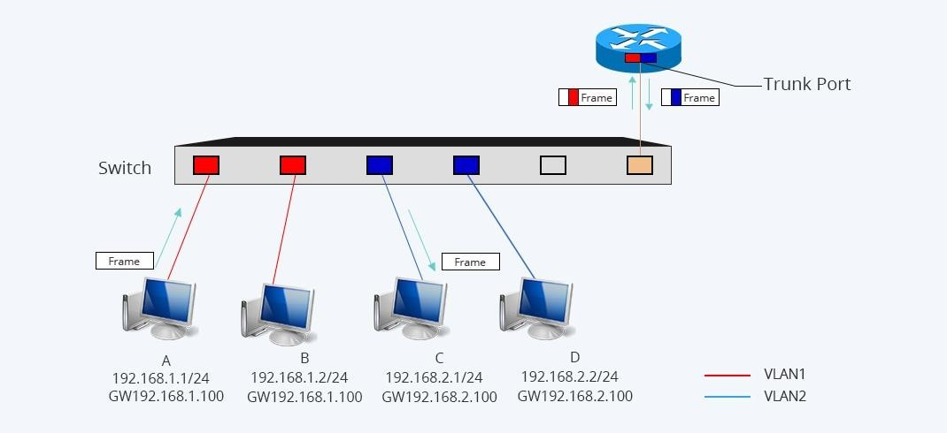
Trunk Port
Unlike an access port, a trunk port can transmit data from multiple VLANs. A trunk port allows you to send all those signals for each switch or router across a single trunk link. In contrast to an access port, a trunk port must use tagging in order to allow signals to get to the correct endpoint.

Slide 34
VLAN Tagging
VLAN tagging, also known as Frame Tagging is a method developed by Cisco to help identify packets travelling through trunk links. When an Ethernet frame traverses a trunk link, a special VLAN tag is added to the frame and sent across the trunk link.
As it arrives at the end of the trunk link the tag is removed and the frame is sent to the correct access link port according to the switch's table, so that the receiving end is unaware of any VLAN information.
IEEE 802.1Q: IEEE industry standard VLAN frame tagging.

Slide 35
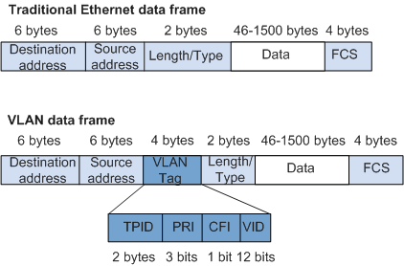
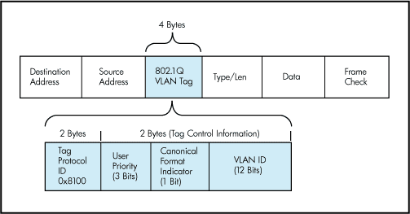
VLAN Frame Tagging

Slide 36
Types of Virtual LAN (VLAN)
Default VLAN
Data VLAN
Voice VLAN
Management VLAN
Native VLAN

Slide 37
Advantages
Performance –The network traffic is full of broadcast and multicast. VLAN reduces the need to send such traffic to unnecessary destination.
e.g.-If the traffic is intended for 2 users but as 10 devices are present in the same broadcast domain therefore all will receive the traffic i.e. wastage of bandwidth but if we make VLANs, then the broadcast or multicast packet will go to the intended users only.
Formation of virtual groups – As there are different departments in every organization namely sales, finance etc., VLANs can be very useful in order to group the devices logically according to their departments.

Slide 38
Security – In the same network, sensitive data can be broadcast which can be accessed by the outsider by creating VLAN, but we can control broadcast domains, set up firewalls, restrict access. Also, VLANs can be used to inform the network manager of an intrusion. Hence, VLANs greatly enhance network security.
Flexibility – VLAN provide flexibility to add, remove the number of host we want.
Cost reduction – VLANs can be used to create broadcast domains which eliminate the need for expensive routers. By using Vlan, the number of small size broadcast domain can be increased which are easy to handle as compared to a bigger broadcast domain.

Slide 39
Memory addressing
In computing, a memory address is a reference to a specific memory location used at various levels by software and hardware.
Memory addresses are fixed-length sequences of unsigned digits conventionally displayed and manipulated as integers.
A memory address is a unique identifier used by a device or CPU for data tracking.
Modern computers are addressed by bytes which are assigned to memory addresses – binary numbers assigned to a RAM cell that holds up to one byte.

Slide 40
Memory addressing
The main memory (or simply the memory) is where variables and other information are stored while a program runs. From the perspective of a program, the computer's memory is a collection of bytes, each with an integer address.
For example, there is a byte with address 1, another with address 2, etc., up to a very large number. A program can fetch the current contents of the byte at a given memory address and it can store a given value into that byte.

Slide 41
Memory addressing
A byte is just 8 bits. Most of the data items that you use are larger than that. For example, a value of type int is usually 32 bits, so it occupies 4 bytes. A program refers to a block of memory using the address of the first byte in the block.
For example, an integer stored in bytes 1000-1003 has address 1000.

Slide 42
Logical and Physical Address
Logical Address is generated by CPU while a program is running. The logical address is virtual address as it does not exist physically, therefore, it is also known as Virtual Address.
This address is used as a reference to access the physical memory location by CPU. The term Logical Address Space is used for the set of all logical addresses generated by a program’s perspective.
The hardware device called Memory-Management Unit (MMU) is used for mapping logical address to its corresponding physical address.

Slide 43
Logical and Physical Address
The value in the relocation register is added to every address generated by a user process at the time the address is sent to memory.
The user program never sees the real physical addresses.
The program can create a pointer to location 346, store it in memory, manipulate it, and compare it with other addresses—all like the number 346.
The user program generates only logical addresses. However, these logical addresses must be mapped to physical addresses before they are use.

Slide 44
Logical and Physical Address
Physical Address identifies a physical location of required data in a memory.
The user never directly deals with the physical address but can access by its corresponding logical address.
The user program generates the logical address and thinks that the program is running in this logical address but the program needs physical memory for its execution, therefore, the logical address must be mapped to the physical address by MMU before they are used.
The term Physical Address Space is used for all physical addresses corresponding to the logical addresses in a Logical address space.

Slide 45
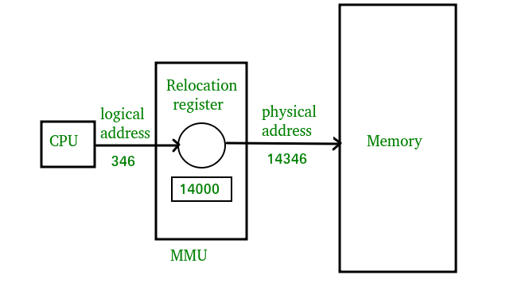
Logical and Physical Address
CPU
logical 346
MMU
will address
generate for eg:
will generate a
relocation register (base register) for eg: 14000
3.In
physical
memory, the address is
located eg:(346+14000= 14346)

Slide 46
Memory Allocation
In the Operating System, there are two techniques for memory allocation and these are as follows:
Contiguous Memory Allocation
Non-Contiguous Memory Allocation

Slide 47
Contiguous Memory Allocation
In Contiguous Memory Allocation whenever any user process request for the memory then a single section of the contiguous memory block is allocated to that process according to the requirements of the process. Contiguous memory allocation is achieved just by dividing the memory into the fixed-sized partition.
In this, all the available memory space remains together at one place and freely available memory partitions are not distributed here and there across the whole memory space.

Slide 48
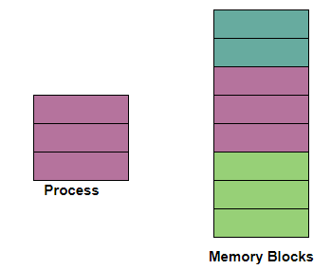
Contiguous Memory Allocation

Slide 49
Non-Contiguous Memory Allocation
With the help of Non-contiguous memory allocation, a process is allowed to acquire several memory blocks at different locations in the memory according to its need.
In the non-contiguous memory allocation, the available free memory space is distributed here and there which means that all the free memory space is not in one place.
In this technique, memory space acquired by a process is not at one place but it is at different locations according to the requirements of the process.

Slide 50
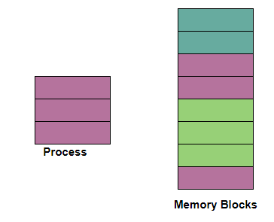
Non-Contiguous Memory Allocation

Slide 51

Differences
Contiguous Memory Allocation | Non-Contiguous Memory Allocation
The contiguous Memory Allocation technique allocates one single contiguous block of memory to the process and memory is allocated to the process in a continuous fashion. | The non-Contiguous Memory allocation technique divides the process into several blocks and then places them in the different address space of the memory that is memory is allocated to the process in a non-contiguous fashion.
In this Allocation scheme, there is no overhead in the address translation while the execution of the process. | While in this scheme, there is overhead in the address translation while the execution of the process.
In Contiguous Memory Allocation, the process executes faster because the whole process is in a sequential block. | In Non-contiguous Memory allocation execution of the process is slow as the process is in different locations of the memory.
Contiguous Memory Allocation is easier for the Operating System to control. | The non-Contiguous Memory Allocation scheme is difficult for the Operating System to control.
In this, the memory space is divided into fixed-sized partitions and each partition is allocated only to a single process. | In this scheme, the process is divided into several blocks and then these blocks are placed in different parts of the memory according to the availability of memory space.

Slide 52
Fragmentation
As processes are loaded and removed from memory, the free memory space is broken into little pieces. It happens after sometimes that processes cannot be allocated to memory blocks considering their small size and memory blocks remains unused. This problem is known as Fragmentation.
Internal Fragmentation
Memory block assigned to process is bigger. Some portion of memory is left unused, as it cannot be used by another process.
External Fragmentation
Total memory space is enough to satisfy a request or to reside a process in it, but it is not contiguous, so it cannot be used.

Slide 53
Paging
Paging permits the physical address space of a process to be non-contiguous. It is a fixed-size partitioning scheme.
In the Paging technique, the secondary memory and main memory are divided into equal fixed-size partitions.
Paging solves the problem of fitting memory chunks of varying sizes onto the backing store and this problem is suffered by many memory management schemes.
Paging helps to avoid external fragmentation and the need for compaction.

Slide 54
Basic Method of Paging
The paging technique divides the physical memory(main memory) into fixed-size blocks that are known as Frames and also divide the logical memory(secondary memory) into blocks of the same size that are known as Pages.
This technique keeps the track of all the free frames.
The Frame has the same size as that of a Page. A frame is basically a place where a (logical) page can be (physically) placed.

Slide 55
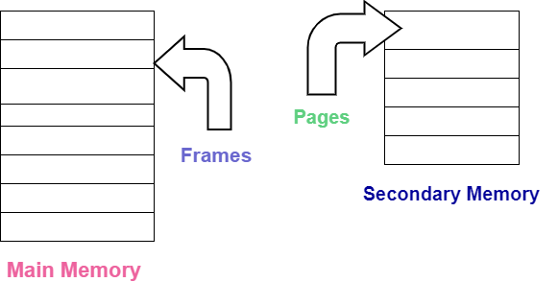
Basic Method of Paging

Slide 56
Basic Method of Paging
Each process is mainly divided into parts where the size of each part is the same as the page size.
There is a possibility that the size of the last part may be less than the page size.
Pages of a process are brought into the main memory only when there is a requirement otherwise they reside in the secondary storage.
One page of a process is mainly stored in one of the frames of the memory. Also, the pages can be stored at different locations of the memory but always the main priority is to find contiguous frames.

Slide 57
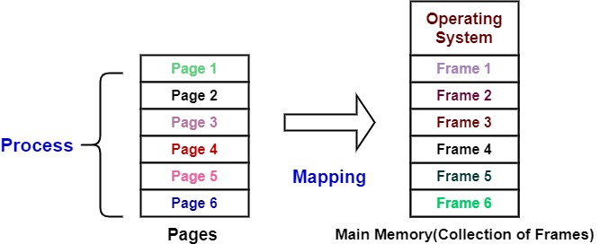
Basic Method of Paging

Slide 58
Translation of Logical Address into Physical Address
Before moving on further there are some important points to note:
The CPU always generates a logical address.
In order to access the main memory always a physical address is needed.
The logical address consists of two parts:
Page Number (p)
Page Offset (d)
generated by CPU always

Slide 59
Translation of Logical Address into Physical Address
where,
Page Number is used to specify the specific page of the process from which the CPU wants to read the data. and it is also used as an index to the page table.
and Page offset is mainly used to specify the specific word on the page that the CPU wants to read.

Slide 60
Page Table in OS
The Page table mainly contains the base address of each page in the Physical memory.
The base address is then combined with the page offset in order to define the physical memory address which is then sent to the memory unit.
Thus page table mainly provides the corresponding frame number (base address of the frame) where that page is stored in the main memory.
The frame number is combined with the page offset and forms the required physical address.

Slide 61
Translation of Logical Address into Physical Address
So, The physical address consists of two parts:
Page offset (d)
Frame Number (f)
where,
The Frame number is used to indicate the specific frame where the required page is stored.
Page Offset indicates the specific word that has to be read from that page.

Slide 62
Translation of Logical Address into Physical Address
The Page size (like the frame size) is defined with the help of hardware. It is important to note here that the size of the page is typically the power of 2 that varies between 512 bytes and 16 MB per page and it mainly depends on the architecture of the computer.
If the size of logical address space is 2 raised to the power m and page size is 2 raised to the power n addressing units then the high order m-n bits of logical address designates the page number and the n low-order bits designate the page offset.

Slide 63

Translation of Logical Address into Physical Address
The logical address is as follows:
where p indicates the index into the page table, and d
indicates the displacement within the page.

Slide 64
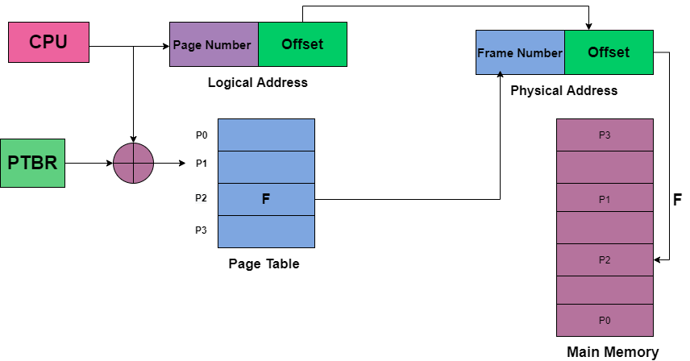

Slide 65
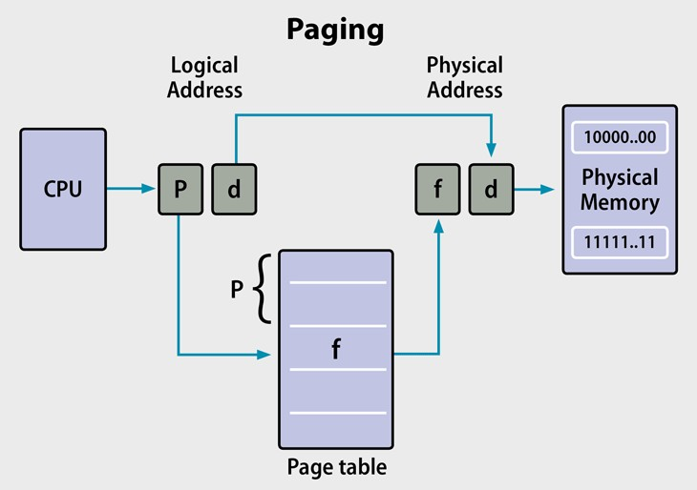

Slide 66
The above diagram indicates the translation of the Logical address into the Physical address.
The PTBR in the above diagram means page table base register and it basically holds the base address for the page table of the current process.
The PTBR is mainly a processor register and is managed by the operating system. Commonly, each process running on a processor needs its own logical address space.

Slide 67
But there is a problem with this approach and that is with the time required to access a user memory location. Suppose if we want to find the location i, we must first find the index into the page table by using the value in the PTBR offset by the page number for I. And this task requires memory access.
It then provides us the frame number which is combined with the page offset in order to produce the actual address. After that, we can then access the desired place in the memory.
With the above scheme, two memory accesses are needed in order to access a byte( one for the page-table entry and one for byte). Thus memory access is slower by a factor of 2 and in most cases, this scheme slowed by a factor of 2.

Slide 68
Translation of look-aside buffer (TLB)
There is the standard solution for the previous problem that is to use a special, small, and fast-lookup hardware cache that is commonly known as Translation of look-aside buffer(TLB).
TLB is associative and high-speed memory.
Each entry in the TLB mainly consists of two parts: a key (that is the tag) and a value.
When associative memory is presented with an item, then the item is compared with all keys simultaneously. In case if the item is found then the corresponding value is returned.
The search with TLB is fast though the hardware is expensive.
The number of entries in the TLB is small and generally lies in between 64 and 1024.

Slide 69
Translation of look-aside buffer (TLB)
TLB is used with Page Tables in the following ways:
The TLB contains only a few of the page-table entries. Whenever the logical address is generated by the CPU then its page number is presented to the TLB.
If the page number is found, then its frame number is immediately available and is used in order to access the memory. The above whole task may take less than 10 percent longer than would if an unmapped memory reference were used.

Slide 70
Translation of look-aside buffer (TLB)
In case if the page number is not in the TLB (which is known as TLB miss), then a memory reference to the Page table must be made.
When the frame number is obtained it can be used to access the memory. Additionally, page number and frame number is added to the TLB so that they will be found quickly on the next reference.
In case if the TLB is already full of entries then the Operating system must select one for replacement.
TLB allows some entries to be wired down, which means they cannot be removed from the TLB. Typically TLB entries for the kernel code are wired down.

Slide 71
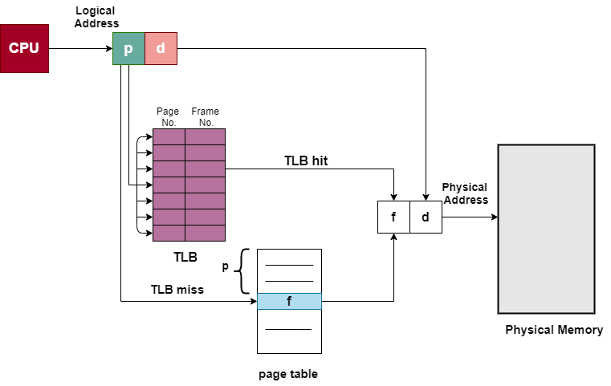
Paging Hardware With TLB

Slide 72
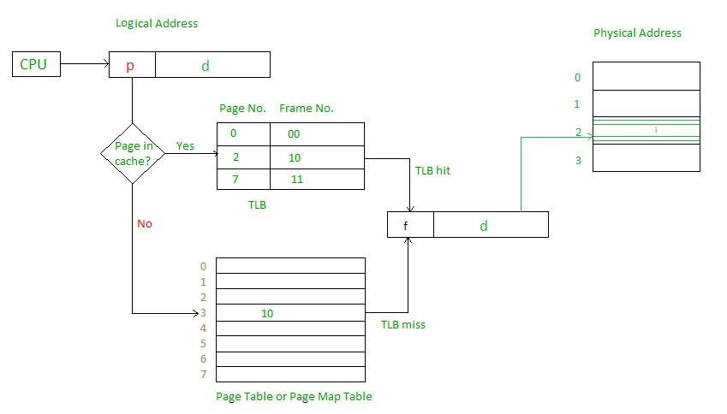
Paging Hardware With TLB - Example

Slide 73
Paging Example
In order to implement paging, one of the simplest methods is to implement the page table as a set of registers. As the size of registers is limited but the size of the page table is usually large thus page table is kept in the main memory.
There is no External fragmentation caused due to this scheme; Any frame that is free can be allocated to any process that needs it. But the internal fragmentation is still there.

Slide 74
Paging Example
If any process requires n pages then at least n frames are required.
The first page of the process is loaded into the first frame that is listed on the free-frame list, and then the frame number is put into the page table.

Slide 75
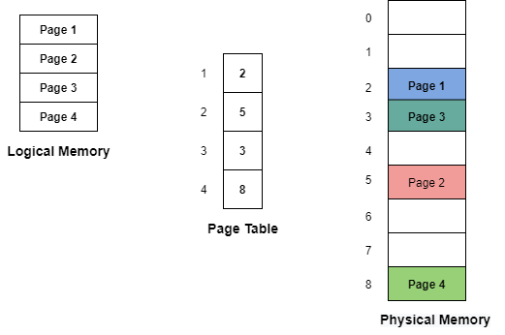

Slide 76
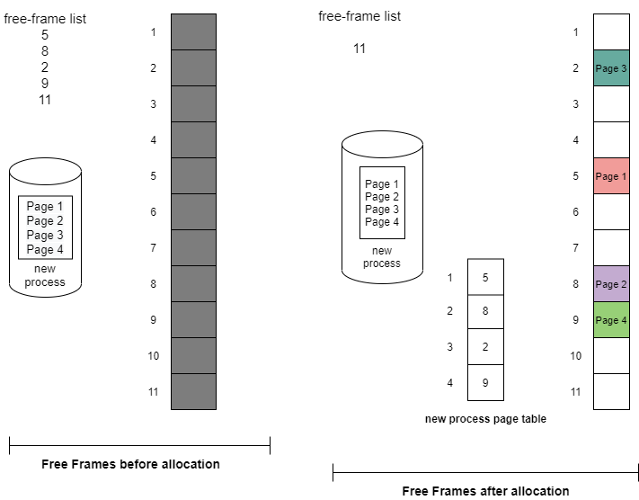
The frame table is a data structure that keeps the information of which frames are allocated or which frames are available and many more things. This table mainly has one entry for each physical page frame.

Slide 77
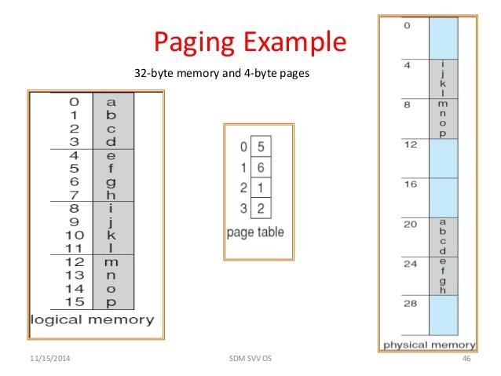

Slide 78
The Operating system maintains a copy of the page table for each process in the same way as it maintains the copy of the instruction counter and register contents. Also, this copy is used to translate logical addresses to physical addresses whenever the operating system maps a logical address to a physical address manually.
This copy is also used by the CPU dispatcher in order to define the hardware page table whenever a process is to be allocated to the CPU.

Slide 79
Advantages of Paging
Given below are some advantages of the Paging technique in the operating system:
Paging mainly allows to storage of parts of a single process in a non-contiguous fashion.
With the help of Paging, the problem of external fragmentation is solved.
Paging is one of the simplest algorithms for memory management.

Slide 80
Disadvantages of Paging
Disadvantages of the Paging technique are as follows:
In Paging, sometimes the page table consumes more memory.
Internal fragmentation is caused by this technique.
There is an increase instruction since now required.
in time taken to fetch the two memory accesses are

Slide 81

Virtual Memory
Virtual Memory is a storage mechanism which offers user an illusion of having a very big main memory. It is done by treating a part of secondary memory as the main memory. In Virtual memory, the user can store processes with a bigger size than the available main memory.
Therefore, instead of loading one long process in the main memory, the OS loads the various parts of more than one process in the main memory. Virtual memory is mostly implemented with demand paging and demand segmentation.

Slide 82
Virtual Memory
Virtual Memory is a storage scheme that provides user an illusion of having a very big main memory. This is done by treating a part of secondary memory as the main memory.
In this scheme, User can load the bigger size processes than the available main memory by having the illusion that the memory is available to load the process.
Instead of loading one big process in the main memory, the Operating System loads the different parts of more than one process in the main memory.
By doing this, the degree of multiprogramming will be increased and therefore, the CPU utilization will also be increased.

Slide 83
How Virtual Memory Works?
In this scheme, whenever some pages needs to be loaded in the main memory for the execution and the memory is not available for those many pages, then in that case, instead of stopping the pages from entering in the main memory, the OS search for the RAM area that are least used in the recent times or that are not referenced and copy that into the secondary memory to make the space for the new pages in the main memory.
Since all this procedure happens automatically, therefore it makes the computer feel like it is having the unlimited RAM.

Slide 84
For example:
Let's assume that an OS requires 300 MB of memory to store all the running programs. However, there's currently only 50 MB of available physical memory stored on the RAM. The OS will then set up 250 MB of virtual memory and use a program called the Virtual Memory Manager(VMM) to manage that 250 MB.
So, in this case, the VMM will create a file on the hard disk that is 250 MB in size to store extra memory that is required.
The OS will now proceed to address memory as it considers 300 MB of real memory stored in the RAM, even if only 50 MB space is available.
It is the job of the VMM to manage 300 MB memory even if just 50 MB of real memory space is available.

Slide 85
Demand Paging
Demand Paging is a popular method of virtual memory management. In demand paging, the pages of a process which are least used, get stored in the secondary memory.
A page is copied to the main memory when its demand is made or page fault occurs. There are various page replacement algorithms which are used to determine the pages which will be replaced.

Slide 86
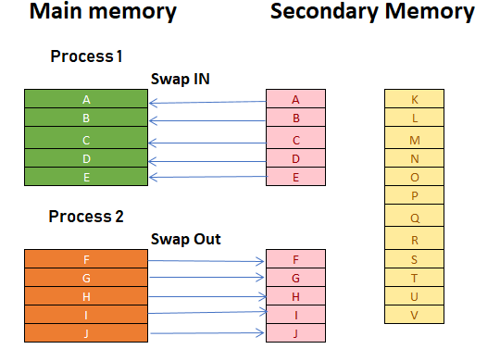


Slide 87
The process includes the following steps :
If CPU try to refer a page that is currently not available in the main memory, it generates an interrupt indicating memory access fault. The OS puts the interrupted process in a blocking state.
For the execution to proceed the OS must bring the required page into the memory. The OS will search for the required page in the logical address space.
The required page will be brought from logical address space to physical address space. The page replacement algorithms are used for the decision making of replacing the page in physical address space.
The page table will updated accordingly. The signal will be sent to the CPU to continue the program execution and it will place the process back into ready state.

Slide 88

Types of Page Replacement Methods
Here, are some important Page replacement methods
FIFO
Optimal Algorithm
LRU Page Replacement

Slide 89
FIFO Page Replacement
FIFO (First-in-first-out) is a simple implementation method. In this method, memory selects the page for a replacement that has been in the virtual address of the memory for the longest time.
Whenever a new page loaded, the page recently comes in the memory is removed. So, it is easy to decide which page requires to be removed as its identification number is always at the FIFO stack.
The oldest page in the main memory is one that should be selected for replacement first.

Slide 90
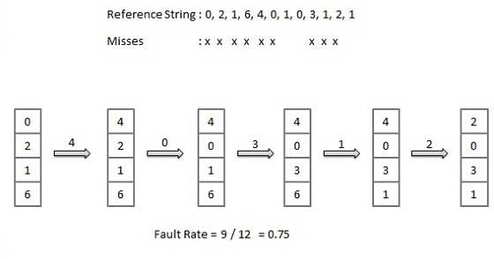


Slide 91
Optimal Algorithm
The optimal page replacement method selects that page for a replacement for which the time to the next reference is the longest.
Features:
Optimal algorithm results in the fewest number of page faults. This algorithm is difficult to implement.
An optimal page-replacement algorithm method has the lowest page-fault rate of all algorithms. This algorithm exists and which should be called MIN or OPT.
Replace the page which unlike to use for a longer period of time. It only uses the time when a page needs to be used.

Slide 92
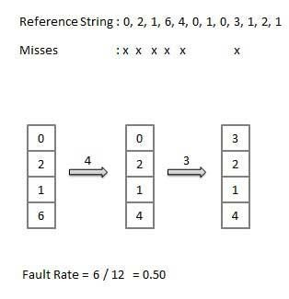
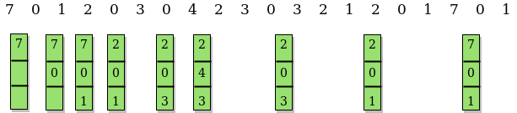

Slide 93
LRU Page Replacement
The full form of LRU is the Least Recently Used page. This method helps
OS to find page usage over a short period of time. This algorithm should be implemented by associating a counter with an even- page.
How does it work?
Page, which has not been used for the longest time in the main memory, is the one that will be selected for replacement.It is easy to implement, keep a list, replace pages by looking back into time.

Slide 94
LRU Page Replacement
Features:
The LRU replacement method has the highest count. This counter is also
called aging registers, which specify their age and how much their associated pages should also be referenced.
The page which hasn't been used for the longest time in the main memory is the one that should be selected for replacement.
It also keeps a list and replaces pages by looking back into time.

Slide 95
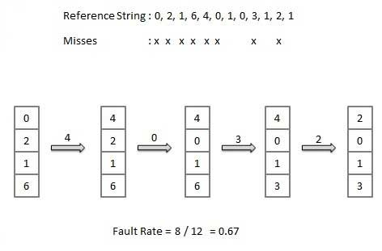

Slide 96
Advantages of Virtual Memory
More processes may be maintained in the main memory: Because
we are going to load only some of the pages of any particular
process, there is room for more processes. This leads to more
efficient utilization of the processor because it is more likely that at
least one of the more numerous processes will be in the ready state at any particular time.
A process may be larger than all of main memory: One of the most
fundamental restrictions in programming is lifted. A process larger
than the main memory can be executed because of demand
paging. The OS itself loads pages of a process in main memory as required.
It allows greater multiprogramming levels by using less of the available (primary) memory for each process.

