Slide 1


GENERATE YOUR OWN BRANDED CERTIFICATES.
EMPLOYEES LOVE TO SHOW OFF THEIR QUALIFICATIONS.

Slide 2
Creating certificates
You can upload/create your own certificates to your own design
We can create one for you to your specifications
Use a pre-defined template already embedded in the system

Slide 3
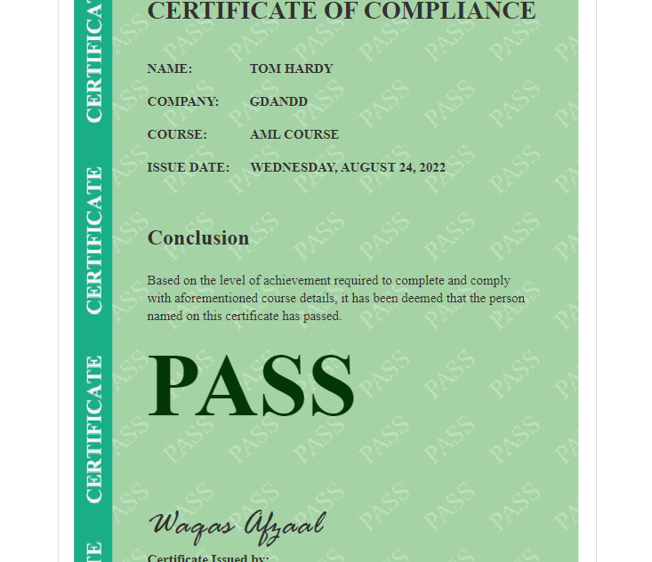
Default certificate

Slide 4
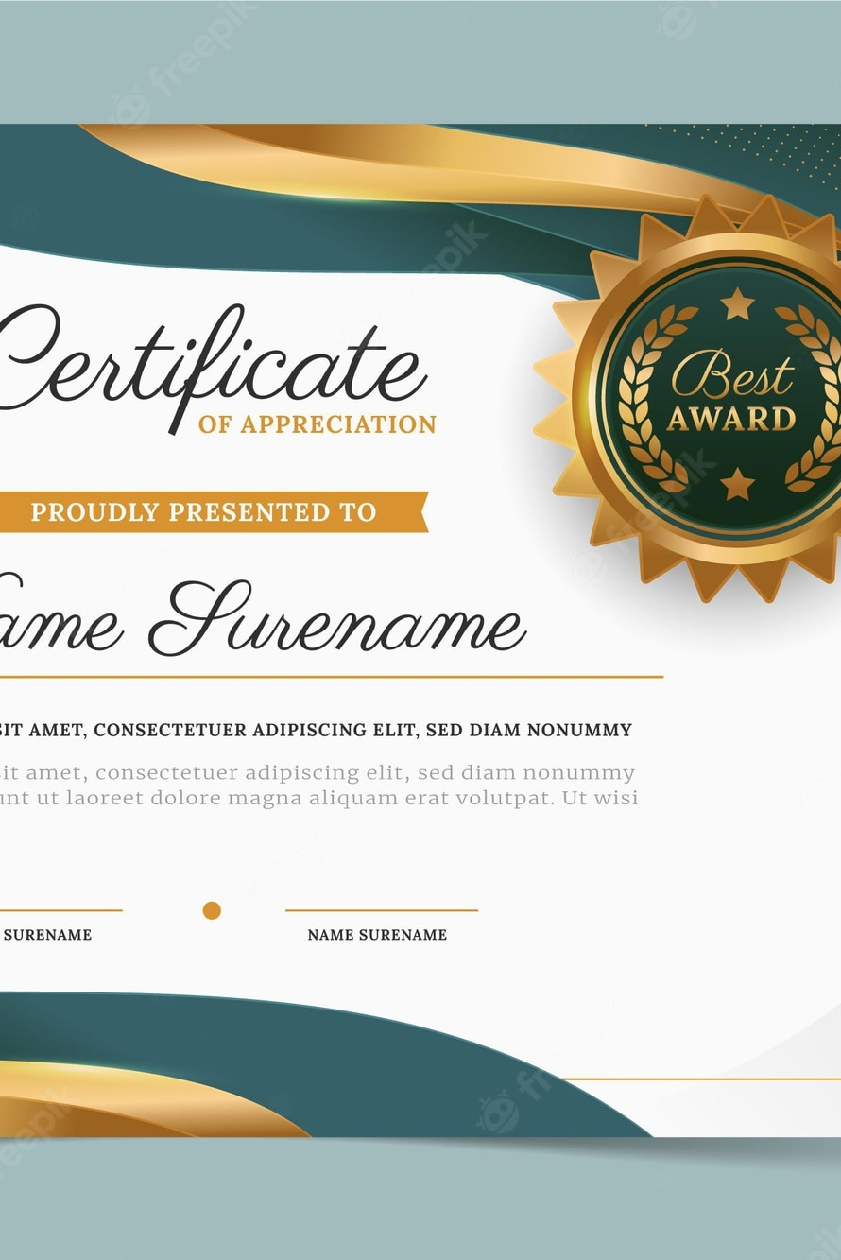
We design the certificate for you

Slide 5
IF YOU GET 70%+ IN THIS COURSE, YOU WILL RECEIVE A CUSTOMISED CERTIFICATE
This is customised for GD&D to show how the system works
There is an offer on the certificate for a trial period
This is an example of giving your certificate to us and we’ll design it for you.

