Slide 1


TESTS THROUGHOUT THE CONTENT.
Write your own questions, as easy or as difficult as you like

Slide 2
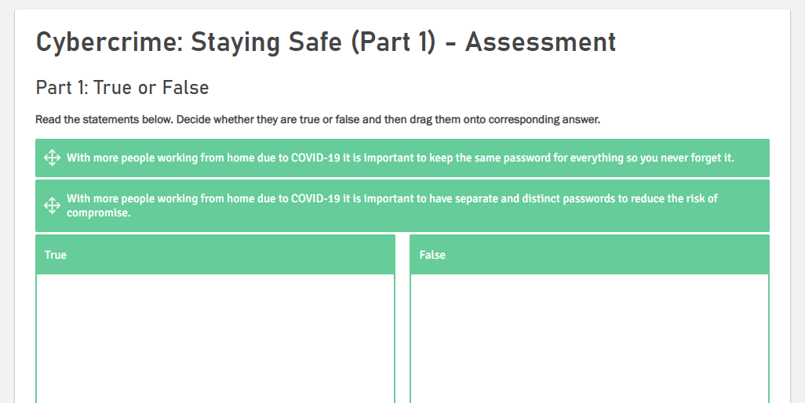

Slide 3
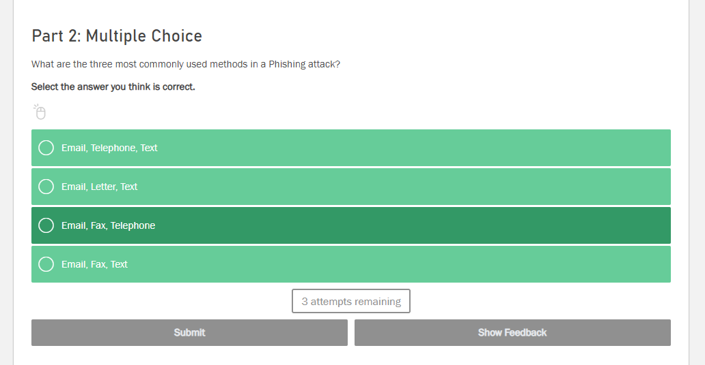

Slide 4
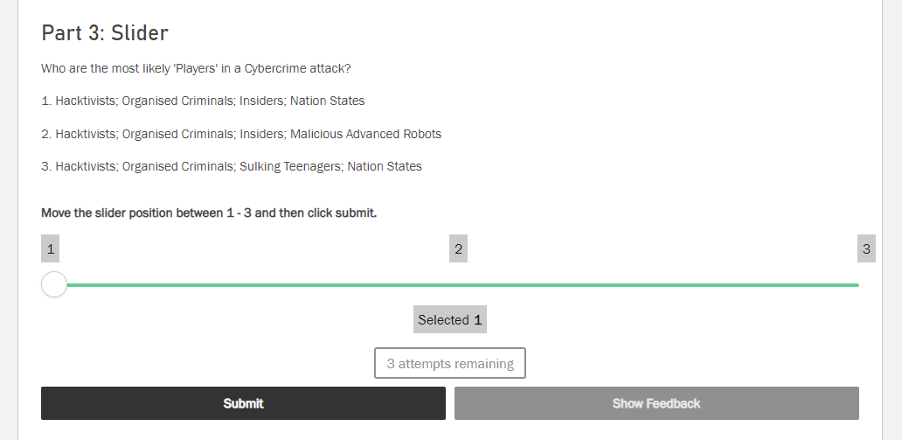

Slide 5
POINTS TO NOTE REGARDING TEST QUESTIONS
You can set your own pass score (%) when you create a course
You can set the number of attempts to get question right, before it is marked correct or incorrect

Slide 6
MAKE PASS OR FAIL - EASY OR DIFFICULT. THE CHOICE IS YOURS.
Allowing more than one attempt at a question can make bluffing your way through a test easier.
Allowing one attempt only is when you really want to test someone's ability.

Slide 7
THE ODDS OF GUESSING THE CORRECT ANSWERS
Two statements, one false and one true, gives you a 1 in 2 chance
Three statements, either true or false, gives you a 1 in 8 chance
Four statements either true or false gives you a 1 in 16 chance
Five statements either true of false gives you a 1 in 32 chance

Slide 8
WHY DIFFERENT MULTIPLE CHOICE METHODS?
Asking similar multiple choice questions using different methods of answering (radio buttons, drag and drop etc) increases attention span
You can make it as simple or complicated as you like to get a question correct.

Slide 9
WHY OPT FOR A FREETEXT QUESTION THAT IS NOT MULTIPLE CHOICE?
If you want to test the depth of understanding of a subject you can ask a question where the candidate has to write his or her own opinion in their own words.
This means that the test will not be automatically finished until a moderator has marked the answer satisfactory or not.

