Slide 1

DOCUMENT DISTRIBUTION, FORCED TO READ (“MUST-READ”)
DISSEMINATE AND DISTRIBUTE MATERIAL AND CONFIRM THAT IT HAS BEEN READ

Slide 2

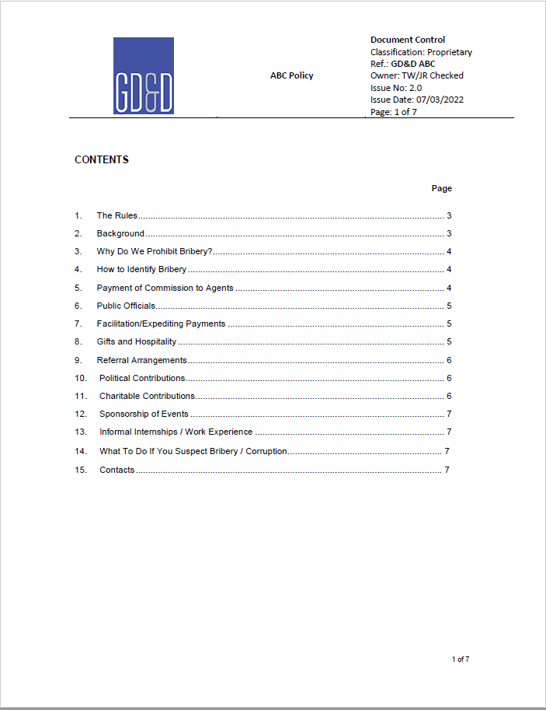
WE HAVE A NEW AML POLICY…
Upload the document as a word or pdf.
Add question. “I confirm I have read the contents of this document fully and understand the content in its entirety”
Add Answer: Yes/No
Set up all employees as users.
Treat as an on-line training course.

Slide 3

To cheat, or not to cheat, that is the question.
Go to the administration portal
Check the individual.
Check that the time recorded is sufficient to have read and digested the information

