Slide 1


Mitigate Professional

Slide 2

Answer Two questions
Are you interested in Risk?
Do you know how much risk you are carrying?

Slide 3

MITIGATE OVERALL PROPOSITION
Transforms Company Risk from the ethereal to the real world

Slide 4
Do you recognise any of the following problems?
Wide variation in scoring risks depending upon who is doing it

Slide 5

WHY YOU SHOULD USE MITIGATE
It standardises the scoring across many risk teams in many geographic regions
It translates the risk parameters into money at every stage in the life of the risk.
You have proper financial information to compare to your corporate risk appetite statement
You can monitor the company’s risk performance from Board level down to Risk, Control and Task owners.
It helps you re-structure your risk people to ensure the data entered correctly and approved at every step of adding the contols

Slide 6
WHO IS THIS PRODUCT TARGETED AT?
Enterprise companies
Global or regional office networks
Companies with a Risk Director and Risk Teams
Companies who want to subcontract the Risk Department to a specialist third party

Slide 7
MITIGATE MONETISES THE RISK AT EVERY POINT IN TIME
Money in terms of Financial Exposure
Change in Money or Financial Exposure over time
Money in terms of Overall Control Budget and spend
Money in terms of Cost of controls

Slide 8
A UNIQUE CORRELATION BETWEEN RISK PARAMETERS AND FINANCIAL EXPOSURE
We calculate the cost of the adverse outcome
We create an algorithm that correlates the cost of the adverse outcome to business impact and likelihood
We calculate how new controls decrease the company’s financial exposure
We filter financial data by Geographic Region, Class and Type of Risk, department, or subgroup.

Slide 9

You can see at a glance
  Changes in Likelihood over time
  Changes in Business Impact over time
  Changes in Urgency to Mitigate over time
  Changes in Mitigation Effectiveness over time
HISTORICAL VIEW OF THE RISK AND ITS ATTRIBUTES OVER TIME

Slide 10
JOB ROLES
Board or Committee member
Risk Controller
Risk Mitigator
Control Owner
Task Owner

Slide 11
NOT SURE ABOUT
WHETHER WHAT FOLLOWS
IS TOO GRANULAR

Slide 12
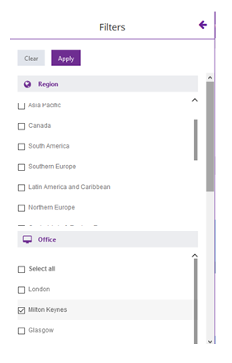
APPLIES TO ALL
COMMITTEE MEMBER BOARD WIDGETS

Slide 13
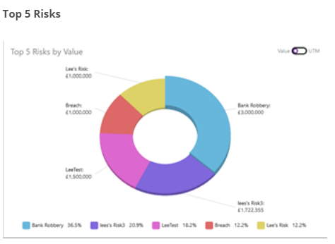
Top 5 Risks Globally, but can be filtered
Top 5 Risks by Urgency to Mitigate
Top 5 Risks by Risk Value (adverse outcome)

Slide 14
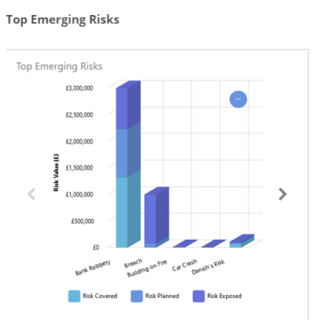
Covered
Planned to be covered
Risk Exposed
Total = Risk Value
Time period = 6 months

Slide 15
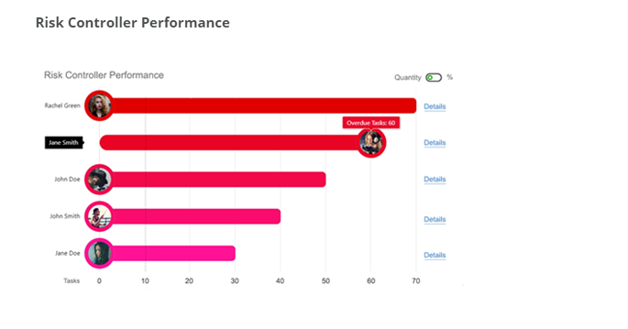
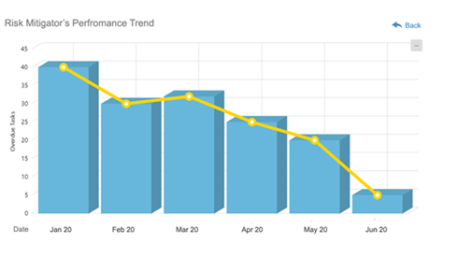
Controllers see their mitigators
Drill down to Control Owners
Drill into Performance over time

Slide 16
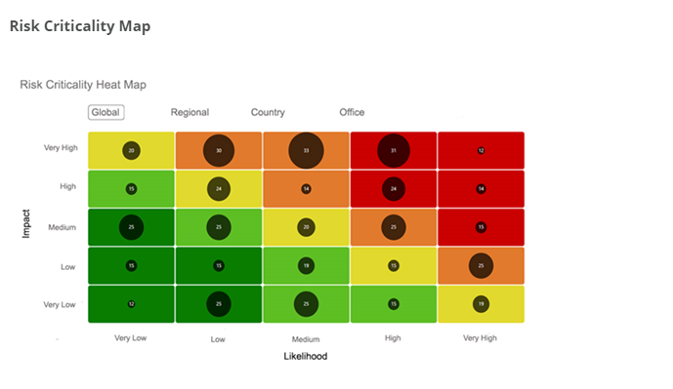
Number of Risks by severity/UTM
Filter by geographic region

Slide 17
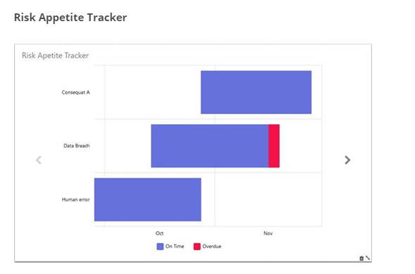
What tasks are overdue
By Risk
By month ongoing

Slide 18
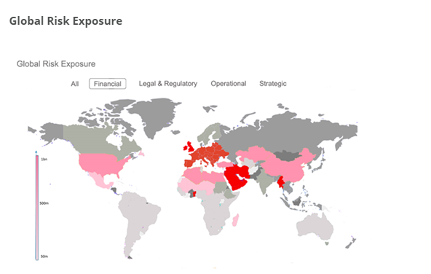
World map
Colour intensity by financial exposure
Filter by Risk Type

Slide 19
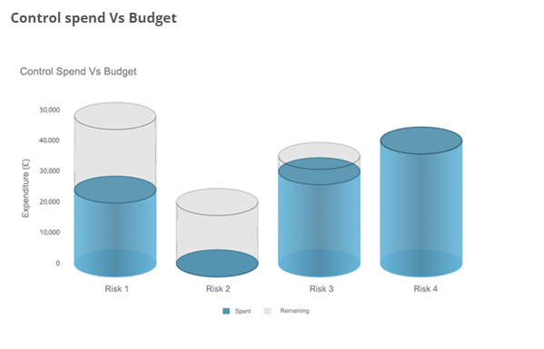
By Risk
Ordered by Top Risks by Risk Value

Slide 20
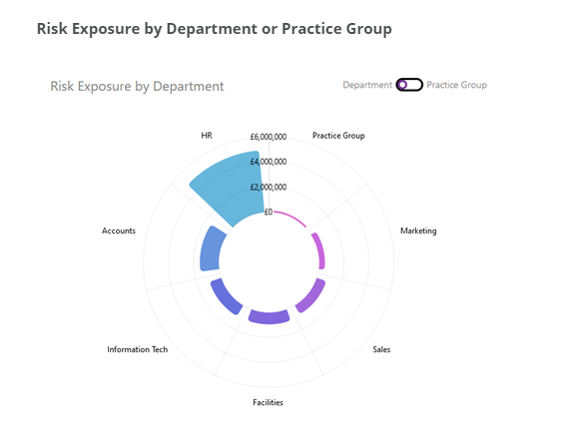
By Risk
Ordered by Top Risks by Risk Value

Slide 21
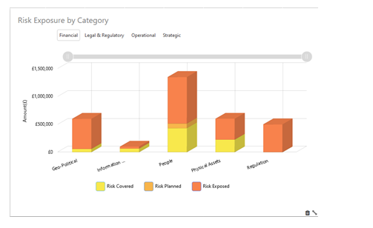
£Risk Covered
£Risk Planned to be covered
£Risk Exposed

Slide 22
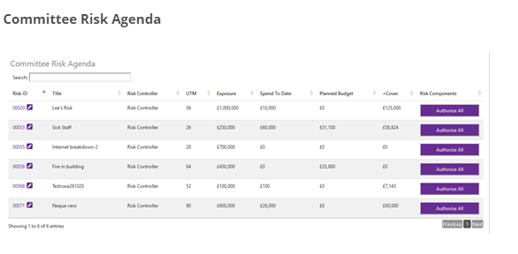
Referred to Board
Board to authorise

Slide 23
Referred to Board
Board to authorise

