Slide 1
What we can do that no one else can.
Spend money intelligently

Slide 2
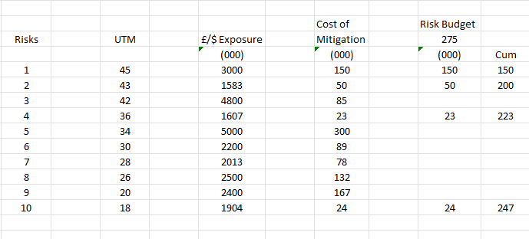
HERE WE HAVE BOTH THE COST OF MITIGATION AND THE RISK BUDGET FOR THE YEAR
Assume you have £275,000 to spend this year on Risk.
You have created a league table by UTM
There is now a cost of mitigation column
And you go down the column spending your £275K

Slide 3
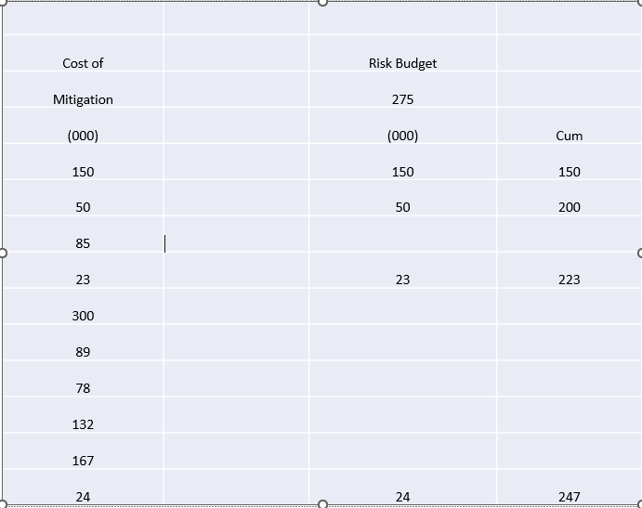
LOOK HOW WE CAN INTELLIGENTLY SPEND THE MONEY
We have £275K to spend. The first control/mitigation cost £150K. We must spend that.
The next is £50K. We can afford that too. We’ve now spent £200K
The next control costs £85K. We don’t have the budget; We must have the appetite to accept the risk as is.
Next is £23K cost. We have the budget. We’ve now spent £223K
Risk No 10’s control cost is 24K so we can also afford that. Let's spend that too. We’ve now spent £247K

Slide 4
WHAT TO DO NOW, EXCEPT ASK INTELLIGENT QUESTIONS
One option is to go down the list to less important risks and intelligently spend the remaining £28K
Convene a meeting of the risk committee and decide whether there is any more money to put controls in place for the higher UTMS
Or partially mitigate them by spending on some controls and not others.

