Slide 1
UTM STANDS FOR URGENCY TO MITIGATE
UTM is the only measure that can tell you which risk to mitigate first. The higher the UTM, the higher the urgency.
No other measure, like probability, business impact, or financial exposure, can do this.
UTM is the only measure that takes into consideration both likelihood and business impact

Slide 2
THE PRODUCT OF TWO PARAMETERS, NOT THE SUM
If 4 men work 3 days, then the quantum of work done is 12 man-days
You cannot ADD 4 men to 3 days, but you can multiply them. The answer is neither men nor days, but a new description of a man-day.
A Risk is classically defined by two properties. It’s the cost of the adverse outcome and the probability of the risk occurring. You cannot add cost to likelihood, but you can multiply them.
This new product taking both impact and likelihood into account has a new description. We call it Urgency To Mitigate or UTM

Slide 3
UTM IS AN INDEX FROM 1 TO 99
Urgency to Mitigate, written UTM has the following mathematical implications
0 < UTM < 100
If UTM = 100 then that means that it’s a certainty. Certainties are not risks.
If UTM = 0 then that means that it is never going to happen. Impossibilities are not risks

Slide 4
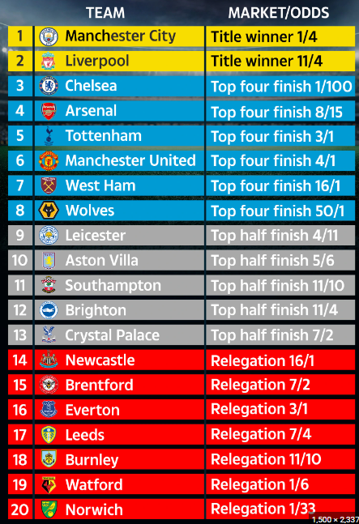
THE UTM ALLOWS US TO CREATE LEAGUE TABLES

Slide 5
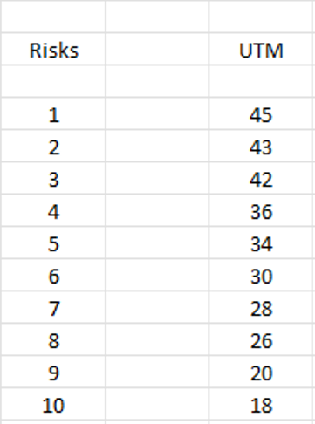
THE HIGHEST UTM IS THE MOST URGENT TO MITIGATE
If you rank risks by UTM, then you get a league table of priority or urgency to mitigate. Risk 1 before Risk 2
Risk Management is all about league tables, which suggest which risks to mitigate first.
The higher the UTM, the more urgent the risk is to mitigate

Slide 6
A raw utm. A current utm. A PREDICTED UTM
A RAW UTM is defined as the UTM associated with a risk if no controls are put in place
A CURRENT UTM is defined as a UTM associated with a risk when some controls are in place
A PREDICTED UTM is where the UTM will end up when one or more further controls are put in place.

Slide 7
PROBABILITY AND BUSINESS IMPACT INDICES RUN FROM 0.5 TO 9.5
There are 17 points on each scale (145 unique combinations)
Remember 0 and 10 are not useable
The UTM is generated by multiplying the Probability index by the business impact index
If the PI= 4.5 and the BII= 6, then the UTM is 27
PI = probability index; BII = Business Impact index
We usually round up the UTM to the nearest whole number

