Slide 1
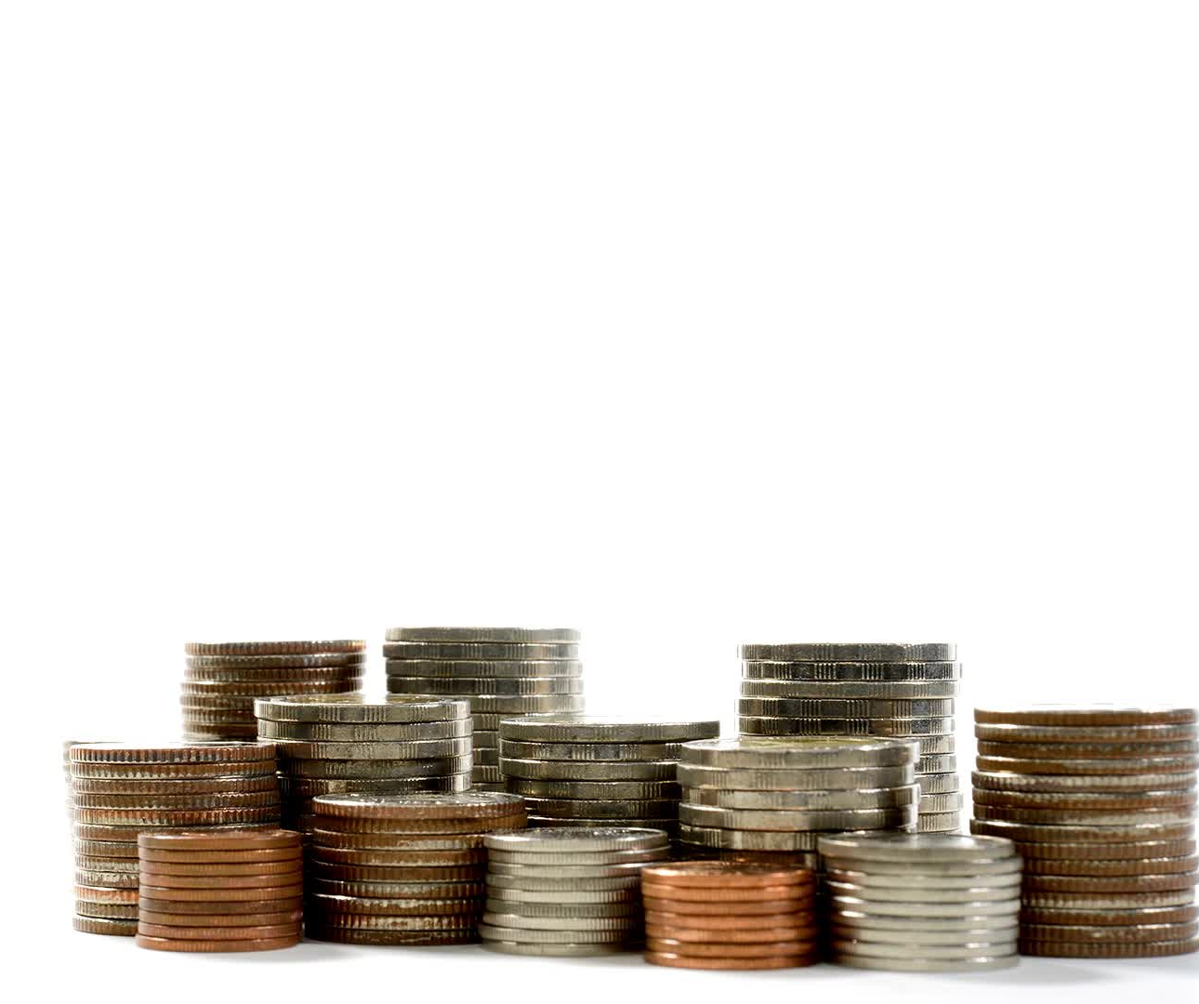
UTM, COVER & FINANCIAL EXPOSURE EXPLAINED
Counter-intuitive

Slide 2
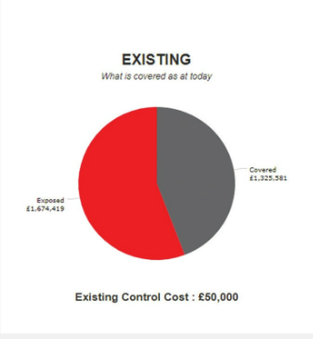
THE RELATIONSHIP BETWEEN COVER AND FINANCIAL EXPOSURE for a given risk
ADVERSE OUTCOME = £ 3 MILLION
The entire circle represents the total of the expected adverse outcome should the risk occur
The grey area represent that amount of money that has been mitigated against
The red area represents the estimated cost to the company should the risk occur
£Adverse outcome= £Covered+£Exposed
Exposed
£1.7 million
Covered
£1.3 million

Slide 3
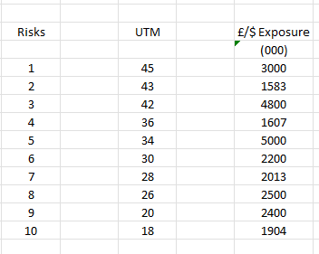
TOP 10 RISKS RANKED BY UTM WITH FINANCIAL EXPOSURE SHOWN AS ADVERSE OUTCOME
If you rank risks by Urgency to mitigate, then you mitigate them in strict numerical order
If you feel that Risk 5 is the most urgent to mitigate, then you haven’t considered its probability of happening which is so small as to cancel out any large financial exposure
Look at what you might do incorrectly on the next chart

Slide 4
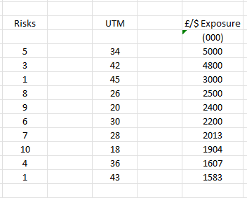
TOP 10 RISKS RANKED BY UTM WITH FINANCIAL EXPOSURE SHOWN AS ADVERSE OUTCOME
If you rank risks by financial exposure and mitigate from top to bottom, you ignore the UTM
What you are doing is ignoring the probability that that risk, will have a lesser adverse outcome
Risk 5 might be that we get invaded by aliens who take over our commercial enterprises.
2

