Slide 1
THE COST-BENEFIT CONSIDERATION
Leading to Risk Appetite

Slide 2
What is risk appetite?
Every risk that needs to be mitigated has two parameters that must be considered together
The cost of the control
The amount of benefit (i.e., additional cover) achieved
If the cost is too great, whether its good value or not in terms of additional cover given, the company must have the “appetite” to accept the risk as is.
Risk Appetite or accepting a risk further unmitigated could be because the control/mitigation is
Poor Value for money
The UTM is low enough to take a chance
The company cannot afford to spend the money

Slide 3
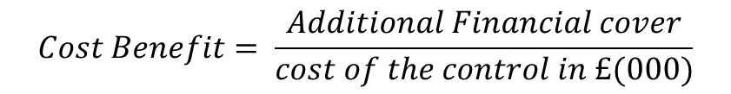
TO LOOK AT THE COST-BENEFIT RANKING WE MUST FIRST CREATE the NEW parameter.
Consider the additional cover you get per ‘000 currency when you spend on a cost control
You then rank them with the highest first and compare the results
The highest Cost-Benefit is the most desirable way to spend the money
It is one more weapon in your armory about how to best spend your risk budget
$$Cost Benefit= \frac{Additional Financial cover}{cost of the control in £(000)}$$

Slide 4
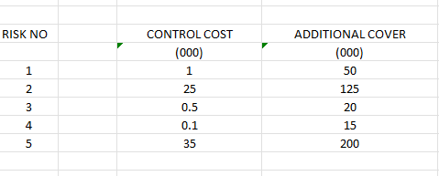
HERE IS A LIST OF HYPOTHETICAL CONTROL COSTS AND THE ADDITIONAL COVER THEY PROVIDE
Risk 1: You spend 1,000 and you get 50,000 additional cover.
Risk 2: You spend 25,000 and you get 125,000 additional cover.
..and so on

Slide 5
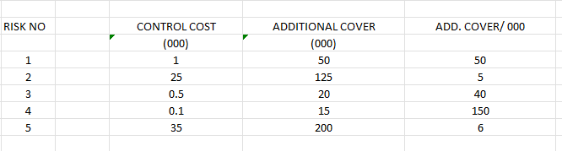
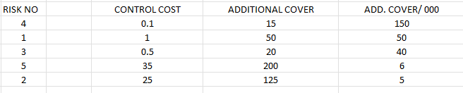
WHICH CONTROL COSTS GIVE YOU THE MOST BENEFIT? Let’s rank by additional cover per thousand

