Slide 1
Mitigation effectiveness
WHAT IS IT AND HOW DO WE CALCULATE IT?

Slide 2
MITIGATION EFFECTIVENESS IS A way to measure how well mitigated a risk has been
The following points apply:
The higher the mitigation effectiveness the better the risk has been mitigated.
The higher the mitigation effectiveness, the lower the UTM
A negative mitigation effectiveness shows that a risk is more likely to happen, or it will do more financial damage, or both as compared to the original values.

Slide 3
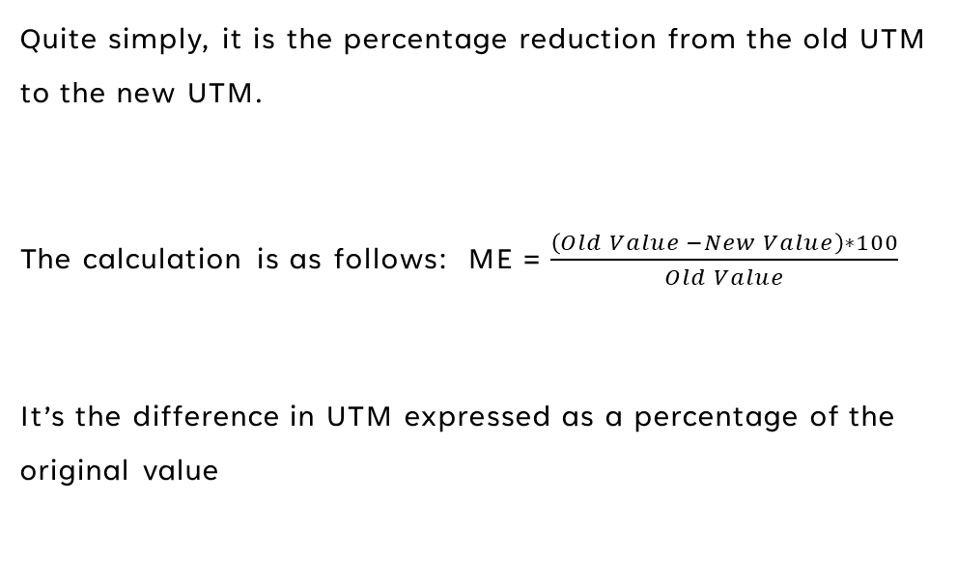
WHAT IS MITIGATION EFFECTIVENESS?
Quite simply, it is the percentage reduction from the old UTM to the new UTM.
The calculation is as follows: ME = $\frac{\left(Old Value −New Value\right)∗100}{Old Value}$
It’s the difference in UTM expressed as a percentage of the original value

Slide 4
Mitigation Effectiveness (ME) CAN GO UP AS WELL AS DOWN
If M.E. goes up it means that the risk is more urgent to mitigate than it originally was
M.E. becomes negative. ME = -40% means that the UTM has gone up by 40%
Perhaps criteria outside of the risk have changed dramatically. War in Ukraine would probably qualify.
Perhaps global criteria have changed dramatically like the supply of gas, or the price of oil adversely affecting the probability or business impact of a risk
BREXIT could easily affect the ability to staff a company and may adversely affect HR Risks
No one deliberately spends money to make matters worse and so this usually happens post the “input of the risk into the system”

Slide 5
COVER AND FINANCIAL EXPOSURE
With every risk, there is an adverse outcome cost. This is the total “raw” cost of the outcome should the risk occur.
When controls are applied to the risk, the mitigation effectiveness brings down the UTM, which makes the financial impact less.
This means that part of the adverse outcome has been taken care of. We call this “cover” (like insurance cover)
The more the cover, the less the financial exposure.
In simple terms: Cover + Financial exposure = Cost of the adverse outcome.

Slide 6
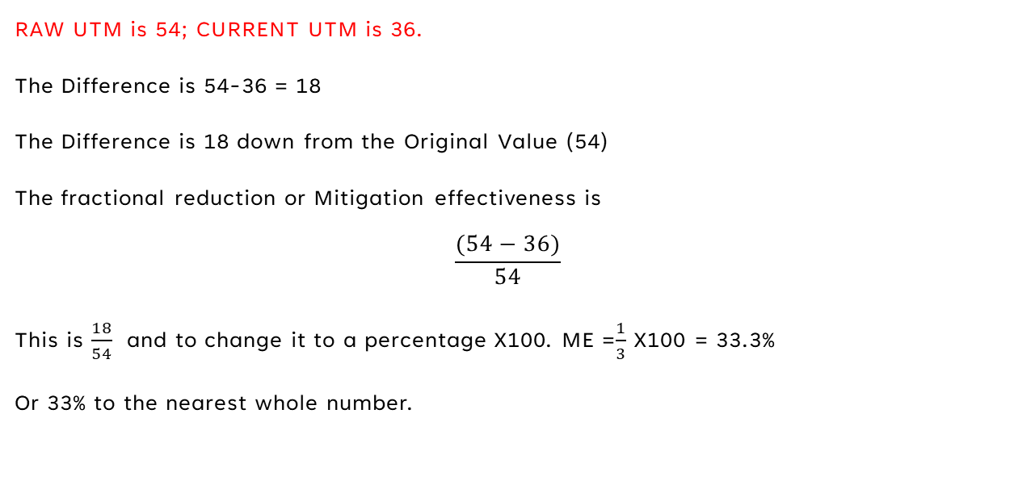
Example 1
RAW UTM is 54; CURRENT UTM is 36.
The Difference is 54-36 = 18
The Difference is 18 down from the Original Value (54)
The fractional reduction or Mitigation effectiveness is
$$\frac{(54−36)}{54}$$
This is $\frac{18}{54}$ and to change it to a percentage X100. ME =$\frac{1}{3}$ X100 = 33.3%
Or 33% to the nearest whole number.

Slide 7
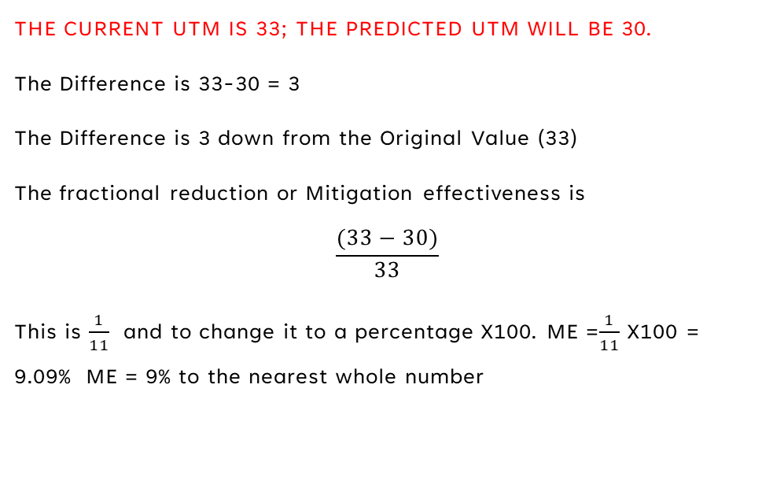
Example 2
THE CURRENT UTM IS 33; THE PREDICTED UTM WILL BE 30.
The Difference is 33-30 = 3
The Difference is 3 down from the Original Value (33)
The fractional reduction or Mitigation effectiveness is
$$\frac{(33−30)}{33}$$
This is $\frac{1}{11}$ and to change it to a percentage X100. ME =$\frac{1}{11}$ X100 = 9.09% ME = 9% to the nearest whole number

