Slide 1
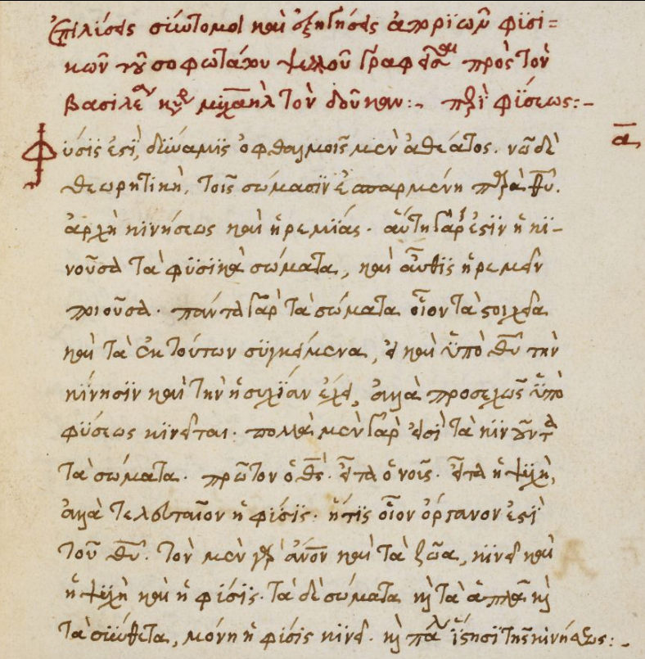
From manuscript image to understanding
TEAM 4
BoleYi · Andriana · Kobiljon · Priyanka · Tom
28 October 2026
Notes:
Introduce ScriptLens as a focused reading and learning tool for students, readers of classical texts, and manuscript researchers. The goal is to connect an Ancient Greek manuscript image with transcription and word-level linguistic context. Do not present planned capabilities as complete.

Slide 2





What we will cover
01
Live demonstration
Select, crop, transcribe and explore words
02
Technology stack
Web, mobile, backend, ML, data and CI tooling
03
How we work
User stories → milestones → issues
04
Continuous integration
Checks on every PR, hooks on every commit
05
Proposed next steps
Recognition, word insights, vocabulary and feedback
Sample input: a 15th-century minuscule hand
Notes:
Roadmap of the talk: target reading experience, technology stack, development workflow, continuous integration, and proposed next steps.

Slide 3
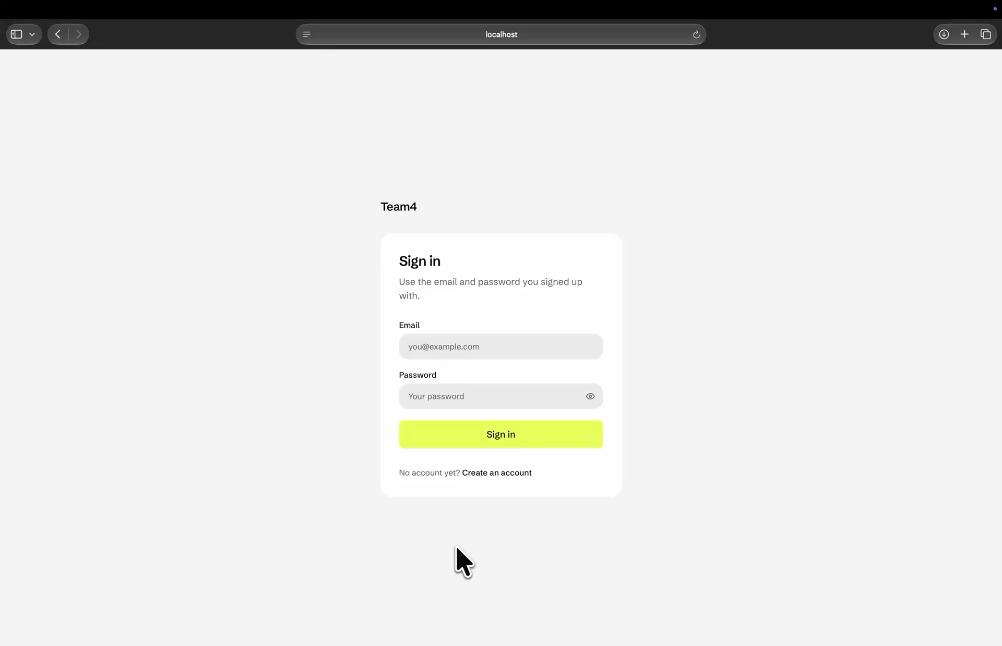





Live demonstration
Select image
upload or capture
Preview & crop
confirm the region
Recognize
transcribe the text
Read together
image + transcription
Explore & revisit
translation · lemma · definition
Notes:
Walk through the intended end-to-end experience: select an image, preview and crop, recognize the manuscript, view the source beside its transcription, explore translations, lemmas and definitions, and revisit words through history and personal vocabulary.

Slide 4






















Technology stack
Web Frontend
Backend API
Machine Learning
Data Layer
Request API
SQLite
Next.js
React
TypeScript
FastAPI
PyTorch
SQLAlchemy
API Response
Alembic
Tailwind CSS
shadcn/ui
Python
Pydantic
Hugging Face models
Request API
API Response
Mobile Application
Kotlin Multiplatform
Compose Multiplatform
Ktor Client (API)
Android
iOS
Testing & CI/CD
pytest
Vitest
Playwright
GitHub Actions
Notes:
Web frontend (Next.js, React, TypeScript, Tailwind, shadcn/ui) and the Kotlin Multiplatform mobile app both talk to the FastAPI backend. The backend runs PyTorch / Hugging Face models and persists via SQLAlchemy + Alembic to SQLite. pytest, Vitest and Playwright run in GitHub Actions.

Slide 5




From user story to code
“
Management
PO-defined user stories become GitHub milestones.
As a user, I want to upload an image of an Ancient Greek manuscript and see the predicted words, their transcription, and their meaning, so that I can understand the text.
Task breakdown
Each milestone is broken into smaller GitHub issues.
Task types
Web · Mobile · Backend · Design · Spike — research & technical investigation
PR collaboration
Team discussions, code reviews & technical decisions happen through PRs.
— PO
Progress tracking
Issues & pull requests track implementation progress and feedback.
Notes:
This user story defines the product direction; it is not a claim that every capability is already implemented. The Product Owner turns the need into a milestone, the team derives issues, and pull requests close the work with CI checks.

Slide 6





Continuous integration
Every pull request and every push to develop and main is checked automatically
Frontend
Backend
Mobile
Docs
ESLint · Prettier · tsc · Vitest
Ruff · mypy (strict) · pytest · Bruno
kotlin.test · Gradle
check-docs.py
Lint
Format
Type check
Unit tests
Lint
Format
Type check
Unit tests
API tests
Unit tests
Android build
Broken links
Line numbers
Stale paths
Git hooks: pre-push runs the same checks as CI before code reaches a PR
Notes:
CI runs on every pull request and on pushes to develop and main: four pipelines (frontend, backend, mobile, docs). Locally, pre-commit lints and formats staged frontend files and pre-push runs the CI checks for the areas you changed.

Slide 7
Four priorities for the next phase
NEXT STEPS
01
Complete manuscript transcription
03
Personal vocabulary and learning
Implement and improve end-to-end recognition and transcription for Ancient Greek manuscripts.
Explore saved words, notes and review alongside the existing history feature.
02
Word-level translation and understanding
04
User feedback and model improvement
Offer translations, lemmas and definitions; support a chosen language where available.
Let users report errors and submit corrections for review; explore validated corrections as future training data.
Notes:
Present the four items as proposed next steps. Emphasize complete manuscript transcription, word-level linguistic support, personal vocabulary and learning, and user feedback with reviewed corrections.

Slide 8
Thank you
Questions?
BoleYi · Andriana · Kobiljon · Priyanka · Tom

