Slide 1
Ohm's Law
Prepared by Luffy
Presentation: October 02, 2025

Slide 2
Learning Objectives
Understand the mathematical statement V = I·R
Relate microscopic picture (drift velocity, collisions) to macroscopic R
Learn experimental verification and plotting V vs I
Distinguish ohmic vs non‑ohmic behaviour
Notes:
Spend ~30s on each objective. Emphasize that by the end audience should be able to calculate resistance and interpret V-I graphs.

Slide 3
Definitions & Units
Voltage (V): electric potential difference, unit volt (V)
Current (I): rate of charge flow, unit ampere (A)
Resistance (R): opposition to current, unit ohm (Ω)
Notes:
Explain volt as energy per charge (1 V = 1 J/C). Ampere as coulombs per second. Ohm is V/A.

Slide 4
Ohm's Law (Mathematical)
Ohm's law: V = I × R
Graphically: V vs I is a straight line through origin for ohmic materials
Slope of V vs I = R (if V on vertical axis and I on horizontal axis)
Notes:
Show how rearranging gives I = V/R. Clarify which axis choice makes slope equal to R vs 1/R.

Slide 5
Microscopic explanation
Charge carriers (electrons) drift under electric field E with average drift velocity v_d
Current density J = n q v_d, and J = σ E (Ohm's macroscopic form)
Conductivity σ = n q^2 τ / m → resistivity ρ = 1/σ = m/(n q^2 τ)
Notes:
Explain n (carrier density), q (charge), τ (mean free time), m (effective mass). Mention collisions with lattice cause resistance.

Slide 6
Resistance & Resistivity
R = ρ L / A (L: length of conductor, A: cross-sectional area)
Materials with low ρ are good conductors; high ρ are insulators
Temperature often increases ρ in metals (approx. ρ(T)=ρ0[1+α(T−T0)])
Notes:
Explain qualitatively why longer wires have more resistance and thicker wires have less. Mention alpha (temperature coefficient).

Slide 7
Ohmic vs Non‑Ohmic
Ohmic: V ∝ I (constant R), e.g., metallic resistor at fixed temperature
Non‑ohmic: e.g., diode, filament lamp (R changes with V or temperature)
Notes:
Give everyday examples: filament lamp brightens, its resistance increases. Diode has exponential I-V curve.

Slide 8
Experimental Setup (to verify Ohm's Law)
Components: battery (variable or power supply), resistor, ammeter (series), voltmeter (parallel), rheostat for varying current
Procedure: set voltage, measure I and V, repeat for several voltages, plot V vs I
Notes:
Explain how to connect ammeter in series and voltmeter in parallel. Mention take multiple readings and average to reduce error.

Slide 9
Sample Data & Calculation
Example: R = 100 Ω; apply V = 0,1,2,...,5 V -> I = V/R
At V = 5 V: I = 5 / 100 = 0.05 A = 50 mA
Notes:
Show the table in the slide (or in speaker notes). Walk through the arithmetic step-by-step for the 5 V example.

Slide 10
Graph: V vs I (Ohm's Law)
Straight lines for different resistances; slope = R
Notes:
Explain that each line's slope corresponds to resistance. For R = 100 Ω slope is steeper than R = 50 Ω etc.

Slide 11
Power Dissipation
Power P = V·I = I^2·R = V^2 / R
Explains heating in resistors (Joule heating)
Notes:
Relate power formulas and when each form is convenient. Mention safety: higher current -> more heating.

Slide 12
Quick Tips for Presentation
Start with the definition and a simple example
Show the experiment or graph early — visuals help
Anticipate questions: 'Why does resistance change with temperature?'
Keep 1–2 backup slides for calculations or derivation if asked
Notes:
Practice explaining the microscopic picture in ~45–60 s. Use the graph to show evidence of Ohm's law.

Slide 13
References & Further Reading
Textbook: Serway & Jewett (or any standard physics textbook)
Online: university physics lecture notes
Notes:
Provide citations if required by your instructor.

Slide 14
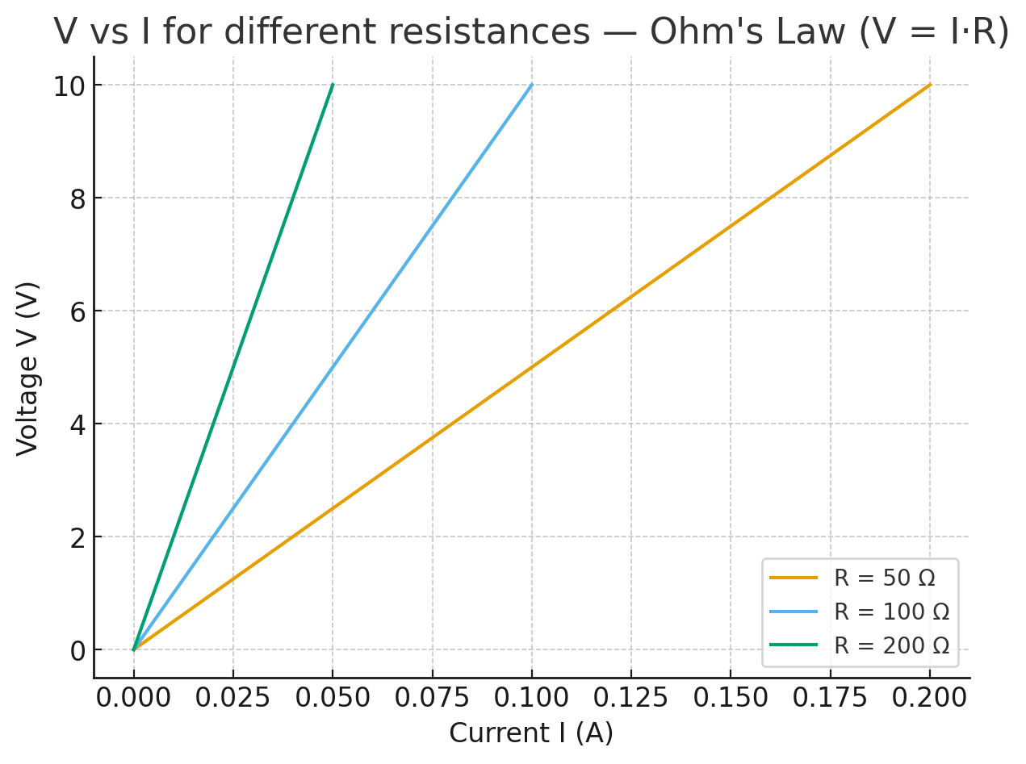
V vs I Graph (Ohm's Law)
Notes:
Explain that V vs I is linear for ohmic materials; slope = R.

